Slide 1
Impact

Slide 2
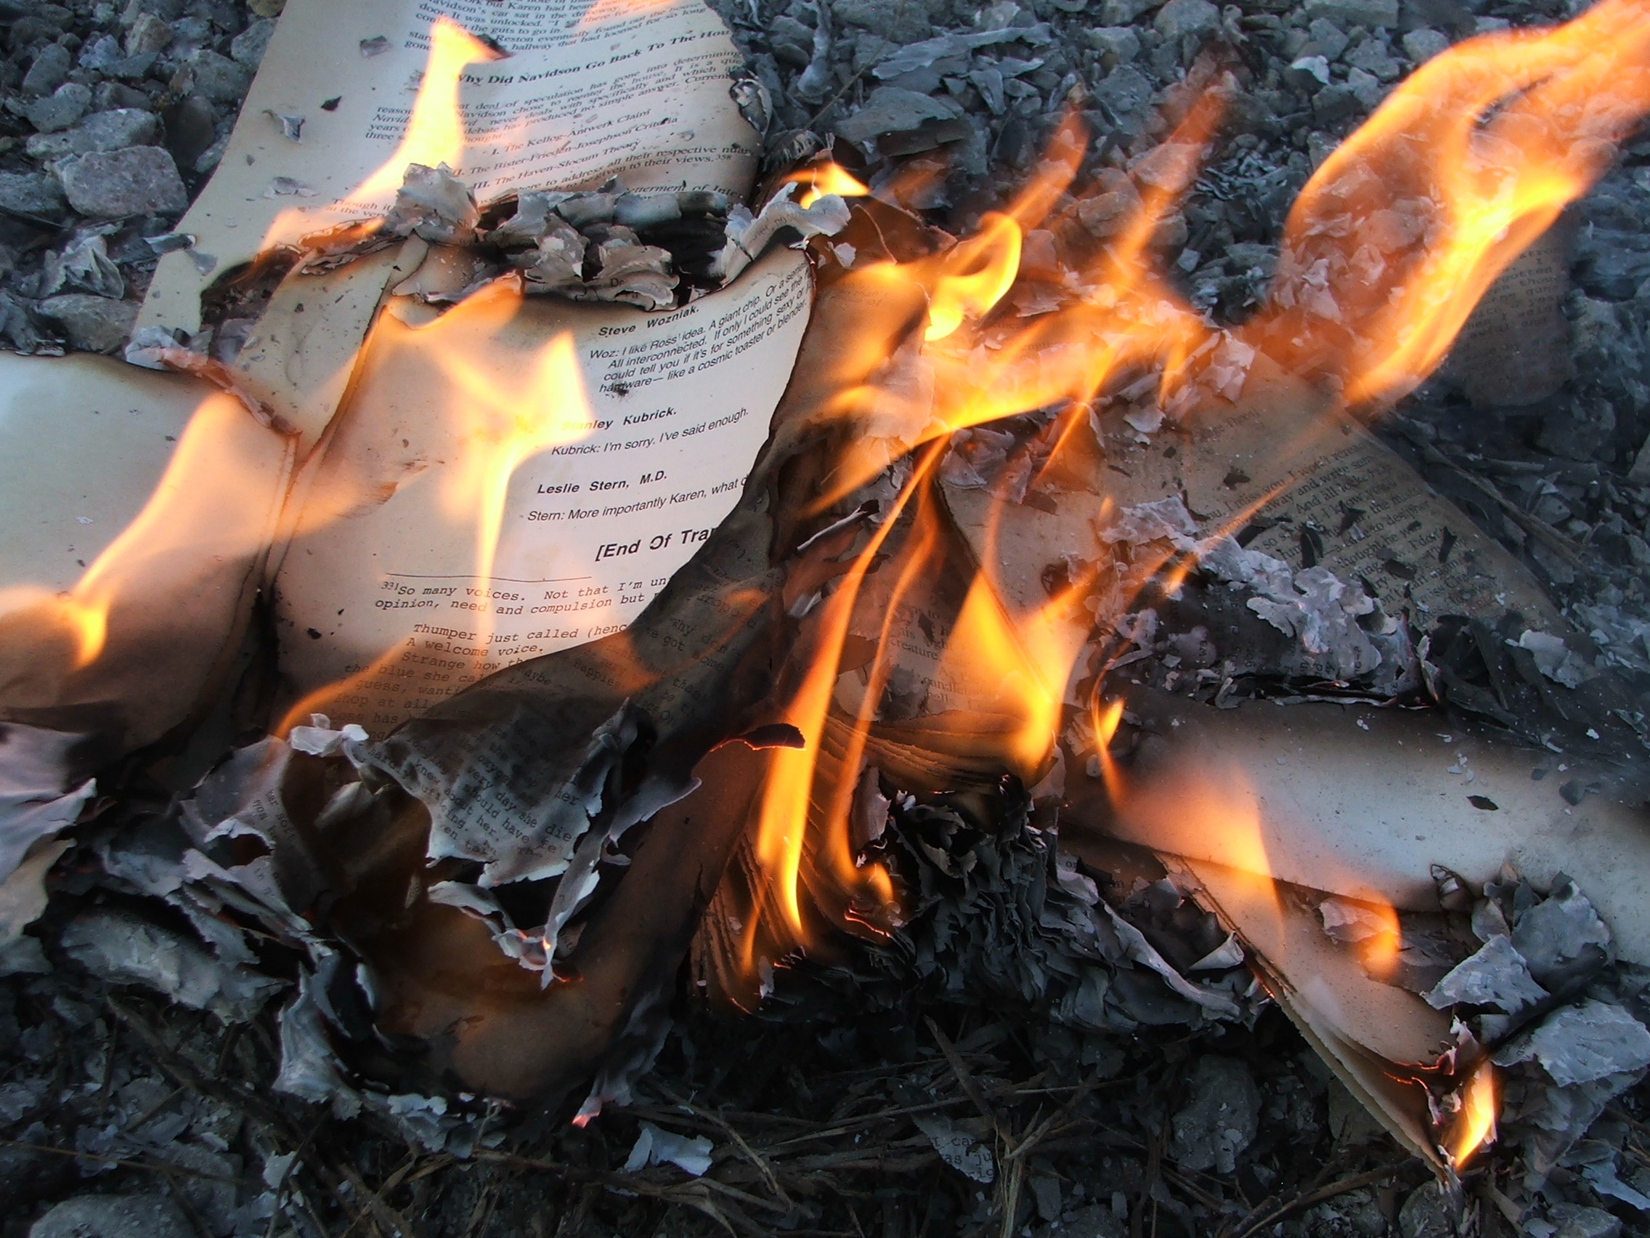
What is impact?
1. Not the same as engagement

Slide 3
What is impact?
1. Not the same as engagement
- Measured and evidenced change
REF definition
‘An effect on, change or benefit to the economy, society, culture, public policy or services, health, the environment or quality of life, beyond academia.’

Slide 4
What is impact?
1. Not the same as engagement
- Measured and evidenced change
2. Change among non-academic ‘stakeholders’
- Relating to/rooted in published academic research

Slide 5
What is impact?
1. Not the same as engagement
- Measured and evidenced change
2. Change among non-academic ‘stakeholders’
- Relating to/rooted in published academic research
3.

Slide 6
Impact in practice for historians
Often (but not always) focused on qualitative evidence rather than (only) quantitative evidence.

Slide 7
Impact in practice for historians
Often (but not always) focused on qualitative evidence rather than (only) quantitative evidence.
Doesn’t have to be huge scale if high quality (depth matters as well as breadth).

Slide 8
Impact in practice for historians
Often (but not always) focused on qualitative evidence rather than (only) quantitative evidence.
Doesn’t have to be huge scale if high quality (depth matters as well as breadth).
Typical stakeholders for history impact include:
Primary and secondary education; lifelong learning beyond HE
Heritage and museums (professionals and audiences/visitors)
Media and culture (producers and audiences)
Policymakers and NGO/third-sector organisations

Slide 9
Why should you care?

Slide 10
Why should you care?
Most importantly, you don’t have to care.

Slide 11
Why should you care?
Most importantly, you don’t have to care.
But …
Career prospects (REF funding—impact accounts for 25% and each case study counts around 8 to 10 times as much as each publication)

Slide 12
Why should you care?
Most importantly, you don’t have to care.
But …
Career prospects (REF funding—impact accounts for 25% and each case study counts around 8 to 10 times as much as each publication)
It can positively influence the research questions you ask and methods you adopt

Slide 13
Why should you care?
Most importantly, you don’t have to care.
But …
Career prospects (REF funding—impact accounts for 25% and each case study counts around 8 to 10 times as much as each publication)
It can positively influence the research questions you ask and methods you adopt
It can sharpen your focus on making a difference beyond the ivory tower

Slide 14
What next?
Think about how impact might come into your work (current or future)
Chat to me (and/or the Arts Faculty Impact team, led by Emma Roberts) if you want advice or a sounding board
If you’re interested, take the plunge and consider incorporating it into applications or PhD-adjacent work (or placement work)
Internal impact funding for PGRs is possible as co-applicant with research staff member(s), so consider applying!

