Slide 1

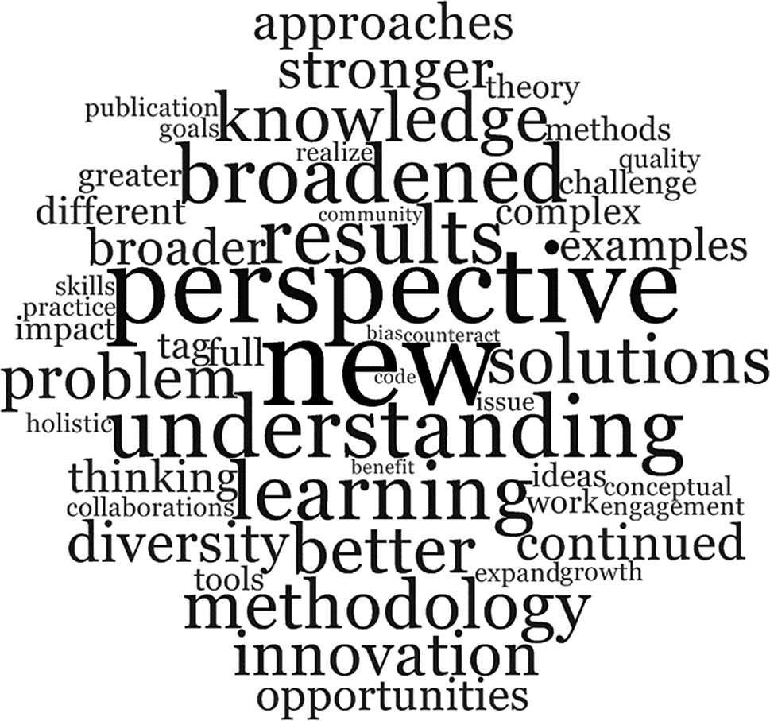

‘-disciplinarity’
Inter-
‘-nationalization’
GRF 2024-25

Slide 2
Internationalization
Transcend the ‘Anglophone Bubble’
Engage with other academic cultures
Reap potential benefits
Accessing work in other countries / languages
Attending conferences and workshops abroad
Opening further funding / fellowship sources
Career opportunities beyond the UK system
...
Enacting Warwick’s university strategy
Researching in overseas libraries / archives
Exploring other perspectives / approaches

Slide 3
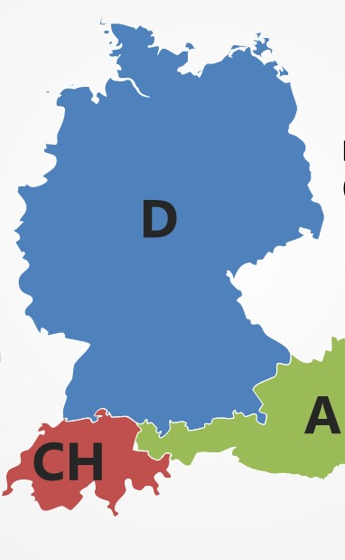
Example 1: The German Lands
Key role in early development of our discipline
Fairly hierarchical / formal structures
Mass universities, few courses selective
Structured support for emerging scholars
Graduate Colleges (interdisciplinary themes [e.g. 2011-20: Religious Knowledge at Tübingen], bespoke training opportunities, international partners …)
National Research Council (DFG) Special Research Areas (e.g. TG Dresden – Invectivity) with postdocs, conferences, publication projects
Second / higher doctorate (Habilitation), less focus on one single area of expertise
Relatively few permanent academic positions and long waiting times post-doctorate, with frequent dead ends

Slide 4
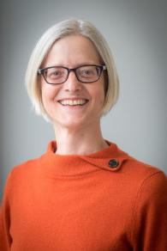
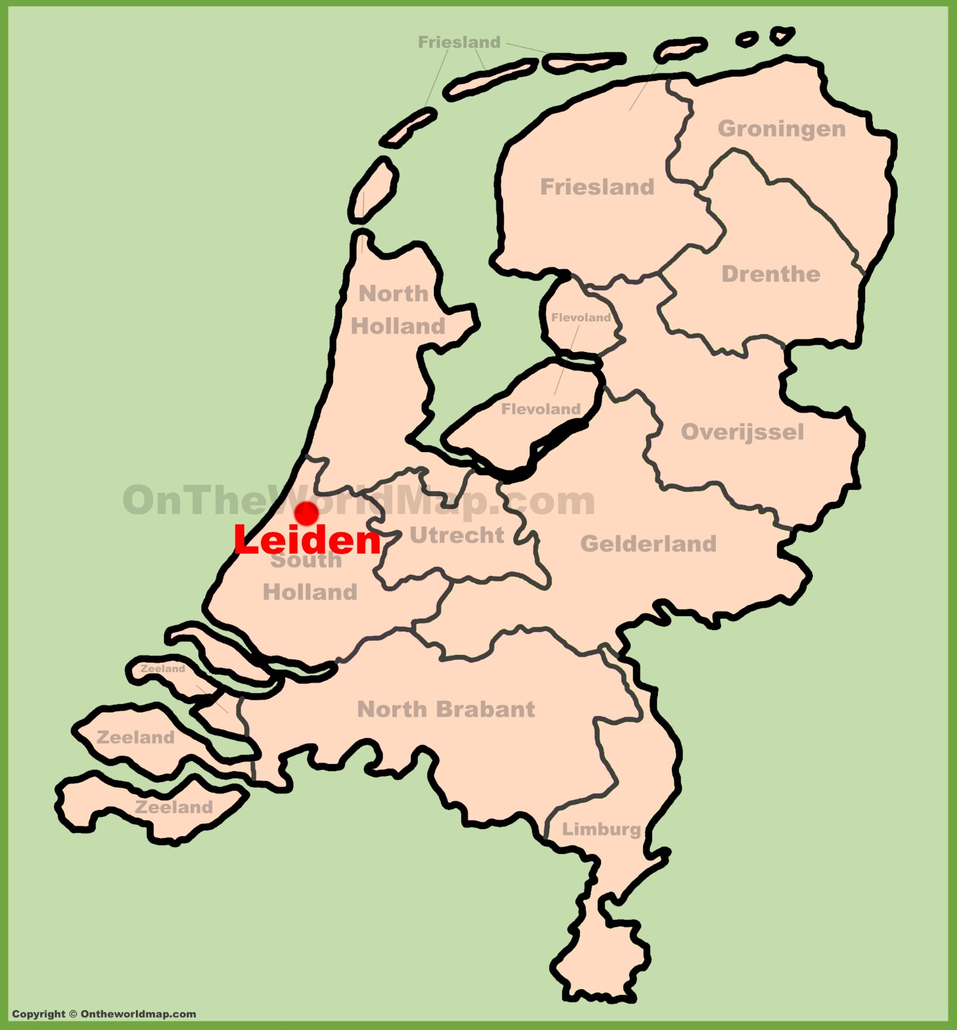

Example 2: The Netherlands
Pathway
Dutch System
Differences
Challenges

Slide 5
The wider world … your experiences ?

Slide 6
What is a discipline?
Communities of scholars who share a field of inquiry or discourse or objects of study
All have a distinct heritage / structure
They may use specialised terminologies or concepts / methods or customs / practices or scholarly traditions / bodies of work – and these can create borders or boundaries with others
They have a system of communication through journals, conferences, centres, events etc

Slide 7
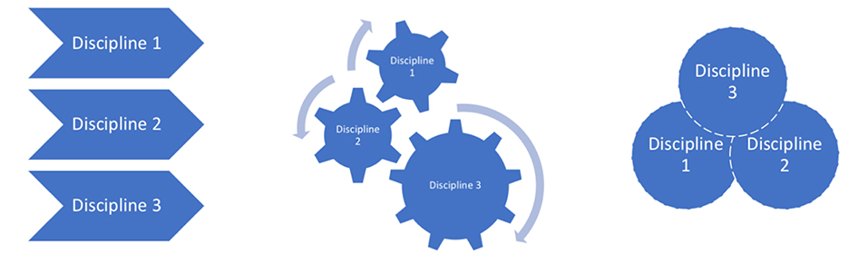
Some Definitions & Distinctions
Multidisciplinarity is understood to be an additive approach – using knowledge from more than one discipline which are not themselves transformed by being used in conjunction with one another.
Interdisciplinarity is characterized as interaction across and between disciplines. Becomes one activity.
Transdisciplinarity aspires to be a more holistic approach, aiming to displace or supersede disciplinary formations.

Slide 8
Types of interdisciplinarity
Three different logics or rationales of interdisciplinarity:
Integrative, working towards synthesis;
Subordinate, belonging under larger umbrella (e.g. social sciences being affiliated to science more generally);
Agonistic / antagonistic, demarcating from specific other approaches
Barry, Born and Weszkalyns, ‘Logics of Interdisciplinarity’ (2008)
In the third form interdisciplinarity emerges through interferences or frictions between disciplines and between disciplines and other forms of knowledge. Disciplines may be transformed in the process.

Slide 9

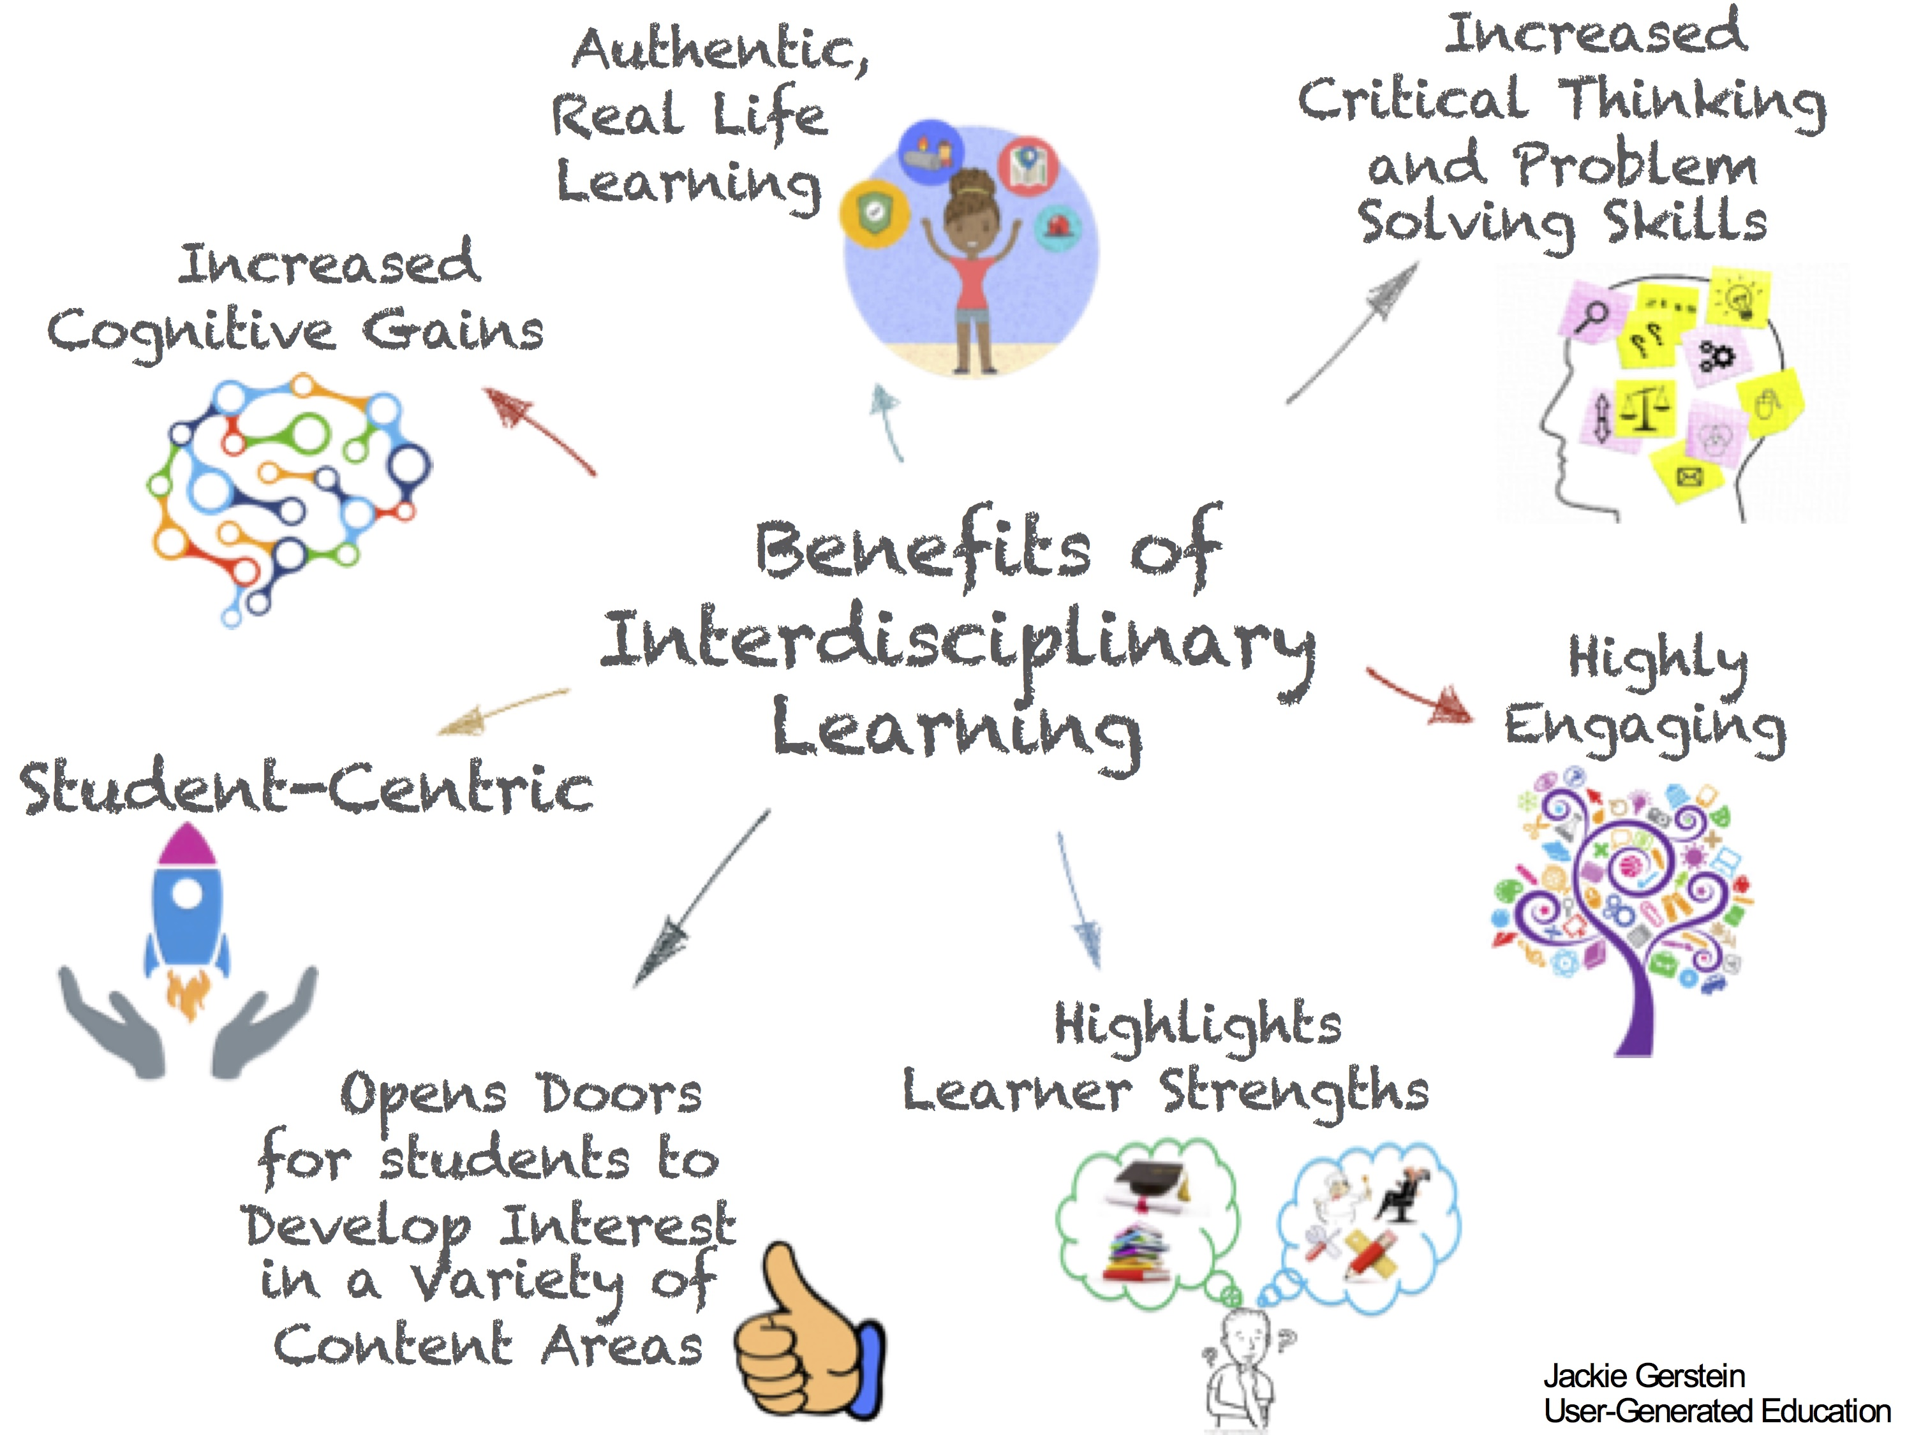
Benefits of interdisciplinarity?

Slide 10
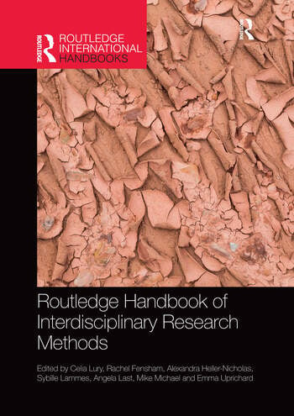
Lury, Celia (ed.), Routledge Handbook of Interdisciplinary Research Methods (2017)
Wedging - something that connects scholars with different interests. (Ch. 16 by Jane Calvert)
Deriving - to derive is not simply to come into possession of something, rather it is to acquire something by means of drawing it out from something else, and often in the endeavor of drawing it out, transforming it. We derive by extension. We derive by modification. … What we derive from design, as mode of making-as-inquiry, is not solutions, but rather productive glitches, difficulties, and complications. (Ch. 3 by Carl Disalvo)
Disrupting - The idea of disrupting, as we develop it here, refers to an improvisatory process that ‘corrupts’ ethnographic and design principles when they are brought together. (Ch. 4 by Yoko Akama and Sarah Pink)

Slide 11
Institutional support
Humanities Research Centre
Centre for Interdisciplinary Methodologies
Institute for Advanced Studies
Interdisciplinary Research Spotlights - Business and manufacturing; Health; Society and Culture; Sustainability plus two themes that run across all those ‘Behaviour’ and ‘Digital’.
School for Cross-Faculty Studies
Cross-faculty centres, projects & initiatives

Slide 12

Challenges / difficulties ?
Different disciplinary training, conventions, expectations and modes of explanation
A sense of ‘loss’ (some art historians value ‘excellence’)
How to write collaboratively?
Mastering diverse literature
Confidence – always struggling to understand, constantly trying to catch up
Institutional barriers

Slide 13
Critical voices
What is behind the recent rise of calls for interdisciplinarity?
Many funding bodies expect it: UKRI, Wellcome Trust
Some writers – such as Richard Tabulawa, ‘Interdisciplinarity, Neoliberalism and Academic Identities’ (2017) – see this in relation to a global context of a growing instrumentalisation of knowledge for utilitarian purposes.
Tabulawa’s suggestion is that interdisciplinarity is not some neutral or technical re-arrangement of knowledge. Rather, it is a political tool seeking to wrest the power to control the processes and products of the university away from academics and forming new structures that support the needs of the market-based economy, i.e. serving a neoliberal agenda

Slide 14
Is History inherently interdisciplinary?
The different branches of social, economic, religious, demographic etc history all have their specific canons, methods and debates, often in natural dialogue with e.g. sociology, economics, theology and statistics.
Historian on the Edge [Guy Halsall], ‘What do we mean by ‘Interdisciplinarity’?:
‘What is at stake here is how one draws and defines the dividing lines on the map of the academy, and what is involved in intellectual exchange. [What] I suggest, might be a more meaningful way of thinking about the fruitful confrontation of difference – a more interesting way of drawing the lines that sub-divide academia – is the confrontation of theoretical approaches.’

Slide 15
In my own research …
… which country / culture could I engage with?
… what other discipline(s) might prove helpful?

Slide 16
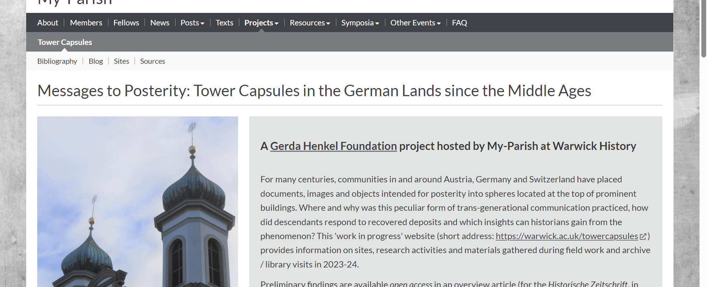
Beat’s research:
Evidence / works from several Central European countries
Local history in dialogue with memory studies, anthropology, architecture, material culture …
Opportunities to link academia with heritage sector and building industry (intersectionality) …

