Slide 1

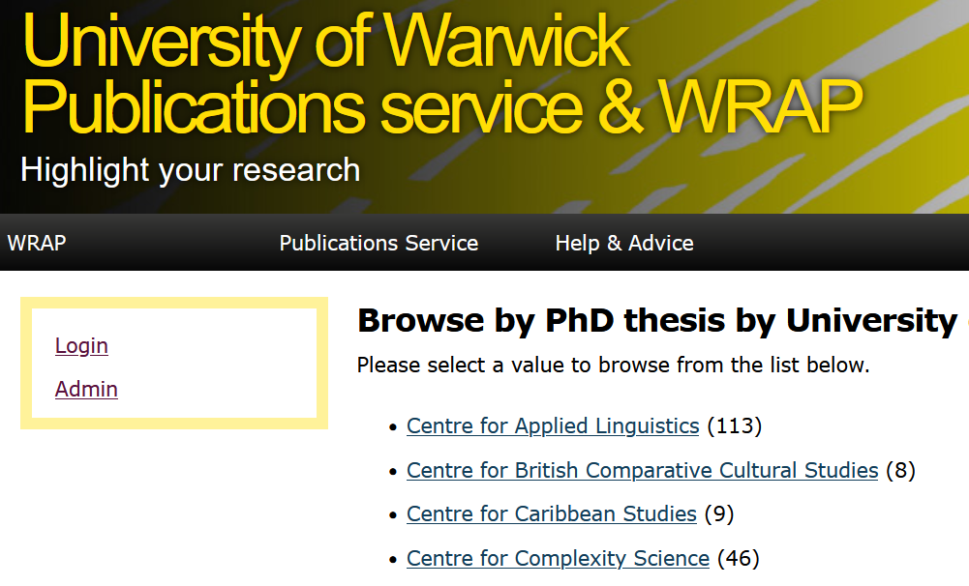
WRAP.warwick.ac.uk
Warwick Research Archive Portal
October 2023
Lindsay Wood – E-Repositories Manager, Library – wrap@warwick.ac.uk

Slide 2
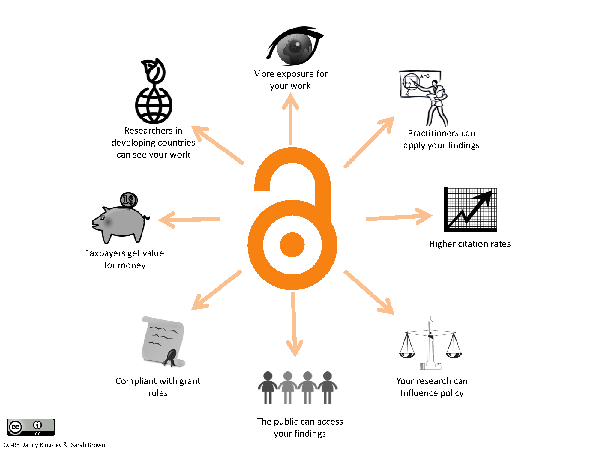
Open Access to research
Open Access is making research work freely available without an expensive subscription or paywall
Deposit a copy of research work in an online repository database
Or publish in a journal that makes the work available immediately for free

Slide 3
Benefits of WRAP institutional repository deposit
Local research browse/search, including very recently accepted research
Global visibility, showcasing the research created by the University
Long-term secure location that links to other institutional systems and processes
Provides you with a persistent web link (URL)
Rigorous checking of publisher copyright policies
Library quality metadata (catalogued records) to describe your work
Indexed by Google/Google Scholar to raise your academic profile harvested by other international, European, and national databases
Acts as a compliant open access repository for funders

Slide 4
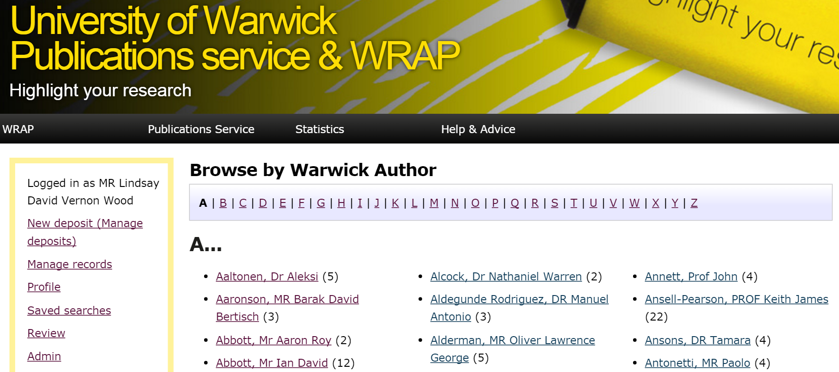
Browse by Author
wrap.warwick.ac.uk/view/author_id/
Notes:
WRAP is an online open access public facing Library database documenting research at Warwick, including very recently accepted research outputs. Journal articles, conference papers, working papers, datasets, book chapters/books, research reports, PhD theses, etc. Browse by Staff Author A-Z, or browse by Library Subject Heading, …

Slide 5
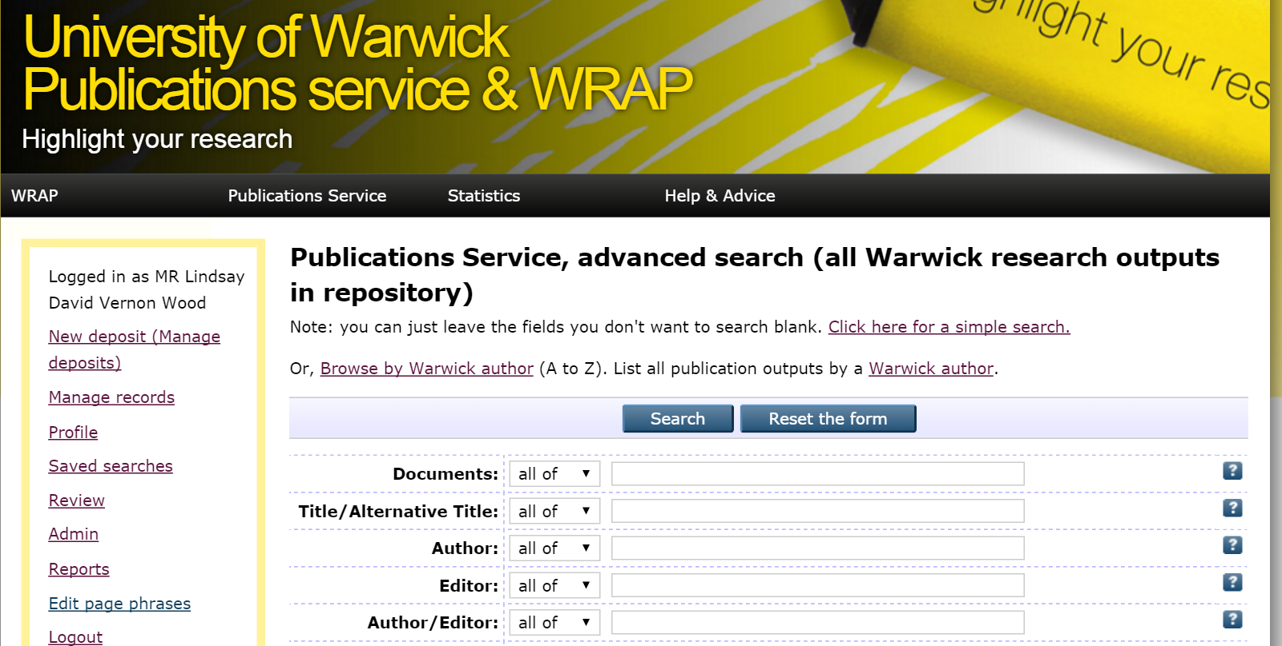
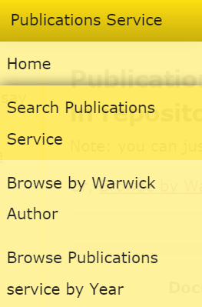
Advanced publications search
wrap.warwick.ac.uk/cgi/search/publications_advanced
Notes:
Or, advanced full Publications Service search – search by thesis department, thesis supervisor, Library subjects / Library of Congress Subject Headings, research output type, etc.

Slide 6
Open Access publishing
Funder requirements (UKRI, Wellcome, EU/Horizon)
Read & Publish open access deals
- by journal: https://search.scifree.se/warwick
- by publisher: https://warwick.ac.uk/services/library/staff/open-access/make-my-work-open-access#RP
UKRI Journal Check: https://journalcheckertool.org/
Notes:
Open Access direct from publisher journal site, increasingly requested by large research funders. Relatively new Library Read & Publish deals allow both reader access and to publish open access in set journals without direct cost to authors. Some funders have supported a journal compliance checker tool.

Slide 7
Research data management
Care of your research data is an essential part of research good practice
Plan to make right decisions about creating, storing and sharing your data before you start your research project
Organise, so you can make your data files easy to store, find and use including formats, storage and file naming.
Make your data accessible and how to access data sources for your research
Discover how to preserve & store your data securely for as long as necessary
Manage PhD research data according to the FAIR [Findable Accessible Interoperable Reusable] principles: https://wrap.warwick.ac.uk/165546/ (Kapoor, 2022)
Notes:
Care of your research data is an essential part of research good practice.

Slide 8

Useful links
WRAP PhD theses: https://wrap.warwick.ac.uk/view/theses/
WRAP Subjects: https://wrap.warwick.ac.uk/view/publications_subjects/
Open Access: https://warwick.ac.uk/services/library/staff/open-access/
Research data: https://warwick.ac.uk/services/library/staff/research-data/
Library Guidance videos: https://www.youtube.com/@uowLibrary/search?query=thesis
International Open Access Week: #OAweek

Slide 9
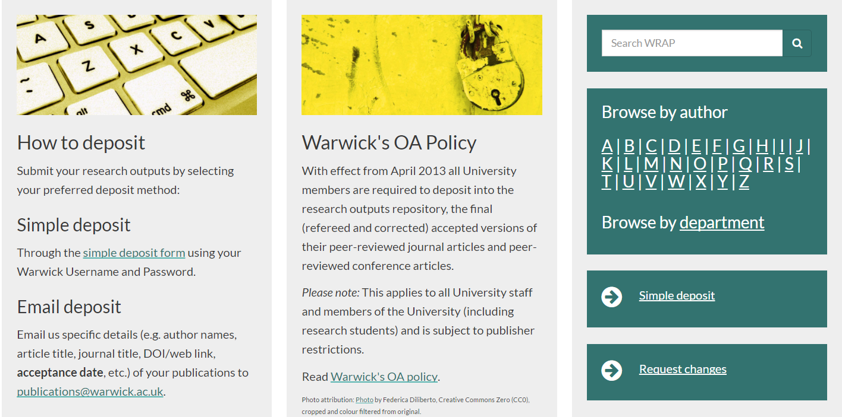
Help & guidance
https://warwick.ac.uk/services/library/staff/warwick-research-publications/

Slide 10
Any questions?

Slide 11
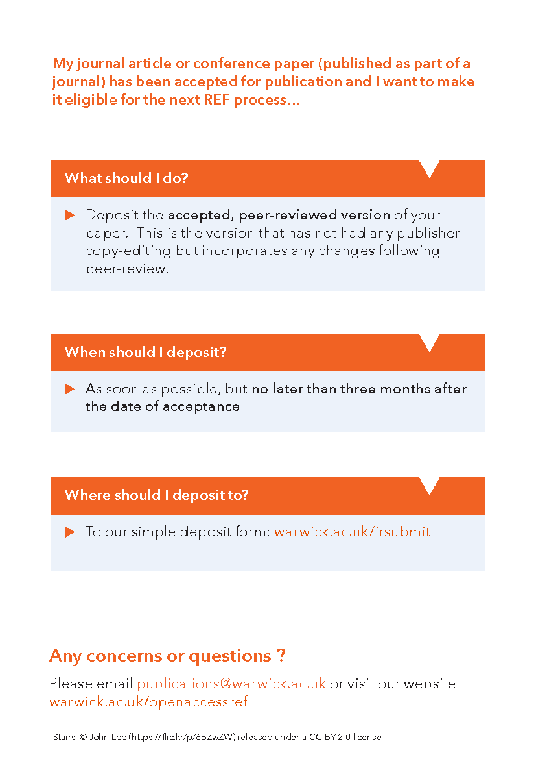
Open Access and REF 2028
Policy remains the same as it has been since 2018 mid-cycle update.
Deposit your author accepted manuscripts to WRAP within three months of the date of acceptance – journals and conference contributions
We are expecting a review of the open access policy for REF2027/8 during summer 2023 … …
Notes:
This policy states that to be eligible for the inclusion for the REF, journal articles and conference contributions must be deposited into a repository. University of Warwick’s policy is that all outputs should be deposited in our institutional repository, WRAP. A further update on REF2028 and open access is expected in by end of 2023.

Slide 12
Submission of an electronic thesis - your options
Both the hard and digital copy thesis can be made publicly available immediately
The hard copy thesis can be made available immediately and the digital copy thesis made publicly available after a period of 2 years
Both the hard and digital copy thesis made publicly available after a period of 2 years
Both the hard copy and digital copy thesis can be made publicly available after _______________ (insert time period in excess of two years). This option requires the prior approval of the Academic Director of the Doctoral College
Notes:
Thesis deposit: https://warwick.ac.uk/services/library/staff/warwick-research-publications/thesis-deposits/
Library declaration form: https://warwick.ac.uk/services/dc/submission/useful_forms/library_declaration_and_deposit_agreement_1.doc

