Slide 1
Oral History
An (incredibly brief) introduction
By Jenny Crane & Gareth Millward, Adapted by Rosie Doyle
Notes:
GM: 3 ; 4 ; 5 ; 6
JC: 7 ; 8
GM: Sierra ; H1N1
JC: NHS70 ; Voices ; ChildLine

Slide 2
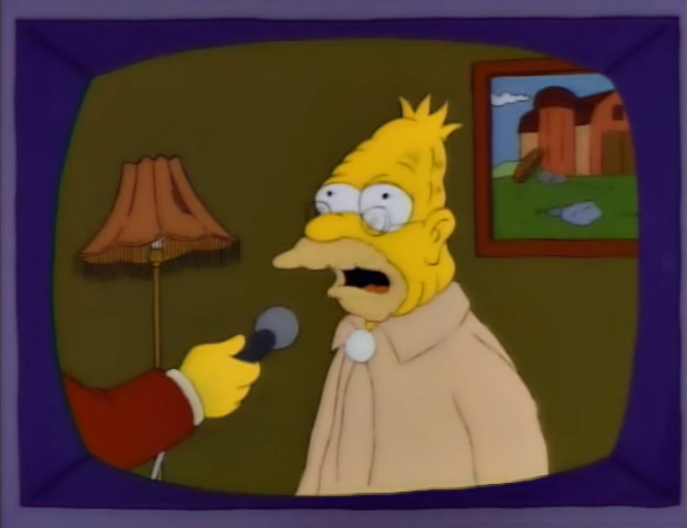
What is oral history?
Spoken testimony as historical evidence
“A source of new insights and perspectives that may change our view of the past”
“Experts of their own life.”
Biography
For more, see the Oral History Society
Notes:
OHS’s front page:
Oral history is the recording of people’s memories, experiences and opinions. It is:
A living history of everyone’s unique life experiences
An opportunity for those people who have been ‘hidden from history’ to have their voice heard
A rare chance to talk about and record history face-to-face
A source of new insights and perspectives that may challenge our view of the past.
Right: Grandpa Simpson, “My son is not a communist”

Slide 3
Why do Oral History
Hidden histories
Information gathering
Personal insights
Gaps
No Documents
Unhelpful Documents
Understanding an archive

Slide 4
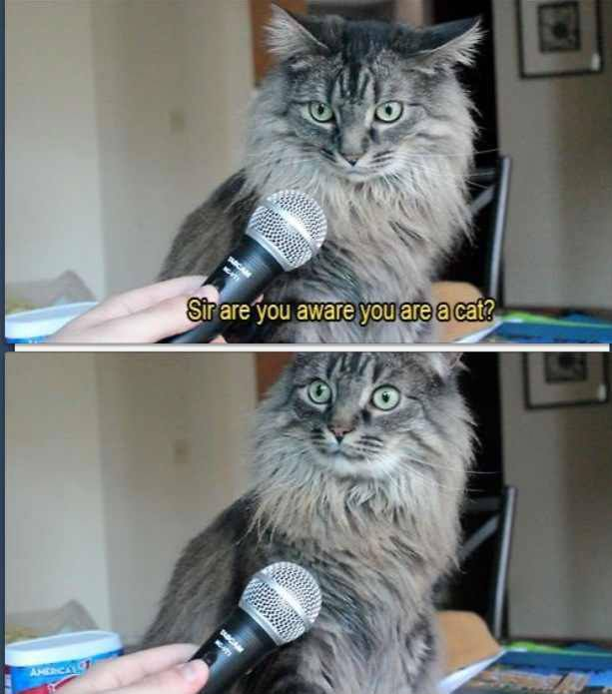
Where did oral history come from?
Growth since 1980s
Improved, accessible recording equipment
New historiographical approaches
BUT – is it “robust”?
And is it really “accessible”?
Notes:
Right: common meme

Slide 5
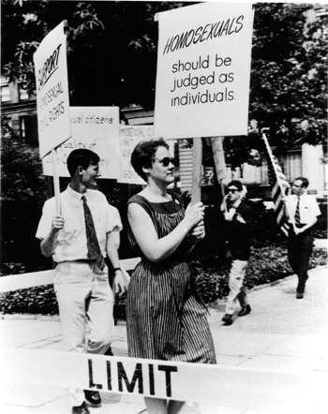
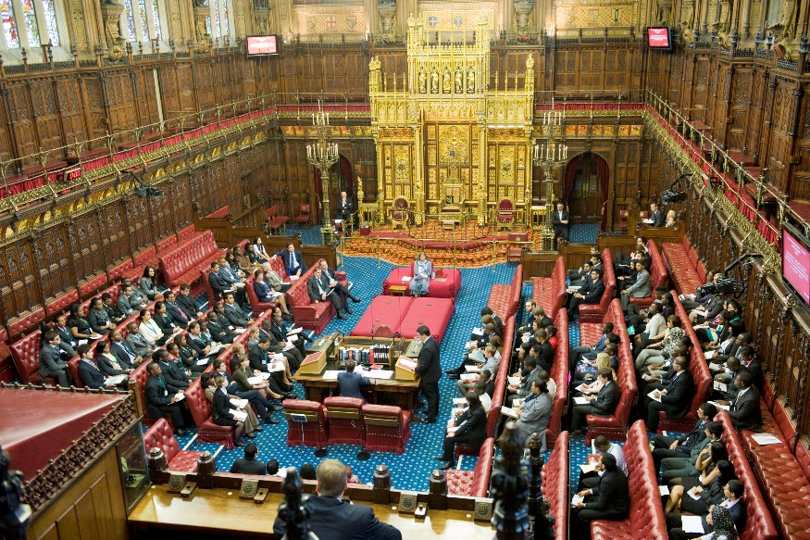
Whose history?
A “history from below”?
Or a new “history of the elites”?
Notes:
Left – Wikipedia entry for “Pride”
Right – Wikipedia entry for House of Lords

Slide 6
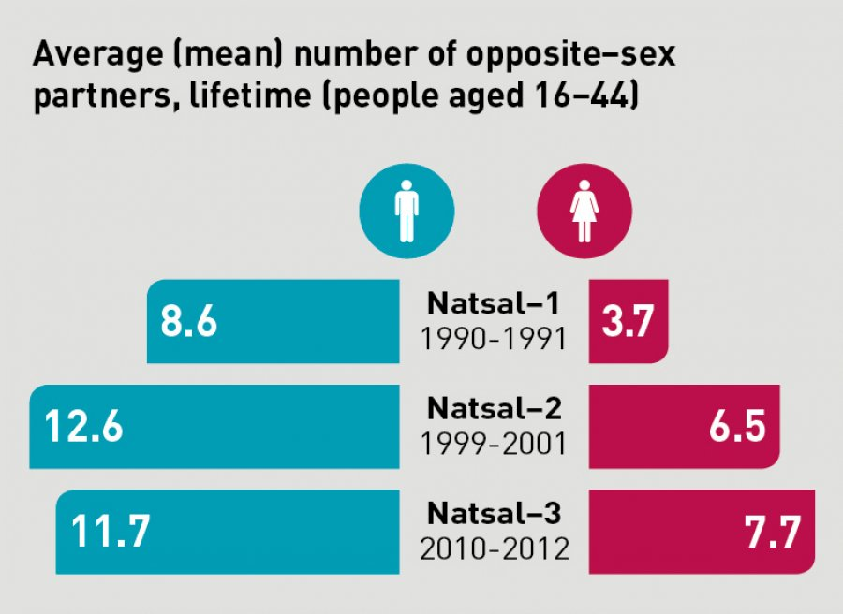
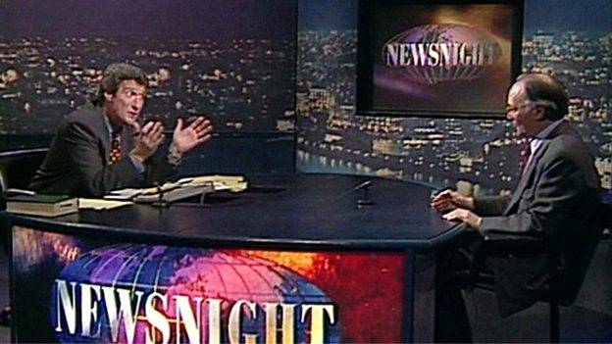
Is it history?
Is it journalism?
No.
Is it sociology?
Maybe.

Slide 7
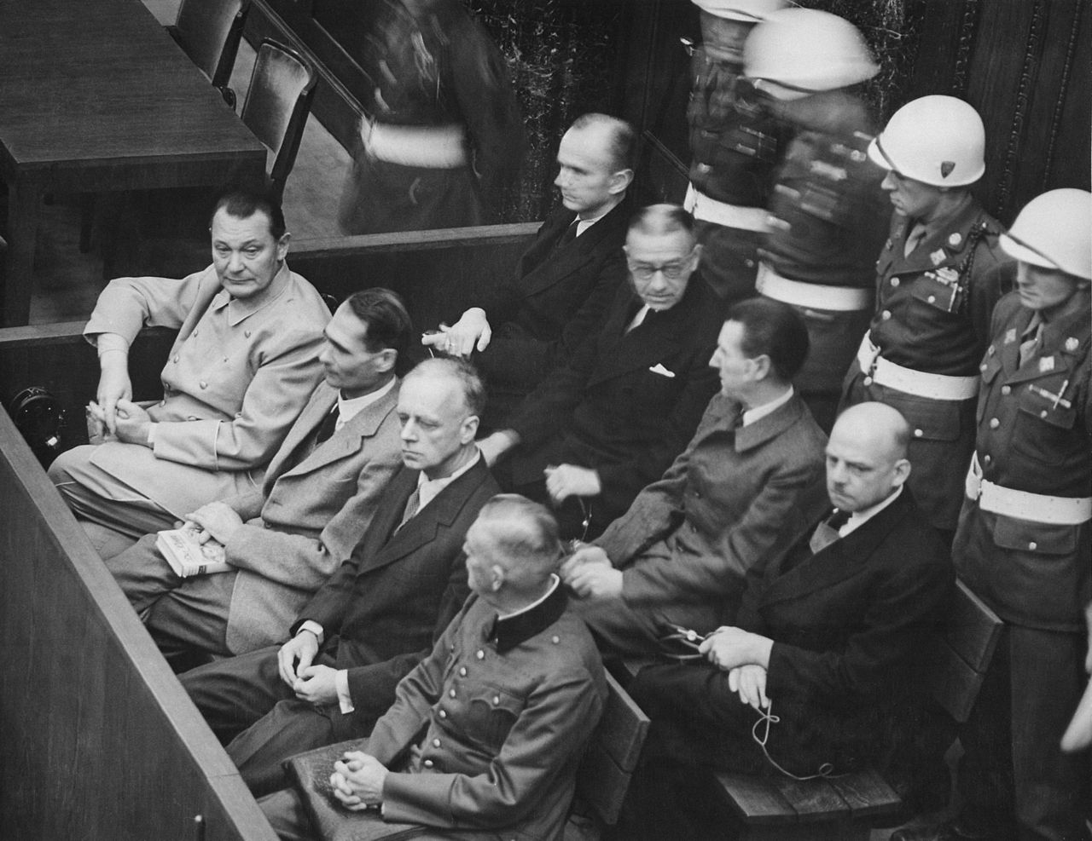
Research ethics
You must get ethical approval before interviewing anyone
This is to protect your interviewees, the university, and you
“Ethics” is not the same as morality…

Slide 8
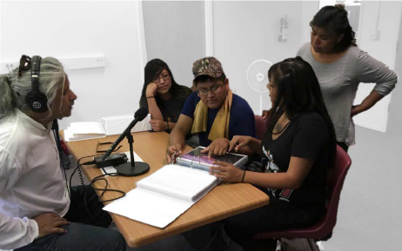
Setting up interviews
Gatekeepers
Translators
Access
Process (questions, images, individual/ group)
Who controls the interview?
Notes:
Image: Zuni Pueblo community members (from New Mexico), including librarian Jennifer Lonjose (standing), practice eliciting and recording cultural memories by “reading” historical photographs during Mukurtu community training workshop with Guha Shankar (left), at Zuni Tribal Library, NM. (Original photo courtesy Mukurtu.org, 2016.)

Slide 9
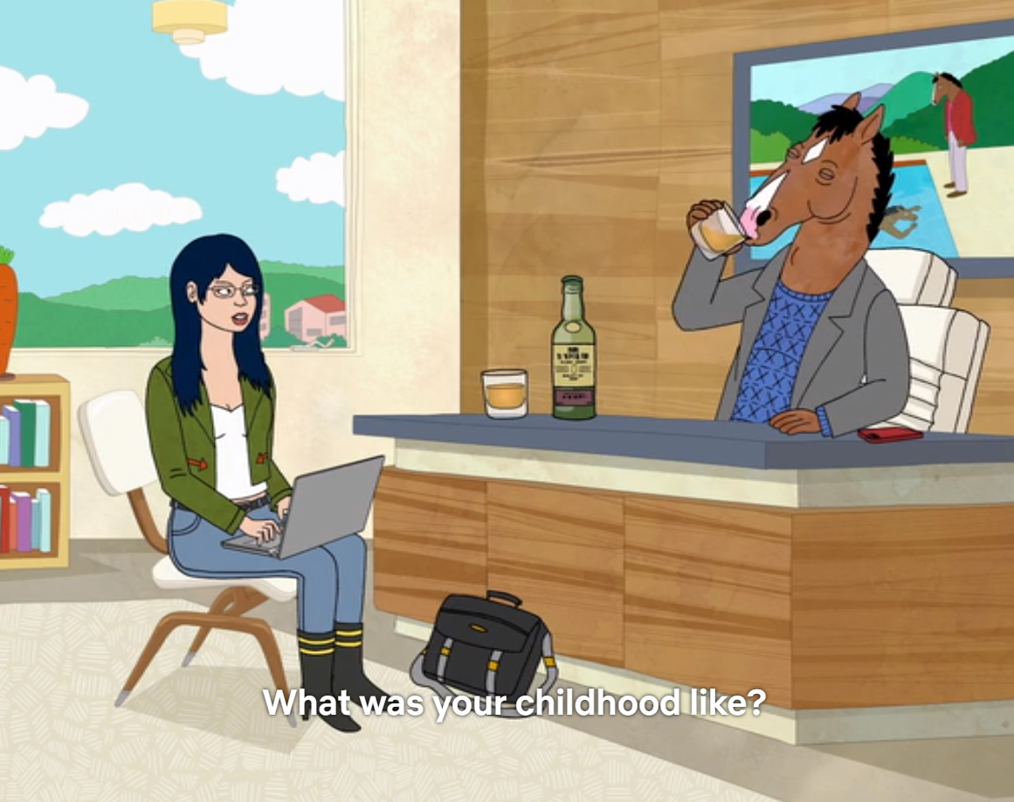
Some final considerations…
What are our data?
Should we – “fact check”?
How do we deal with “informed consent”?
Are our interviewees co-authors?
Should we anonymise?
Who owns the archive?

