Slide 1

Connect with your
Postgraduate
Community
Library Community Engagement

Slide 2
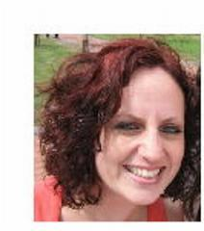
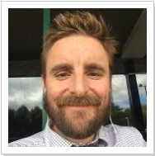
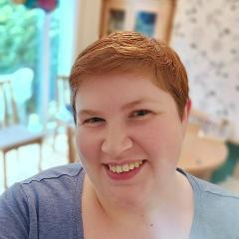
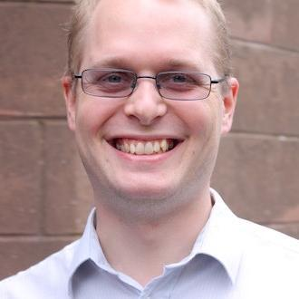

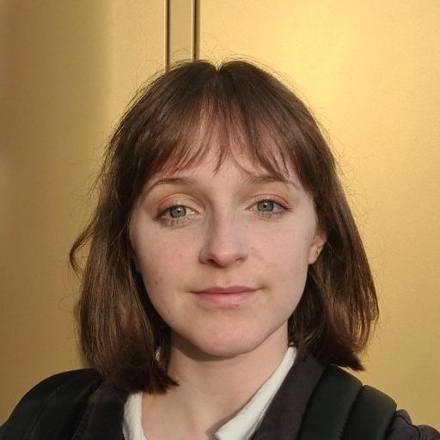
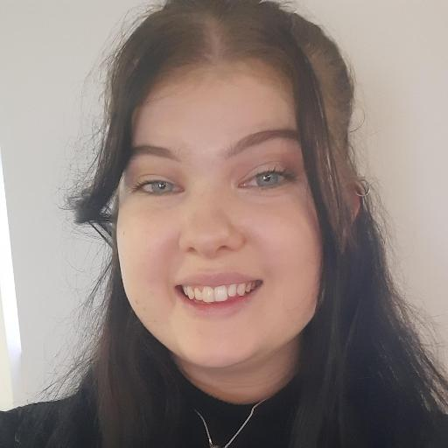
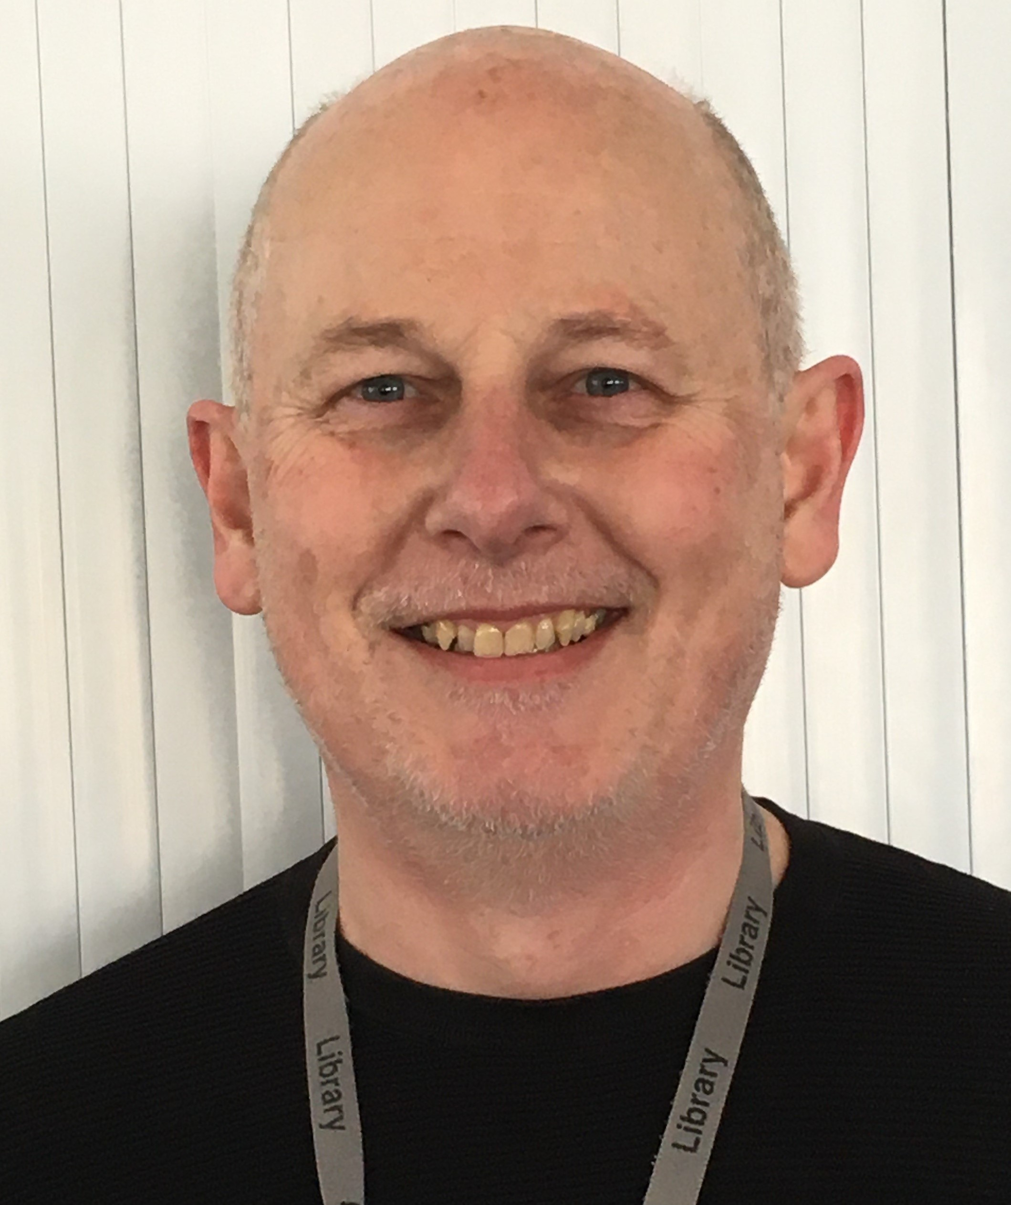
Meet the Team
Phil (he/him), Gemma (she/her), Sam (they/them) and Steve (he/him)
Hannah (she/her), Marie (she/her) and Keiron (he/him)
Notes:
So, to start us off, the Community Engagement team is made up of eight members of staff, all of whom are here to help you. First up we have Phil and Gemma. You may not see a lot of them but they’re both very friendly. We than have Aysa, Sam, (me), Hannah, and Marie. We look after the community events, initiatives, and activities and you’re very likely to see both Hannah and Marie at the events. Lastly, but certainly not least, we also have Steve and Kieron. It’s their job to look after our co-creation space and teaching grid – more info on both of these to come. But, now that you know who we are, who are you? And do you have any fun facts that you’d like to share with us? Or, if you want you can send into chat an emoji that best describes your favourite thing to do in your spare time or your favourite hobby! Thank you so much for sharing with us! Some fun facts about us are that Marie is a twin, Kerion was a college fencing champion, Sam will have participated in four 5ks by the end of 2023 and Hannah has lived in five different cities!

Slide 3
Get Started at the Library
We’re open 24/7. Helpdesk is open 8.30am – 9.30pm daily.
We have over 1 million print books and over 1.3 million e-resources
No Fines and As Many Loans As You Need
Click and Collect Service
Get it For Me Service
Specialist Librarians for your subject
Accessibility Services; including accessible and sensory rooms and loanable equipment

Slide 4
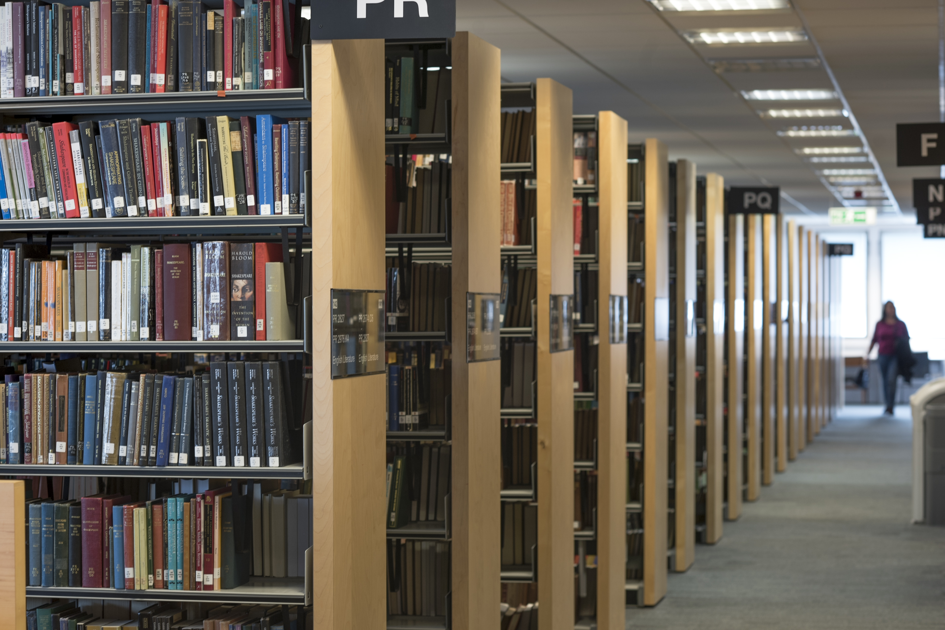
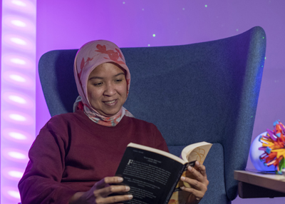
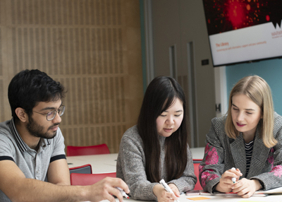
Your Library Spaces
Main Library
The main Library has five floors and two extension floors. Floors 1 and 2 are for collaborative study. The other five floors are quiet study floors. There are also two silent study areas on 2x.
Accessible Study Rooms and Areas
In the Main Library there are three accessible study rooms, two sensory study rooms and an assistive technology area. There is also one accessible study room at University House Learning Grid.
Learning Grids
There are four Learning Grids on campus. Two are at University House and one is at Rootes. There is also the BioMed Grid at Gibbet Hill for Life Sciences and Medical Students.
Notes:
It’s important to us that every single person is able to study efficiently and thus we have a multitude of different study spaces to offer you. In our Main Library building, we have five floors and two extension floors. There are bookshelves on Floors 2, 2x, 3, 3x, 4 and 5. These floors also all provide quiet study areas as well. These desks are all for individual study and students should keep their noise level to a minimum while working and walking around on these floors. On the second floor extension, there are also two silent study areas as well. The desks in these rooms are also all for individual study. Floors 1 and 2 are for collaborative study. This means that talking is allowed – however we do still try and ask that noise is kept to a respectable volume – it is still a Library after all!
As well as that, we also have three accessibly study rooms in the Main Library. These are private rooms that can only be booked by students registered with disability services – like yourselves. In these rooms you will find all of the assistive tech that you should need – though please do get in touch with our Accessibility Officer if you need any help with these rooms. You are also able to allow one carer into the room with you if this is required. We also have two sensory study rooms. These rooms can also only be booked by students registered with disability services. These rooms have lighting that you can change and other sensory toys and furniture for you to use to help create the perfect environment for you to study in.
If you mentioned that you need noise cancelling headphones to study but do not own any, you can also loan some from the Library. Just ask the staff at the Helpdesk for these.
Lastly, but certainly not least, we also have two different Learning Grids on Campus. The first is at University House. We’ve heard from Autism at Warwick that this is often favoured among autistic students as it is often a quieter space to study in. This learning grid also has a bookable accessible study room as well. The other learning grid is over at Rootes and is a more popular learning grid and so can often be a little bit louder, especially in the collaborative working area.
We also have the biomed grid over at Gibbet Hill for our Medical and Life Sciences students. This is a small study room with individual study areas and collaborative study areas too.
Lastly, for our postgraduates, we also have the PG Hub – which also has a bookable accessible study room and has individual and collaborative study areas – and the Wolfson Research Exchange which is exclusively for our researchers and is typically a collaborative space but is often quite quiet in there too.

Slide 5
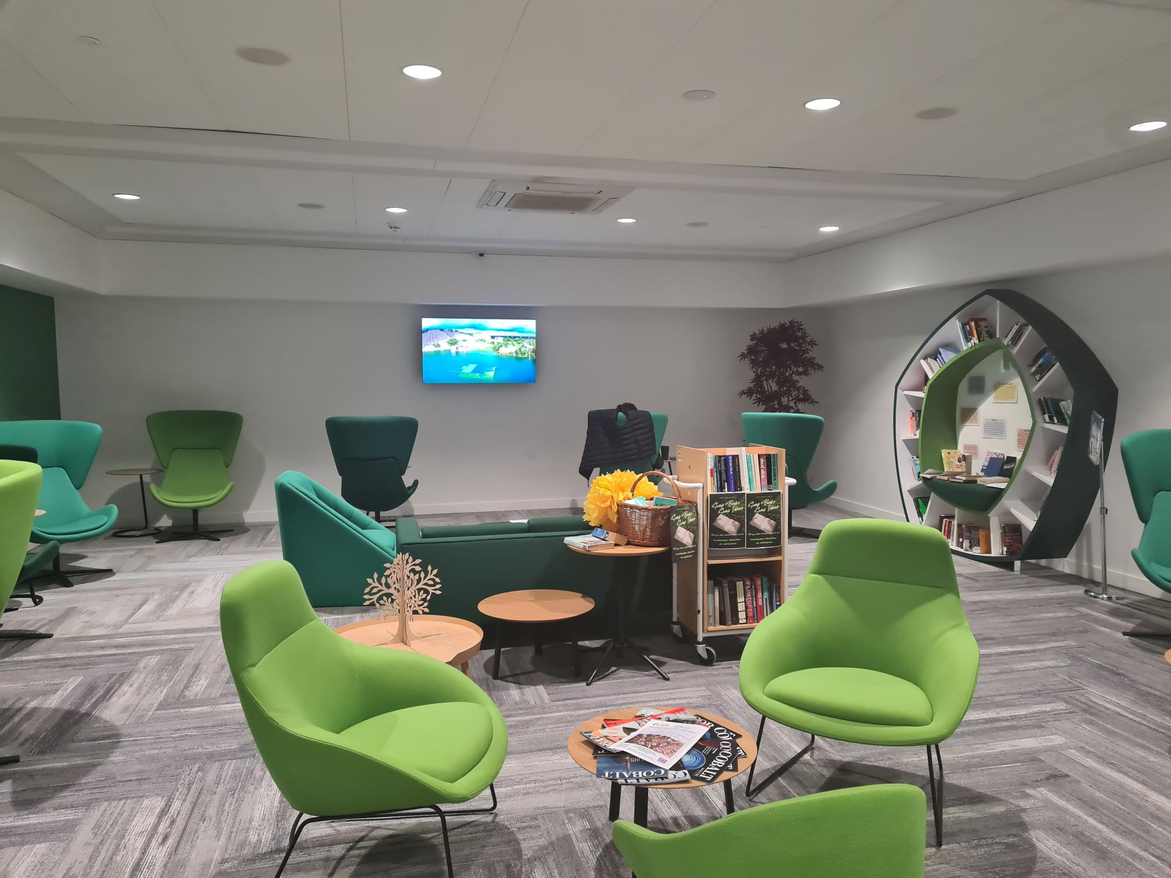
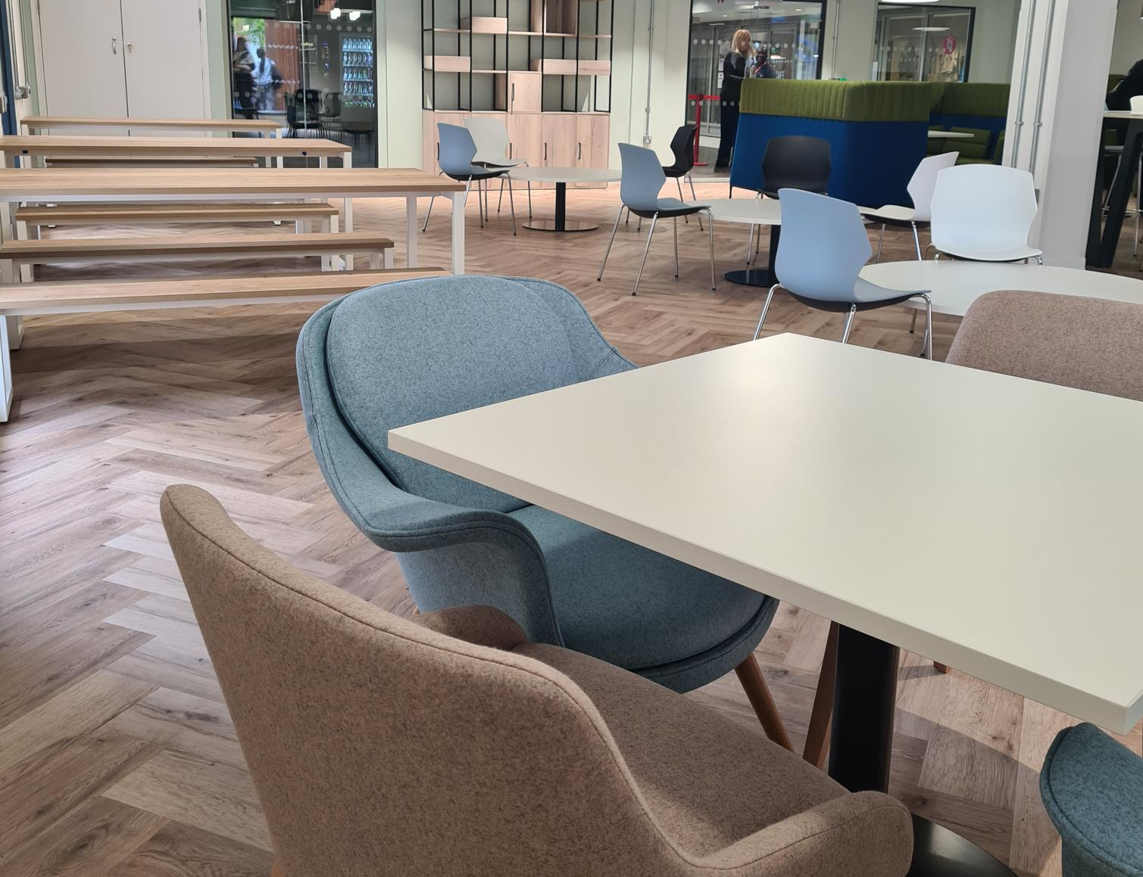
Your Library Spaces
Breathing Space
Located on the First Floor of the Library is our Breathing Space. In this space, we encourage students to take a break from their studies and have a peruse of our Leisure Reading Collection.
The Eating Place
Located on the Ground Floor, this is now open and will shortly include microwaves. It has a hot water tap as well for making hot drinks. This is the only place in the Library which allows hot food.
Notes:
On top of all of that, we also have three other unique spaces. The first is the Breathing Space. This is on the first floor of the Library and is a space where we encourage you to take a break and have a little bit of a relax. It has soothing lo-fi music playing throughout, comfy seating and it also includes our leisure reading collection, all of which can also be borrowed as well. We then also have the Teaching Grid, which I mentioned at the beginning of this talk. You may not spend a lot of time in here during your time at university but it’s a versatile space which can be arranged to meet lots of different needs. It is mostly used for teaching training or practicing but we do also sometimes use it for some of the events that we host in the Library. Lastly, but certainly not least, is the Co-Creation Space. This space is a bookable room that can be used for co-creation. The furniture inside the room is also very versatile so that the room can be set up in multiple different ways. When it’s not booked out, it is open for use by students as extra study space as well.

Slide 6
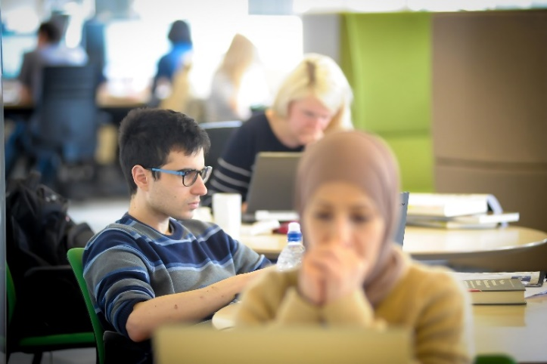
Wolfson Research Exchange
A community space encouraging interdisciplinary collaboration, peer support and study space for Warwick Researchers.
In this space are individual study desks, group study areas, computers, printers, a small kitchenette with a hot water tap for hot drinks, lockers, and a comfortable break area with bean bags and games.
Research Refresh
Every Thursday from 10.30am – 12pm, we hold Research Refresh in the WRex, which is a chance for you to meet fellow researchers from different disciplinaries, unwind, play some games, and refuel with some free refreshments.

Slide 7
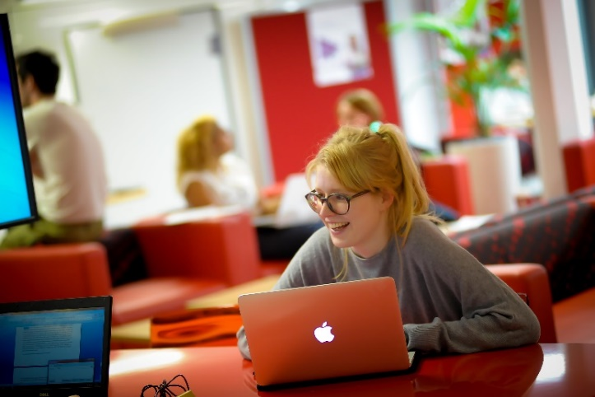
PG Hub at Junction
A hub of activity for PG Students. There is a silent study space, a collaborative study space, bookable rooms, and a relaxation room with bean bags, some games, and LED lighting that you can control.
There is also a small kitchenette near the Hub where you can get hot water as well.
PG Tips (PG Hub)
Held on Tuesdays from 3pm – 4pm in the PG Hub. This is an event for all postgraduates. It’s a space to meet fellow PGs and includes weekly topics to discuss each week, such as Healthy Study Practices. There are also free refreshments too.

Slide 8
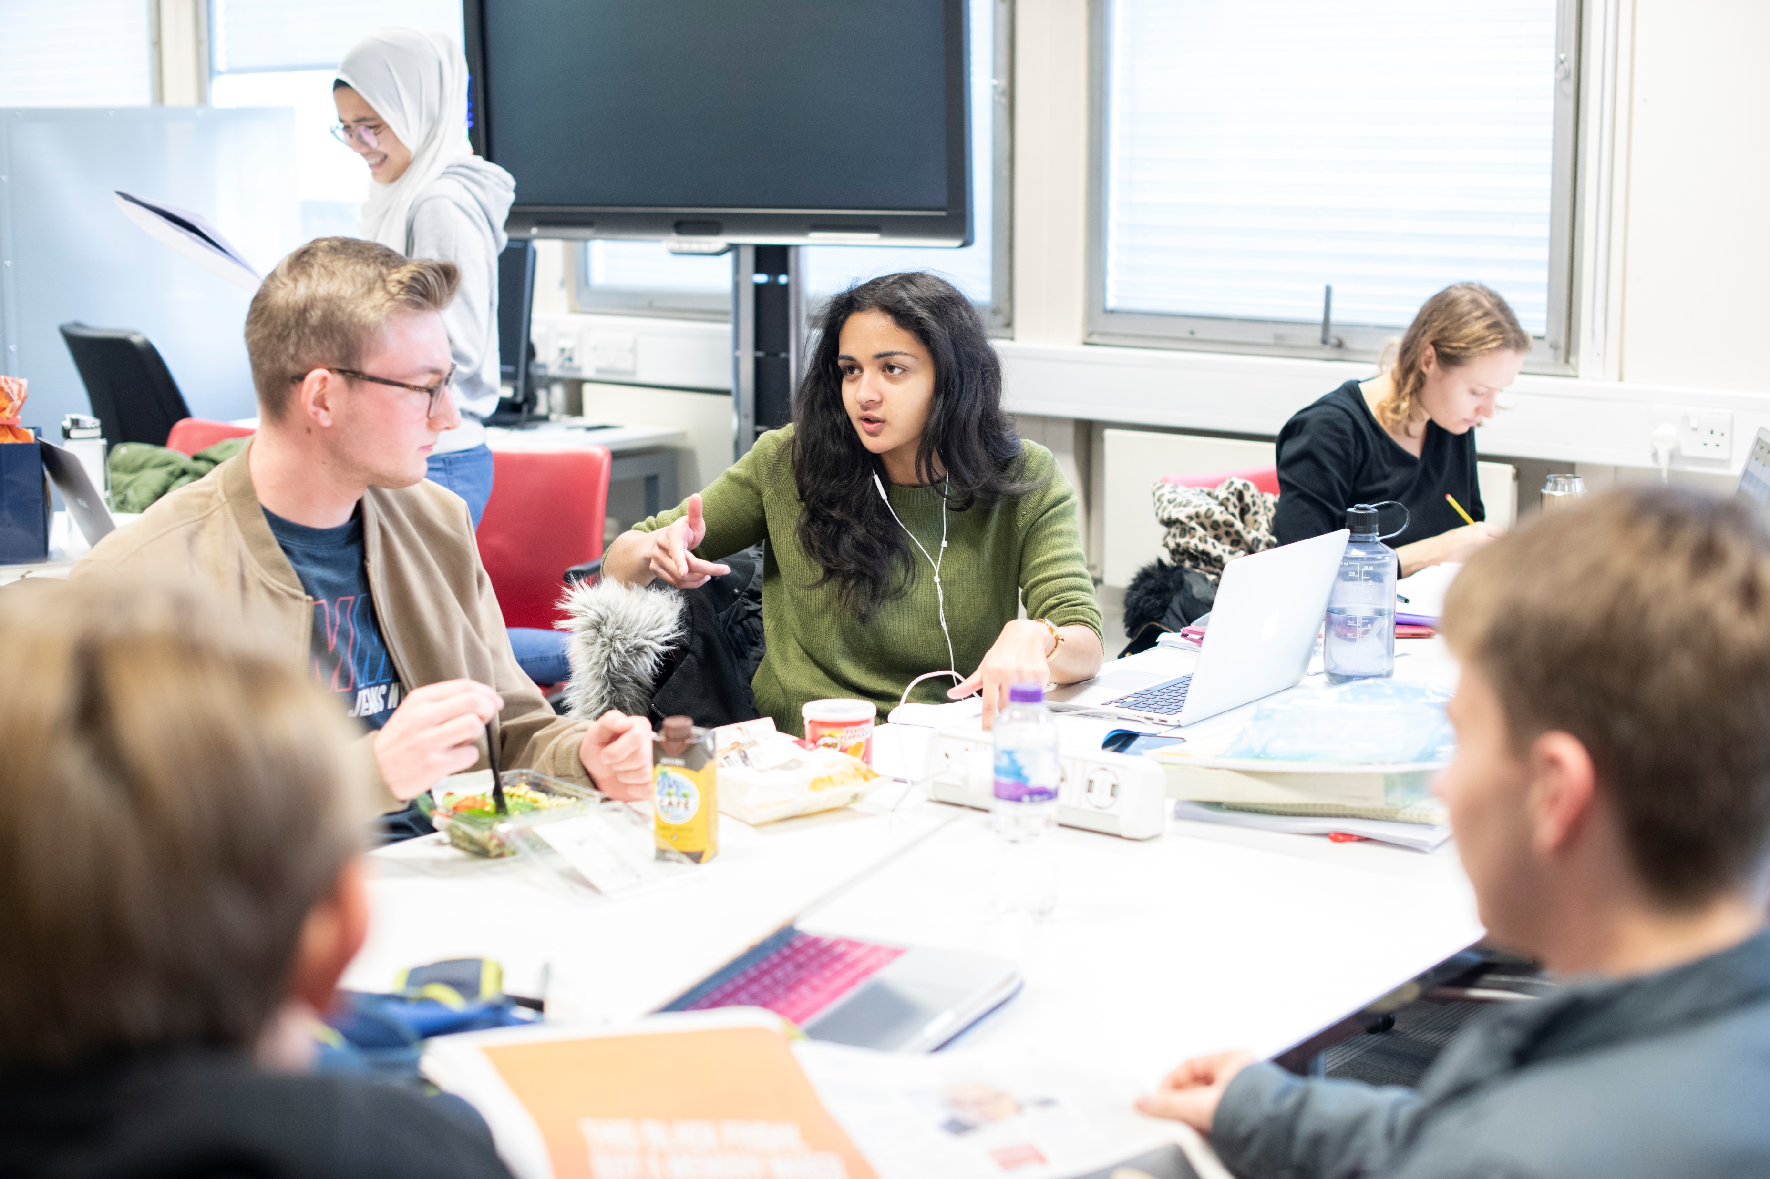
Other Events
We run a variety of different events at the Library, all of which are designed to support you through your time at the University. Our events focus on connecting you to your peers, helping you to learn and study independently, and ensuring that you’re able to get the support and help you require.
Here are a just two of the events that are open to all students:
Write Here Write Now; a pomodoro style event where you can work alongside fellow students to get your work done.
Sensory Refresh; an event that allows you to explore your senses and learn what senses help you to focus better.
Keep an eye on our website and the WhatsOn Calendar throughout the year.

Slide 9

Online
Postgrad Realities Moodle
warwick.ac.uk/postgradrealities
Supervisor Relationships
Imposter Syndrome
Expectations
Perfectionism
Culture Shock
Procrastination

Slide 10
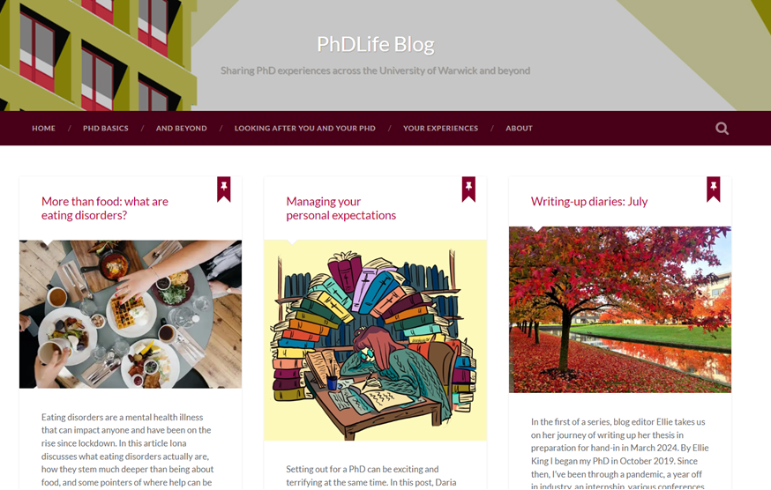
Online
PHDLife Blog
https://phdlife.warwick.ac.uk
PhD-ing 101
Composing & Writing
Building Relationships
Being Well
Moving On & Transitions
Notes:
We also have a Study Blog! This blog is written by students too, so all the advice and tips found on the blog are written by your peers. I would highly recommend having a little browse of it before you get here to get as many tips and advice as you can before it all becomes a little bit too overwhelming. We’re also open to suggestions of blog topics too and so if you have a topic that you would like to write about at any point during your time at Warwick, please do let us know.

Slide 11
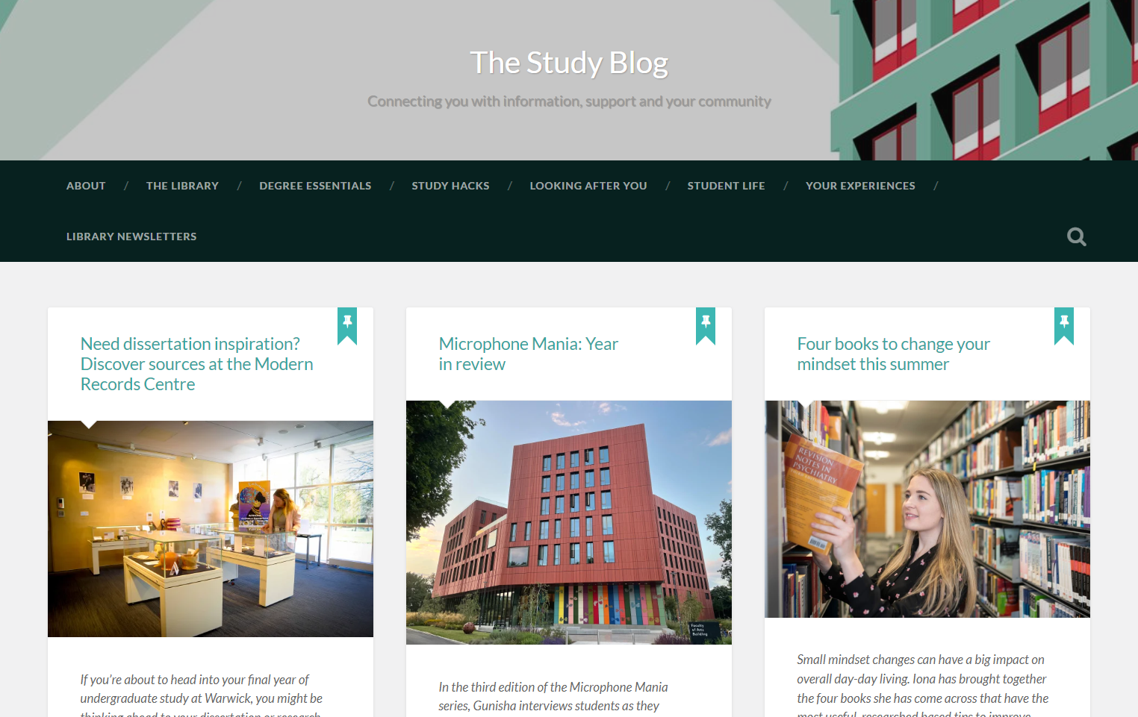
Online
The Study Blog
https://studyblog.warwick.ac.uk
Library Skills
Dissertations
Searching and Databases
Work-Life Balance
Notes:
We also have a Study Blog! This blog is written by students too, so all the advice and tips found on the blog are written by your peers. I would highly recommend having a little browse of it before you get here to get as many tips and advice as you can before it all becomes a little bit too overwhelming. We’re also open to suggestions of blog topics too and so if you have a topic that you would like to write about at any point during your time at Warwick, please do let us know.

Slide 12
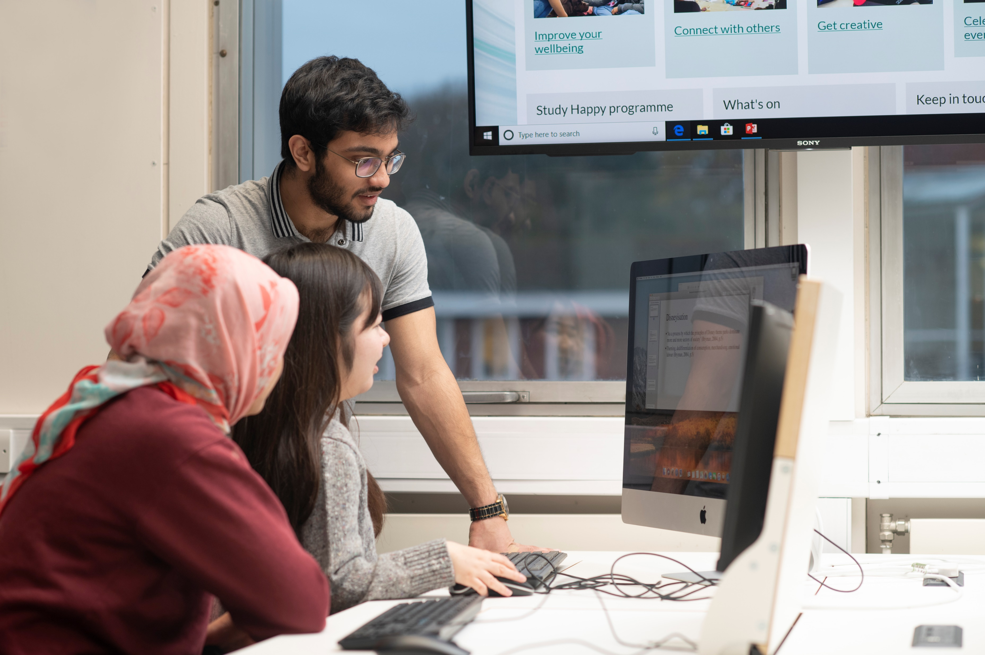
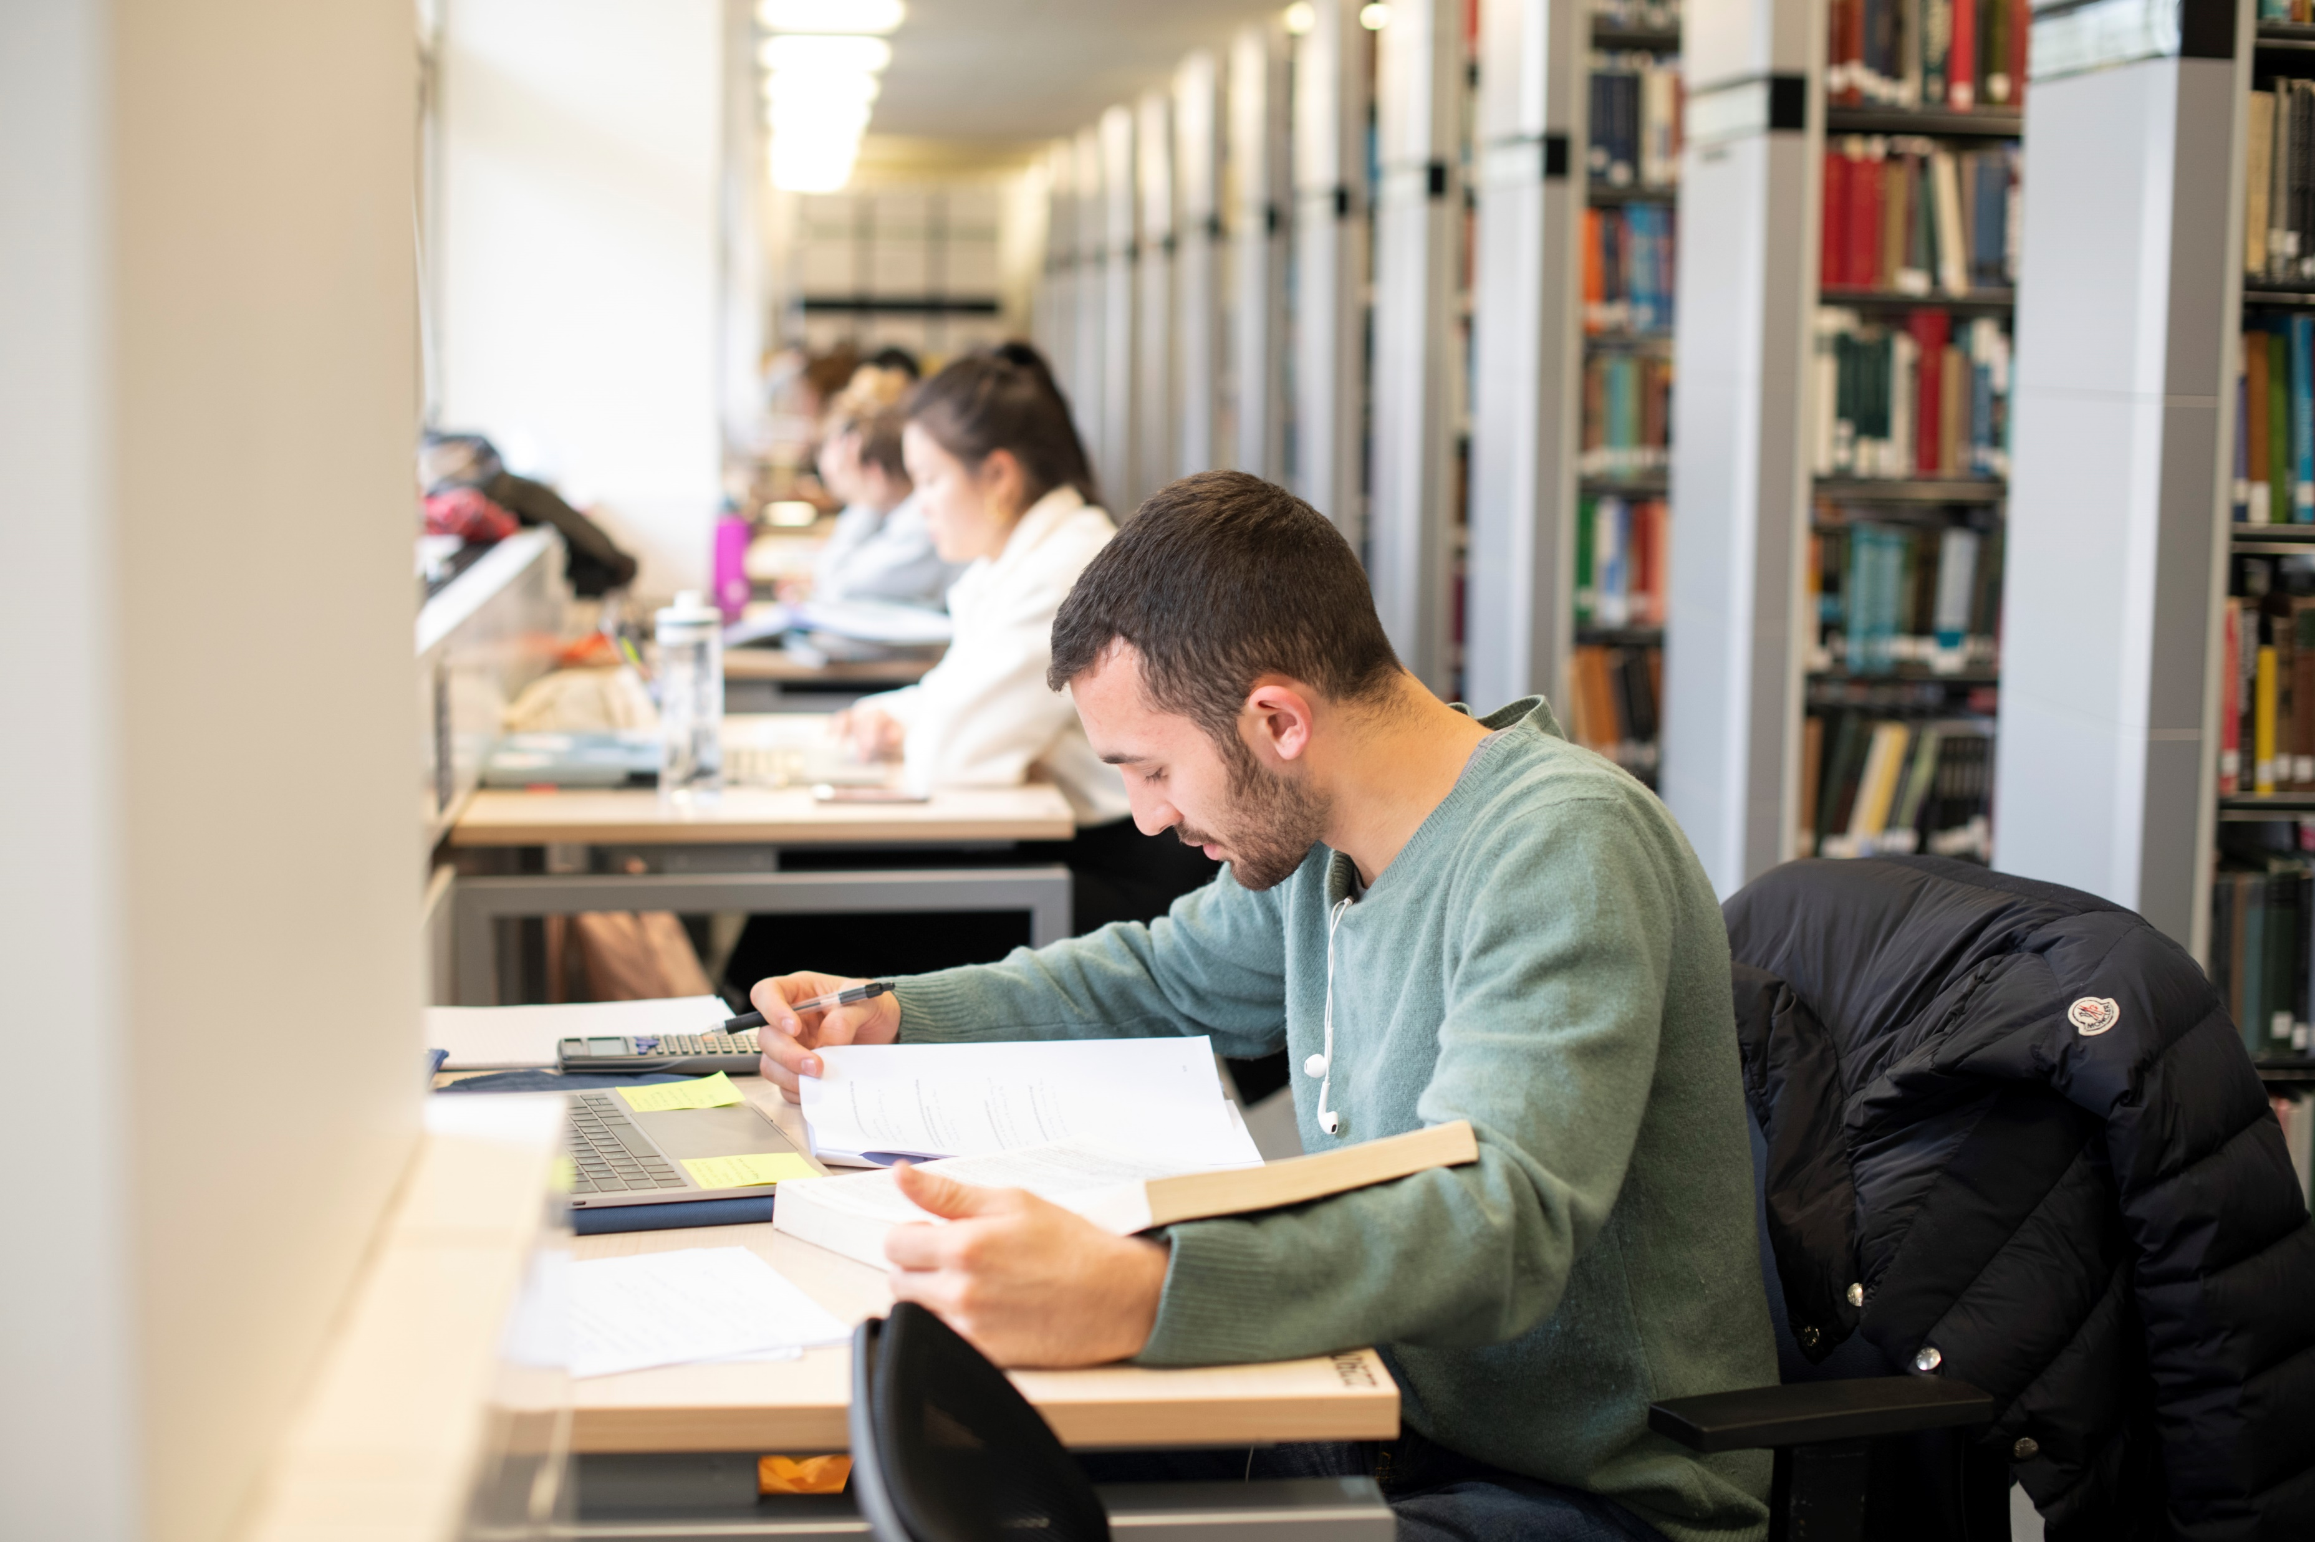
Library Student Partners
Helping us with our events and to help us improve the Library, are our Library Student Partners.
These peers are here to help connect with you and support you during your time at the University, so if you need help or have any suggestions for making the library a better place, do talk to them.
Notes:
We’re also quite active on social media and we love to connect with our students! You can find us on Facebook, Instagram and Twitter. If you follow us on there, you’ll find up to date information about our offers, initiatives and events and you can also ask us questions too. If you do need to get in touch with us for any other reason, please do feel free to reach out to us at lib-community@warwick.ac.uk.

Slide 13
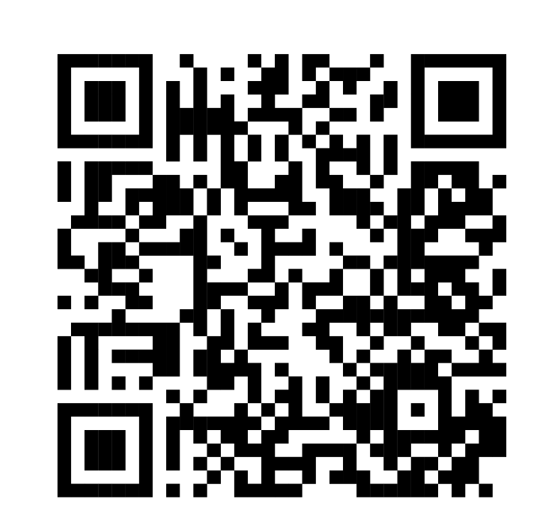




Thank You
Lastly, but certainly not least, you can also connect with us on Social Media or by emailing us.
@WarwickUniLibrary
lib-community@warwick.ac.uk
@WarwickLibrary
@WarwickLibrary
Notes:
We’re also quite active on social media and we love to connect with our students! You can find us on Facebook, Instagram and Twitter. If you follow us on there, you’ll find up to date information about our offers, initiatives and events and you can also ask us questions too. If you do need to get in touch with us for any other reason, please do feel free to reach out to us at lib-community@warwick.ac.uk.

