Slide 1

PGR Induction
Mark Knights
Director of Postgraduate Research

Slide 2
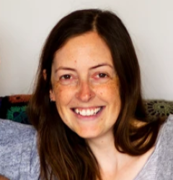
Introducing…
Kay Jones, PGR Co-Ordinator. PGHistoryOffice@warwick.ac.uk Tel 50495 Office: FAB 3rd Floor Office
CADRE Welcome and Induction (warwick.ac.uk); Sharron Wilson
Doctoral College - information for new PGRs Welcome Resources (warwick.ac.uk); in-person ‘welcome’ event 21st November. Also runs Researcher Development - Researcher Development (warwick.ac.uk). NB Wed 11th October 11-12 online Skills Training Session to outline what is on offer.
Library The Library - University of Warwick – runs PG Tips at the PG Hub in the Junction Building; Warwick Postgraduate Spaces - Postgrad Hub; online courses Online courses - University of Warwick Library; support for referencing software; Subject librarian: Rhiannon Taylor

Slide 3
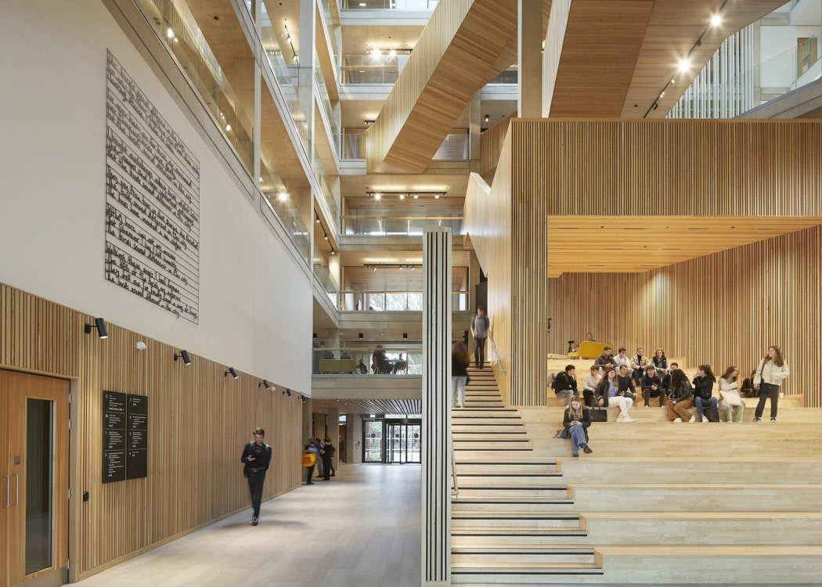
Careers –Millie Tissut
English Language Support classes: Mondays 3-4.30 in OC1.08
In-Sessional English (warwick.ac.uk)
Wellbeing Team - Wellbeing Support Services (warwick.ac.uk) NB I am your personal tutor
Workspaces:
  In FAB, 3rd Floor Quadrant C – just turn up; PCs; lockers
  And CADRE space on Floor 2 - PGR Workspaces (warwick.ac.uk)
  Wolfson Research Exchange, floor 3 (extension) of Library Warwick Postgraduate Spaces - Wolfson Research Exchange
Social events PG Research Social Events (warwick.ac.uk)
Communication: email (please check!); pg newsletter each week; Teams pg common room

Slide 4
Some basics
Warwick core values:
Include commitments to equality, diversity, excellence in all areas of research and learning, an ambitious and entrepreneurial attitude, an openness to rational enquiry with intellectual integrity, and accessibility to students from all backgrounds at all stages of their learning. Ours is a highly cosmopolitan and diverse community in which different perspectives are essential to the generation of ideas.
As part of that community, we expect you to treat your peers and colleagues with respect; engage with ideas, disagree courteously
There is support and a reporting system at
Report + Support - University of Warwick (a link is also on MyWarwick)

Slide 5

Our Research Culture
As a graduate student, you are part of our research community
Large, research-active department. Most permanent members of staff on teaching and research contracts, all actively involved in advancing our field and involved in individual and collaborative projects
Centres (Early Modern and Eighteenth Century; History of Medicine; Global History and Culture; European History)
and networks (Feminism, violence, medieval, oral, queer, parish, science and technology)
+ some cognate ones outside the dept (Centre for the Study of the Renaissance; Yesu Persaud Centre for Caribbean Studies; Humanities Research Centre; Institute for Advanced Studies).
You can be involved in more than one!

Slide 6


Please do attend research seminars and workshops! In-person/online/hybrid!
Regular Wed pm slot for in-person/online seminars: 12-2 – these are compulsory. Research (warwick.ac.uk)
PGR ‘Work in Progress’ meets weekly on Mondays 5-6.30 via Teams – these are highly recommended.
You can suggest activities too!
Some of our Research Centres run collective blogs – contact the Centre directors
The Department also runs one and a twitter account – contact Jane Mallin Jane.Mallin@warwick.ac.uk
You can contribute to public engagement activity elsewhere – NB the week 7 GRF on this!

Slide 7

The pgr handbook Postgraduate Research Handbook (warwick.ac.uk)
Has lots of information about
The department
Welfare and support
Research course regulations
Progression and examination
Personal development
Funding and Travel
University support
Student Voice

Slide 8
Roles
Your role:
  develop your own project with initiative as well as guidance
  Be proactive about planning ahead, researching secondary materials, contacting libraries and archives etc
  write frequently and submit it on time
  Take the initiative to ask for meetings with supervisors and to tell them about skills training you need (nb SkillsForge)
  Please read the Handbook on the website – sets out expectations of meetings – and engage with Doctoral College/CADRE (Centre for Arts Doctoral Research Excellence)

Slide 9
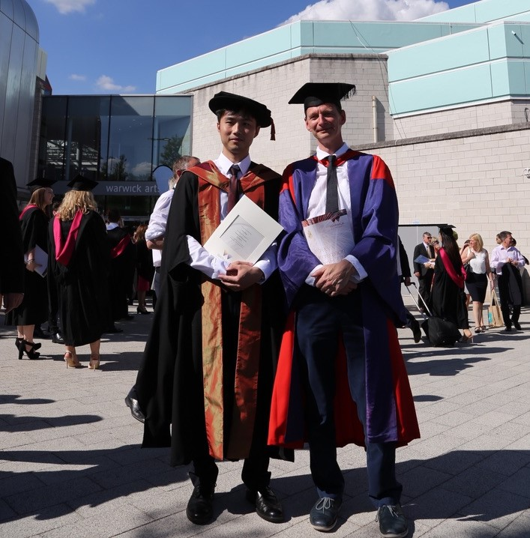

The Supervisors’ role
  ‘To give guidance about the nature of research and the standard expected, about the planning of the research programme, about literature and sources and the use of requisite techniques (including instruction where necessary) aware of all relevant developments within the subject’.
  To read material you write and give feedback
  To maintain regular contact
  Discuss training requirements
  Ensure you are on track to complete within the registration period
  To be accessible by arrangement
  To assist with development of transferable skills eg conferences
  To advise on ethical issues
  Two supervisors is the norm – no ‘right’ way of running these but
  Key that this is right!

Slide 10
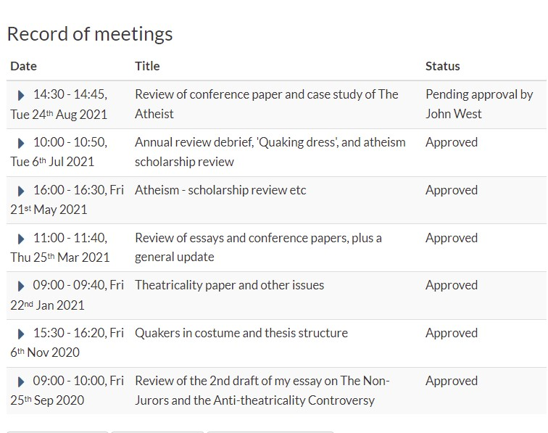
SUPERVISIONS should occur every 3-4 weeks in the first year, monthly thereafter during term-time; less frequently out of term and for part time students. You can initiate these. Students funded via M4C have their own recording portal.
UP TO THE STUDENT to log a short note recording the session on tabula – supervisor then reads this and approves the record. YOU MUST DO THIS PLEASE
You may also need to remind your supervisor to log your meeting as a ‘monitoring point’

Slide 11
My role
NB I am your personal tutor – for issues that you would prefer not to discuss with your supervisors
My office hours are Mondays 2-3 and Thursdays 4-5
I’d like to see you individually in the next few weeks so do drop by
Run the Graduate Research Forum (GRF) – Thursdays 5-6.30 FAB2.43. COMPULSORY!
Week 2 Project Design, The Upgrade and Ethics
Week 3. Navigating the Library. NB Tuesday 18 October 11.00-13.00 CADRE PhD Survival Guide
Week 4 Warwick’s Modern Records Centre – the session will cover what the MRC holds but also, more broadly, how to find and use materials in archives.
Week 5 Oral History - with Rosie Doyle from the Warwick Oral History Network
Week 6 ---------- Reading Week - No GRF session
Week 7 Public Engagement - a joint, online session with Birmingham university and with Angela McShane (formerly of V&A and Head of Research Development, Wellcome Trust) and Alexander Lee.
Week 8 Digital Humanities - with James Tripp.
Week 9 Research Journeys: Claire Shaw.
Week 10 Postdoctoral Projects and Applications - a joint session with existing postdocs, facilitated by Anne Gerritsen, Director of Research

Slide 12
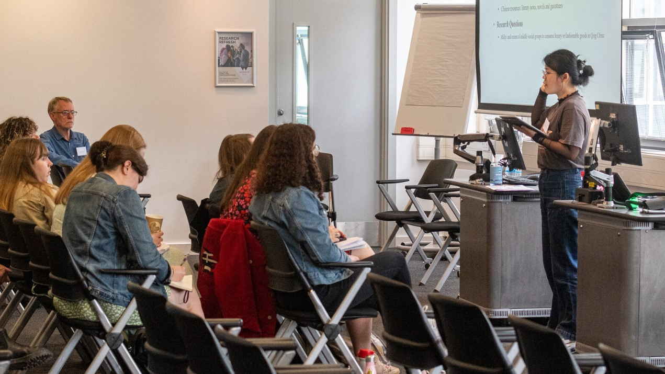
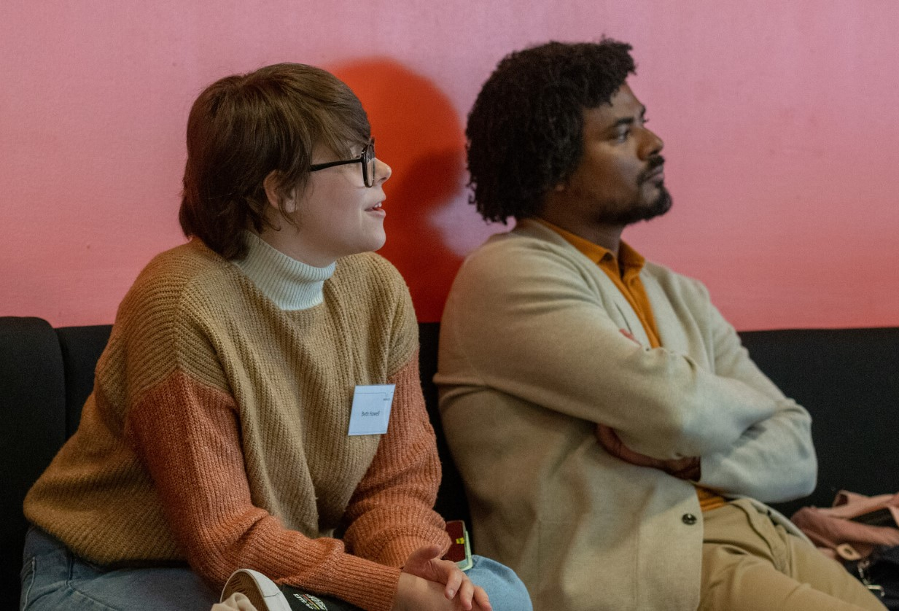
And…
Oversee the pgr community’s progress
Troubleshoot where necessary
My ‘office hours’ are Mondays 2-3pm and Thursdays 4-5
Liaise with your reps
Run an annual review process (usually in May) – again this is different for M4C funded students
Help facilitate the annual postgraduate conference in May
Predominantly a PGR event; expect you all to present AT LEAST once or twice in your career; first year is a good opportunity to get more feedback on general shape of your project
Some MA students will also present on their work, but this is really YOUR SHOW
Panels organised by PGRs; ORGANISING COMMITTEE IS COMPOSED OF STUDENTS, W/ ADVICE FROM DIRECTOR OF PGR. Many First years take advantage of this opportunity.
Conference: Staff v. happy to come along and chair / commentary / audience
Very enjoyable, social end to the academic year!

Slide 13

Useful to know!
Temporary withdrawals [TWD] Temporary Withdrawal (warwick.ac.uk)
You must discuss with your supervisor and me first. This is an online form process to the Graduate Office, but be aware of implications:
If you’re funded, funding may stop
lose contact w/ supervisor until you re-register
Visa implications for overseas students
So if you’re thinking about it you must speak with supervisors and I have to approve it.
Similarly for changing between FT and PT – how that change happens also depends on how you are funded, so talk to us at earliest opportunity.

Slide 14

Money
Matters
Different funding councils have different arrangements
many of you are on FUNDED PhDs - these have expense and travel and research allowances built into them, and you should apply for those [NB PLAN AHEAD]
Departmental support: I administer a personal research grant for every self-funding student in History – about £250 per student per year to support your research activities. This is yours to use – online form through which you can reimburse. No deadline.
This needs to be precise amounts and receipts – get you in the practice of being a history researcher, where this occupies much of your time. (please note this – incomplete data means delays or even no money!
OTHER PLACES offering funding – Humanities Research Committee; Institute of Advanced Study (IAS); Royal Historical Society has small grants; Economic History Society, likewise

Slide 15

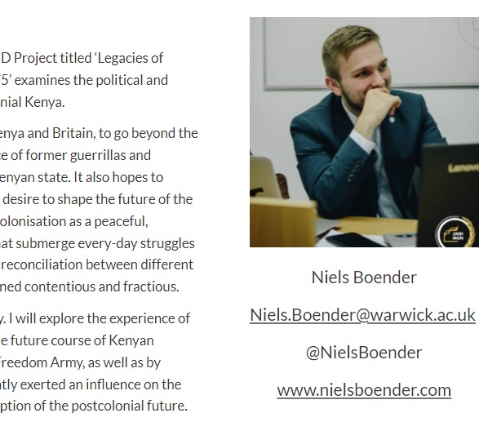
E-PORTFOLIOS
Current PhD Students (warwick.ac.uk) ePortfolio Request Form (warwick.ac.uk)
Being part of research community!
Up on the Dept website
Describe project, funding;
Describe talks, conferences you attend, update it regularly
Link it to twitter profiles or academica.edu profiles, if you have those, or blogs
Everyone needs to construct one!
I will be chasing you to see that this is regularly updated
Visibility massively helps in job hunt / postdoc positions at the end
The website uses its own software – relatively intuitive.

Slide 16

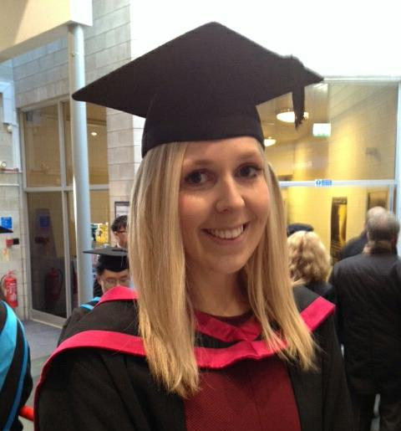
Teaching Opportunities
This is open to you to do, after your first year, and important to consider if you are thinking about a career in academia. Graduate Teaching Assistant [GTA]
PGRs can teach up to 2 seminars a week, max.
There is a module run by the Learning Development Centre – ‘Prepare to Teach’ - it is compulsory for anyone wanting to teach and it will run in term 2.
Teaching is run by the History Office – so any queries / expressions of interest to CLAUDIA GRAY. We can’t guarantee teaching but try to accommodate requests.

Slide 17
Some Homework for next time!
Research Integrity training
Research integrity covers a range of areas - from adhering to policies, standards and protocols, through good research practice, to reporting research findings clearly and transparently.
In order to support the community’s understanding of the principles and practices that protect the integrity of research, the University has a dedicated online Research Integrity Training Programme, ‘Epigeum’: https://warwick.ac.uk/services/ris/research_integrity/trainingandmentoring/online-training/
The University has mandated the completion of Research Integrity training for all staff and students delivering research and has recently approved a Research Integrity training policy: https://warwick.ac.uk/services/ris/research_integrity/trainingandmentoring/ritrainingpolicy/
There are two versions of the training package – only the ‘concise’ one (45 mins) is obligatory. It focuses on human participants research, animal research, conflict of interest, safety and health, and intellectual property.

