Slide 1
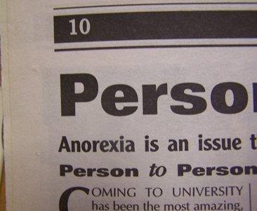
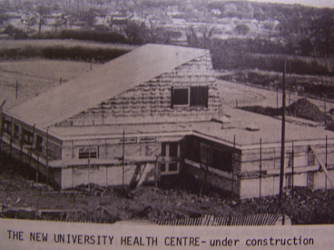
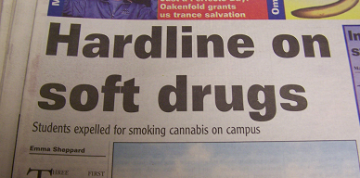
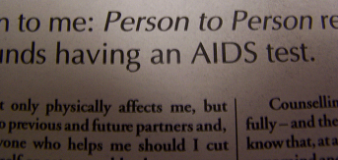

Student Health at the University of Warwick
Researcher: Monica Callus
Supervisor: Mathew Thomson
Contact: m.callus@warwick.ac.uk
Abstract:
This project aimed to investigate the history of student health at the University of Warwick as presented by student publications. Newspapers such as The Boar were focused on primarily because of its longevity (it has not been out of print since its beginning in 1973), but other journals were researched like The Giblet (1960s) and the Mercury (1980s). The findings of this project would support the idea that the student attitude towards health aligned to a contemporary national outlook. Also, it has been found that there was a change in the way healthcare was being reported by the students themselves, which would suggest that there was a development of attitudes across the period. A total of fifteen years’ worth of publications were analysed, selected at random in a cross-section, from the first days of Warwick, right up to the present.
1960s
The Giblet, a precursor to The Boar, had few articles relating to health. The only instances regarded the politics of health as far as it concerned current affairs, the prime example being a series of articles regarding the legalisation of abortion.
1990s
Adverts for student-run counselling service Nightline existed in the very first editions of the Warwick newspapers,
but from the 1990s, counselling was discussed more openly, in particularly in relation to topics that had not been mentioned before, such as eating disorders. These were current interest stories, but they also provided information on seeking help. Advisory articles outweigh the number of those that just regard the politics of national health issues, and for the first time, personal experience articles appear with regard to health.
1970s
The articles still act as a political barometer, but healthcare provisions on campus become a primary focus of the writers.
This is a continued pattern throughout. In particular, some articles are critical of the efficiency of the medical centre; both in terms of the capabilities of the after-hours service, and with regard to individual practitioners. In this way, The Boar acts as a mouthpiece for dissatisfied students rather than just for promotion of political ideals that concerned health.
2000s
With the articles of the 2000s, there seems to be a continuation of themes that occurred in the nineties, with
1980s
The national publicity that AIDS was now receiving was
particular emphasis on behavioural health - the dangers of drinking and smoking are regular topics. However, healthy lifestyles is a new subject matter; the current debates surrounding obesity are explored as an example of national crises, and it is in these articles that there is a merging between the politicisation of health as evident in the sixties, and the advisory nature of editorials written in later decades.
reflected in the large quantity of articles regarding safe sex and sexually transmitted infections. The style of the writing continued to move away from being merely political, and adopted the approach of peer-to-peer education. As well as this, The Boar acted as an advertisement for health related events which it had not before, such as the AIDS Awareness Week of December, 1987. This informal spread of information regarding health is particularly interesting, as it suggests that this might have been an alternative to institutionalised healthcare.

