Slide 1


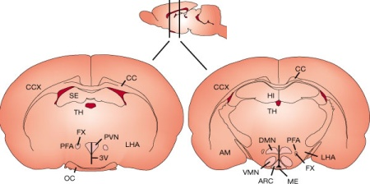
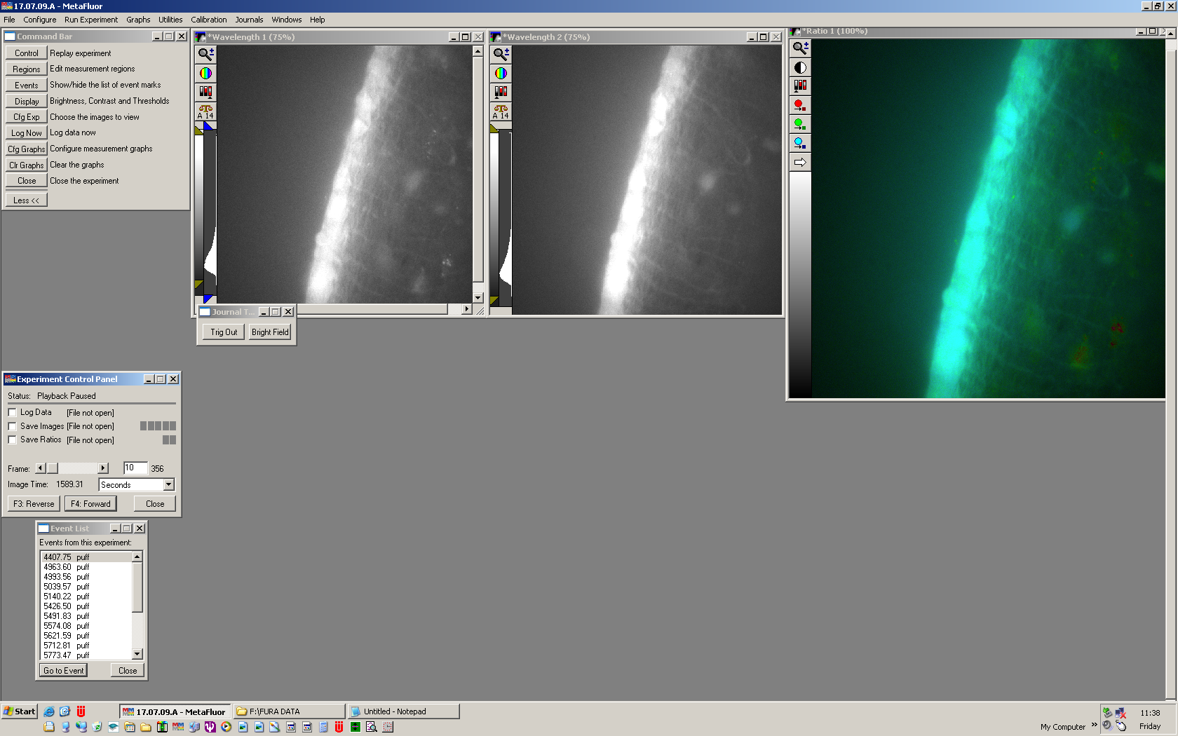
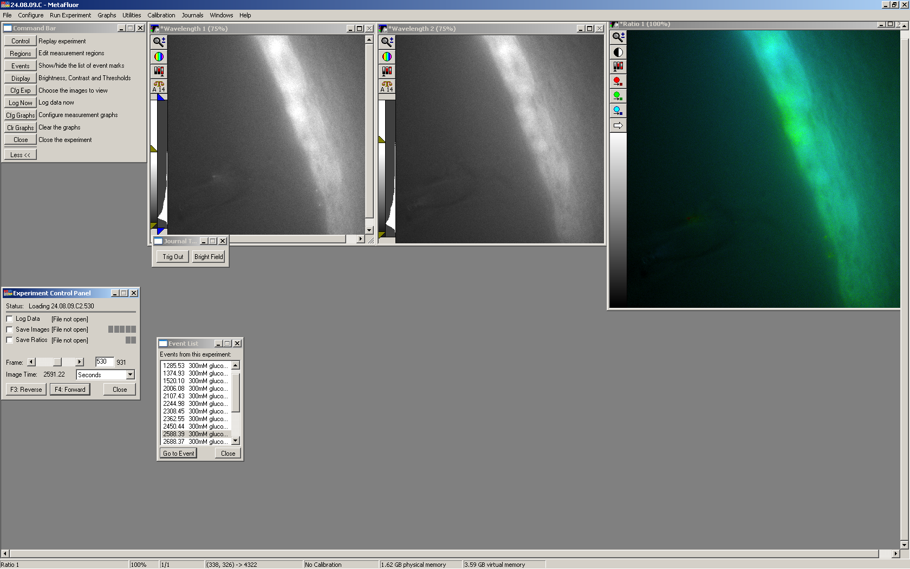
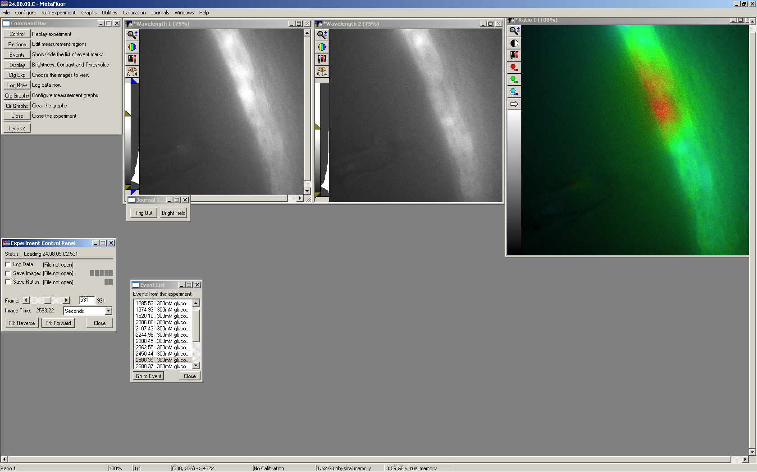
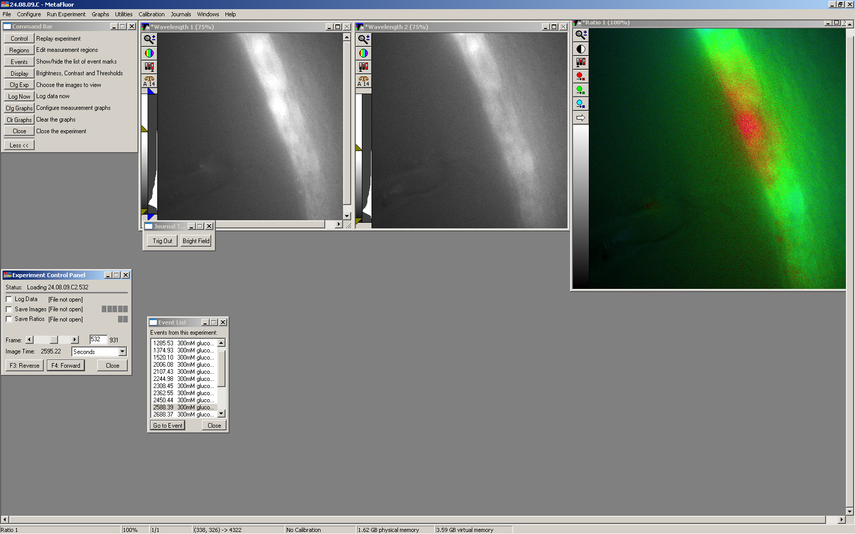
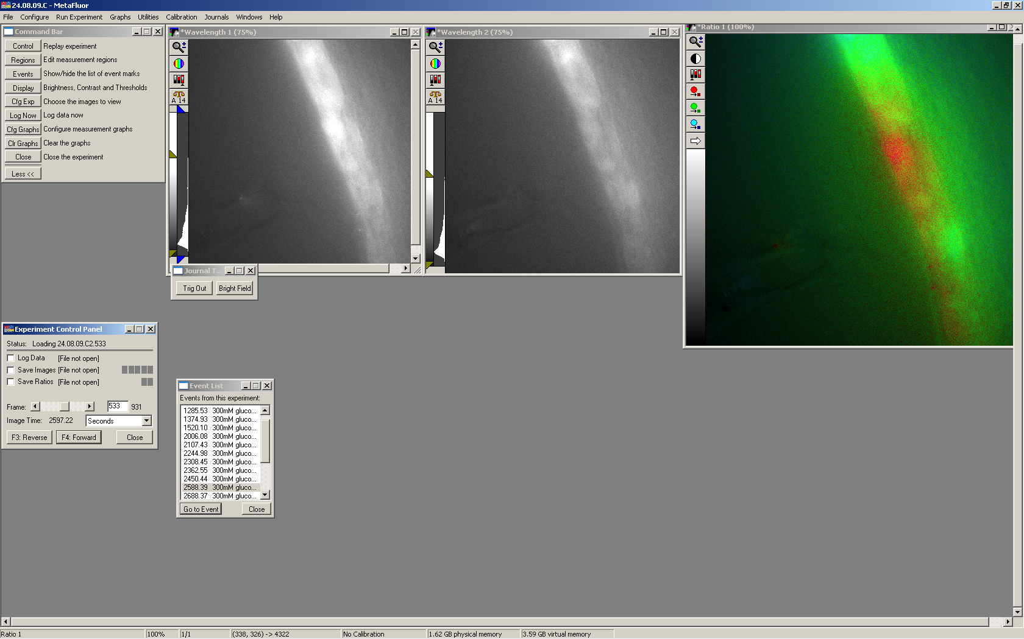
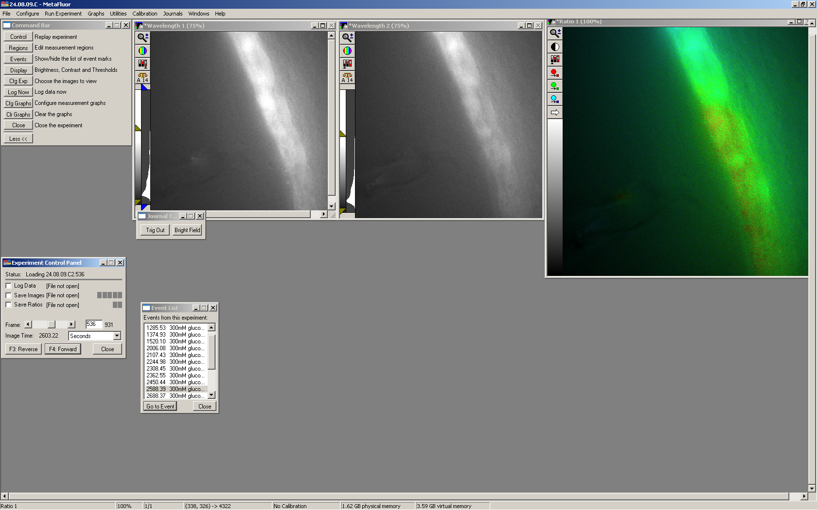
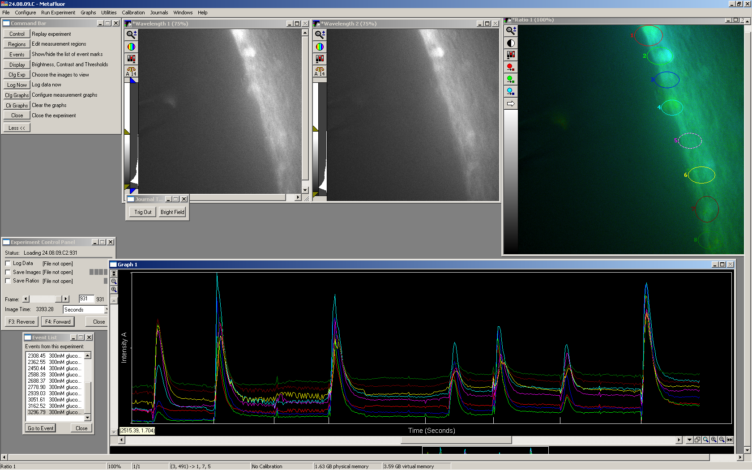
Ruth Britton; Supervisor: Nicholas Dale
Tanycyte and Neuronal Communication in the
Hypothalamus
Introduction
Objectives and Methods
Tanycytes are cells located in a layer in the floor of the third ventricle of the brain, with a single long process each extending into the hypothalamus. Their role is to allow communication between the blood and the neurons of the brain. They are involved in the control of feeding and sleeping cycles. The cells are found in the layer of the rat brain shown in figure 1.
The aims of this project were to stimulate tanycytes with a variety of stimuli and record the responses via calcium release levels. This was was carried out by using fluorescent dye Fura-2. This binds to free intracellular calcium and is excited at 340 and 380nm. The fluorescence can be measured and this directly correlates to a ratio of calcium present. Software was used to view the changing cellular images as the experiments were carried out. Responses from neurons located in the hypothalamus where also studied to show any communication between the two cell types.
Figure 1
Tanycytes have been shown to release ATP in response to stimuli and are thought to communicate with neurons within the hypothalamus to initiate responses to these stimuli
400µm rat brain slices were used of the areas near the median eminence where the tanycytes are found. The cells were loaded with Fura-2 for 1hour 45 minutes and then studied under the microscope under UV light to visualise the fluorescence. The solutions for cell stimulation were loaded into small glass pipettes that were positioned and then the solution was puffed at the tanycyte layer for between 200 and 400 m/s. A photograph was taken down the microscope view every 2 seconds to record the cell responses.
Tanycyte cell body
Neuron
Third ventricle
Median Eminence
Tanycyte location
(Image from Nature.com)
Tanycyte process
Figure 2: tanycyte layer dyed with fluorescent Fura-2
Results Images
Saline was used as a control to test whether just mechanical stimulation affected the tanycytes. 300mM glucose was used to determine whether this is the cause of the responses in natural feeding cycles where blood glucose levels would be monitored.
No responses were seen with the saline control stimulus:
Tanycytes
Results Summary
The tanycytes responded to the 300mM glucose solution quite frequently and not to the saline control. Occasional responses in neurons were seen but more research is needed to determine the communication links between the tanycytes and neurons in response to the stimuli. A chi squared test shows that there is significant difference between the numbers of responses to the glucose versus the control. Chi squared value was 8.597 which means p<0.01 so glucose response is significantly different from saline control.
The following figures show the tanycyte layer responses to glucose. The red fluorescence shows an increase in calcium, during the cellular response. The responses are very quick; these images are 2 seconds apart and the cells rapidly returned to the normal fluorescence and so calcium levels.
Conclusions
The results gained in this project prompt further research into the glucose responses compared with other control solutions to determine if other stimuli cause the same reactions from the tanycytes.
The neurons must further be studied to examine the communication between the tanycyte response and the neuron activity as not enough data were collected in this area to draw conclusions.
Image :1 2 3 4 5
Seconds: 528 530 532 534 536
Experiences
Taking part in this vacation scholarship project has allowed me to gain a true insight into the environment and experience of working in a research lab. I have gained many skills I would not have learnt at an undergraduate level that are both transferable to other work, such as independent practical work and some unique to this type of laboratory work. This experience has offered an insight to real scientific research thus helping in decisions about my post-graduate plans.
Graph of fluorescence against time, showing an example of many responses to glucose (peaks) in one experiment. Each response gave cell response sequences similar to those shown above in images 1-5.
This project was funded by the Wellcome Trust

