Slide 1
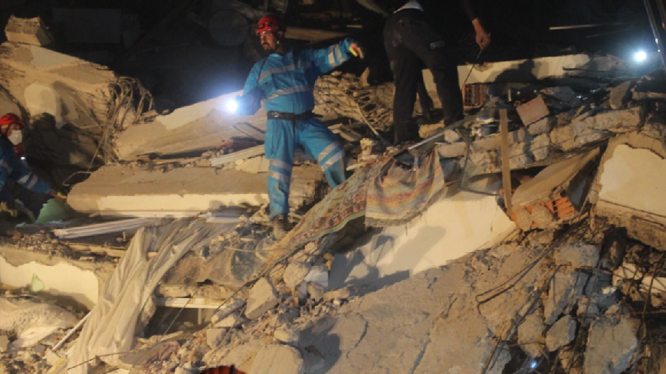
URSS Department of History
Dr Rosie Doyle- Student Engagement Coordinator
Nyssa Addae- Final Year History and Sociology Student and URSS Veteran

Slide 2
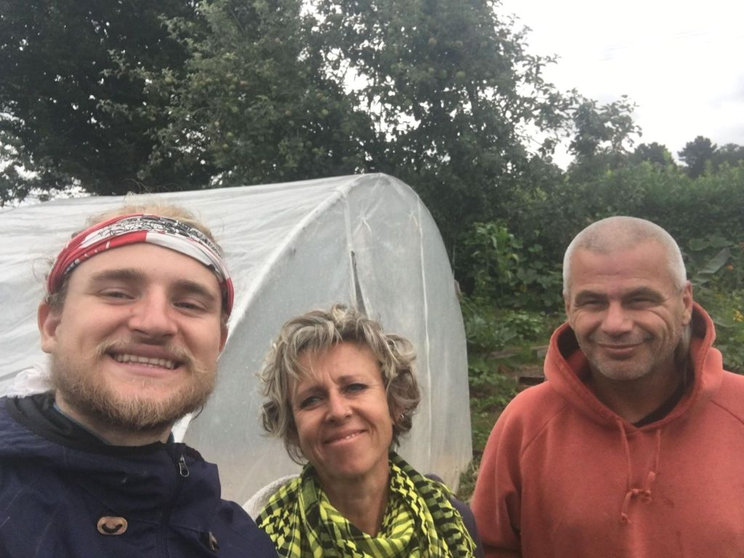
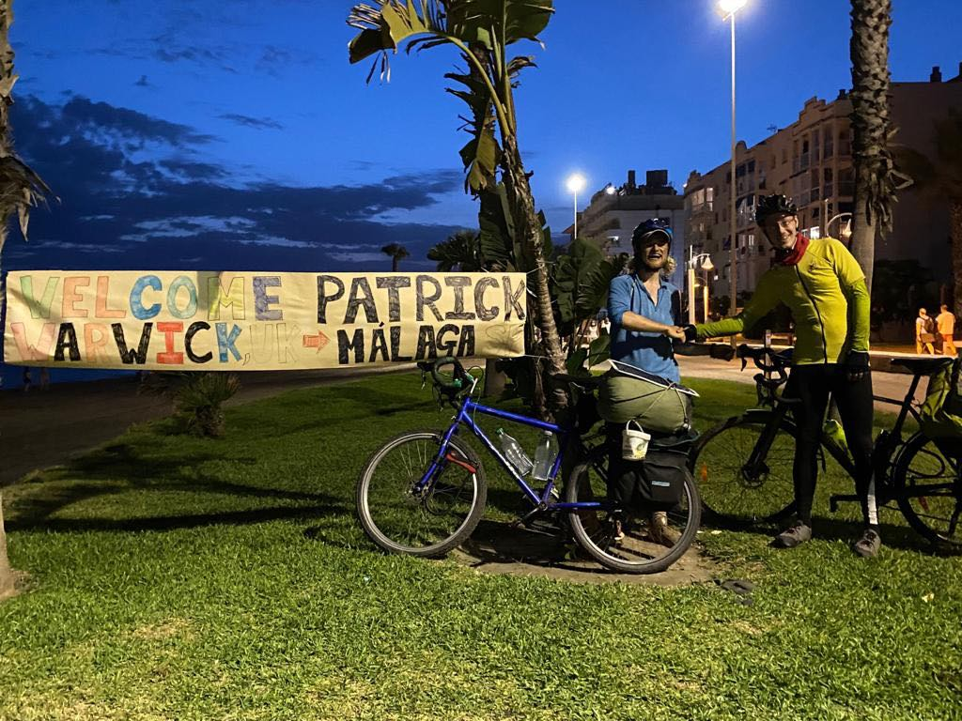
Why do a URSS or EURSS
Insight into research
Bursary- experience of winning funding for your research (v. important if you are thinking about a research career)
Learn new skills
Make contacts and enhance future career. Good for career development and personal development.
Enhance your degree performance. Research shows that students who do URSS/EURSS get better degree qualifications.
Build self-confidence
Get international research experience
Patrick Vasy de la Cruz’ Trails of Sustainable Living and background information about this project.

Slide 3
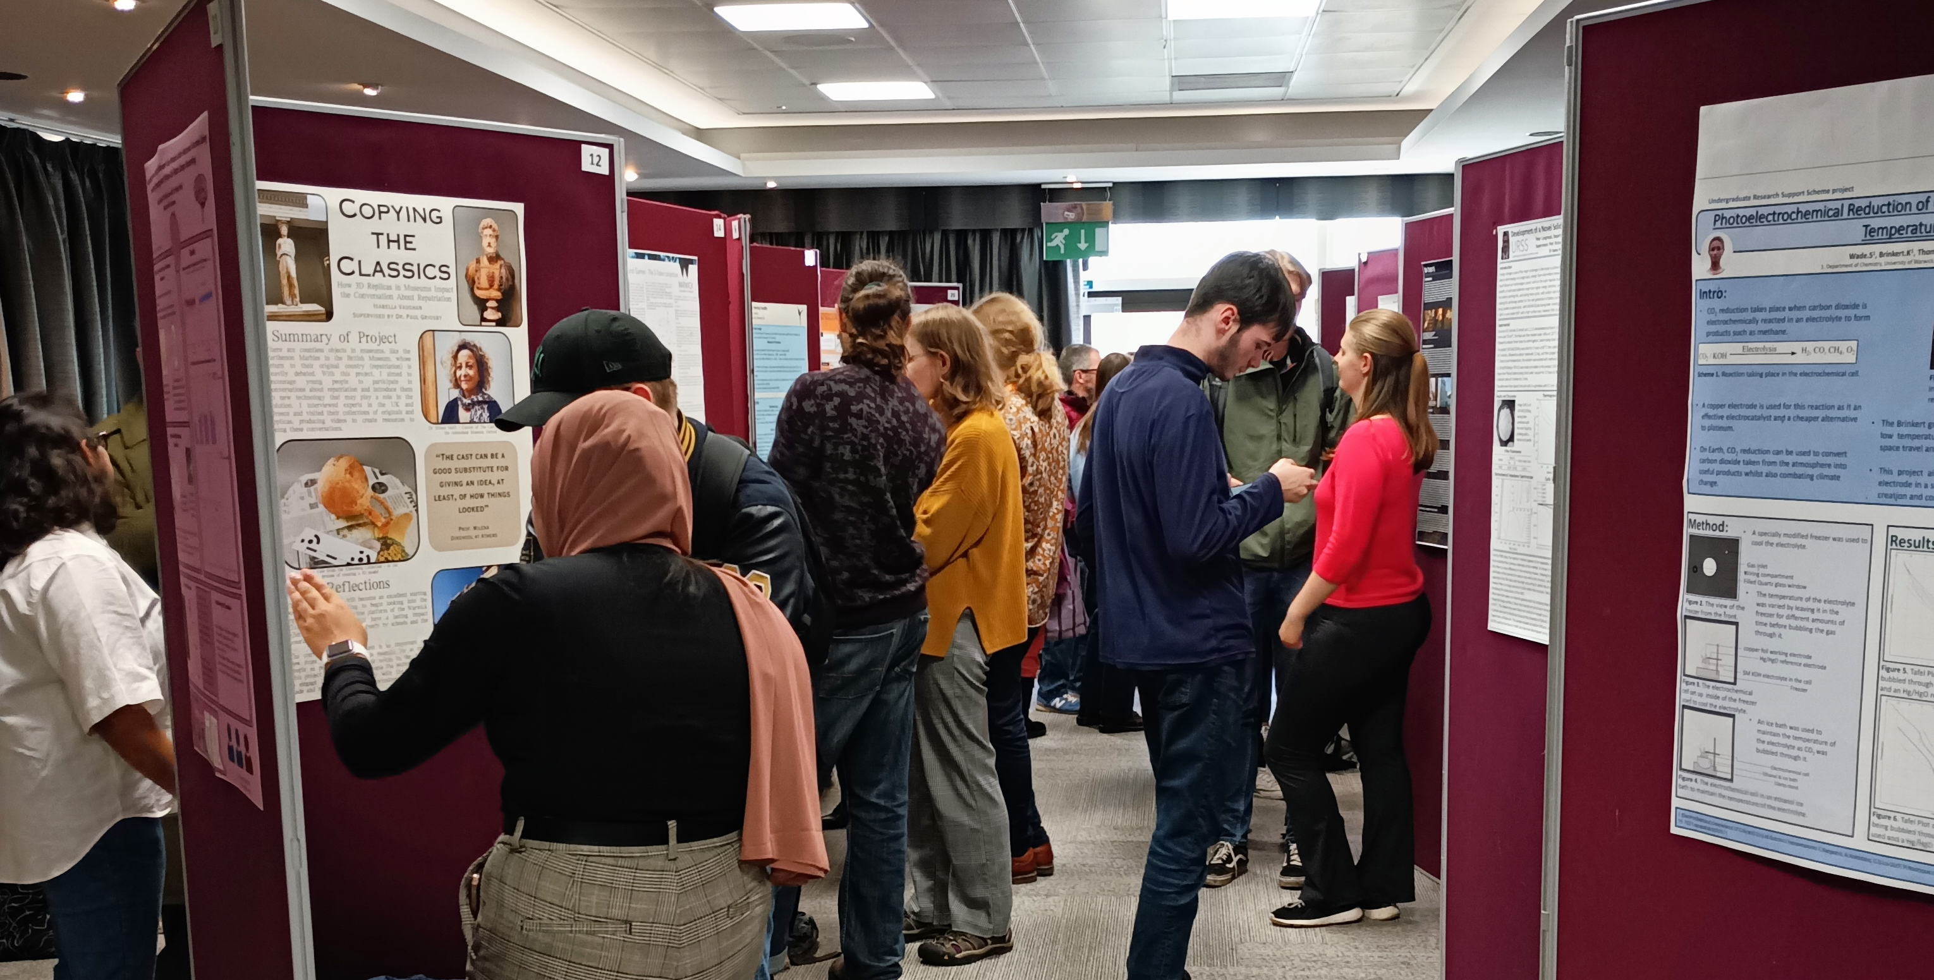
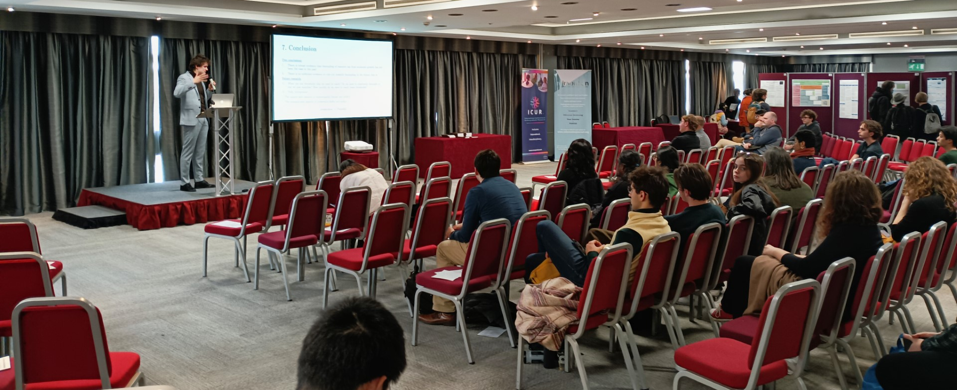
How to take your research further.
Participate in Undergraduate research conferences (eg. BCUR and ICUR)
Present at the annual showcase (at Warwick in Term 1)
Lord Rootes Fund
Publish research
Public engagement
ICUR
BCUR
URSS Showcase

Slide 4

How to apply: groundwork
7 February 2025 deadline
Identify research area.
See showcase for an idea of what students have done in the past: https://urss.warwick.ac.uk/
History specific here: https://warwick.ac.uk/fac/arts/history/urss/
If you are in a Eutopia CoLeCo, you may want to extend the work you have already started.
Approach academic to supervise
Check departmental web pages
Join ongoing projects
Listen to former URSS participants-on the Warwick History Hour WHH
Identify organisations, NGOs etc.

Slide 5

Projects in History
History of Travel Writing
The Wheeler History of Travel Writing Fund will support a URSS on the History of Travel Writing, you will need to find a supervisor appropriate for your region or theme.
Social Indigenous history from the Americas or Mexican codices in the UK
With Dr Ricardo Aguilar: jose-ricardo.r.aguilar-gonzalez@warwick.ac.uk

Slide 6
The William Godwin Diary
We are looking for students interested in undertaking a URSS project to help in rescuing, updating, and editing material that was developed for the William Godwin Diary website at the Bodleian Library. Editorial skills, proof-reading and the ability to write clearly are essential, although we are also interested in involving students with some digital/web skills – such as experience with XML and TEI , and/or HTML, CSS and JavaScript. But they are not requirements! Up to 6 posts will be established under the terms of the URSS scheme through which applications will be made. If you are interested, please first contact mark.philp@warwick.ac.uk.

Slide 7
Mapping Women’s Suffrage
Get involved with the Mapping Women's Suffrage project www.mappingwomenssuffrage.org.uk
It's perfect for a summer project as you can do it from anywhere and research on suffrage campaigners wherever you spend your summer (that is if you spend your summer in the U.K- If not you may be able to apply for funds for accommodation and travel). There's also good potential for engagement/impact events to follow on from their research as being a suffrage map and 'place based' research, community interest historically has always been good.
Tara Morton: tara.morton.1@warwick.ac.uk

Slide 8
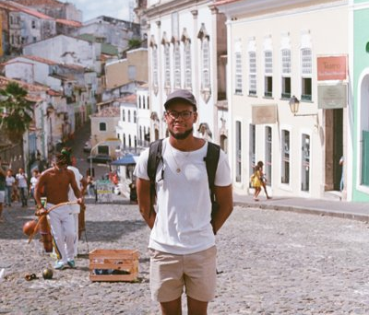
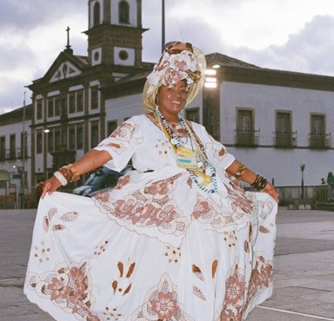
How to apply: completing the proposal
Complete the proposal and application form here: https://myadvantage.warwick.ac.uk/Form.aspx?id=3120898
Make your application clear and concise. Readers and assessors may not be in your field.
Make sure your project is achievable in the time and on the budget. Applying for less money doesn't mean you are more likely to get it. Money is for accommodation, travel and archive costs, not equipment.
Impact is an important part. Why are you doing it? How are you hoping that your skills will be improved?
Complete application in conjunction with your supervisors. Contact your supervisors in plenty of time before the deadline so that they have time to comment on your proposal and write their supporting comments.

Slide 9
Pathways Project
Ringfenced Funding for students who self-identify as being either Black or of Black heritage.
https://warwick.ac.uk/research/research-culture-at-warwick/pathway-programme/urss/

