Slide 1
Can We Cultivate
Our Passions?
Matthew Dennis, Department of Philosophy, University of Warwick

Slide 2
Passion:
[count noun] a thing arousing great enthusiasm. (OED)

Slide 7
What are passionate attachments?

Slide 8
EXAMPLES OF PASSIONATE ATTACHMENTS:
Creative or intellectual endeavours, aesthetic projects or social ideals, or attachments to parents, children, friends, or spouse.

Slide 9
Can we cultivate our passionate attachments?

Slide 10
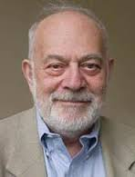
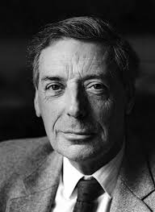
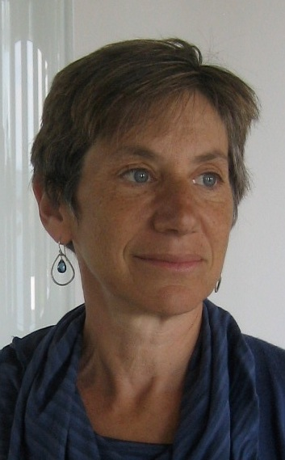
Harry Frankfurt
Bernard Williams
Susan Wolf

Slide 11
FRANKFURT: ‘What we love is not up to us. We cannot help it that the direction of our practical reasoning is in fact governed by the specific final ends that our love has defined for us. We cannot fairly be charged with reprehensible arbitrariness, nor with a wilful or negligent lack of objectivity, since these things are not under our immediate control at all.’ (2004: 49)

Slide 12
“Attachments are of great seriousness. Choose you attachments carefully. Choose your temple of fanaticism with great care. What you wish to sing of as tragic love is just an attachment not carefully chosen.”
David Foster Wallace, Infinite Jest (1996)

Slide 13
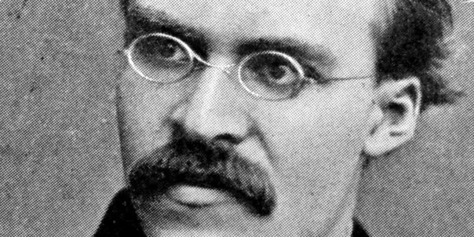
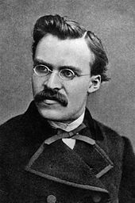

Slide 14
NIETZSCHE (Q3): ‘The man who does not wish to belong to the mass needs only to cease taking himself easily; let him follow his conscience, which calls to him: “Be your self! All you are now doing, thinking, desiring, is not you yourself.”’ (1876: 127)

Slide 15
NIETZSCHE (Q6): ‘Let the youthful soul look back on life with the question: what have you truly loved up to now, what has drawn your soul aloft, what has mastered it and at the same time blessed it? (1876: 129)

Slide 16
NIETZSCHE (Q6): ‘Set up these revered objects before you and perhaps their nature and their sequence will give you a law, the fundamental law of your own true self. (1876: 129)

Slide 17
NIETZSCHE (Q6): ‘For your true nature lies, not concealed deep within you, but immeasurably high above you, or at least above that which you usually take yourself to be.’ (1876: 129)

Slide 18
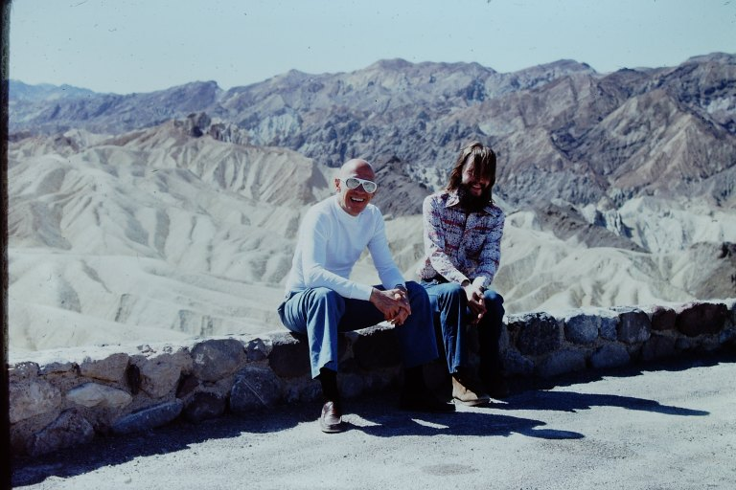

Slide 19
FOUCAULT (Q7): ‘[In Hellenistic culture] – a culture to which we owe a certain number of our most important and constant moral elements – there was a practice of the self, a conception of the self, very different from our present culture of the self. (1994 [1983]: 271).

Slide 20
FOUCAULT. (Q7): In the Californian cult of the self, one is supposed to discover one’s true self, to separate it from that which might obscure or alienate it, to decipher its truth thanks to psychological or psychoanalytic science, which is supposed to be able to tell you what your true self is. (1994 [1983]: 271).

Slide 21
FOUCAULT (Q7): Therefore, not only do I not identify this ancient culture of the self with what you might call the Californian cult of the self, I think they are diametrically opposed.’ (1994 [1983]: 271).

Slide 22
