Slide 1

The paradox of fashionable melancholy
Simona Di Martino
S.Di-Martino@warwick.ac.uk

Slide 2
How was melancholy perceived?
How can melancholy be defined?
Italian lyrics of the late eighteenth century;
Adaptation from English sources (mainly the graveyard poets);
Lots of bibliography about the theory of melancholy in the British context; lack regarding the Italian context.
Melencolia I is a 1514 engraving by the German Renaissance artist Albrecht Dürer.

Slide 3
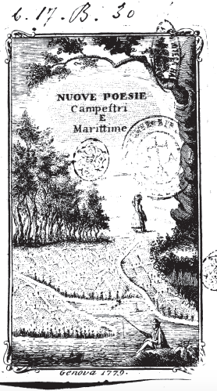
Aurelio De’ Giorgi Bertola
La malinconia
From ‘Nuove Poesie Campestri e Marittime’
Genova, 1779
The melancholy
From ‘New rural and maritime poems’
Genoa, 1779

Slide 4
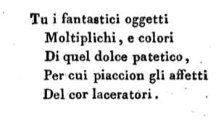
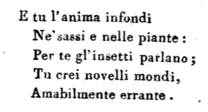
You multiply objects of fantasy
And you colour them
Of that sweet pathos,
Whereby the tearing affections of the heart
Are appreciated.
And you infuse the soul
Into both rocks and plants:
Through you the insects talk;
You create new worlds,
Pleasantly wandering.

Slide 5
TU
YOU

Slide 6
TU / YOU
You = Melancholy, previously depicted as a woman
A Muse, a nymph or a divinity
Source of inspiration
Tasso’s definition of melancholy: ‘some mental alienation suspended between actual disease and divine possession’

Slide 7
FANTASTICI OGGETTI
OBJECTS OF FANTASY
MOLTIPLICHI E COLORI
MULTIPLY AND COLOUR

Slide 8
OBJECTS OF FANTASY
THAT (YOU) MULTIPLY AND COLOUR
‘Fantasy’: the melancholic subject is characterised by an overabundant imagination (see ‘to multiply’) and propensity to daydream.
The melancholic subject is obsessed with the idea of possessing an object of desire situated outside the domain of actuality.
The adjective ‘fantastic’ defines a purely mental image.

Slide 9
QUEL DOLCE PATETICO
THAT SWEET PATHOS

Slide 10
THAT SWEET PATHOS
Kind of an oxymoron: ‘sweet passion’ (a sweet strong emotion)
Can a strong emotion be sweet?
Typical trait of melancholic poets who feel pleasure when indulging in sufferance / pain / despair.

Slide 11
GLI AFFETTI DEL COR LACERATORI
PAINFUL AFFECTIONS OF THE HEART

Slide 12
PAINFUL AFFECTIONS OF THE HEART
Laceratore = tearing (‘lacerare’ means ‘to tear apart’)
A love disappointment or in a broader sense the awareness of the caducity of life.
This outlines an emotional context in which the poet is able to reflect on the deeper mysteries of human existence.
Key features: introspection and sense of loss (depression?)

Slide 13
L’ANIMA INFONDI NE’ SASSI E NELLE PIANTE
YOU INFUSE THE SOUL INTO BOTH ROCKS AND PLANTS

Slide 14
YOU INFUSE THE SOUL INTO BOTH ROCKS AND PLANTS
Stimulus to creativity
The theory of the ‘genius’ by Aristotle: ‘all men who have become outstanding in philosophy, statesmanship, poetry or the arts are melancholic’
From the Renaissance onwards this was seen as a mark of both superior social and intellectual status, a fashionable condition to be affected by.
Elitist conception of melancholy: it affects only a privileged group of people.

Slide 15
NE’ SASSI E NELLE PIANTE
INTO BOTH ROCKS AND PLANTS

Slide 16
INTO BOTH ROCKS AND PLANTS
The importance of nature
Melancholic poets depict themselves immersed into the nature creating in this way a predefined imaginary of melancholic environment.
Stock-images are: the night, the graveyards, the moonshine, the owl, the river, the woods, the ruins…
Contemplation of the absence, the darkness or unending spaces.

Slide 17
PER TE GLI INSETTI PARLANO
THROUGH YOU THE INSECTS TALK

Slide 18
THROUGH YOU THE INSECTS TALK
One of the most common symptoms of melancholy: hallucinations
Introspection could be considered a double-edged sword, providing material for:
Literary creativity
The seeds of mental illness

Slide 19
AMABILMENTE ERRANTE
PLEASANTLY WANDERING

Slide 20
PLEASANTLY WANDERING
Fashionable image of the wandering poet who embodies the meditative man isolated from the rest of the world.
A few friends …
Suicide was sometimes an option / solution to stop suffering

Slide 21
Questions
Could melancholy be considered a ‘passion’?
In terms of gender: is melancholy a masculine ‘passion’?
In terms of fiction: is it a natural ‘passion’ or is it a fashion’s construction?
Intrinsic duplicity: does melancholy involve interiority or does the melancholic subject take advantage of isolation in order to actually show himself/herself off?

