Slide 1
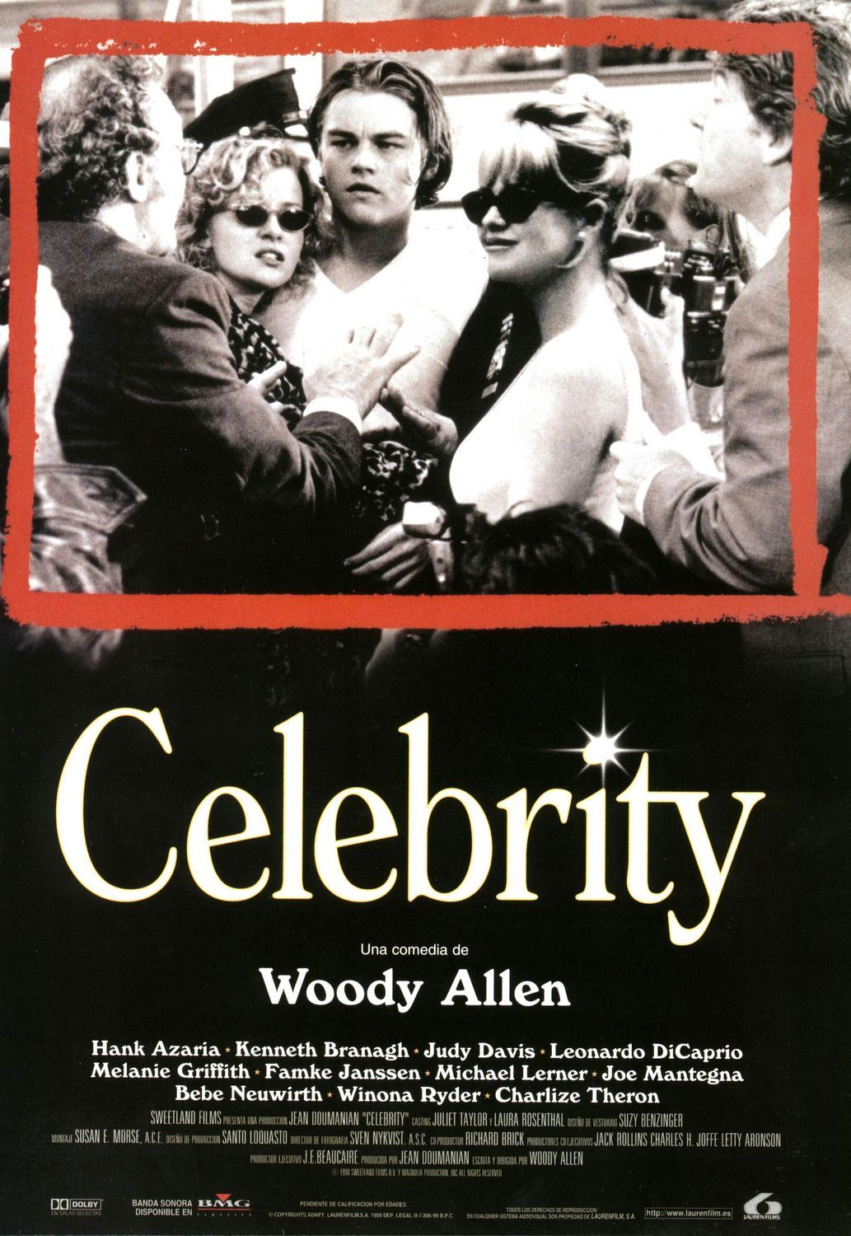
Sophie Shorland s.shorland@warwick.ac.uk
A Passion for Celebrity

Slide 2
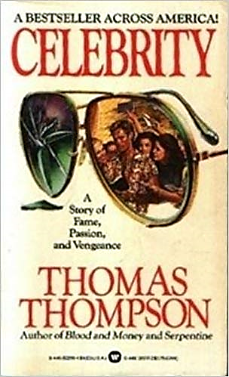
The spectacular fact about such personae is that they can claim and achieve intimacy with what are literally crowds of strangers, and this intimacy, even if it is an imitation and a shadow of what is ordinarily meant by that word, is extremely influential with - and satisfying for - the great numbers who willingly receive it and share in it. They “know” such a persona in somewhat the same way they know their chosen friends…
- Horton and Wohl, 216.

Slide 3
Para-social
A one-way relationship from audience/fan to celebrity. The fan imagines a personal relationship with the celebrity.

Slide 4
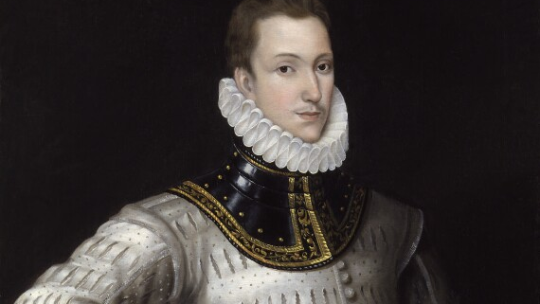
Philip Sidney

Slide 5
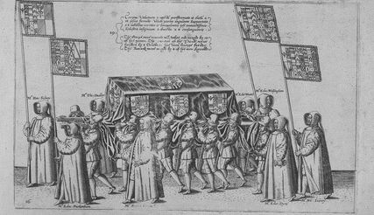
Muse you to see, distressed how men plaine… Then turne your eyes, and view his covered hearse… And judge you then, how rightly men may say: Their somme of joys, the Fates have reft away.
- Angel Day, Upon the life and death of the most worthy, and thrise reowmed knight, Sir Phillip Sidney (London, 1586)

Slide 6
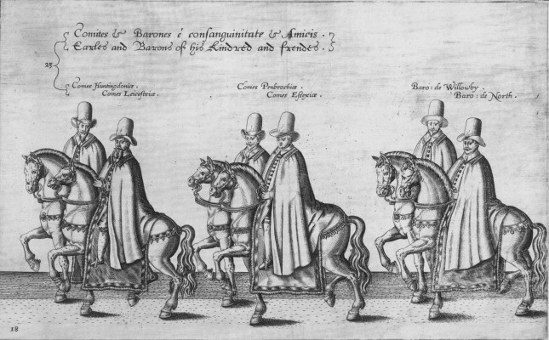

Slide 7
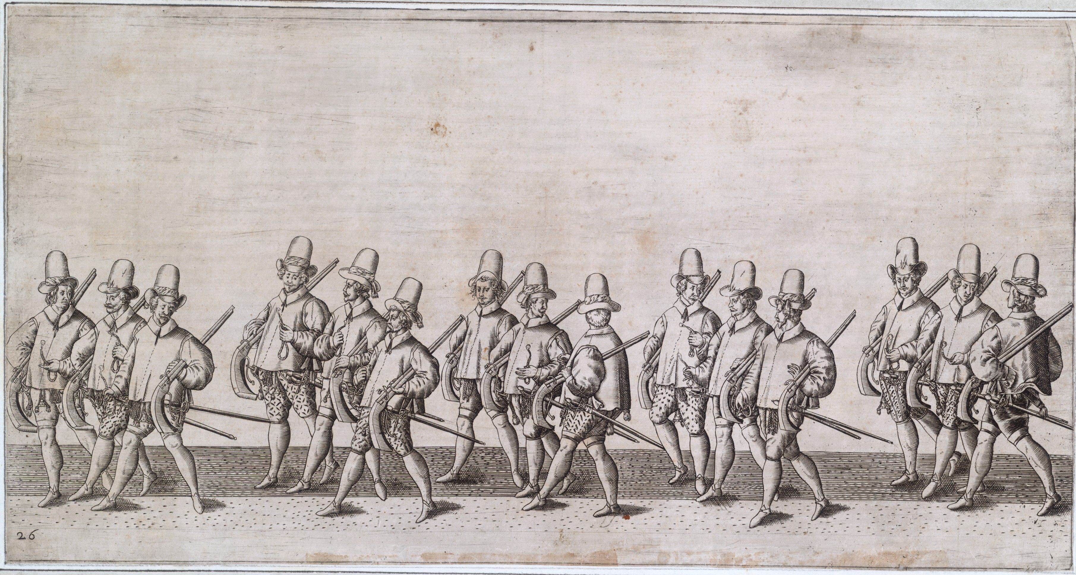

Slide 8
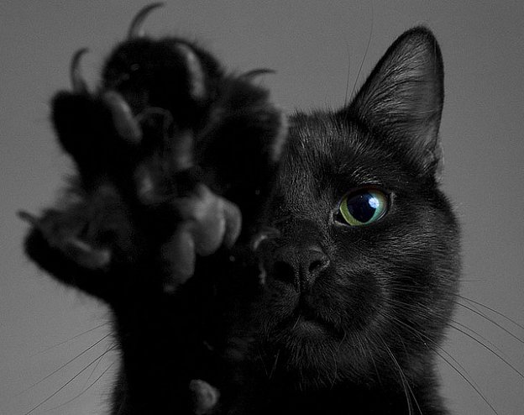
Magical Contagion
The value of an object increases the more the celebrity has come into contact with it.

Slide 9
Research Questions
Can or should academic discussion engage with passionate emotion of fans and the crowd, or is this effectively sacred space?
How might the appetite for news about celebrity lives relate to the passions? What is the difference between ‘appetite’ and ‘passion’ in terms of news/media cultures?
Are passions always intersubjective? Does this change over time?

