Slide 1
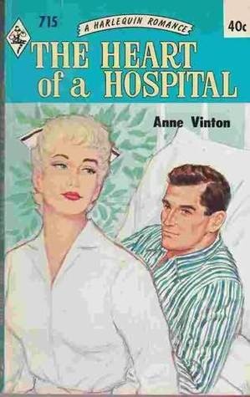
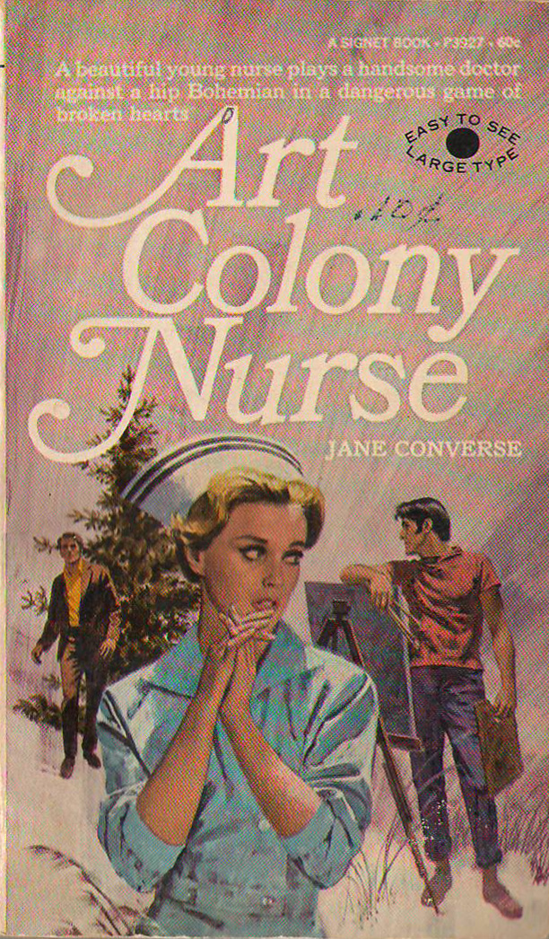
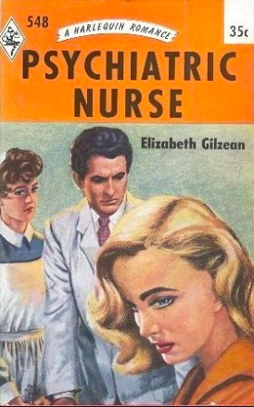
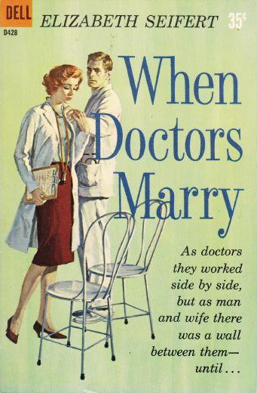
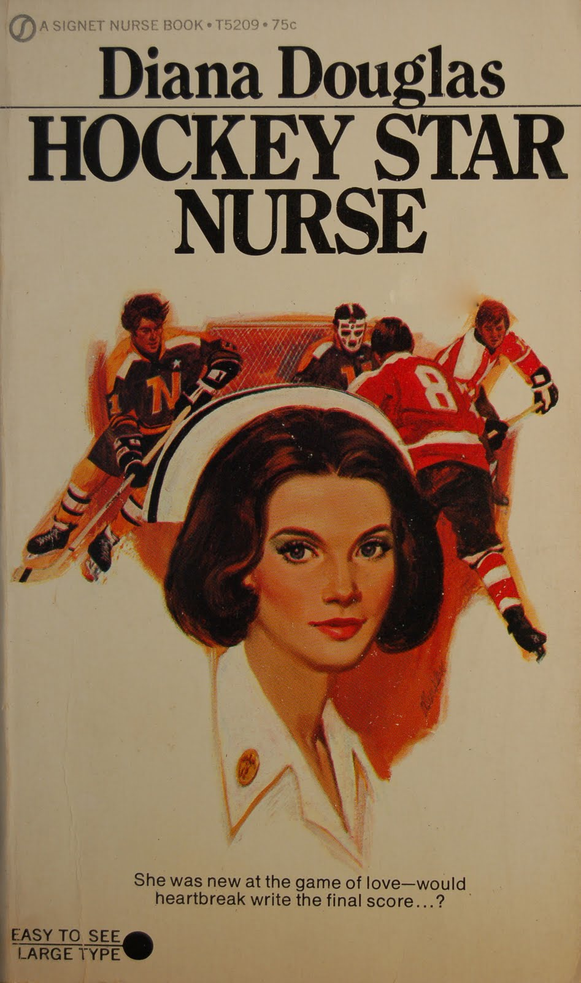
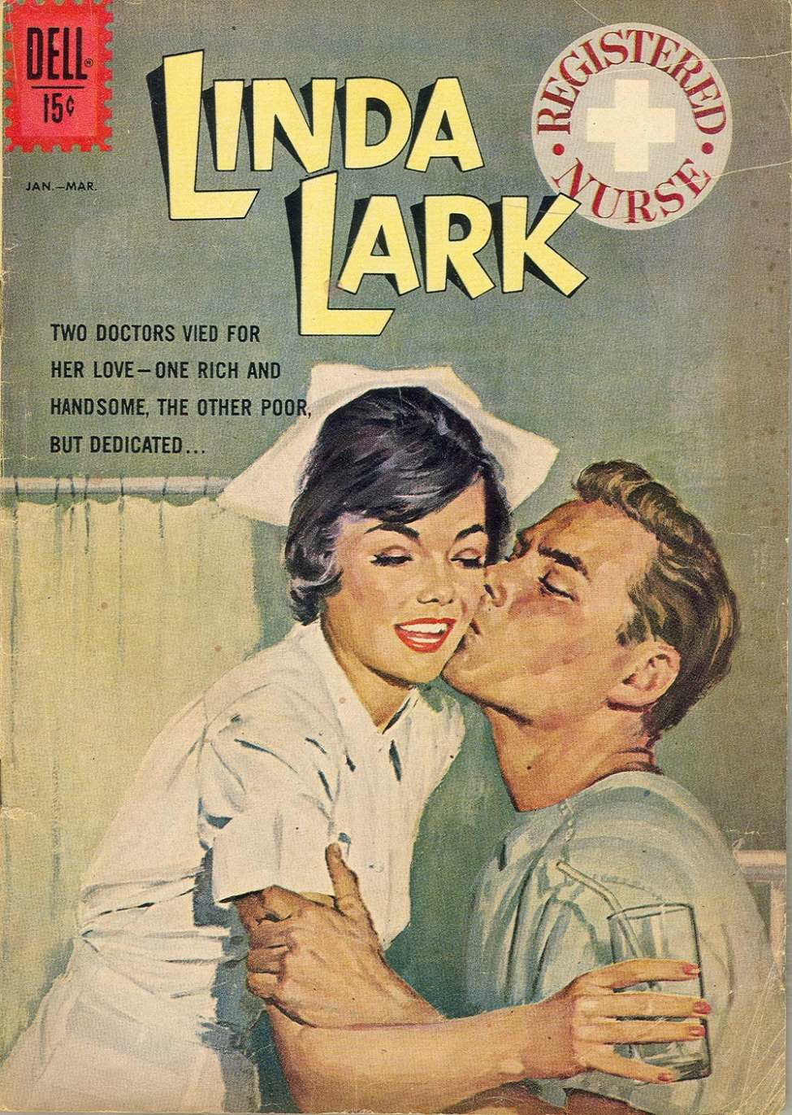
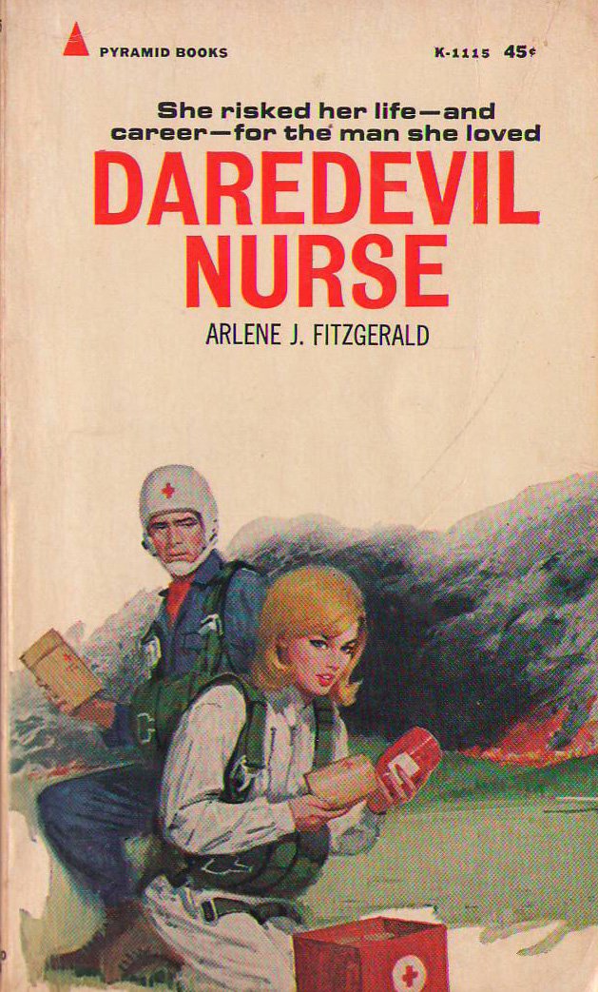
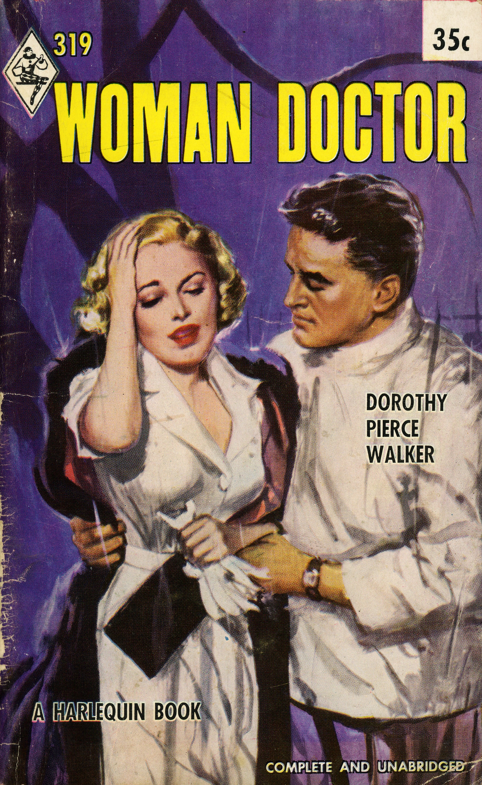
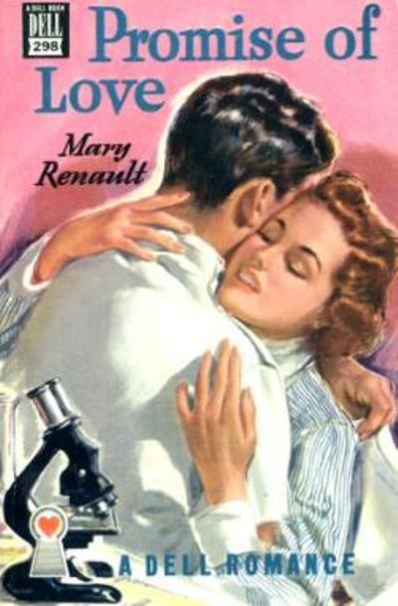
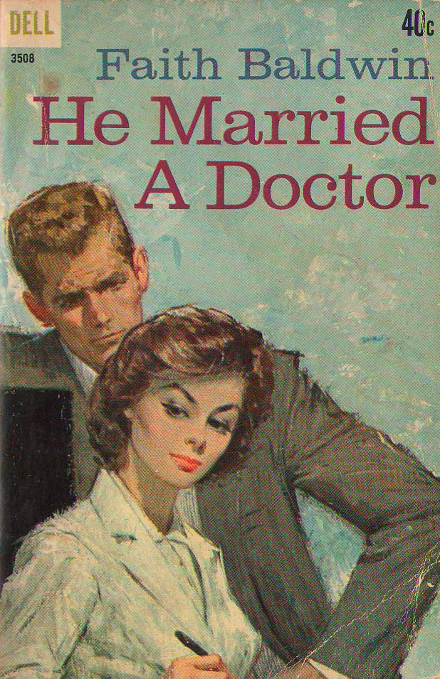
Medical Romance in Historical Context

Slide 2
Harlequin Romances 1960
502—Blood of Her Ancestors (Lucy Agnes Hancock)
503—Nurse in Charge (Elizabeth Gilzean)
504—Peter Raynal, Surgeon (Marjorie Moore)
505—Meet Doctor Kettering (Marguerite Lees)
506—Queen’s Counsel (Alex Stuart)
507—It’s Wise to Forget (Elizabeth Hoy)
508—Senior Surgeon (Marjorie Moore)
509—Nurse Secretary (Marjorie Moore)
510—Doctor Halcott (Marguerite Lees)
511—Strange Recompense (Catherine Airlee)
512—Australian Hospital (Joyce Dingwell)
513—Far Sanctuary (Jane Arbor)
514—Twin Nurse (Bess Norton)
515—A Case for Nurse Claire (Marguerite Lees)
516—Prisoner of Love (Jean S. MacLeod)
517—Doctors Together (Jean S. MacLeod)
518—Hospital in Paradise (Juliet Shore)
519—Doctor Pamela (Anne Vinton)
520—Doctor Derrington (Marjorie Moore)
521—On the Air (Mary Burchell)
522—The Living Legend (Alan Philips)
523—Doctor Reid (Peggy Gaddis)
524—Queen’s Nurse (Jane Arbor)
525—Nurse Elliot’s Diary (Kate Norway)
526—When You Have Found Me (Elizabeth Hoy)
527—Return to Love (Alex Stuart)
528—Wife By Arrangement (Mary Burchell)
529—Theatre Nurse (Hilda Pressley)
530—Dr. Daring’s Love Affair (Anne Vinton)
531—Doctor Memsahib (Juliet Shore)
532—To Win a Paradise (Elizabeth Hoy)
533—Over the Blue Mountains (Mary Burchell)
534—Doctor’s Wife…In Secret (Anne Vinton)
535—Under the Red Cross (Juliet Shore)
537—Hospital at Night (Marguerite Lees)
538—Strange Request (Marjorie Bassett)
539—Hospital on Wheels (Anne Lorraine)
540—Village Nurse (Marguerite Lees)
541—The Way In the Dark (Jean S. MacLeod)
542—City of Dreams (Elizabeth Hoy)
543—The Little Doctor (Jean S. MacLeod)
544—Doctor Sara (Peggy Gaddis)
545—Nurse Lang (Jean S. MacLeod)
546—Choose the One You’ll Marry (Mary Burchell)
547—The Gated Road (Jean S. MacLeod)
548—Psychiatric Nurse (Elizabeth Gilzean)
549—Doctor Mary’s Mission (Juliet Shore)
551—Grass Roots Nurse Georgia Craig)
552—Caribbean Melody (Peggy Dern)
553—The House of Seven Fountains (Anne Weale)
554—My Dear Doctor (Anne Lorraine)
555—Love The Physician (Hilda Nickson)
556—Staff Nurse in the Tyrol (Elizabeth Houghton)
557—Nurse Carol’s Secret (Nerina Hilliard)
558—Nurse in Malaya (Vivian Stuart)
559—Nurse Wayne in the Tropics (Anne Vinton)
560—Wintersbride (Sara Seale)
561—The Girl Who Kept Faith (Marguerite Lees)
562—Christmas Gift (Lucy Agnes Hancock)

Slide 3
Harlequin Romances 1960
502—Blood of Her Ancestors (Lucy Agnes Hancock)
503—Nurse in Charge (Elizabeth Gilzean)
504—Peter Raynal, Surgeon (Marjorie Moore)
505—Meet Doctor Kettering (Marguerite Lees)
506—Queen’s Counsel (Alex Stuart)
507—It’s Wise to Forget (Elizabeth Hoy)
508—Senior Surgeon (Marjorie Moore)
509—Nurse Secretary (Marjorie Moore)
510—Doctor Halcott (Marguerite Lees)
511—Strange Recompense (Catherine Airlee)
512—Australian Hospital (Joyce Dingwell)
513—Far Sanctuary (Jane Arbor)
514—Twin Nurse (Bess Norton)
515—A Case for Nurse Claire (Marguerite Lees)
516—Prisoner of Love (Jean S. MacLeod)
517—Doctors Together (Jean S. MacLeod)
518—Hospital in Paradise (Juliet Shore)
519—Doctor Pamela (Anne Vinton)
520—Doctor Derrington (Marjorie Moore)
521—On the Air (Mary Burchell)
522—The Living Legend (Alan Philips)
523—Doctor Reid (Peggy Gaddis)
524—Queen’s Nurse (Jane Arbor)
525—Nurse Elliot’s Diary (Kate Norway)
526—When You Have Found Me (Elizabeth Hoy)
527—Return to Love (Alex Stuart)
528—Wife By Arrangement (Mary Burchell)
529—Theatre Nurse (Hilda Pressley)
530—Dr. Daring’s Love Affair (Anne Vinton)
531—Doctor Memsahib (Juliet Shore)
532—To Win a Paradise (Elizabeth Hoy)
533—Over the Blue Mountains (Mary Burchell)
534—Doctor’s Wife…In Secret (Anne Vinton)
535—Under the Red Cross (Juliet Shore)
537—Hospital at Night (Marguerite Lees)
538—Strange Request (Marjorie Bassett)
539—Hospital on Wheels (Anne Lorraine)
540—Village Nurse (Marguerite Lees)
541—The Way In the Dark (Jean S. MacLeod)
542—City of Dreams (Elizabeth Hoy)
543—The Little Doctor (Jean S. MacLeod)
544—Doctor Sara (Peggy Gaddis)
545—Nurse Lang (Jean S. MacLeod)
546—Choose the One You’ll Marry (Mary Burchell)
547—The Gated Road (Jean S. MacLeod)
548—Psychiatric Nurse (Elizabeth Gilzean)
549—Doctor Mary’s Mission (Juliet Shore)
551—Grass Roots Nurse Georgia Craig)
552—Caribbean Melody (Peggy Dern)
553—The House of Seven Fountains (Anne Weale)
554—My Dear Doctor (Anne Lorraine)
555—Love The Physician (Hilda Nickson)
556—Staff Nurse in the Tyrol (Elizabeth Houghton)
557—Nurse Carol’s Secret (Nerina Hilliard)
558—Nurse in Malaya (Vivian Stuart)
559—Nurse Wayne in the Tropics (Anne Vinton)
560—Wintersbride (Sara Seale)
561—The Girl Who Kept Faith (Marguerite Lees)
562—Christmas Gift (Lucy Agnes Hancock)

Slide 4



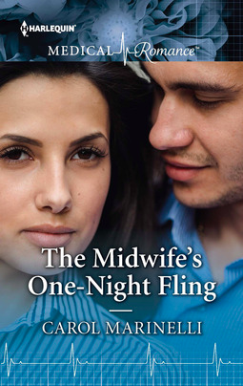
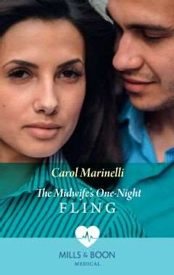
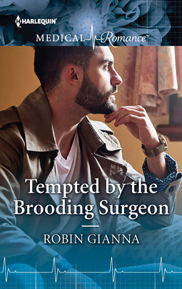


Slide 5
Objectives
1—To chart the rise of ‘medical romance’ as a distinct subgenre from the 1920s onwards, and to account for its popularity during its ‘peak period’, c.1950-1980.
2—To consider the growth of this subgenre against wider changes in attitudes towards medicine and women’s participation in the profession.
3—To evaluate the particular construction of medical knowledge and practice through these texts, particularly focusing on the role of female practitioners and their positioning in both domestic and foreign settings.
4—To consider the degree to which authors and editors pursued clinical accuracy, and whether their texts reflected contemporary trends in medical practice.

Slide 6
‘More Doctor than Woman?’
‘You still are presenting yourself as a gruesome aspect of womanhood. A brain without a body… I don’t understand you, Page! You pride yourself on being clever! Yes, you do! And clever as a biologist. Yet, you set yourself to prove that a woman can live without biological love---and some female creatures do so live…. But, Page, look at yourself! Your hair is soft and silky—but it clings to no man’s fingers. Your full pink lips mean nothing because they talk only of viruses and nuclei. Your arms never hold a man close to your heart, so they only seem soft and white and round. Your body, so far as you respect its living purpose, might as well lie dark and leathery over in an anatomy vat! You’ve had a very short life in a biological sense, Dr. Aning!’
-Elizabeth Seifert, The Doctor Takes a Wife, 1954

Slide 7
Questions
To what extent are passions gendered?
Are women’s passions treated differently than men’s? Are they taken less seriously?
Why have ‘low-brow’ depictions of passion been marginalised? Is there an inevitable elitism in what sources are privileged in the study of passions/emotions?

