Slide 1
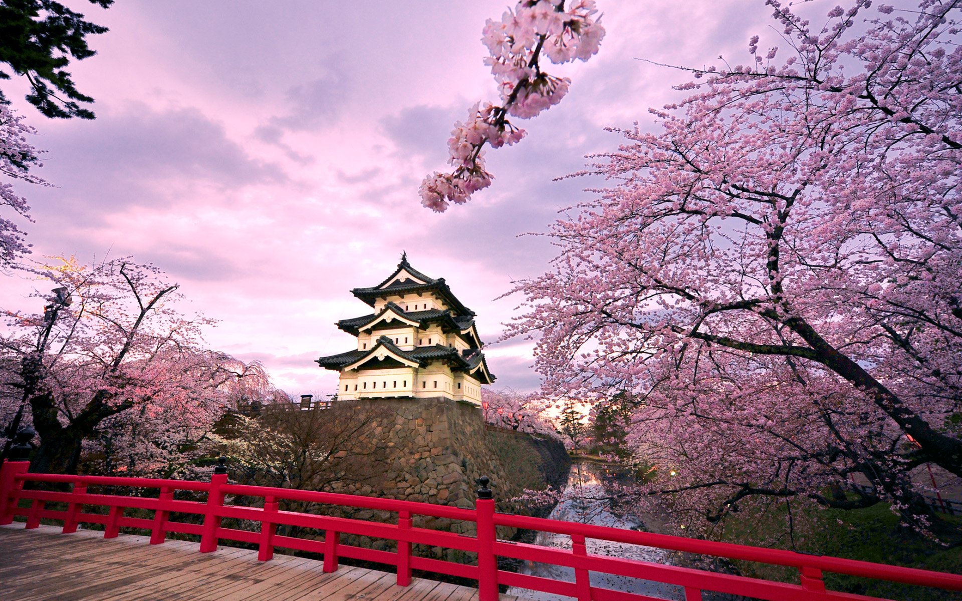
Japanese
Street
Food

Slide 2
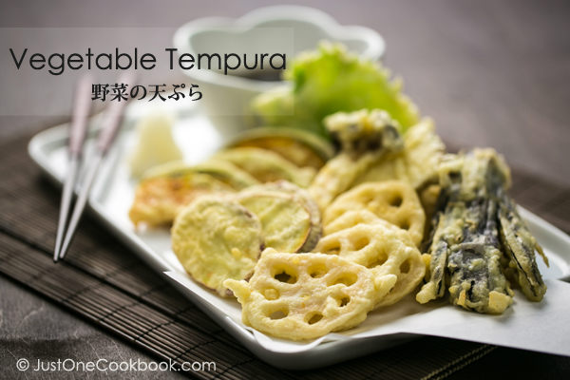
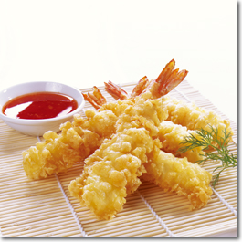
Tempura 天ぷら or 天麩羅
Tempura is a Japanese dish of seafood or vegetables that have been battered and deep fried.

Slide 3
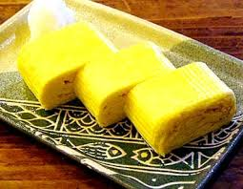
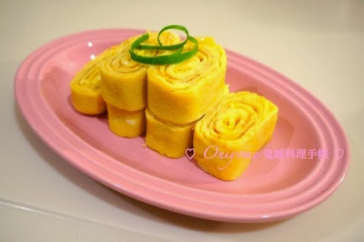
Tamagoyaki たまごやきor卵焼き

Slide 4
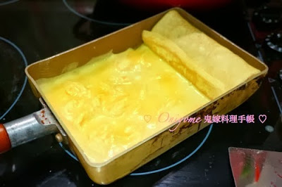
Tamago is a type of Japanese omelette, which is made by rolling together several layers of cooked egg. These usually are prepared in a rectangular omelette pan called a 玉子焼き鍋---たまごやきなべ(Tamagoyakinabe).
Tamago is made by
combining eggs, rice vinegar,
and sometimes sugar or soy sauce.
An alternative version includes a mix of shrimp puree, grated mountain yam, sake and egg, turned into a custard-like cake

Slide 5
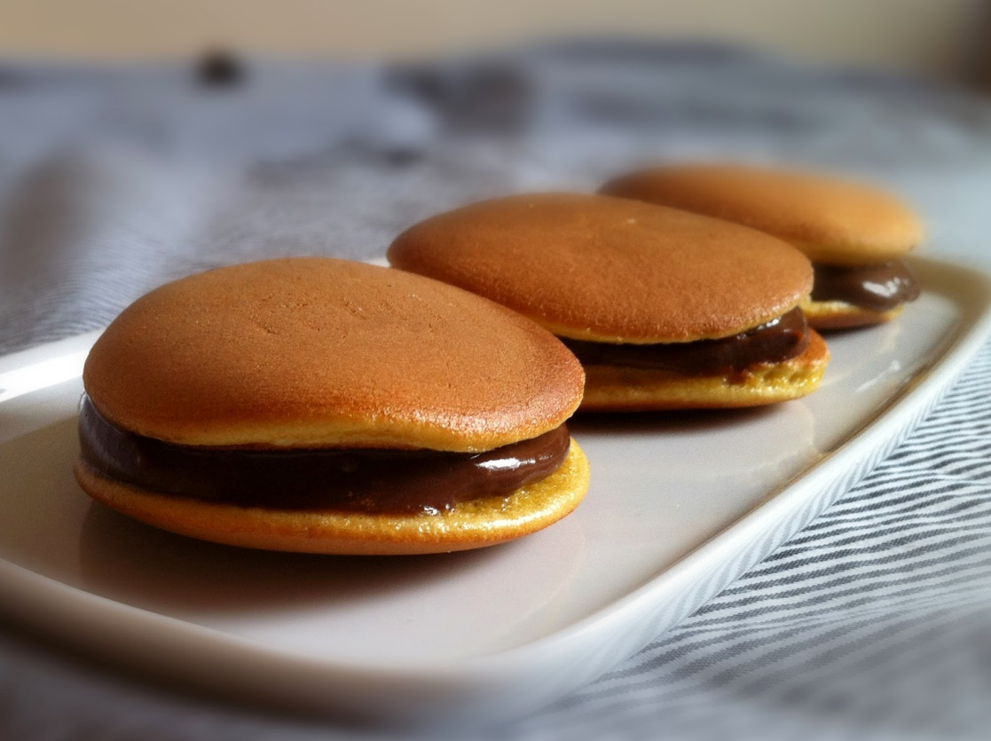
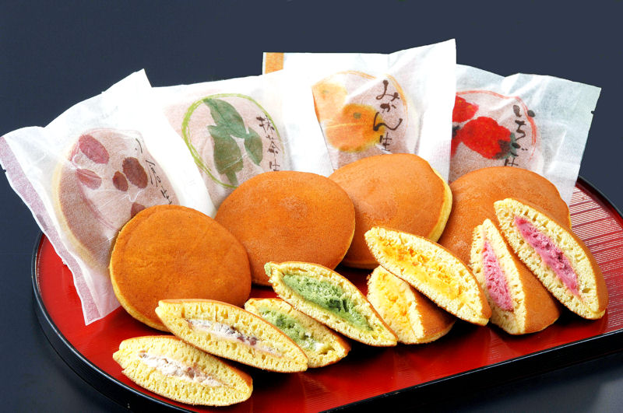
Dorayaki (どらやき, 銅鑼焼き, ドラ焼き)
Dorayaki is a type of Japanese confection, а red bean pancake which consists of two small pancake-like patties made from castella wrapped around a filling of sweet red bean paste.

Slide 6
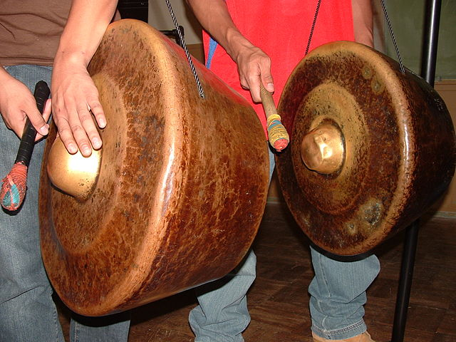
In Japanese, dora means "gong", and because of the similarity of the shapes, this is probably the origin of the name of the sweet. Legend has it that the first Dorayaki were made when a samurai(soldier) named Benkei forgot his gong (dora) upon leaving a farmer’s home where he was hiding and the farmer subsequently used the gong to fry the pancakes, thus the name Dorayaki.

Slide 7

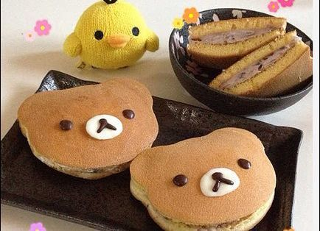

Slide 8
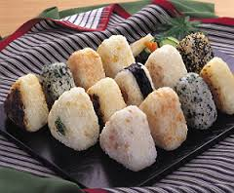
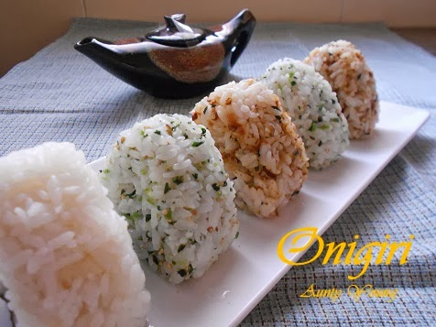
お握り---おにぎり (Onigiri)

Slide 9
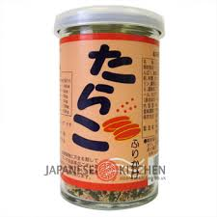
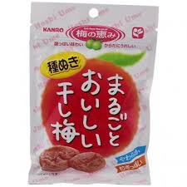
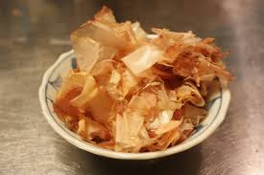
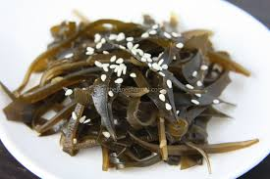
お握り is also known as o-musubi or rice ball, a Japanese food made from white rice formed into triangular or oval shapes and often wrapped in nori(seaweed). Traditionally, an お握り is filled with pickled ume (umeboshi), salted salmon, katsuobushi, konbu, tarako, or any other salty or sour ingredient as a natural preservative.

Slide 10
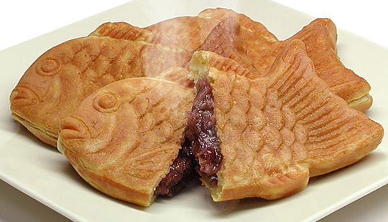
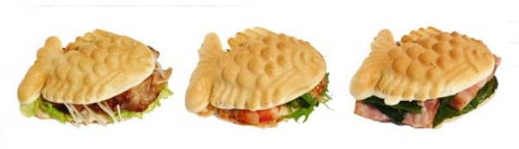
Taiyaki (鯛焼き,たいやき)
Taiyaki is a Japanese fish-shaped cake. The most common filling is red bean paste that is made from sweetened beans. Other common fillings may be custard, chocolate, cheese, or sweet potato. Some shops even sell taiyaki with okonomiyaki, gyoza(dumpling) filling, or a sausage inside.

Slide 11
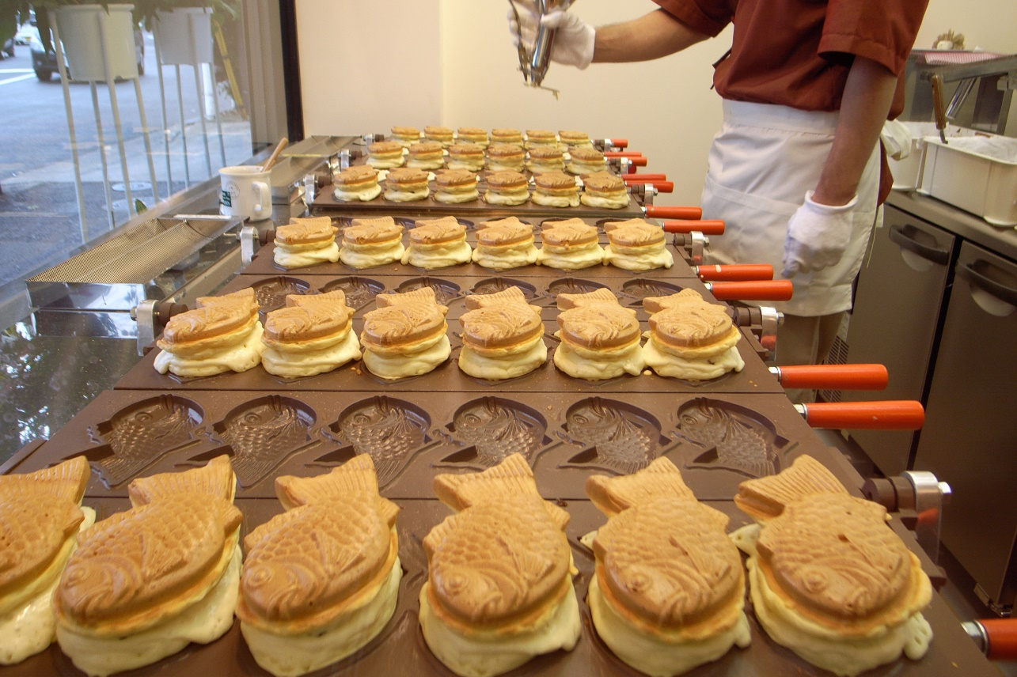
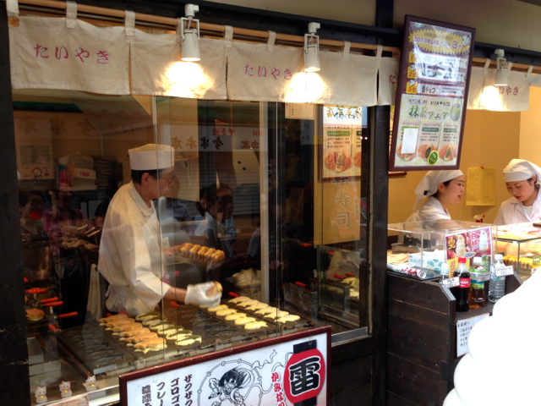
Taiyaki is made using regular pancake or waffle batter. The batter is poured into a fish-shaped mold for each side. The filling is then put on one side and the mold is closed. It is then cooked on both sides until golden brown.

Slide 12

寿司--- すし (Sushi )

Slide 13
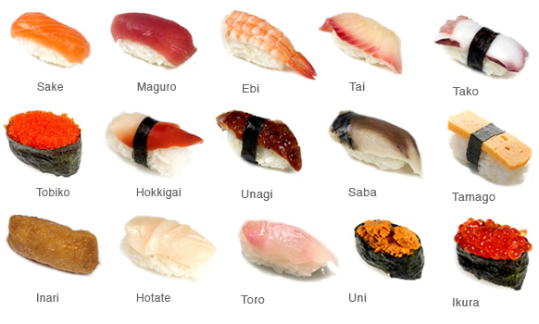
Sushi is a Japanese food consisting of cooked vinegared rice combined with other ingredients, seafood, vegetables and sometimes tropical fruits. Ingredients and forms of sushi presentation vary widely, but the ingredient which all sushi have in common is rice.

Slide 14
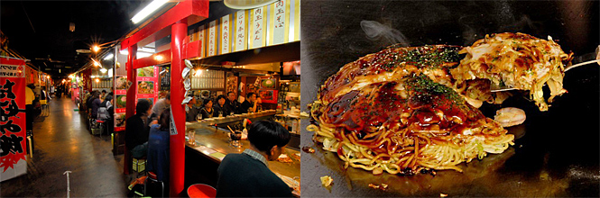
Okonomiyaki(お好み焼き,おこのみやき)
Okonomiyaki is a Japanese savoury pancake containing a variety of ingredients. The name is derived from the word okonomi, meaning "what you like" or "what you want", and yaki meaning "grilled" or "cooked".

Slide 15
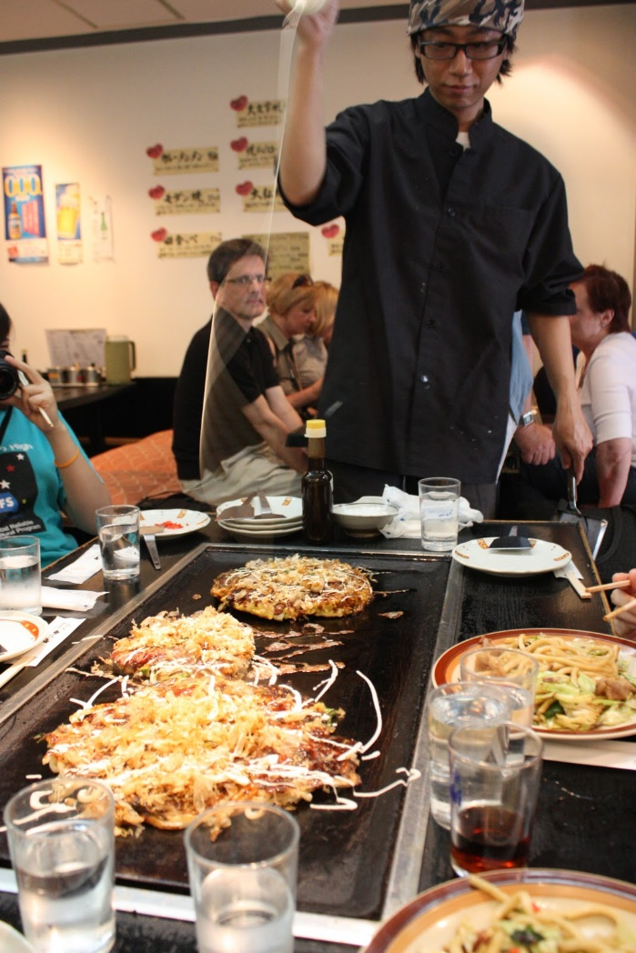
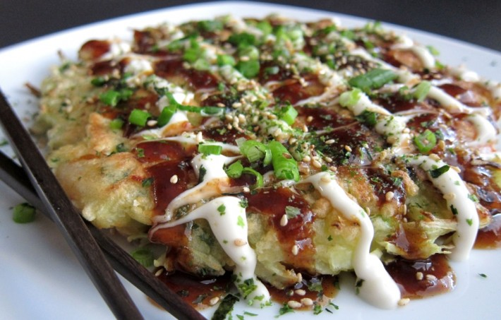
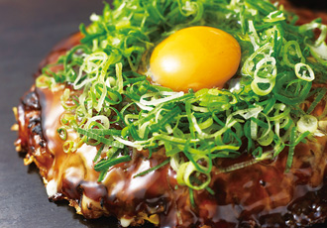

Slide 16
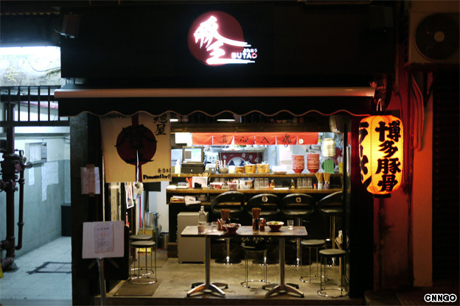
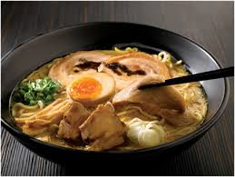
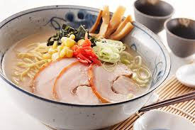
拉麺---ラーメン (Ramen)

Slide 17
Ramen is a Japanese noodle soup dish. It consists of Chinese-style wheat noodles served in a meat- or (occasionally) fish-based broth, often flavored with soy sauce or miso, and uses toppings such as sliced pork, dried seaweed, kamaboko, and green onions.
Ramen are also available in many different regional varieties, some of which have become extremely popular and may be found nationwide. A few of the best known regional varieties include:

Slide 18
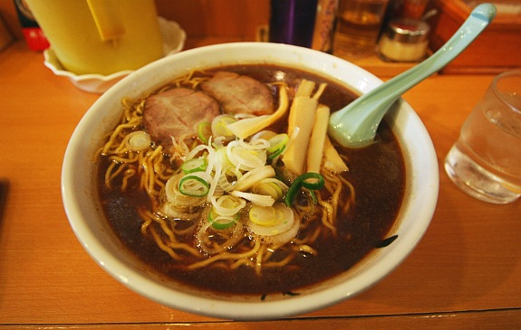
Asahikawa Ramen
Hailing from the very centre of Hokkaido, Asahikawa Ramen are known for their oily, shoyu based soup. They includes thin, wavy noodles, which are typically topped with green onions, chashu, menma, and egg. Shops serving Asahikawa Ramen can be found throughout Asahikawa.

Slide 19
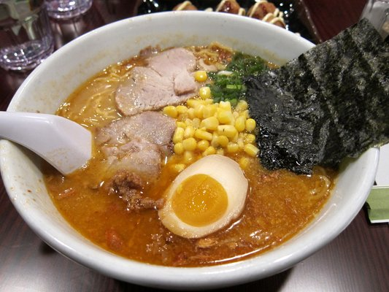
Sapporo Ramen
Sapporo's famous miso ramen are thick and hearty. They usually features fat, robust noodles and are often topped with filling Hokkaido specialties such as creamy butter and sweet corn. Miso Ramen are among the most popular regional ramen varieties and have become a mainstay at ramen-ya all over the country.

Slide 20
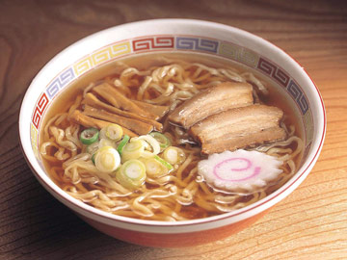
Kitakata Ramen
From Fukushima Prefecture, Kitakata Ramen feature a light shoyu soup typically flavored with pork bones, chicken stock and dried sardines, and are filled with wide, flat noodles that are chewy and wavy. Kitakata Ramen are usually topped with green onions, menma, and generous amounts of chashu.

Slide 21
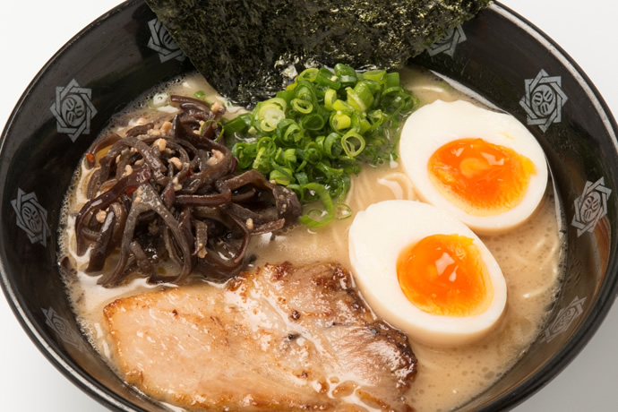
Tokyo Ramen
Tokyo style ramen typically features medium thick, wavy noodles in a shoyu soup flavored with dashi fish stock. Tokyo Ramen are served nationwide and have become popular to the point that they are essentially the stereotypical shoyu ramen.

Slide 22
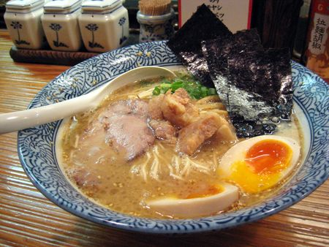
Hakata Ramen
Hakata Ramen feature thin noodles in a thick, creamy tonkotsu soup, usually topped with chashu. The best place to enjoy Hakata Ramen is at one of the food stalls in Fukuoka, but they can now also be found at specialty ramen-ya nationwide.

Slide 23
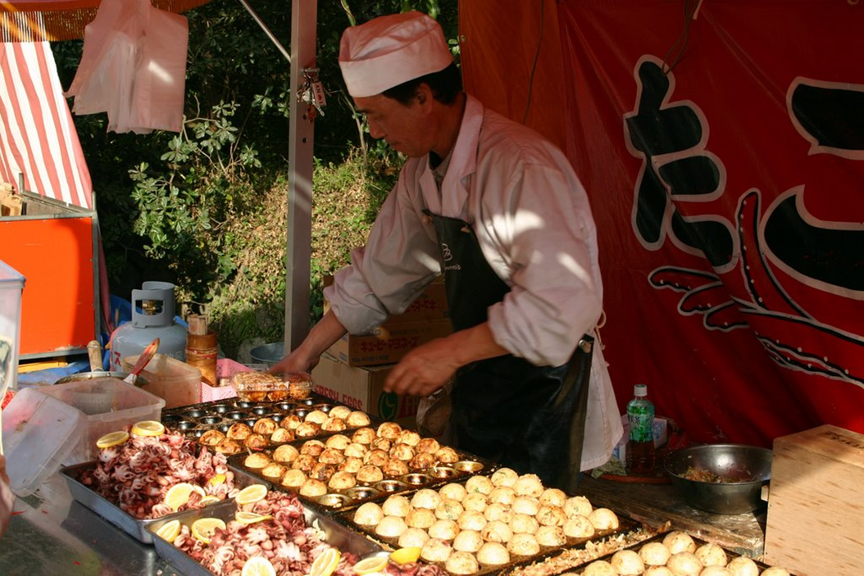
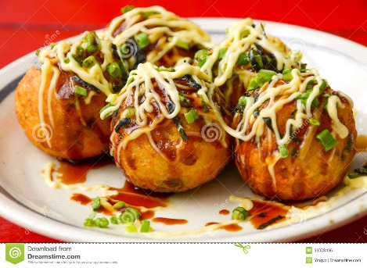
Takoyaki (たこ焼き,たこやき)
Takoyaki is a ball-shaped Japanese snack made of a wheat flour-based batter and cooked in a special takoyaki pan. It is typically filled with minced or diced octopus(tako), tempura scraps (tenkasu), pickled ginger, and green onion.

Slide 24
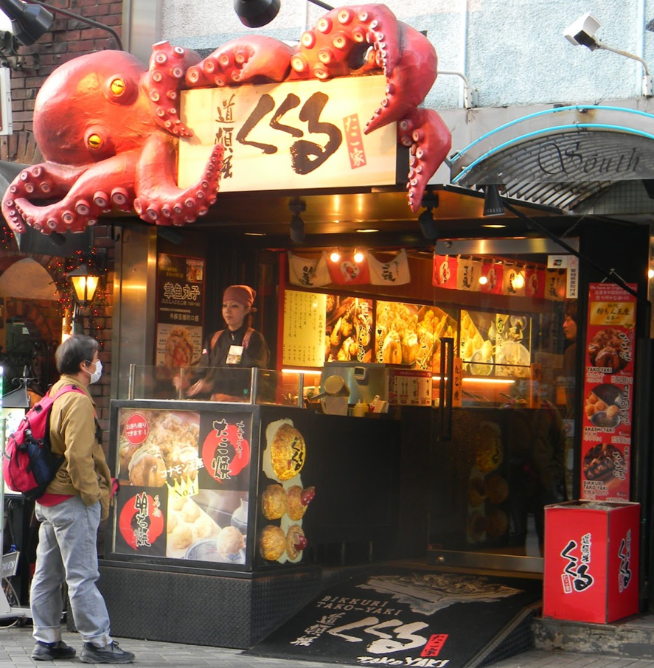
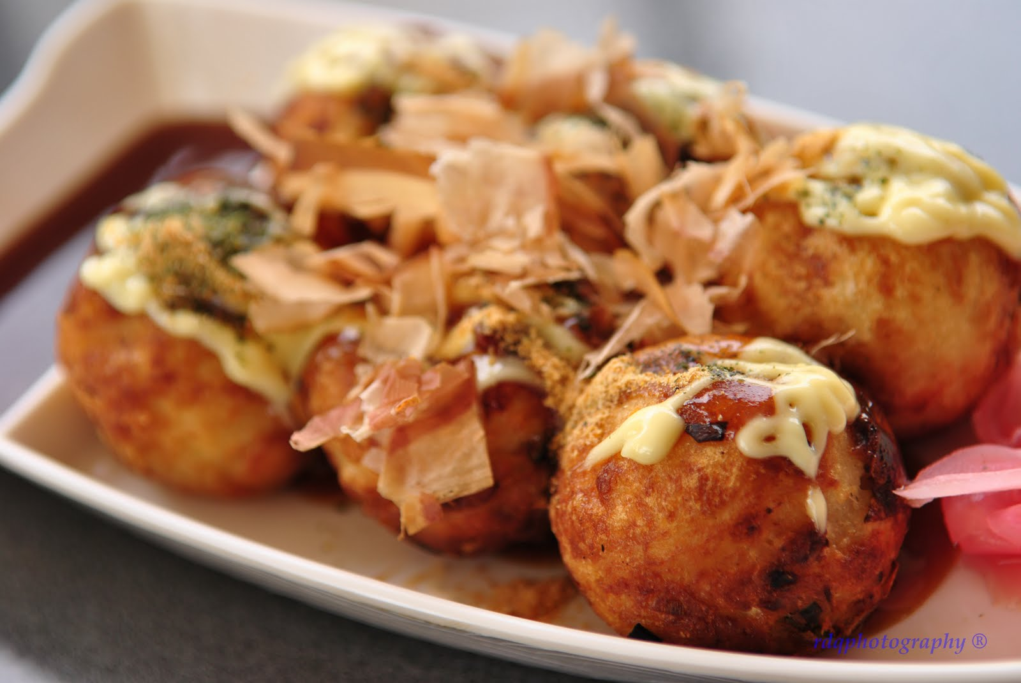
Takoyaki are brushed with takoyaki sauce, similar to Worcestershire sauce, and mayonnaise. The takoyaki is then sprinkled with green laver (aonori) and shavings of dried bonito (katsuobushi).

Slide 25
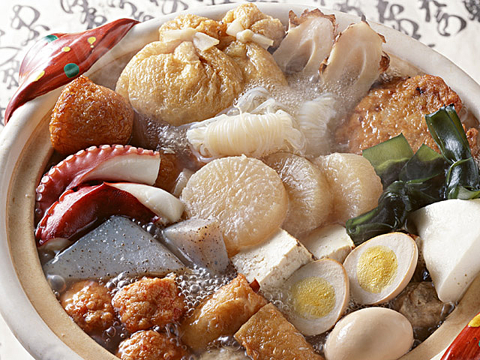
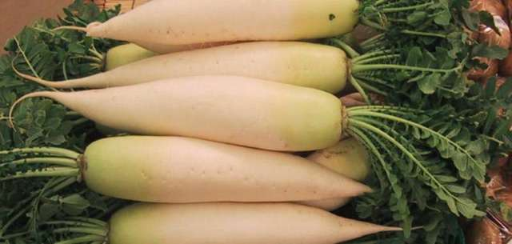
Oden (おでん,かんと だき)
Oden is a Japanese winter dish consisting of several ingredients such as boiled eggs, daikon, and processed fishcakes stewed in a light, soy-flavoured dashi broth. Ingredients vary according to region and between each household. Karashi is often used as a condiment.
daikon

Slide 26
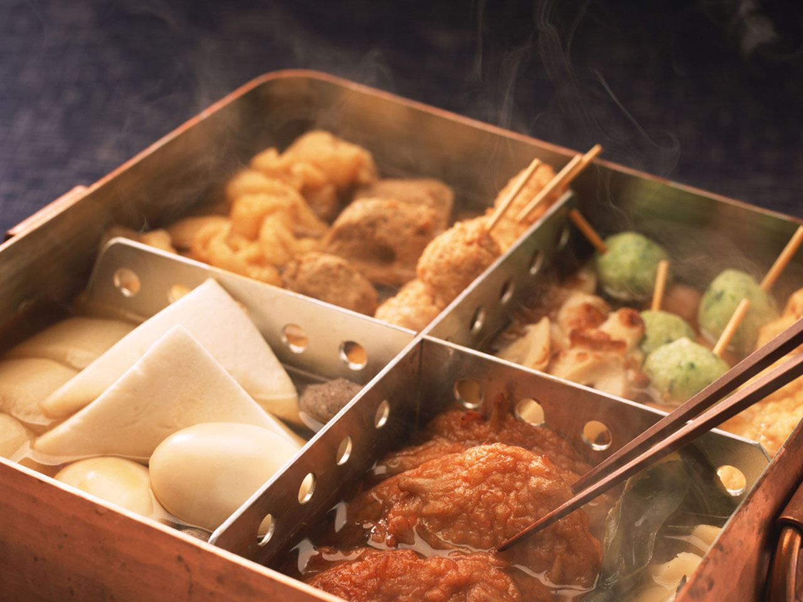
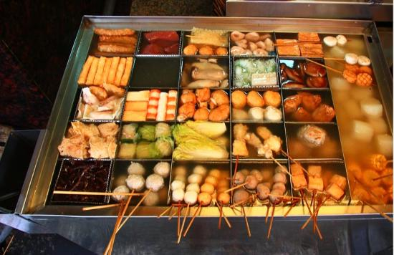
Oden is often sold from food carts, and most Japanese convenience stores have simmering oden pots in winter. Many different kinds of oden are sold, with single-ingredient varieties as cheap as 100 yen.

Slide 27
Word list
Tamagoyaki たまごやき or 卵焼き
Tempura 天ぷら or 天麩羅
Dorayaki どらやき or 銅鑼焼き, ドラ焼き
Onigiri おにぎり or お握り
Taiyaki たいやき or 鯛焼き
Okonomiyaki おこのみやき or お好み焼き
Ramen ラーメン or 拉麺
Takoyaki たこやき or たこ焼き
Oden おでん or かんと だき

