Slide 1
Languages and Cultures Beyond Boundaries
Term 2, Week 7
Lessing’s Nathan the Wise (1779)

Slide 2
The history of anti-Semitism 1.1. Medieval anti-Judaism
Ideology:
Religious motivation and legitimation of hatred and discrimination (Jews as murderers of Christ, as stubborn deniers of the truth of the Christian faith etc.).
Popular superstition (Jews as sorcerers, in league with the devil, sacrificing Christian children, poisoning the wells and spreading the plague etc.) (slides 3,4).

Slide 3
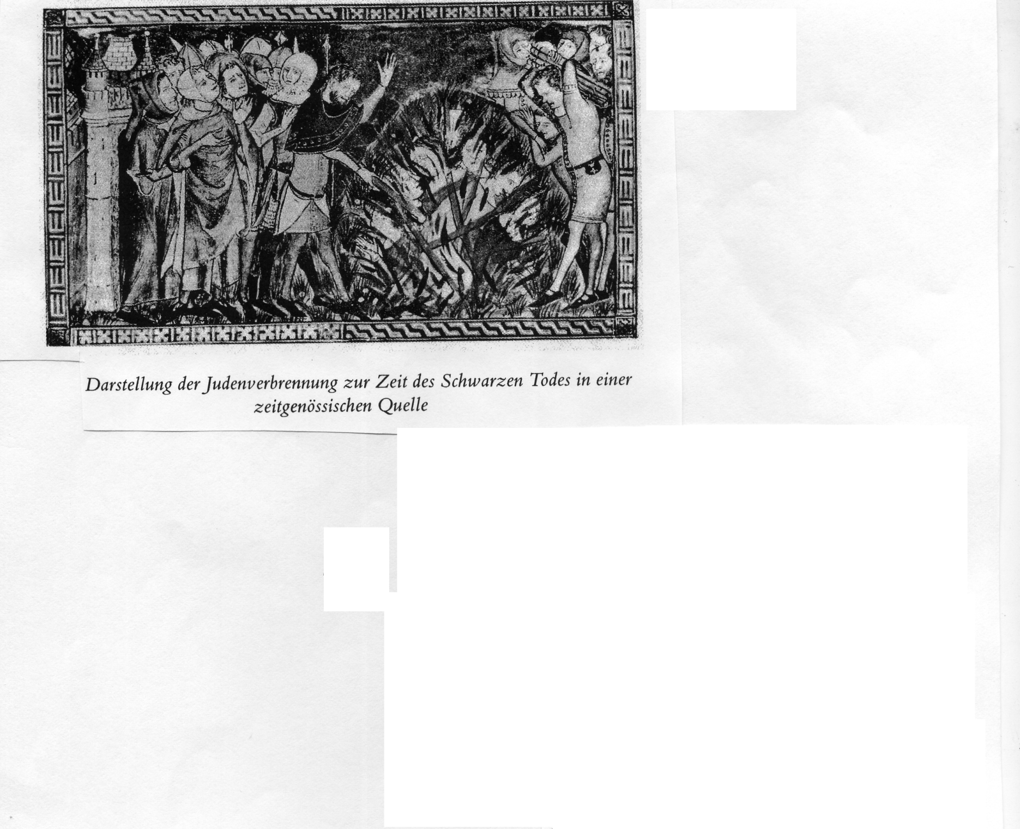
Judenverbrennung im Mittelalter
Source: Deutsch-jüdische Geschichte in der Neuzeit, vol. 1, p. 52

Slide 4
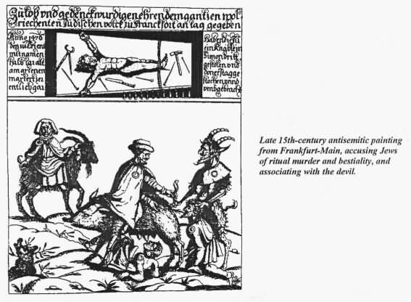
Antisemitic woodcut, late 15th ct.

Slide 5
The history of anti-Semitism 1.1. Medieval anti-Judaism
Social situation:
Exclusion of Jews from owning land and from membership in the guilds – which means: they could not become farmers or craftsmen.
Therefore: many Jews had to survive on money lending, pawn broking or peddling (slide 6).
Jews had hardly any rights (e.g. to stay in a particular place) and therefore were dependent on protection by the prince or local ruler.
Jews were forced to largely lived a life apart from the gentile population (often in ghettos) and were made clearly visible as ‘different’ (e.g. through imposed special clothing).

Slide 6
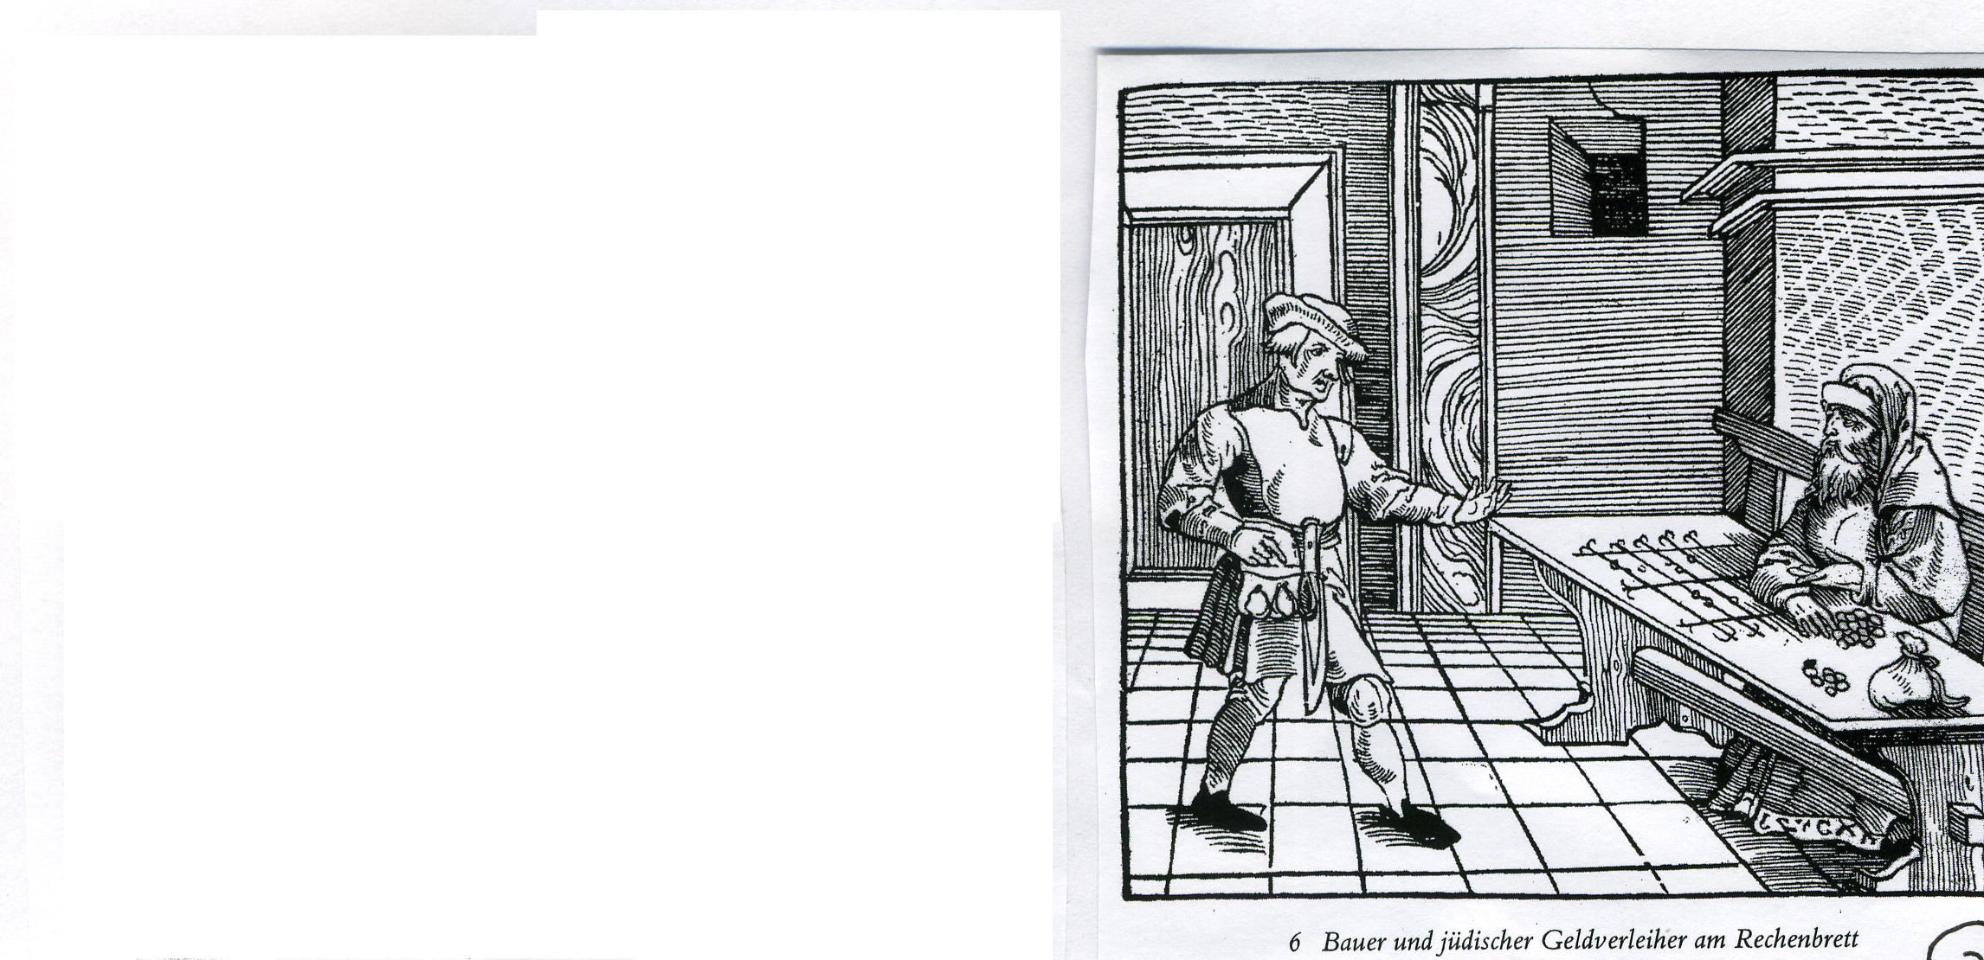
Jüdischer Geldverleiher
Source: Deutsch-jüdische Geschichte in der Neuzeit, vol. 1, p. 52

Slide 7
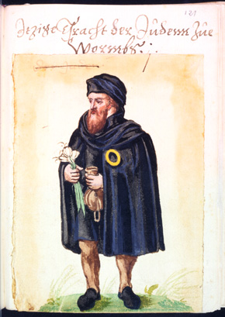
The ‘Judenfleck’

Slide 8
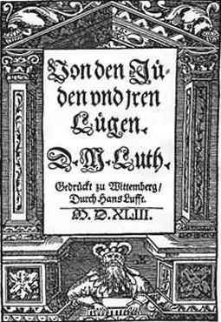
Luther and the Jews

Slide 9
‘Von den Juden und ihren Lügen (1543)
“Jawohl, sie halten uns [Christen] in unserem eigenen Land gefangen, sie lassen uns arbeiten in Nasenschweiß, Geld und Gut gewinnen, sitzen sie dieweil hinter dem Ofen, faulenzen, pompen und braten Birnen, fressen, sauffen, leben sanft und wohl von unserm erarbeiteten Gut, haben uns und unsere Güter gefangen durch ihren verfluchten Wucher, spotten dazu und speien uns an, das wir arbeiten und sie faule Juncker lassen sein … sind also unsere Herren, wir ihre Knechte.“

Slide 10
“Ich will meinen treuen Rat geben: Erstlich, das man jre Synagoga oder Schule mit feur anstecke und, was nicht verbrennen will, mit erden überheufe und beschütte, das kein Mensch ein stein oder schlacke davon sehe ewiglich Und solches sol man thun, unserm Herrn und der Christenheit zu ehren damit Gott sehe, das wir Christen seien.“

Slide 11
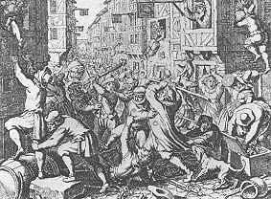
Pogrom in the Frankfurt Ghetto, 1614

Slide 12
Enlightenment universalism – e.g. American Declaration of Independence (1776)
“We hold these truths to be self-evident, that all men are created equal, that they are endowed by their Creator with certain unalienable Rights, that among these are Life, Liberty and the pursuit of Happiness. That to secure these rights, Governments are instituted among Men, deriving their just powers from the consent of the governed, That whenever any Form of Government becomes destructive of these ends, it is the Right of the People to alter or to abolish it, and to institute new Government […]”

Slide 13
Historical Context: Enlightenment and its Others
Enlightenment Universalism and its faultlines:
“Aufklärung ist der Ausgang des Menschen aus seiner selbstverschuldeten Unmündigkeit. Unmündigkeit ist das Unvermögen, sich seines Verstandes ohne Leitung eines anderen zu bedienen. Selbstverschuldet ist diese Unmündigkeit, wenn die Ursache derselben nicht am Mangel des Verstandes, sondern der Entschließung und des Mutes liegt, sich seiner ohne Leitung eines andern zu bedienen.” Kant, from Beantwortung der Frage: Was ist Aufklärung (1784)
How inclusive is ‘Mensch’ to be understood?
“Eine Frauenzimmer, das den Kopf voll Griechisch hat […] oder über Mechanik gründliche Streitigkeiten führt […] mag nur immerhin noch einen Bart dazu haben […]” I.Kant, Beobachtungen über das Gefühl des Schönen und Erhabenen (1764)
“In den heißen Ländern reift der Mensch in allen Stücken früher, erreicht aber nicht die Vollkommenheit der temperierten Zonen. Die Menschheit ist in ihrer größten Vollkommenheit in der “race” der Weißen. Die gelben Inder haben schon ein geringeres Talent. Die Neger sind tiefer, und am tiefsten steht ein Teil der amerikanischen Völkerschaften.” I. Kant, Bestimmung des Begriffs einer Menschenrace (1785)

Slide 14
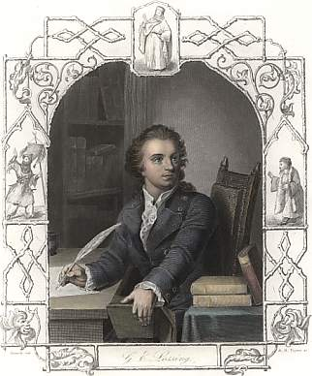
Gotthold Ephraim Lessing (1729 – 1781)
Despite earlier neo-classical leanings, he pioneered the theory and practise of German drama, leading the path away from French neo-classical models.
Laid the blueprint for ‘bourgeois tragedy’ (Emilia Galotti).
Lessing himself a representative of an educated and rising Middle Class.
An Enlightenment man, preaching religious tolerance. As head librarian in Wolfenbüttel he entered into theological debates publicly with pastors and theologians, particularly following the publication of Samuel Reimarus’s Fragmente – critical of religion . He was censored from further publications, but stated in a letter to Reimarus’s wife September 1778:
“Ich muss versuchen, ob man mich auf meiner alten Kanzel, auf dem Theater, wenigstens noch ungestört wird predigen lassen.”

Slide 15
Lessing works
Der junge Gelehrte (1748)
Der Freigeist (1749)
Die Juden (1749)
Miß Sara Sampson (1755)
Laokoon oder Über die Grenzen der Malerei und Poesie (1766)
Minna von Barnhelm (1767)
Emilia Galotti (1772)
Anti-Goeze (1778) (written against Johann Melchior Goeze, pastor in Hamburg)
Nathan der Weise (1779)
Ernst und Falk - Gespräche für Freymäurer (1776–1778)
Die Erziehung des Menschengeschlechts (1780)

Slide 16
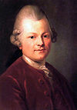
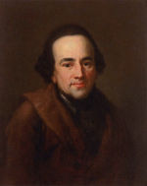
Moses Mendelssohn 1729-1786

Slide 17
Contexts for Nathan der Weise
The Abrahamic Religions (from Islam: People of the Book)
Abrahamic religion is a term commonly used to designate the three prevalent monotheistic religions – Judaism, Christianity, and Islam – which claim Abraham as a part of their sacred history. Judaism and Islam worship a Supreme Deity which they conceive strictly as one being. Exclusivity and the access to God.
Specific Historical Context:
The Third Crusade (1189–1192) was an attempt by European leaders to re-conquer the Holy Land from Saladin. Spurred on by religious zeal, Richard I of England and Philip II of France ended their conflict with each other to lead a new Crusade. On September 2, 1192, Richard and Saladin finalized a treaty by which Jerusalem would remain under Muslim control, but which also allowed unarmed Christian pilgrims to visit the city. The failure of the Third Crusade would lead to the call for a Fourth Crusade six years later.

Slide 18
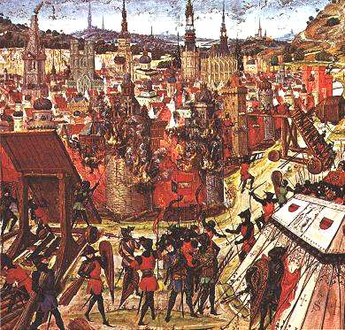
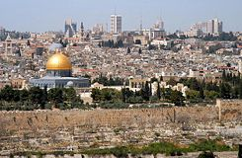
Further Contexts
The Geographical Location:
Jerusalem a historical point of conflict and dispute.
The site of Solomon’s temple, burial site of King David.
Significance in Christ’s life: his education there, proximity to the last supper and Christ’s grave
Muhammad's Night of Ascension (c. 620 CE). Muslims believe Muhammad was miraculously transported one night from Mecca to the Temple Mount in Jerusalem, whereupon he ascended to Heaven to meet previous prophets of Islam.
All religions appear to have a ‘claim’. Historically (from Crusades) there has been and continues to be friction as to the rights of religious groupings.

Slide 19
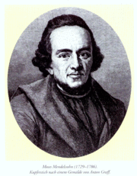
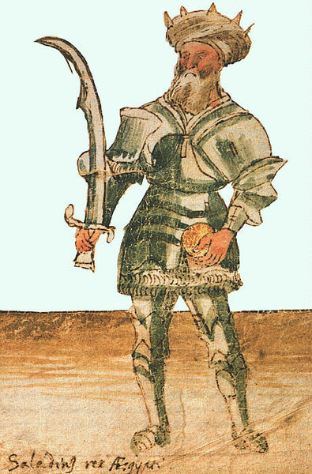
Biographical and Textual Sources
The Decameron: a novelle from this collection of 14th century prose stories in Italian. Passed through the further ‘filter’ of Enlightenment tolerance
A ‘Vorbild’ for Nathan: Lessing’s friend, the Enlightened German-Jewish Philosopher Moses Mendelssohn (1729 – 1786).
Saladin - Salah ad-Din Yusuf bin Ayyub صلاح الدين يوسف بن أيّوب
A powerful ruler, depicted as a barbarian Muslim warrior king in European art – historically proven capable of some ‘compromise’ with Christian rulers.

Slide 20
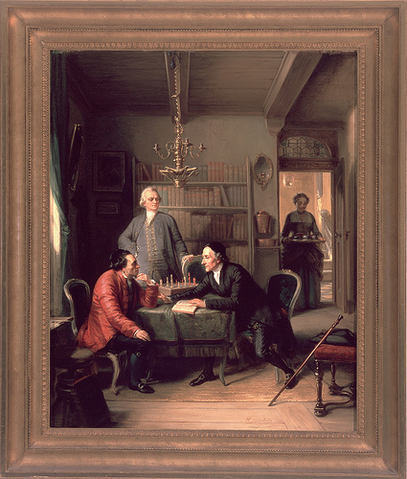
Lavater and Lessing visit Moses Mendelssohn
Moritz Daniel Oppenheim (1856)

