Slide 1
WELCOME TO ALL OUR NEW STUDENTS
French Studies – School of Modern Languages & Cultures
26th September 2018

Slide 2
Plan for today’s talk
Welcome
Introductions
Language modules
Cultural modules
French Society

Slide 3
Douglas Morrey
Head of French Studies
Room H 4.34

Slide 4
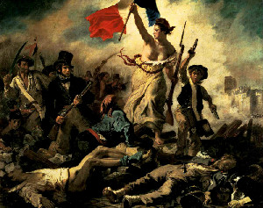
The French Section
On the 4th floor
Our team:
Research academics
Teaching fellows
Lecteurs (H4.42)

Slide 5

How you fit in…
Coming to classes
Keeping in touch with us
Punctuality
Professional communication
Independent learning
Notes:
Time spent on work; professional engagement; etc …

Slide 6

Meeting us
Office hours
Personal tutors
Your teachers
Email
Notes:
Mention office hours this coming Tuesday ; mention attendance

Slide 7
LANGUAGE TIMINGS
NEXT WEEK (FIRST TEACHING WEEK):
Oral classes scheduling session: Thursday 9am, Physics Lecture Theatre
Diagnostic grammar test: Thursday 2 – 5pm, rooms RO.39 and 41
Grammar lecture workshop: Friday 11 – 12noon, H0.51

Slide 8
DIAGNOSTIC TEST
No preparation required
1 hour, exam conditions
Computer-based multiple-choice questions
R041 and R039, Student Computer Centre, near library
Thursday afternoon (2-5pm), different groups according to degrees [See web page]
Come 10 minutes before
Please try out mock test that will be sent out to you on Weds of next week.

Slide 9
CULTURE MODULE TIMINGS
NEXT WEEK (FIRST TEACHING WEEK):
FR122 intro lecture: Tues, 4pm, H3.44
FR119:
intro lecture: Weds, 9 – 10am, H0.03
Intro seminar: Weds 12 – 1, H4.43
FR105: intro workshop: Thurs, 2 – 4pm, H0.56
FR 121: intro: Fri, 1pm, L4

Slide 10
NOT SURE ABOUT MODULES?
CULTURE CAFÉ : This Thursday 12 – 1pm, ground floor language centre
FRENCH MODULE DROP IN: First teaching week, Tuesday 2 – 3pm, H4.36

Slide 11
Story of Modern France
Study of how modern France came into being
Focus on culture, politics, history and society
Examination of language France uses to define herself across time

Slide 12
France across time and across forms
Notes:
Ch de R – what was France then? Borders and boundaries different…
Bastille – event or non event. Who was really liberated?
Un Héros – myth of resistance
Malik – France and multiculturalism

Slide 13
SMF (FR121) CORE FOR
French Studies
All French ‘with’ degrees
French ‘and’ degrees with another language (ie: French and German)
PAIS and French
French and Economics

Slide 14
SMF optional for:
English and French
French and History
(you can do EITHER SMF OR French Cultural Landmarks)

Slide 15
SMF optional for
BAML students
ML with Linguistics students
You can choose from ANY French culture module

Slide 16
FR122 Cultural Landmarks: Love, Language, Power
Cultural landmarks:
key social / cultural moments in pre-20th Century France and the francophone world
Language of love and desire
Mapping of emotional / psychological landscape
The genres used to explore this: medieval love lyric, short story, novel, theatre, poetry

Slide 17
How? texts taught simultaneously in French and in translation
Medieval romance:
Marie de France, Guigemar
Anon., La Chalelaine de Vergy
Short Story
Marguerite de Navarre, L’Heptaméron
Maupassant, ‘Boule de Suif’
The Novel
Mme de Graffigny, Lettres d’une Péruvienne

Slide 18
How?
Theatre
Racine, Phèdre
Rostand, Cyrano de Bergerac
Poetry –sonnet, gender, muse
16th century sonnets: Ronsard, Louise Labé
19th / 20th century sonnets: Verlaine, Baudelaire, Apollinaire

Slide 19
Who can take Cultural Landmarks?
French Studies students
French ‘with’ degree students
English and French students
French and History students
BAML students
ML with linguistics students

Slide 20
FR119 Society and Business in Modern France
Develops business French language skills and cultural / political knowledge:
Cultural material studied and examined in English
French business language studied and examined in French
Focus on the contemporary: Hollande post 2012 – Macron presidency
Looked at through the prism of the history of the 5th Republic

Slide 21
How
Politics, society and ideas:
Journalistic texts
Video
Contemporary non-fiction writing
French language
Study of vocabulary, syntax, idiom in the domain of French business
Business-related tasks in French

Slide 22
Who can take Society and Business?
French Studies students
French ‘with’ degree students
BAML students
ML with linguistics

Slide 23

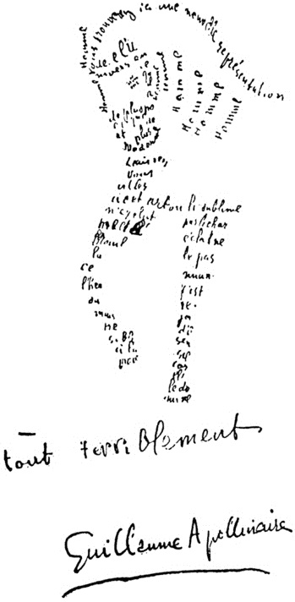
FR105: Approaches to Reading in English and French
What Approaches… offers
Skills… translation, close reading, analysis, comparison
Short poems… work with complete texts
Poems as poems… interplay of form and content
Culture and language… similarities and differences
Variety… schools, movements, subjects, themes
How to decide if you want to do the module?
See… module details
Read… previous students’ comments
Come… to the Week 1 session and see how you get on
Some previous students’ comments
• ‘my favourite module this year… inspired me to study more French poetry.’
• ‘helped improve my close reading and analysis … enhanced my French language abilities and my translation skills … a great opportunity to get to know other first years studying the English and French degree combination.’
• ‘Time always flew!’
• ‘excellent for broadening my horizons’

Slide 24
Who can take Approaches to Reading?
French Studies students
French ‘with’ degree students
BAML students
ML with linguistics
English and French students (as part of the ‘English’ side of your degree)

Slide 25

Lectures
teacher-led
Contextual information
‘ways in’ to material
Ways of reading
Close focus
Form and structure
Theories / approaches

Slide 26

Seminars
Small groups
Student- and teacher- led
You prepare work
Place for trying out ideas
Written work also set
compulsory - must inform tutor if absent

Slide 27
Bonne journée!

Slide 28
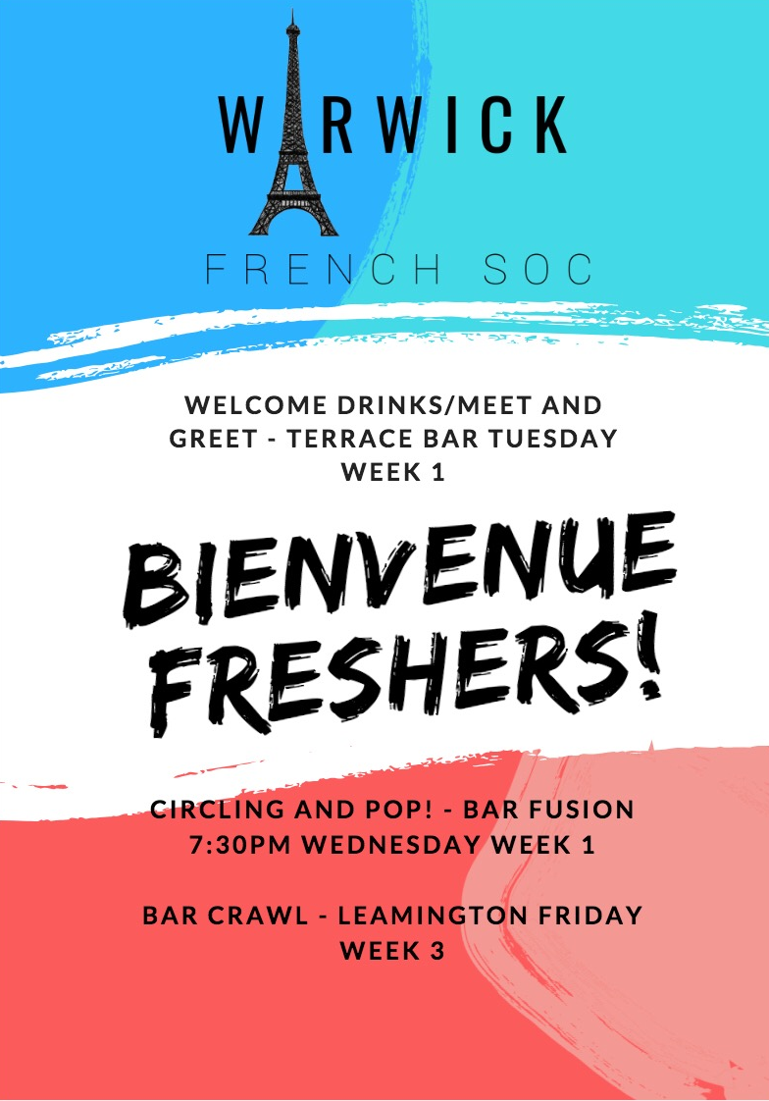

Slide 29
À quoi bon? What’s the point?
Circling and POP!
Bar Crawls in Leamington Spa
French Film nights
Curiositea Café and Croissants Meet Ups
Society meals
Peer led revision drop-ins

Slide 30
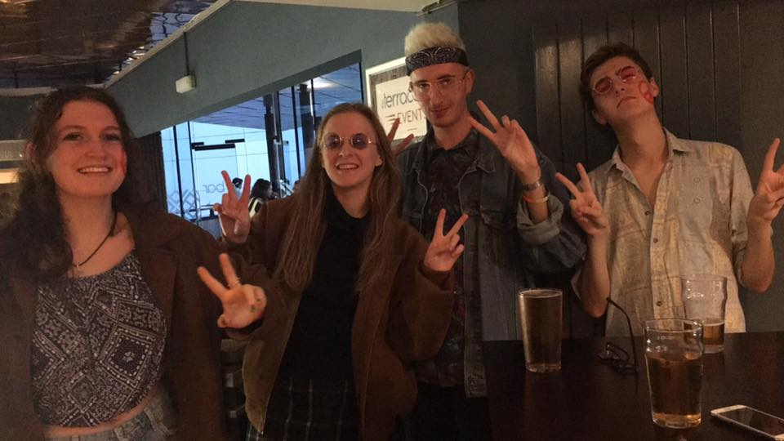
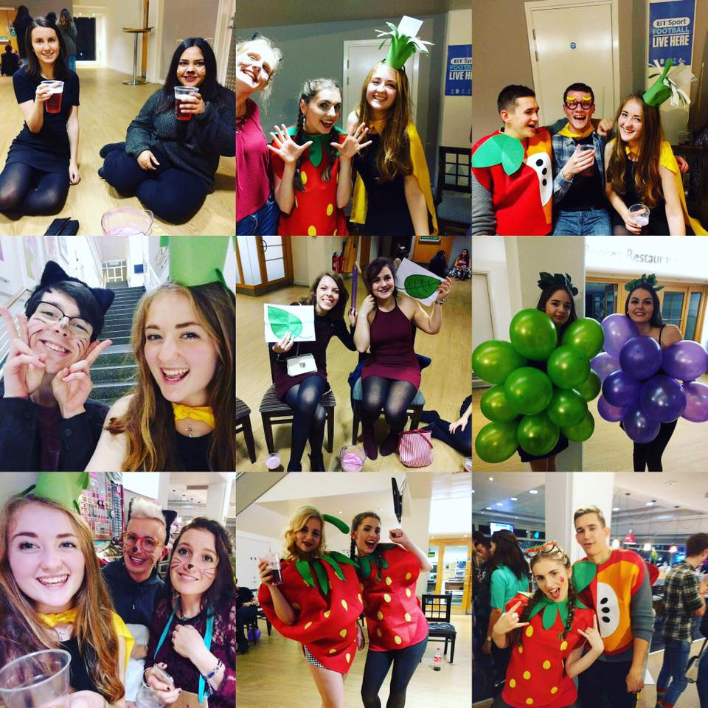

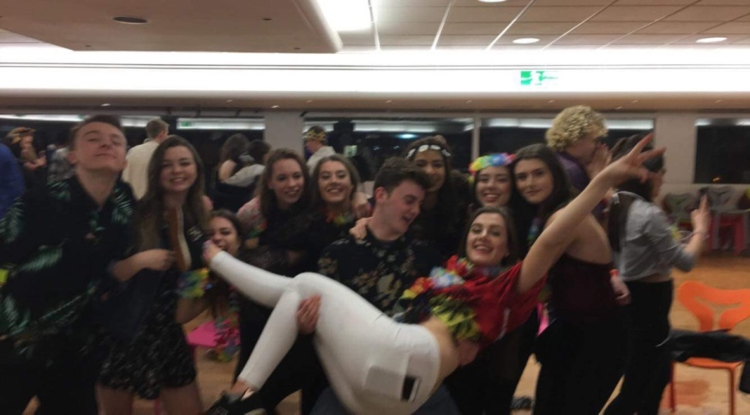
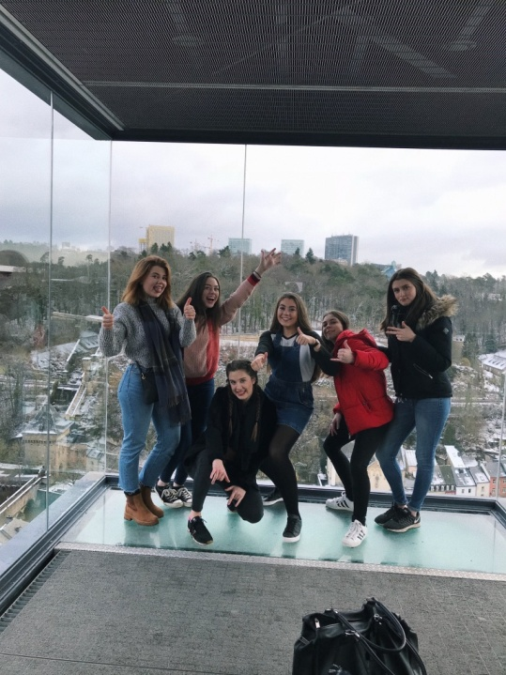
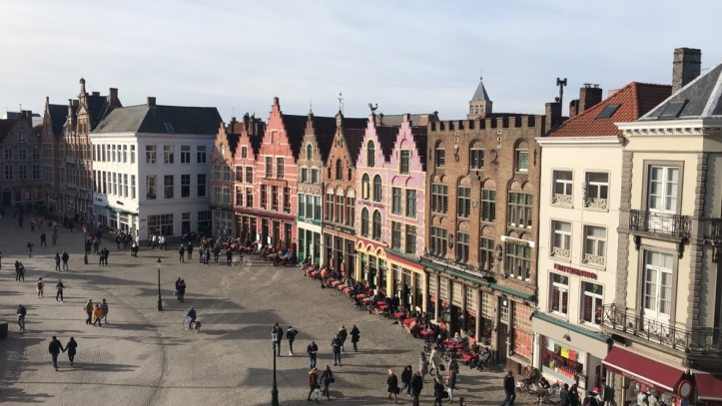
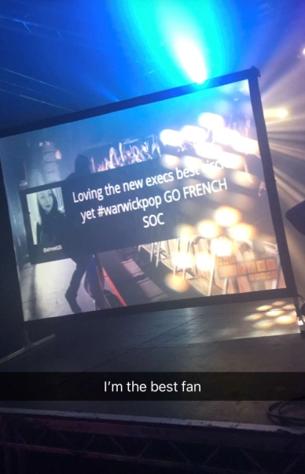

Slide 31
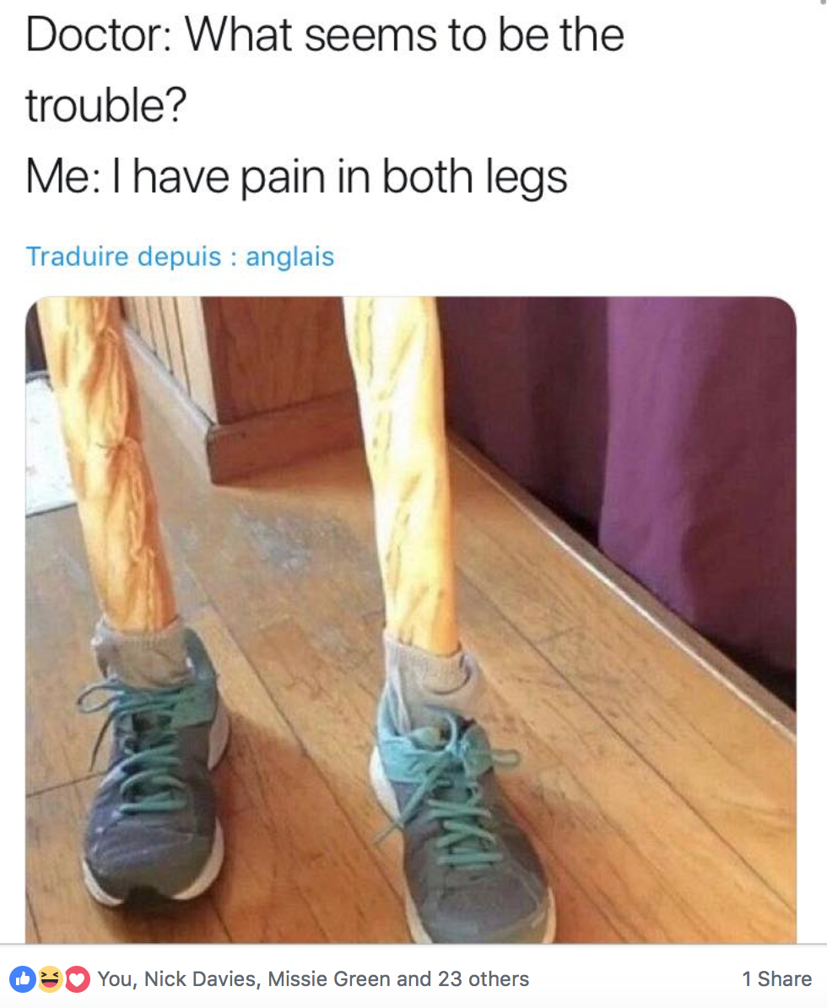
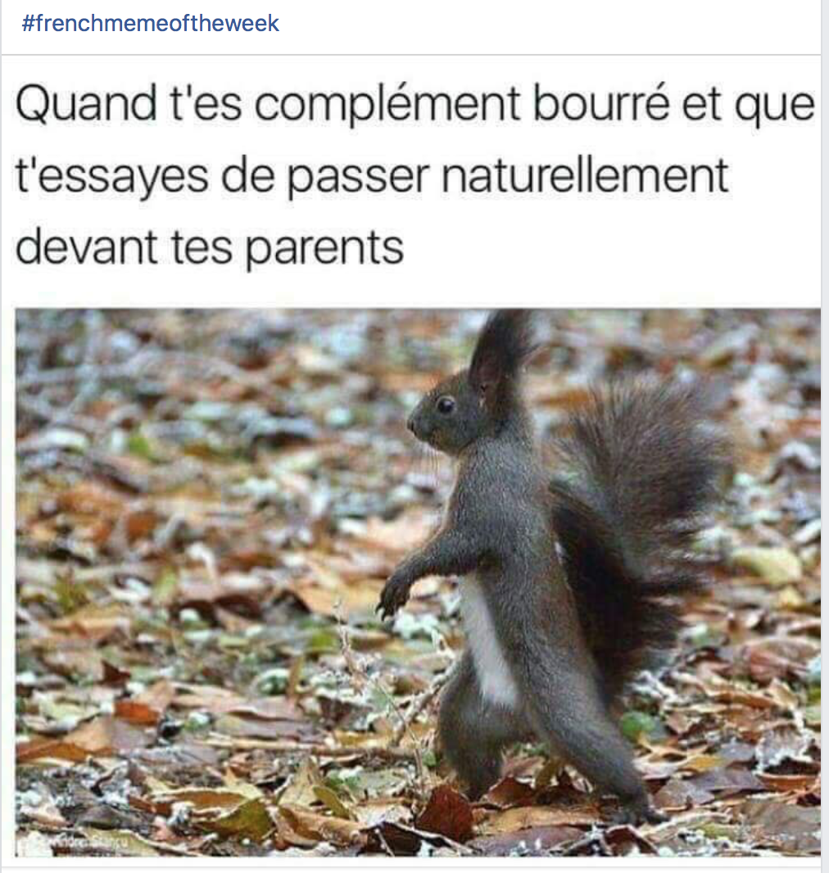
FRENCH MEME OF THE WEEK

Slide 32
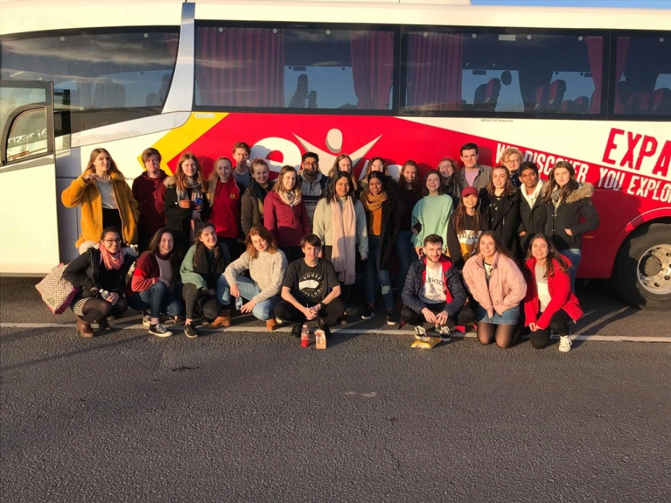

TOUR

Slide 33
See you next week for our meet and greet!
Terrace Bar 7:30!

