Slide 1
Modern and Contemporary France Week 2 Term 2
France in the 1940s:
German Occupation, Vichy and the Resistance
David Lees

Slide 2
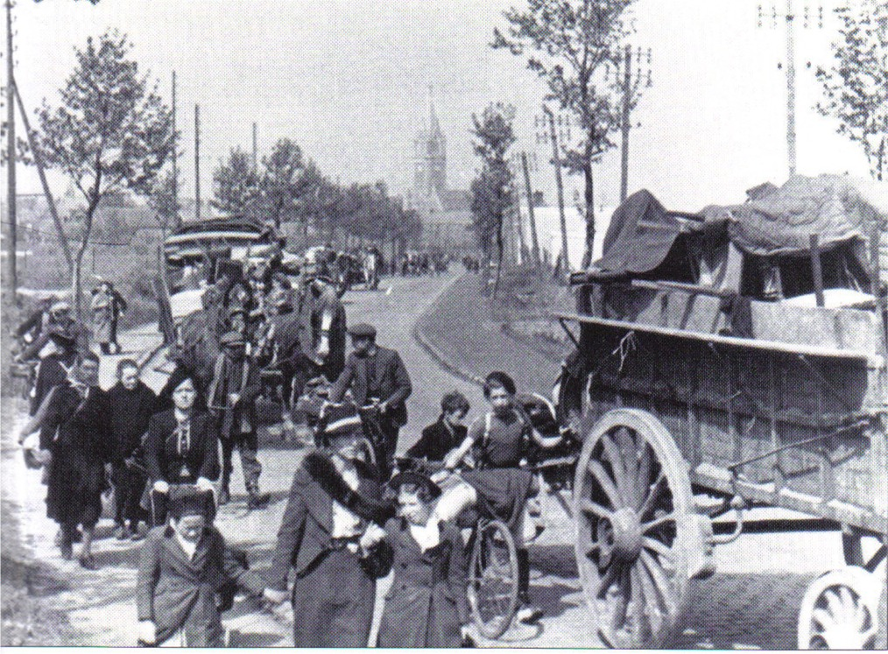
Vichy in Context: Defeat and Exode

Slide 3
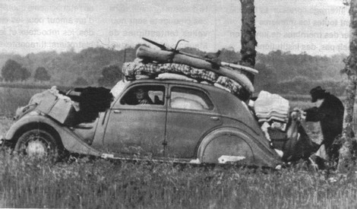
Vichy in Context: Defeat and Exode

Slide 4
Vichy in Context: Defeat and Exode
‘They were evacuating. There was no haven for them. No road open to them. But they were evacuating all the same. A great boot had smashed into an anthill in the north, and the ants were on the move.’
‘Every garage, shed and barn has vomited into the narrow streets every kind of machine: new cars, wagons from another age that have slept under dust for half a century […] every box on wheels has been exhumed and the jumbled treasures of the home tipped into it.’
ANTOINE DE SAINT-EXUPÉRY, Flight to Arras (London: Penguin, 2000) [originally published as Pilote de guerre in 1942]

Slide 5
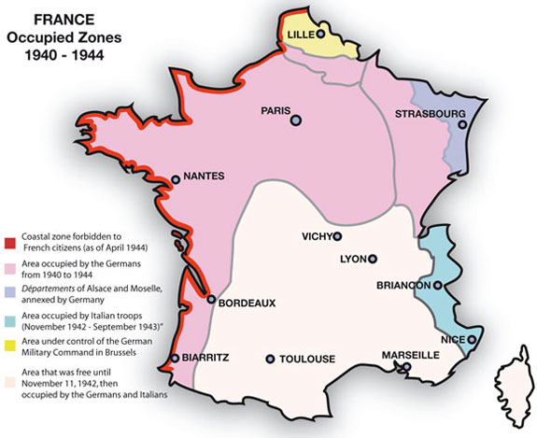

Slide 6
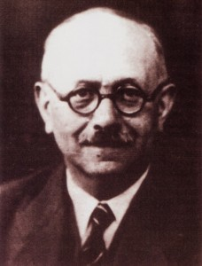
Aftermath of the Defeat the view of Marc Bloch (1886–1944)
Teacher, soldier, resister
Distinguished medieval historian, member of the Annales group
Spent the drôle de guerre in the Intelligence service; evacuated at Dunkirk
Tried to understand defeat by writing its history (published in 1946 as L’Etrange défaite)

Slide 7
Marc Bloch, L’Etrange défaite (Paris, Gallimard, 1946)
‘Il arrive que, dans une nation, les pires adversiares respirent, sans s’en douter, la même atmosphère mentale…’

Slide 8
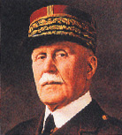
Aftermath of the Defeat
Marshal Pétain (1856–1951)
The Chamber of Deputies voted in favour of full powers to Pétain (569 votes to 80) so that he could create a new constitution
His three ‘constitutional acts’ attributed almost all power to himself

Slide 9
Aftermath of the Defeat
Pétain’s Broadcast, 17 June 1940
‘Français! À l’appel de Monsieur le Président de la République, j’assume, à partir d’aujourd’hui, la direction du gouvernement de la France. [...] Je fais à la France le don de ma personne pour atténuer son malheur.
En ces heures douloureuses, je pense aux malheureux réfugiés qui, dans un dénuement extrême, sillonnent nos routes. Je leur exprime ma compassion et ma solitude. C’est le cœur serré que je vous dis aujourd’hui qu’il faut tenter de cesser le combat. Je me suis adressé cette nuit à l’adversaire pour lui demander s’il est prêt à rechercher avec nous, entre soldats, après la lutte et dans l’honneur, les moyens de mettre un terme aux hostilités.’

Slide 10
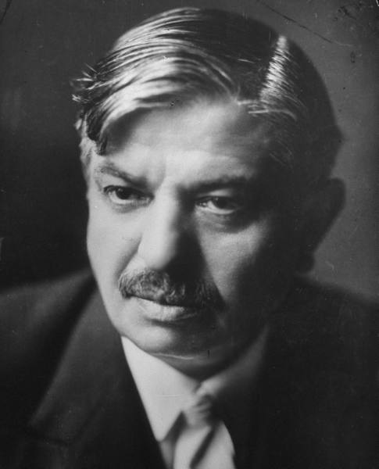
Aftermath of the Defeat
Pierre Laval (1883–1945)
Socialist during WWI, later became a neo-socialist and headed towards the right
Insisted that he was interested in pragmatic, not ideological politics, and European peace (whether this meant negotiating with Stalin in 1935 or Hitler in 1940…)

Slide 11
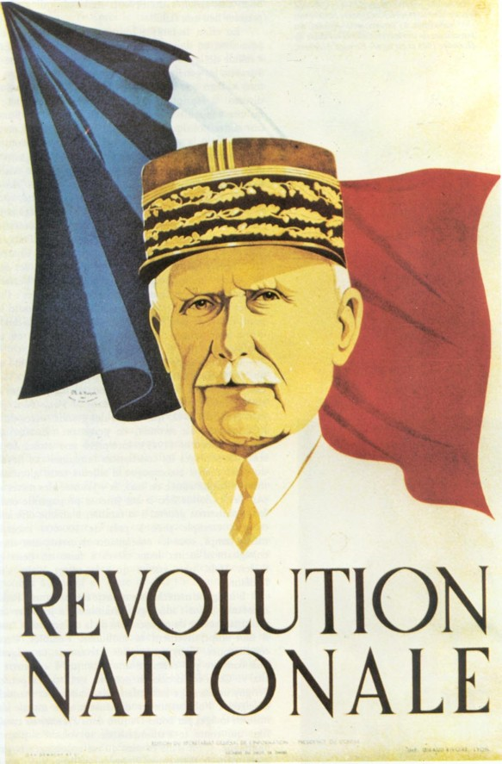
National Revolution

Slide 12
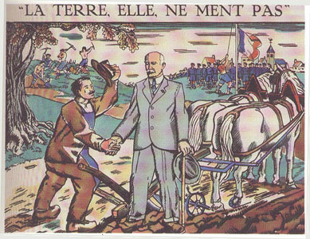
National Revolution

Slide 13
National Revolution
Pétain, 15 August 1940
‘La vie n’est pas neutre. Elle consiste à prendre partie hardiment. Il n’y a pas de neutralité possible entre le vrai et le faux, entre le bien et le mal, entre la santé et la maladie, entre l’ordre et le désordre, entre la France et l’anti-France.’

Slide 14
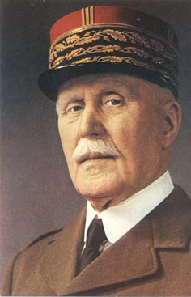
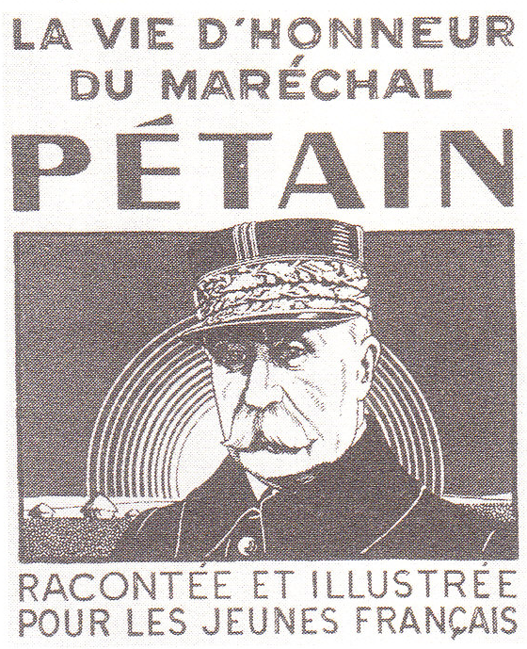
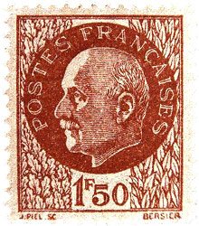
National Revolution
Pétainisme

Slide 15
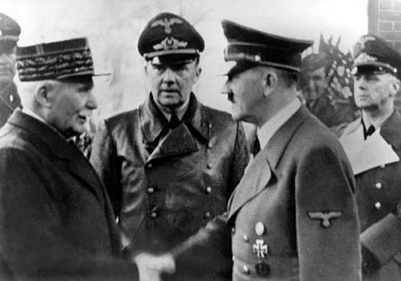
Collaboration
Pétain meets Hitler, Montoire-sur-le Loir, 24 October 1940

Slide 16
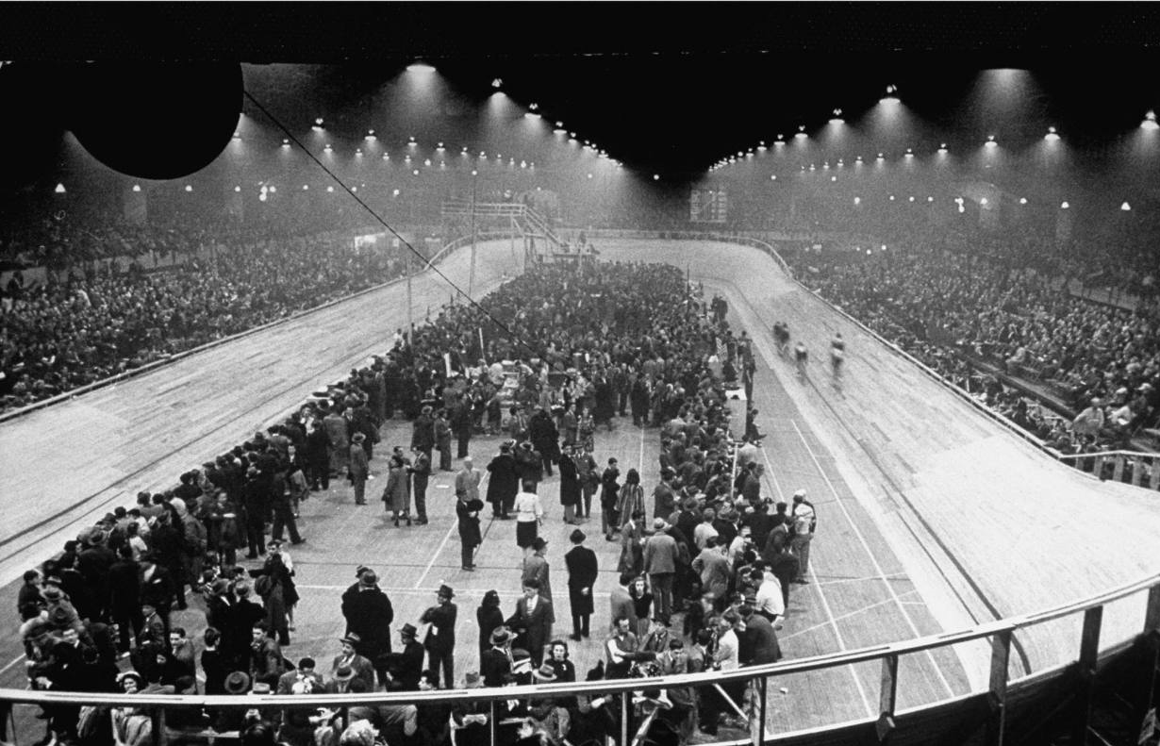
Collaboration
La Rafle Du Vel D’Hiv, 16-17July 1942

Slide 17
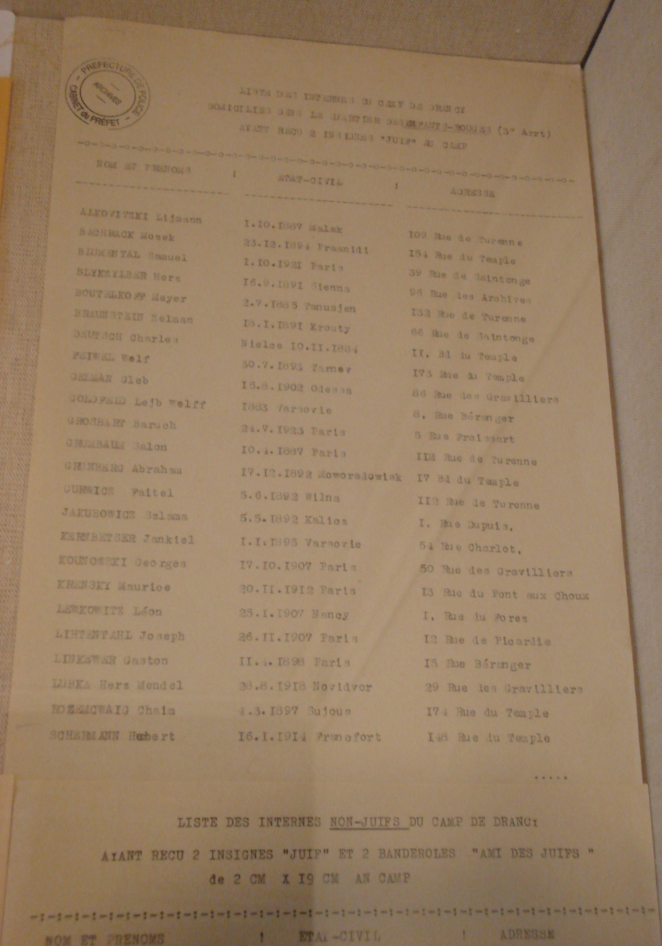

Slide 18
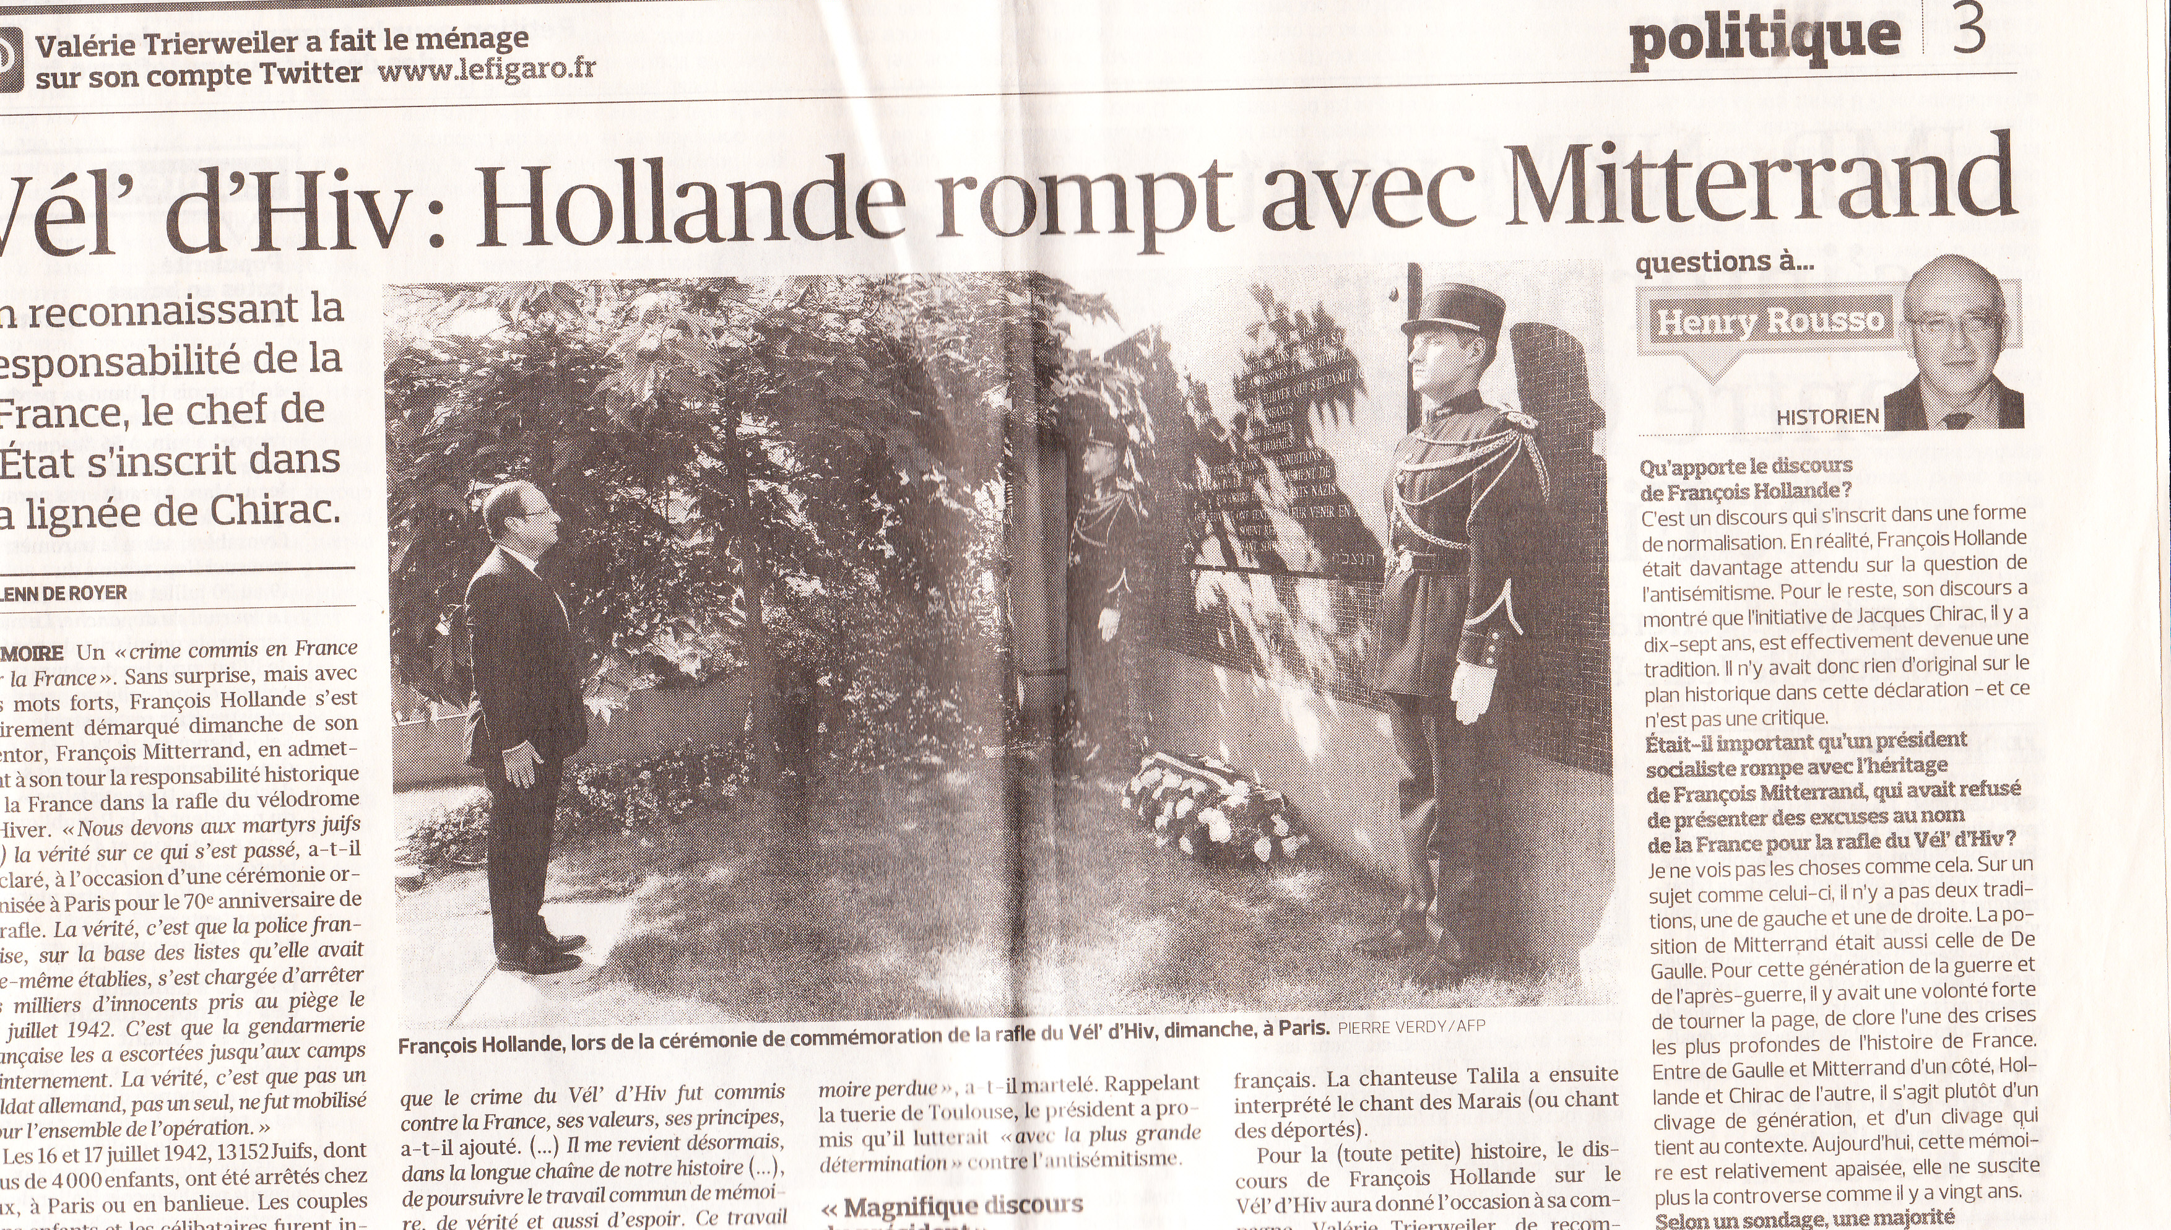
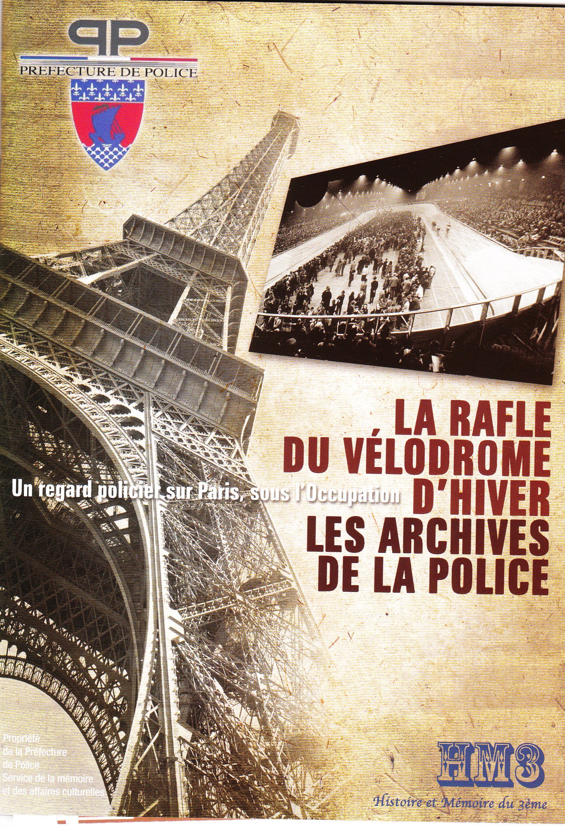

Collaboration
La Rafle Du Vel D’Hiv 70 Years on

Slide 19
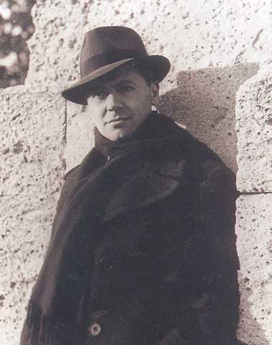
Resistance
Jean Moulin (1899–1943)
Prefect of Chartres, imprisoned by invading Germans
Escaped to London and became a Resistance hero (although his reputation subsequently became more controversial)
Codenamed ‘Max’
Tortured to death by the ‘Butcher of Lyons,’ Klaus Barbie, 1943

Slide 20
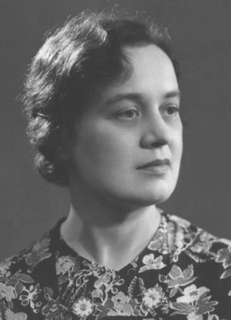
Resistance
Agnès Humbert
Employee at the Musée de l’Homme in Paris
Member of early resistance group
Deported to a German factory

Slide 21
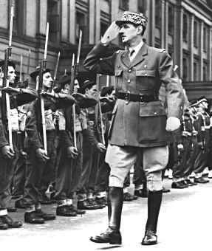
Resistance
General Charles de Gaulle (1890–1970)
Succeeded in uniting the Communist and non-Communist resistance in the Mouvements unis de la Résistance
Heavily dependent on the Allies, yet claimed on 25 August 1944 that Paris had liberated itself…

Slide 22
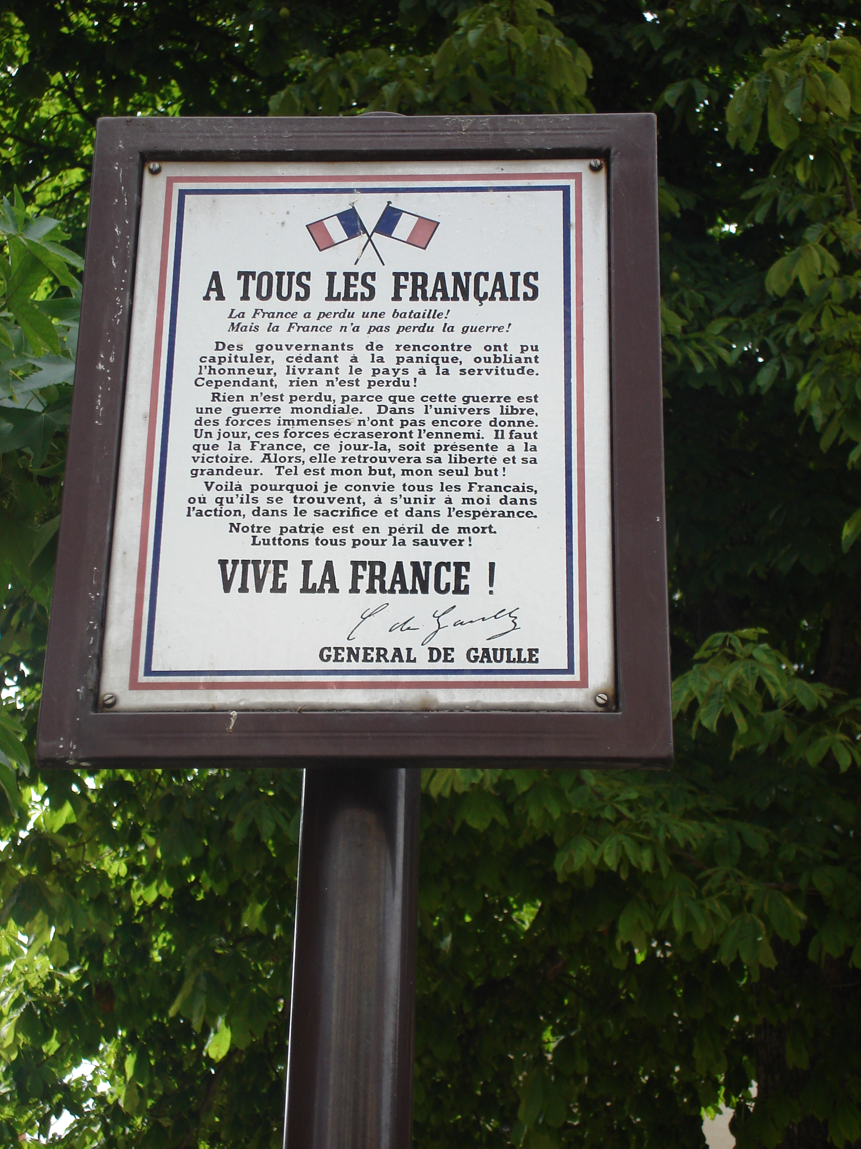
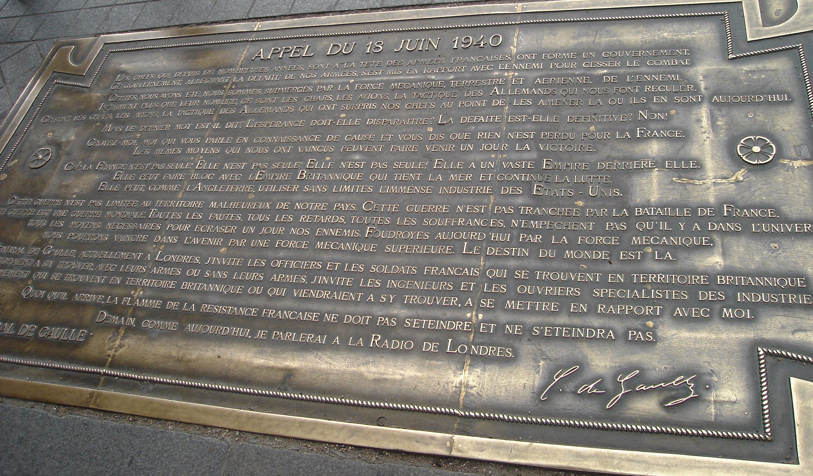

Slide 23
Resistance
General De Gaulle, L’Appel du 18 Juin 1940
‘Certes, nous avons été, nous sommes, submergés par la force mécanique, terrestre et aérienne, de l'ennemi. Infiniment plus que leur nombre, ce sont les chars, les avions, la tactique des Allemands qui nous ont fait reculer. Ce sont les chars, les avions, la tactique des Allemands qui ont surpris nos chefs au point de les amener là où ils en sont aujourd'hui.’

Slide 24
Afterword: The Vichy Syndrome
De Gaulle re-wrote French history in his 25 August 1944 speech; claimed that Vichy was illegal and Republic had never ceased to exist
Creation of ‘Gaullist myth’
Prevailed until 1969: Production of Le Chagrin et la Pitié and 1972: Publication of Robert O. Paxton’s Vichy France: Old Guard and New Order
Henry Rousso coined the term ‘the Vichy syndrome’ in 1981

