Slide 1
Modern and Contemporary France Week 5, Term 2 The French Education System I: Pre-university education David Lees

Slide 2
Lecture outline
Introduction: French education system from the British perspective
Education from the Revolution to the Third Republic: towards free education for all
Education from Fourth Republic to Pompidou: a ‘common’ education?
Education since Giscard d’Estaing: consolidation and development of education system
Problems and Challenges since Giscard
Conclusions: plus ça change, plus c’est la même chose?

Slide 3
Introduction: French education system from the British perspective
‘Expressed in the very language of the teacher and Monsieur le Directeur when they welcomed me, as a parent, into la communauté scolaire and embedded in the things they chose to teach my children was a morality inherited from the values of the Revolution. This morality- conveyed through words like solidarité, collectivité and laïcité- was generally reasonable, but rarely inspiring. It excluded all those who were attached to values like cultural diversity, spirituality or, in my case, originality and free-thinking.’
Lucy Wadham, The Secret Life of France (London: Faber and Faber, 2009) p.76

Slide 4
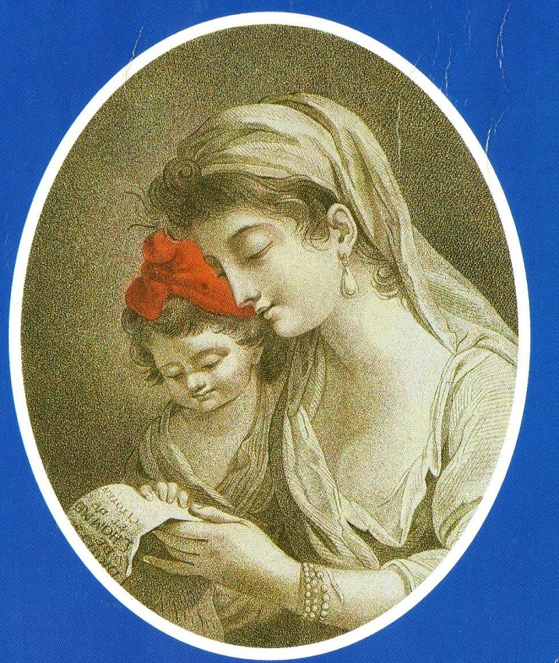
Education from the Revolution to the Third Republic: towards free education for all
Up to Revolution (1789), education in hands of Catholic Church.
1792: Condorcet proposes that education should be "national" (i.e. provided by State): the republican tradition in French education.
(split between ‘liberal’ and ‘total’ approaches to education)

Slide 5
Napoleon adopts principle of State education for secondary level, but as a means of social control, designed to produce "des citoyens attachés à leur religion, à leur prince, à leur patrie et à leur famille” (decree of 17/3/1808)
Napoleon’s legacy of powerful central administration (though primary and women’s schooling left in hands of Church).

Slide 6
Network of primary schooling continued to spread, particularly from 1833 under Guizot, who saw in it an instrument for the ‘gouvernement des esprits’
1848: Second Republic – bold blueprints
1850: Loi Falloux: clerical and conservative backlash

Slide 7
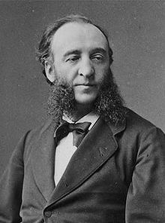
Jules Ferry's legislation of 1882: introducing free, obligatory and secular primary education for both sexes from ages 6-13.
Principle of laïcité
Reformers of 1880's setting out to "faire disparaître la dernière, la plus redoutable des inégalités qui viennent de la naissance, l'inégalité de l'éducation" (J.Ferry, 10/4/1870).

Slide 8
Great mass of population:
écoles primaires [certificat d'études at 12] > world of work.
[Option for better pupils of further practical schooling, integrated into the primary set-up - either cours complémentaires or école primaire supérieure]
Upper and upper middle classes:
"petites classes" of lycées > lycées > baccalauréat [at 18]
(secondary education still fee-paying up until 1930s)
(N.B. Ferry in 1880s had already strengthened the position of the petites classes, and consolidated their distinction from the mass primary sector)

Slide 9
Education from Fourth Republic to Pompidou: a ‘common’ education?
Various reform proposals:
From 1918: movements for an école unique (though struggles as to who would control it)
1944-1947: landmark Langevin-Wallon commission and report

Slide 10
Reforms 1959-1975
Response to:
social demand;
demographic changes (baby boom);
government perception of changing economic prospects and requirements.

Slide 11
(i). 1959 (under de Gaulle): raising school leaving age to 16 (coming into effect in 1967).
(ii). 1963 (under de Gaulle): institution of ‘collège d’enseignement secondaire’ designed to accommodate all pupils between 11 and 15, divided nonetheless into three sections: a) long ‘general’ curriculum, classical or modern; b) short ‘general’ curriculum, modern; c) practical transition stream.
(iii). 1975 (under Giscard d’Estaing): Haby reform instituting ‘collège unique’ in which all pupils 11-15 follow the same broad ‘common trunk’.

Slide 12
Education since Giscard d’Estaing: consolidation and development of education system
1960: 3.5 million pupils in secondary education
1980: 5.5 million pupils in secondary education
But also, statistics in 1980s showing that:
working-class children had 1 in 4 chance of getting baccalauréat
children of managers and teachers had 3 in 4 chance of getting baccalauréat...
Major structural reform not matched by adequate reflection on curriculum reform (despite Giscard’s stated aspirations for the ‘définition d’un savoir commun’)

Slide 13
Consolidation of French educational system, 1977-
3 levels after nursery school and prior to university - écoles (primaires), collèges, lycées, respectively 5, 4, 3 years.

Slide 14
Ecole maternelle: 2-6 years.
Ecole (primaire): 6-11 years.

Slide 15
Premier cycle du second degré:
Collège: 11-15 years (6e to 3e) [brevet at end of 3e]
Broadly common trunk, though some options in last two years.
> ORIENTATION. "Travaillez, sinon vous serez orientés...".
(some orientation taking place before)

Slide 16
Second cycle du second degré
Lycée professionnel:
Certificat d'Aptitude Professionnelle (CAP - 3 years from 4e [13-16])
Brevet d'Etudes Professionnelles (BEP - 2 years from 2e [15-17])
(Both second cycle court)
Baccalauréat professionnel (since 1985)
Lycée d’enseignement général: 15-18.
Baccalauréat

Slide 17
Classes and ages (at rentrée).
6e 11
5e 12
4e 13
3e 14
**
2e 15
1ère 16
Terminale 17
>leave lycée at approx. 18 yrs.
[But N.B. possibility of redoublement]

Slide 18
Baccalauréat’s symbolic importance:
“l’un des blocs de granit sur lequel la République s’est faite” (Xavier Darcos, April 2008)
"un monument historique national (...), un rite de passage que nous devons conserver" (Jack Lang, June 2011)
‘le sas symbolique d'accès à l'université et l'examen emblématique du système égalitaire sur lequel repose l'éducation nationale (...), il demeure pour les jeunes et leur famille un rite de passage sacralisé vers l'âge adulte’ (Le Monde editorial, June 2011)

Slide 19
Current system for ‘generalist’ bacs (since 1994):
littéraire (L)
économique et social (ES)
scientifique (S)
(though within these, students can choose specialities; there in now a substantially common block for 2e, which is then subject to progressive differentiation)
Note: there are also bacs technologiques and bacs professionnels (see subsequent lecture on key education statistics for details on uptake)

Slide 20
Principles of baccalaureat reform carried through under Luc Chatel from Autumn 2010:
Greater common trunk in options for 2e (approx. 84%) and 1ere (approx 60%), before accentuated specialisation in terminale
2 hours per week of targetted ‘support and accompaniment’
Endeavour to reinforce literary bac (notably through emphasis on foreign languages and ‘internationalisation)
Some autonomy granted to school in determining overall curriculum specialities/options

Slide 21
Baccalauréat gives right to entry into university.
But N.B. strongest students tend not to go to university: they take ‘preparatory classes’ (hypokhâgne and khâgne) to prepare for ‘concours’ for ‘grandes écoles’.

Slide 22
Problems and Challenges since Giscard
State versus ‘Private’ Education
Recognition of local specificity and limited autonomy
Cultural difference and cultural integration
Rising levels of Qualification: Managing Further Expansion.
Notes:
abbrev vs fr425

Slide 23
STATE V. ‘PRIVATE’ SCHOOLING...
95% of French private schools Catholic.
But N.B. Debré Law (1959): contrat d'association, etc..
[Guermeur Law (1977)]
Mitterrand's 1981 objective: a "grand service public unifié et laïque de l'Education Nationale".
But July 1984: massive demonstration against Socialist plans to curb autonomy of private schooling; resignation of Education Minister Alain Savary.

Slide 24
Was the Catholicism - laïcité polemic a smokescreen?
a). In 1986, 11% of French people practising Catholics, but 16% of pupils were in private education.
[2008: 9% practicing Catholics; 17% in private education]
In a 1982 poll, religious factors came only sixth in the list of motives inciting parents to send children to private schools.
b). Educational "freedom" supported by 23% of population in 1946; 46% in 1951; 77% in 1974......
c). Approx. 50% French families have recourse at some point to private education ("la deuxième école") [study by G. Langouët & A. Léger published in 1997]

Slide 25
N.B. great difference in fees compared to UK, due to contracts with State: average annual fees in 2008 336€ in primary schools; 427€ in collège; 667€ in lycée (though significant variations notably in Paris).
Contrat d’association means State pays staffing costs and regional/departmental councils pay running costs.
1992: les accords Lang - Cloupet (la paix scolaire...)
But also N.B. 1993-4: aborted reform of Loi Falloux.

Slide 26
Zones d'éducation prioritaire [ZEPs] (from 1981).
‘Relaunched’ by education minister Claude Allègre, 1997-2000, who also launched associated category of Réseaux d’éducation prioritaire
Relabelled in 2005-6 ‘Réseaux d’ambition réussite’ (for most disadvantaged collèges and feeder primary schools) and ‘Réseaux de réussite scolaire’.
In 2009, out of 5,261 state collèges, 254 were placed in category of ‘réseaux d’ambition réussite’ and 821 in category of ‘réseaux de réussite scolaire’
(The term ‘positive discrimination’ is now officially used to describe this policy – see http://www.education.gouv.fr/cid187/l-education-prioritaire.html )

Slide 27
April 2010: launch of ‘Clair’ programming, targetting (only) most problematic institutions, and giving greater autonomy in recruiting and managing school.
2007-2011: creation of ‘internats d’excellence’ (for ‘motivated’ pupils in underperforming schools) and ‘établissements de réinsertion scolaire’
2012: other challenges to ‘stigmatizing’ function of ZEP system – movement to UK style ‘pupil premium’?

Slide 28
Idea of projets d'établissement
Finally inscribed in Lionel Jospin's major education bill of 1989.
(Savary's real objective on promoting idea in 1984 to integrate `private' secondary education into a more flexible and diverse state system)
(2010-2012: lycée reforms allowing greater scope for institutions to inflect curriculum development at margins)

Slide 29
Cultural differences?
"l'affaire du voile", Creil, October 1989.
transgressing principle of laïcité.
le droit à la différence?
Commission Stasi, 2003
Law on laïcité of 2004 forbidding ‘ostensible’ religious signs in schools.
Difficulties of application; national and international reverberations.

Slide 30
Conclusions
Continued attempts at reform since Giscard
Some emulation of British school system
BUT some considerable differences retained (e.g. laïcité; importance of bac over brevet; role of State in private school sector)

