Slide 1
Modern and Contemporary France
Week 2, Term 2
State Control of the Media II: Television from de Gaulle to Hollande
David Lees

Slide 2
Lecture outline
Introduction: French television viewed by the British
Development of television in France
State control of the television in France
Conclusions

Slide 3
Introduction
‘The British are excellent watchers and makers of television. The French, on the other hand, with their love of grand ideas and their contempt for reality, make execrable television.’
Lucy Wadham, The Secret Life of France (London: Faber and Faber, 2009)

Slide 4
Development of French television
1950s (Fourth Republic): very little take-up
1960s-70s (de Gaulle/Pompidou): increase in popularity; heavy State control
1970s-1980s (Giscard d’Estaing): move towards diversity; less State control
1980s-1990s (Mitterrand): Privatisation of some channels; buffer organisation for State control
1990s-2000s (Mitterrand/Chirac): Increasing diversity, changes in nature of ‘buffer’ organisation
2000s-2010s (Sarkozy/Hollande): Some State intervention, further changes to the medium

Slide 5
Stage 1. 1945-1957. Cinema/radio/record
1950: 297 homes possessing l'étrange lucarne or le petit écran
Growing attraction exerted by le direct
    Tour de France
    Coronation of English queen (!)
    Theatre
    TV not central to governmental news agenda as such

Slide 6
Stage 2. 1960-1973 (approx.). Rise of TV to status of mass medium
    [1% of households with TV in 1954; 6% in 1957; 13% in 1960; 40% in 1965; 66% in 1969...]
  Diversification of programmes
      Feuilletons..; development of ‘genres’ (information, fiction, entertainment)
  Emergence of grille (schedules)
      Tuesday evening – theatre; Wednesday – childrens’ programming; Friday – new magazines...
  Defining mission of "public service“
      ‘Inform, educate, cultivate, entertain’
  Heavy state control of broadcasting
      Television journalism as ‘la voix de la France’ (Pompidou)
      Tradional morality upheld (newscaster’s knees…)
      May 68…
    (second channel introduced in 1964; becoming Antenne 2 in 1974 [now France 2]; third channel, France Régions 3 (FR3) introduced in 1972)

Slide 7
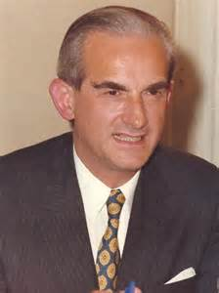
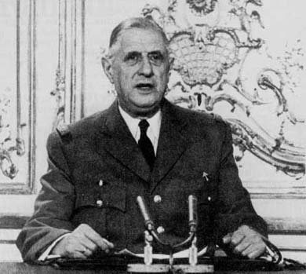
De Gaulle appears on French television news, April 1961
Alain Peyrefitte, Minister for Information, 1962-1966

Slide 8
Stage 3. 1973-1981. Banalisation of TV
1974: Splitting up of ORTF (Office de Radio-Diffusion-Télévision Française)
Cahiers de charges
Followed by rising effects of competition
      for share of license fee
      for share of advertising (even though State TV)
      some perverse ‘counterprogramming’
      lack of quality fiction
      relative disdain for television among artistic creators

Slide 9
View of television critic of Le Monde after a visit to London in 1980:
‘Britain, for a telly-lover, is sheer joy! You press a button, and you have a feeling of uncorking a champagne bottle, of being bathed in a cascade of wit, fun and imagination unknown on our side of the Channel. What light-years separate London from Paris!’

Slide 10
Stage 4. 1981-1988: A WATERSHED
a). End of direct State control over public broadcasting (regulation taken over by ‘buffer’ institution:
  Haute Autorité de la Communication audiovisuelle (1982-1986)
  Commission nationale de la communication et des libertés (1986-1989)
  Conseil supérieur de l'audiovisuel (CSA) (1989 to present).
b). End of State commercial monopoly over French TV and radio broadcasting > first commercial channels:
  Canal+, La Cinq & TV6 (future M6) by 1986
  Privatisation of TF1 in 1987.
  Only remaining state channels were France 2 and FR3.
Continuing rise in volume of TV; intensification of ratings wars (‘la dictature de l’audimat’)
⇨ 1991: Collapse of La Cinq (‘toutes les chaînes sont mortelles...’)

Slide 11
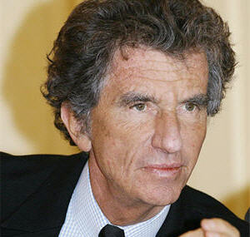
Jack Lang, Minister for Culture, 1981-86; 1988-92

Slide 12
Stage 5. ca. 1992-2005.
a). Multiplication/fragmentation of audiovisual media
  Satellite bouquets (only remaining one now CanelSatellite)
  Cable and broadband provision provision
b). Governmental efforts to strengthen identity of public service pole of broadcasting:
  Launching of cultural channel Arte (1992) and educational channel La Cinquième (1994) [subsequently renamed France Cinq from 2002]
  France 2, France 3 and La Cinquième brought together under a common holding company France-télévisions (2000); now also includes France 4 (TNT channel)
  Reduction of advertising on public channels from 12 to 10 mins (2000), then to 8 mins (2001).

Slide 13
Stage 6. 2005 – 2014
2005: Launch of télévision numérique terrestre (TNT). CSA chooses channels (18 free channels, with 5 public channels plus 2 parliamentary channels); 85% coverage by 2008.
Generalization of converging ‘screen culture’
Sarkozy’s audiovisual reforms of 2008:
  Abolishing advertising on State television programmes in evenings (from 2009)
  Nomination of head of France Télévisions by President of Republic (subsequently revoked in 2013)

Slide 14
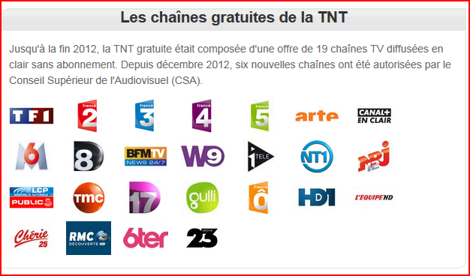

Slide 15
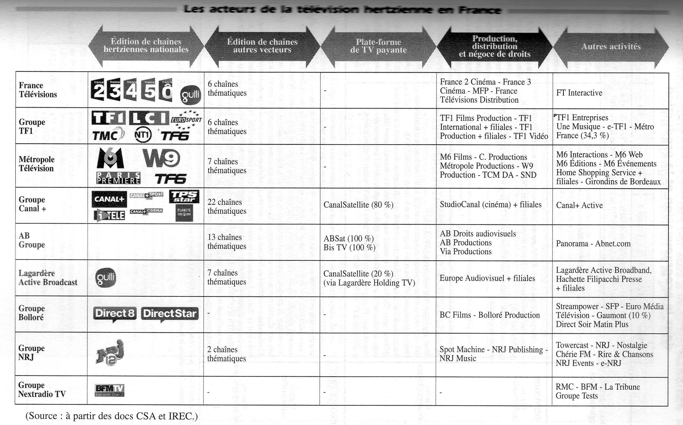
Source: Balle, Médias et Sociétés, 2011, p. 437

Slide 16
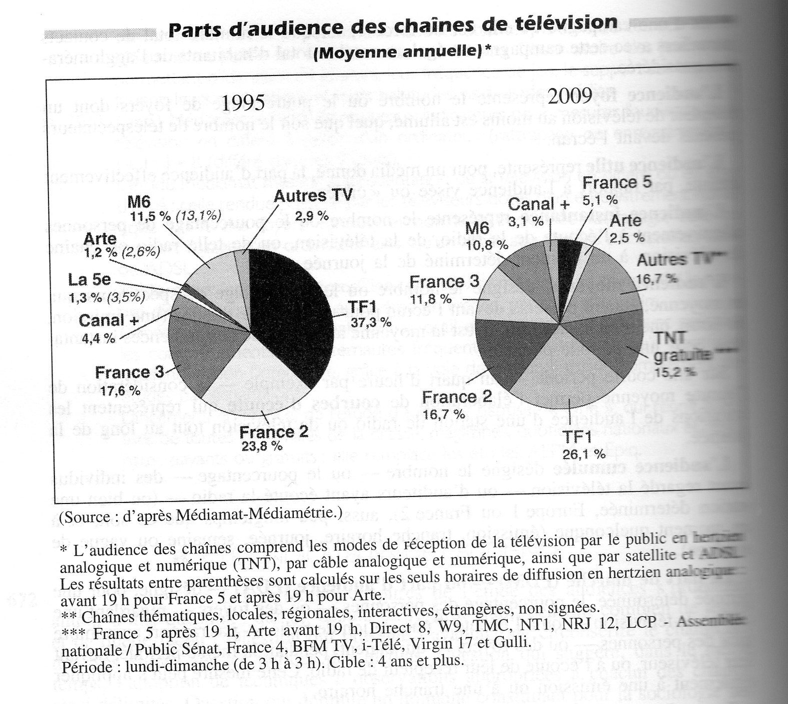
Source: Balle, Médias et Sociétés, 2011, p. 716

Slide 17
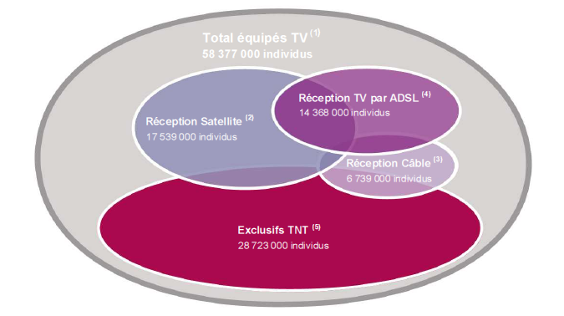
Television in France, January 2011 (Médiamétrie figures)

Slide 18
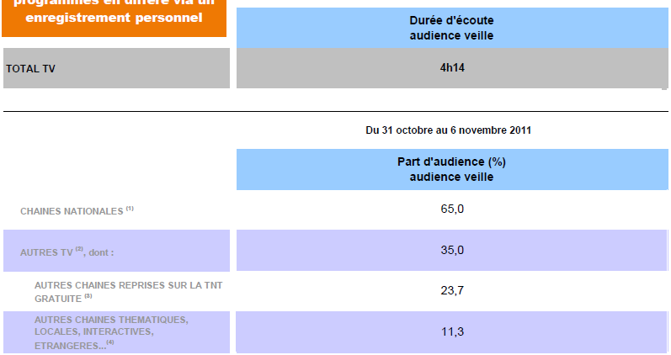
TV viewing figures (31 Oct to 6 Nov 2011). [Source: Mediametrie –
http://www.mediametrie.fr/television/

Slide 19
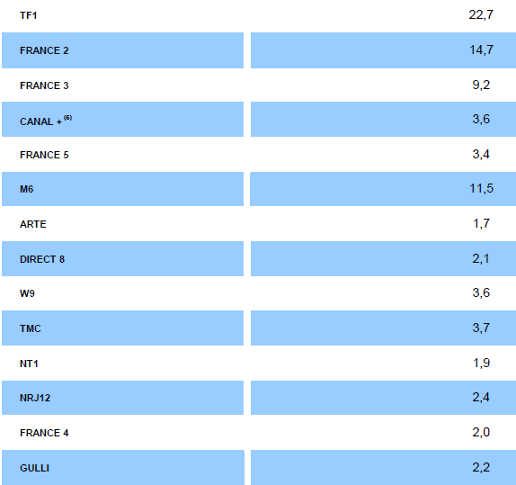
TV viewing figures (31 Oct to 6 Nov 2011)

Slide 20
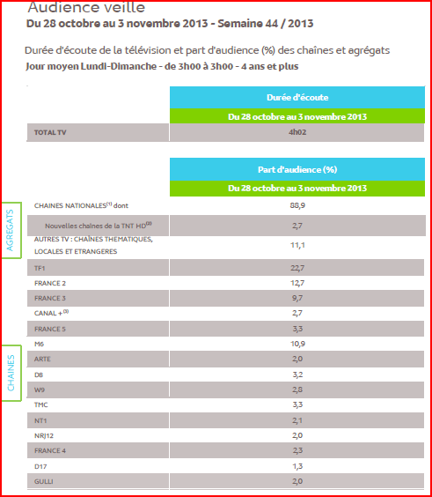
Figures from
http://www.mediametrie.fr

Slide 21
Conclusions
Change in viewing patterns and behaviour of French
More subtle State control?
Television still one of many art forms in France, still lacks same status and quality of British TV

