Slide 1
Modern and Contemporary France
Week 1, Term 2
State Control of the Media I: Vichy and the media
David Lees

Slide 2
Lecture outline
Context: Film propaganda before Vichy
The Vichy propaganda machine
‘Screening reality’? Vichy and control of the news
Conclusions: anticipating state control of the media post-Vichy

Slide 3

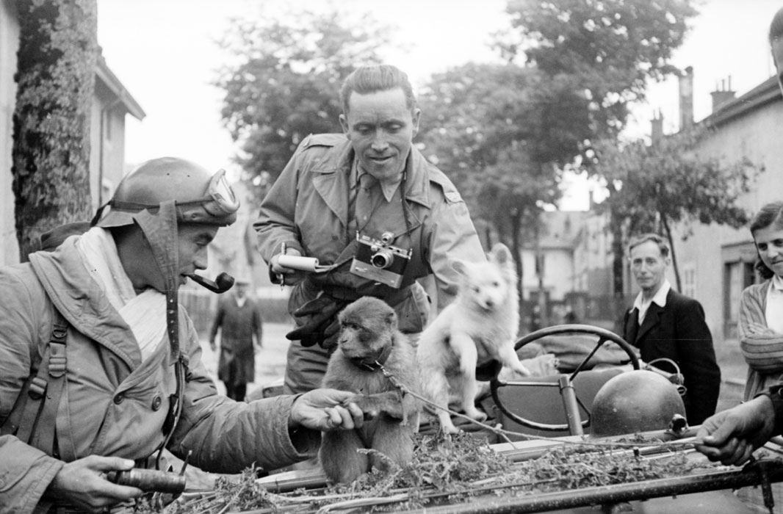
Context: Film propaganda before Vichy

Slide 4
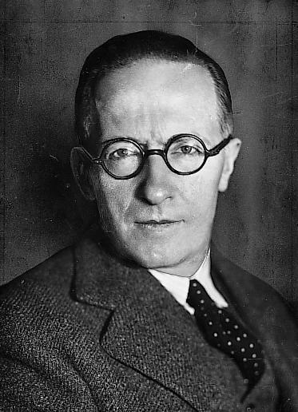
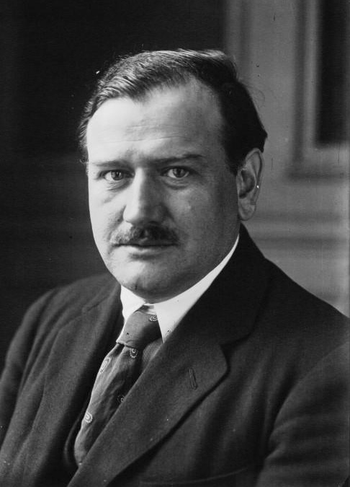
Key figures pre-Vichy

Slide 5
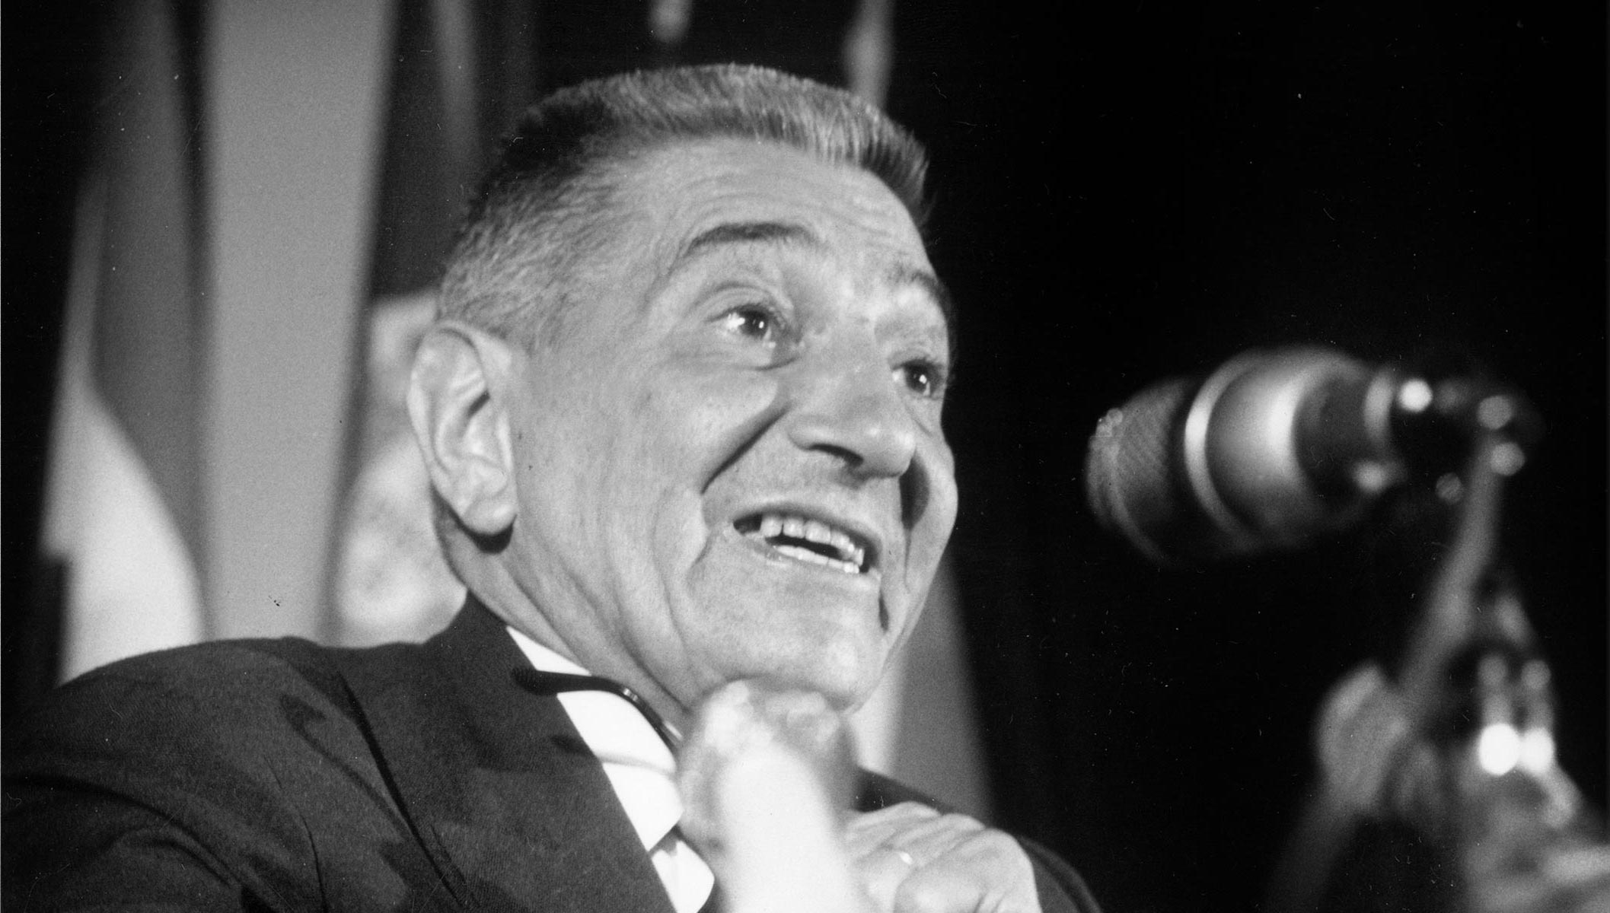
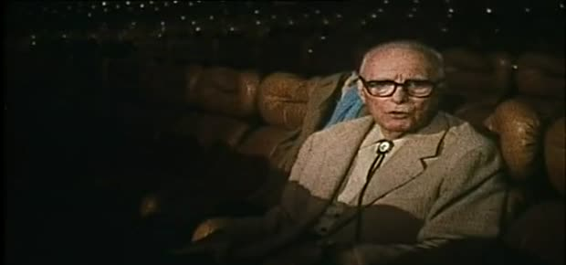
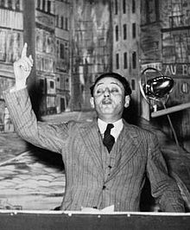
The Vichy propaganda machine

Slide 6
‘Screening reality’? Vichy and the news
Newsreel | Dates | Director
France-Actualités Pathé-Gaumont | October 1940-August 1942 (shown exclusively in Unoccupied Zone) | Philippe Este
France-Actualités | August 1942-August 1944 (shown across whole country) | Henri Clerc
Actualités-Mondiales | August 1940-August 1944 (shown exclusively in Occupied Zone) | Heinrich von Weyrauch

Slide 7
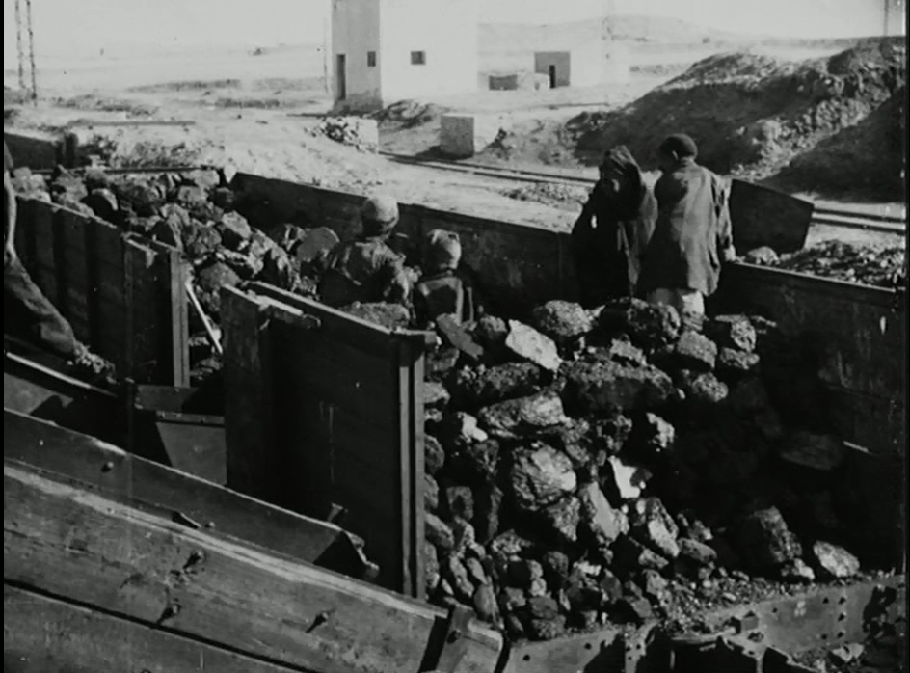
Méditerranée/Niger (1941) © CNC, film number: 94744

Slide 8
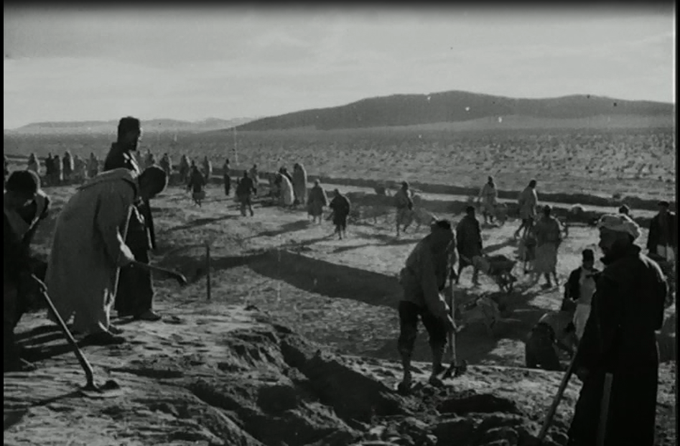
Méditerranée/Niger (1941) © CNC film number: 94744

Slide 9
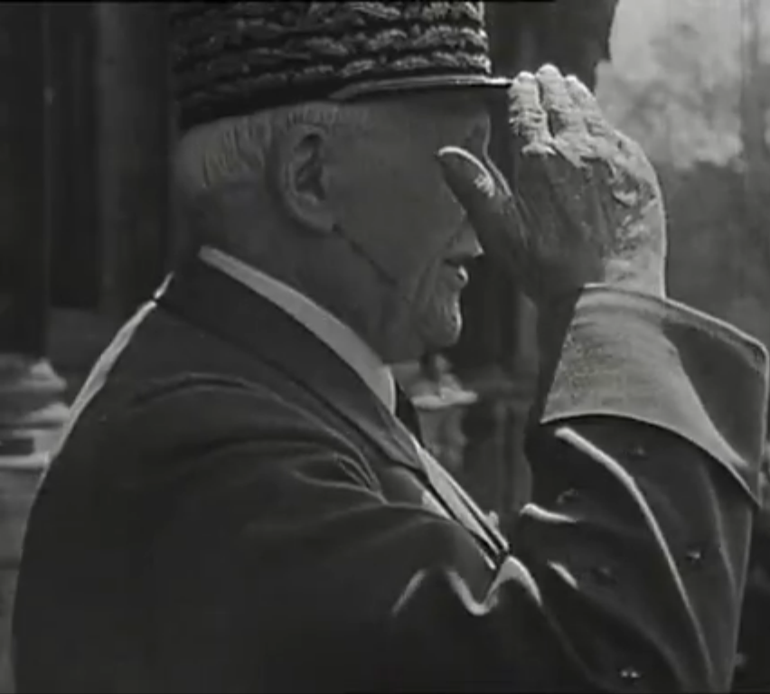
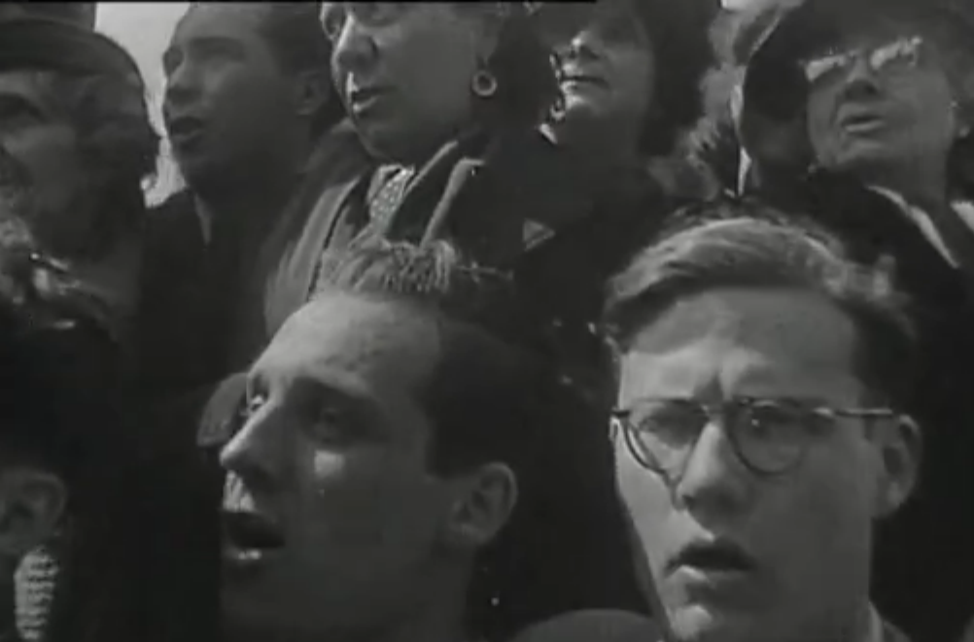
‘Le Maréchal Pétain à Paris’, France-Actualités, 28/04/1944

