Slide 1
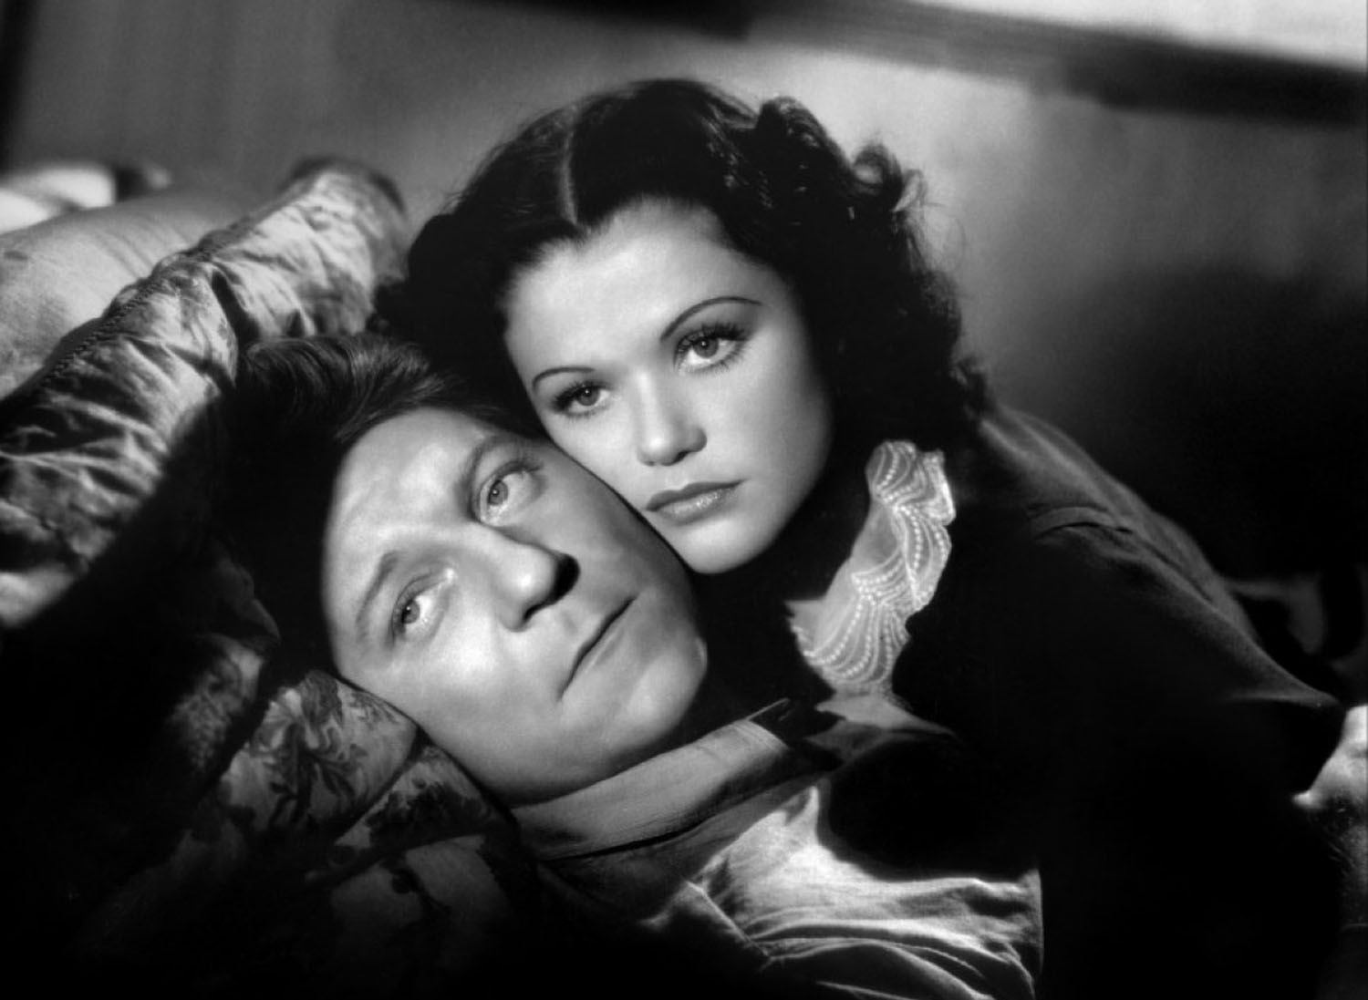
La Bête humaine (Jean Renoir, 1938)

Slide 2
Approaches to the film
Adaptation studies: La Bête humaine as adaptation of a novel by Émile Zola
An auteurist approach: La Bête humaine as a film by Jean Renoir
Socio-historical approach: a film from the late 1930s
Star studies: a Jean Gabin film
Film as film: close analysis of a sequence

Slide 3
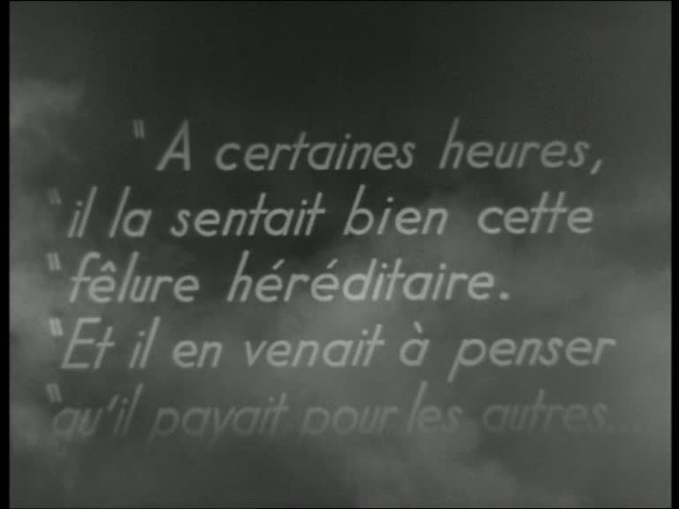

Slide 4
Framing La Bête humaine
A certaines heures, il la sentait bien, cette fêlure héréditaire. Et il en venait à penser qu’il payait pour les autres… les pères, les grand-pères qui avaient bu… les générations d’ivrognes dont il était le sang gâté. Son crâne éclatait sous l’effort, dans cette angoisse d’un homme poussé à des actes où sa volonté n’était pour rien, et dont la cause en lui avait disparu.
‘Pauvre vieux. Il a dû souffrir pour en arriver là.’

Slide 5

Adaptation of Émile Zola’s novel
La Bête humaine (1889-90)
Volume seventeen of Les Rougon-Macquart: L’histoire naturelle et sociale d’une famille sous le Second Empire

Slide 6
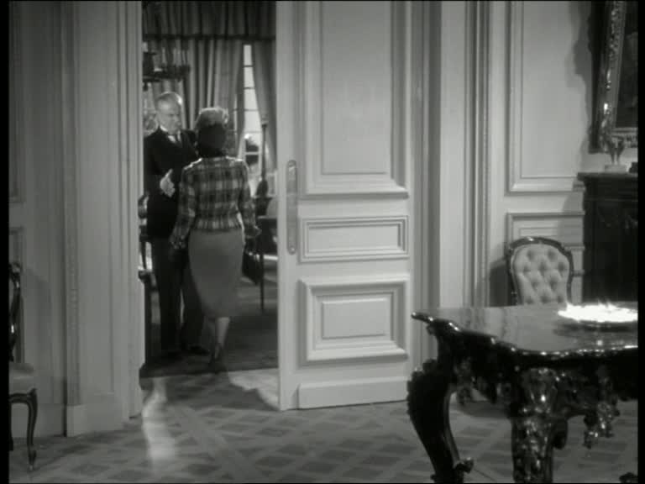
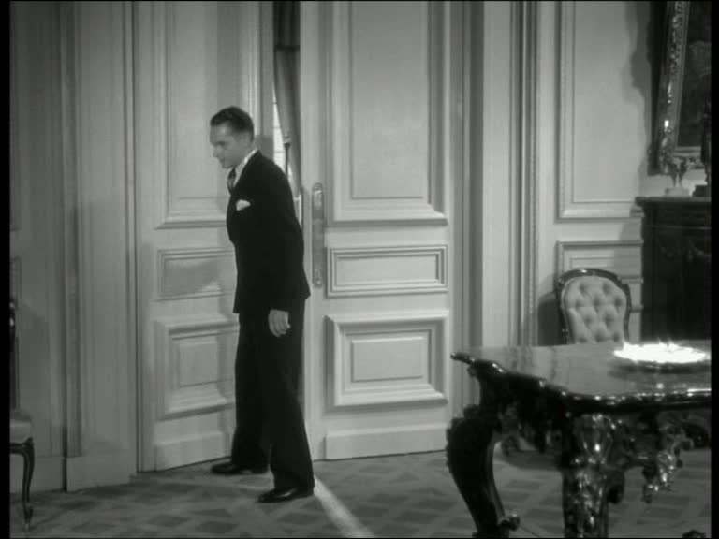

Slide 7
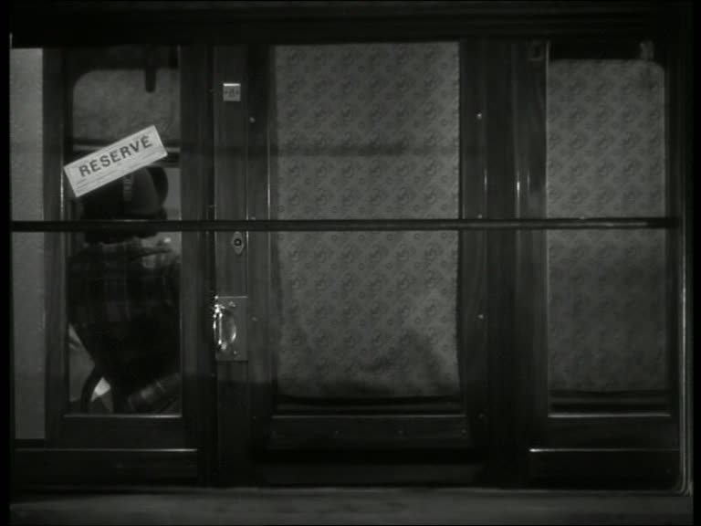

Slide 8
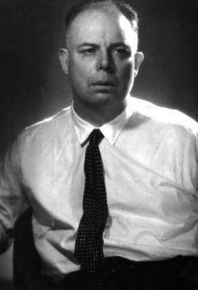
La Bête humaine: a film by Jean Renoir
Renoir an interesting case study for the ‘politique des auteurs’
Films include:
La Vie est à nous (1936)
Le Crime de Monsieur Lange (1936)
La Marseillaise (1938)
La Règle du jeu (1939)

Slide 9
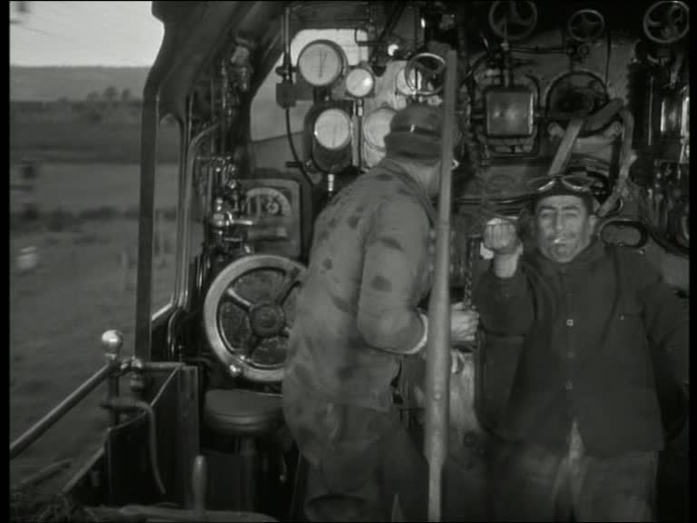

Slide 10
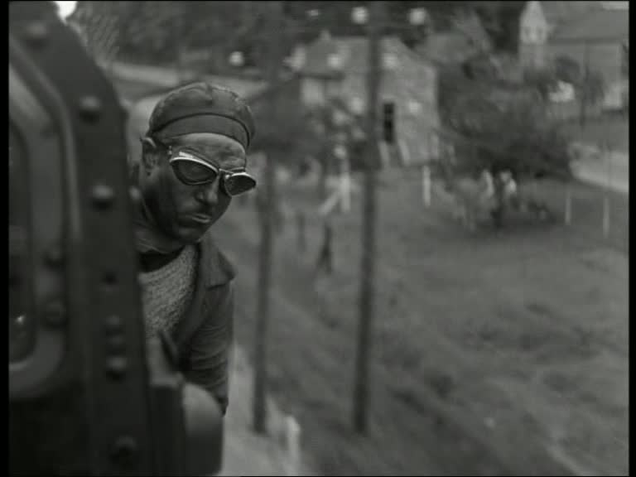

Slide 11
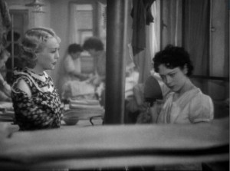

Slide 12
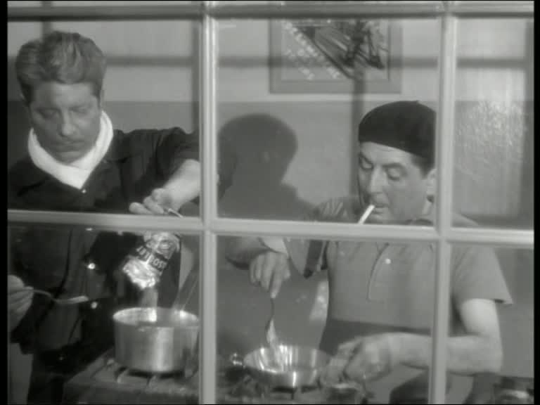

Slide 13
Timeline 1929-38
October 1929 Wall Street Crash is the catalyst for the Great Depression (6 million unemployed in Germany; 3 million in the U.K.)
January 1933 Hitler becomes Reichskanzler; Germany leaves the League of Nations
February 1934 Right-Wing Riots in Paris attack the Chambre des députés. Daladier's government resigns.
1936: 756,000 unemployed in France; Renoir: Le Crime de Monsieur Lange and La Vie est à nous
March 1936: Hitler remilitarises the Rhineland
April-May 1936: Popular Front Government elected (including the SFIO, PCF, and some Radicals);Léon Blum becomes Prime Minister in France's first socialist-led administration
July 1936 Military in Spain rebel against the Popular Front Republican government elected in February; the French Popular Front government stands on the sidelines
June 1937 Renoir: La Grande Illusion; Fall of the Popular Front Government
February 1938 Renoir, La Marseillaise

Slide 14
Timeline 1938-39
March 1938: Anschluß: annexation of Austria by Germany
Aug-Sep 1938 Filming of La Bête humaine; France: industrial production is 17% lower than 1928
September 1938 Munich accords signed by Chamberlain and Daladier, ceding German-speaking territories in Czechoslovakia to Hitler: ‘Peace in our time’.
December 1938 La Bête humaine opens in Paris
March 1939 With the help of Hitler and Mussolini, Franco's Phalangists finally defeat the Republicans in Spain. Hitler invades Czechoslovakia
July 1939 Renoir, La Règle du jeu;
September 1939: Hitler invades Poland; France and Britain deliver an ultimatum to Hitler: War is declared.

Slide 15


Slide 16
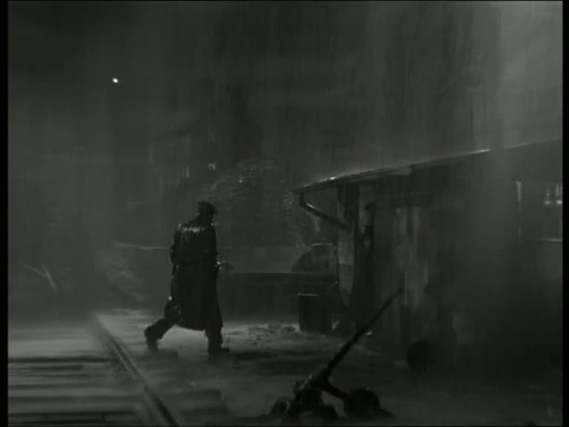
Poetic realism
Other films include:
Pépé le Moko (Julien Duvivier, 1937)
Le Quai des brumes (Marcel Carné, 1938)
Le Jour se lève (Marcel Carné, 1939)

Slide 17
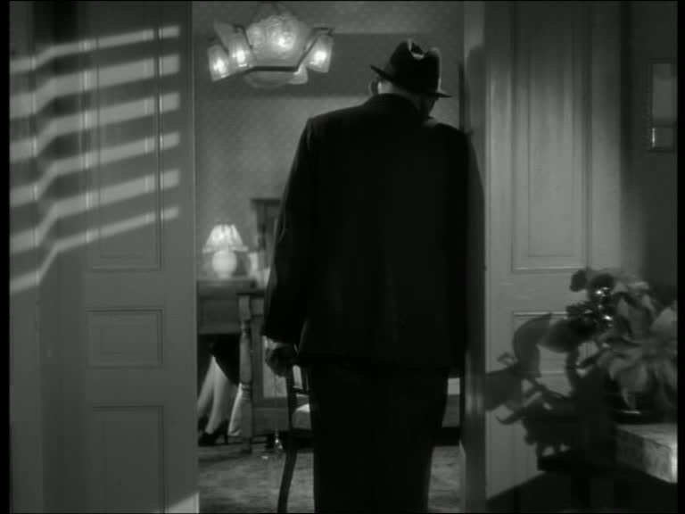
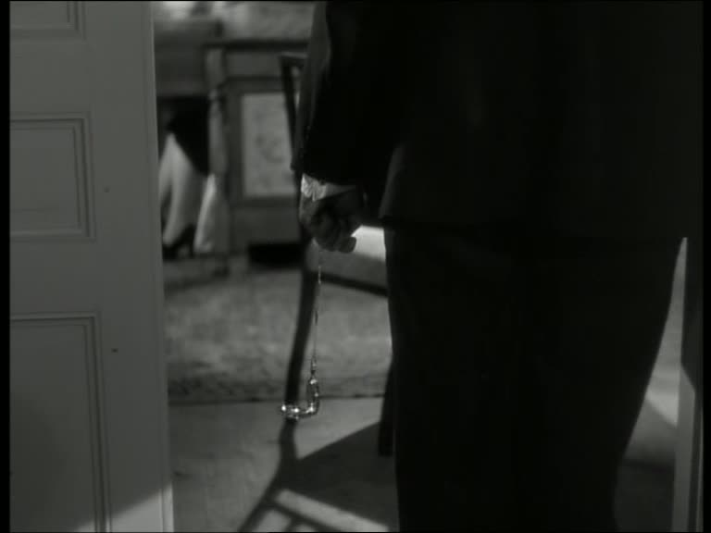
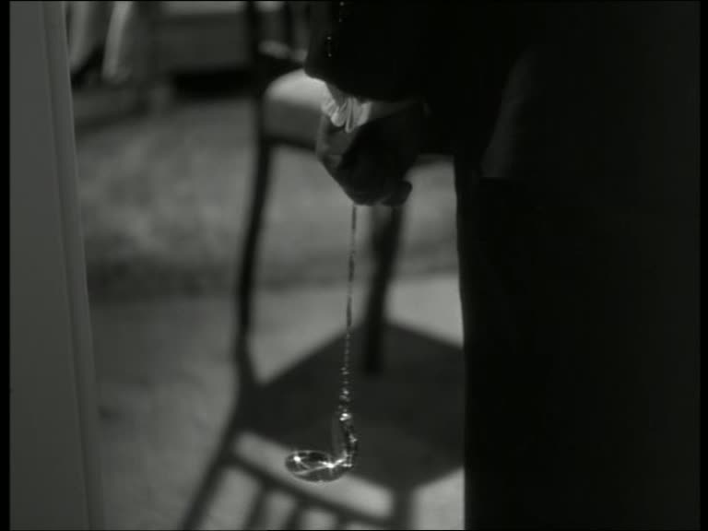

Slide 18
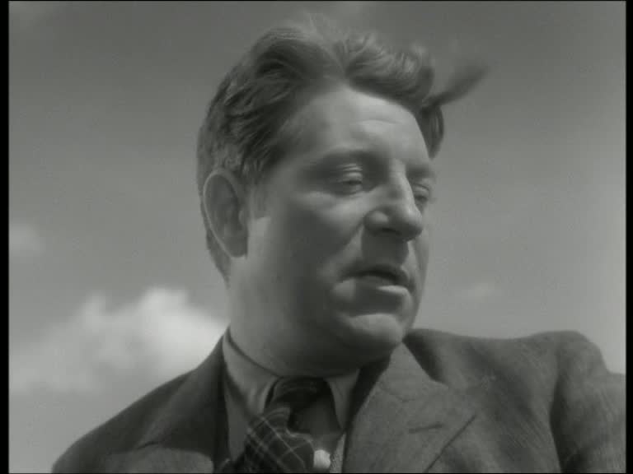
A Jean Gabin film
‘Oedipus in a cloth cap’ (André Bazin)

Slide 19
