Slide 1
Michel Foucault, Surveiller et punir. Naissance de la prison (1975)
Lecture 2 of 2
Dr Oliver Davis
Friday H0.51, 1-2pm

Slide 2
Today’s lecture
Commentary on the remaining excerpt
Systematic reconstruction of Foucault’s argument about ‘disciplinary power’
Discussion of key criticisms and wider relevance

Slide 3
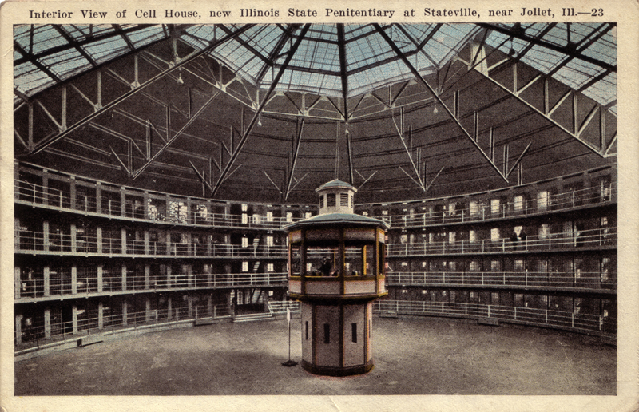
3. ‘Le panoptisme’ (pp. 228-64)
The Panopticon: ‘le diagramme d’un mécanisme de pouvoir ramené à sa forme idéale’ (SP, 239) and ‘une figure de technologie politique’ (SP, 239).

Slide 4
Plague-containment: a local ‘state of emergency’
‘un strict quadrillage spatial’ (SP, 228)
  The Algerian War of Independence (1954-62)
a hierarchized regime of inspection:
  les habitants
  le syndic
  les intendants
  le maire
continuous record-keeping and reporting

Slide 5
From plague-containment to the Panopticon
an assertion of continuity (e.g. SP, 233)
Jeremy Bentham (1748-1832) and utilitarianism
cellular arrangement: the end of ‘la foule’
solves the ‘problem’ of reciprocity:
  ‘Il est vu, mais il ne voit pas; objet d’une information, jamais sujet dans une communication.’ (SP, 234)
economic savings in prisoners’ uncertainty

Slide 6
From the Panopticon to ‘Panopticism’
The Panopticon:
  ‘un schéma’ (SP, 240)
  ‘une figure de technologie politique’ (SP, 235)
  ‘un dispositif’ (SP, 235)
  ‘une machine’ (SP, 235)
  ‘un modèle généralisable’ (SP, 239)
  ‘le diagramme d’un mécanisme de pouvoir ramené à sa forme idéale’ (SP, 239)
Panopticism / disciplinary power / ‘Panoptic power’ (Dews)

Slide 7
Disciplinary power: a reconstruction
‘sovereign power’ => disciplinary power
context of demographic growth and industrial organization of labour
Max Weber: from ‘charismatic’ to ‘legal-rational’ domination
the ‘softening up’ of individuals for the factory
the production of ‘corps dociles’ (docile bodies)
power as ‘productive’? But not only productive.

Slide 8
Criticisms
no room for resistance in Foucault’s account
Giddens: Foucault confuses different kinds of institution
the lack of an account of internalization of the norm

