Slide 1
Gender and Sexuality
Dr Susannah Wilson
s.m.wilson@warwick.ac.uk

Slide 2
Today’s lecture
Feminism
The critical implications of feminism
Gay/lesbian critcism
Queer theory

Slide 3
Feminism
‘First wave’ feminists
Simone de Beauvoir, Le Deuxième sexe (1949)
Virginia Woolf, ‘A Room of One’s Own’ (1929)
‘Second wave’ feminism = women’s liberation movement (1960s)
‘French’ feminism: Luce Irigaray (Belgian); Julia Kristeva (Bulgarian); Hélène Cixous (born in Algeria)

Slide 4
Feminism
‘Anglo-American’ feminism
Elaine Showalter, ‘Toward a Feminist Poetics’ (1979)
Sandra Gilbert and Susan Gubar, The Madwoman in the Attic (1979)
Alison Finch, Women’s Writing in Nineteenth-Century France (2000)

Slide 5
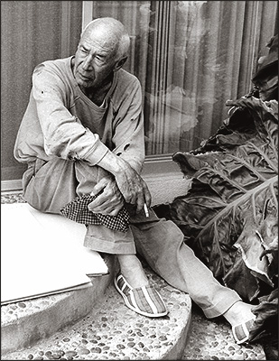
Henry Miller

Slide 6


Slide 7

George Orwell, ‘Inside the Whale’ (1940)

Slide 8
[R]ead him for five pages, ten pages, and you feel the peculiar relief that comes not so much from understanding as from being understood. 'He knows all about me,’ you feel; 'he wrote this specially for me.’ It is as though you could hear a voice speaking to you, a friendly American voice, with no humbug in it, no moral purpose, merely an implicit assumption that we are all alike. For the moment you have got away from the lies and simplifications, the stylized, marionette-like quality of ordinary fiction, even quite good fiction, and are dealing with the recognizable experiences of human beings.
From Orwell, ‘Inside the Whale’

Slide 9
Feminist responses
Kate Millett, Sexual Politics (1970)
Jeanette Winterson, Oranges are Not the Only Fruit (1985)
Winterson wrote a review of Renegade: Henry Miller and the Making of “Tropic of Cancer”, by Frederic Turner (Yale University Press, 2012)

Slide 10
Well, what if we accept Turner’s assertion that “Cancer” has travelled from banned took to spiritual classic that tells us “who we are”? A reasonable objection is that “we” cannot include women, unless a woman is comfortable with her identity as a half-witted “piece of tail.”
[…]
There is beauty as well as hatred in “Cancer,” and it deserves its place on the shelf. Yet the question it poses was stupidly buried under censorship in the 1930s, and gleefully swept aside in the permissiveness of the 1960s. Kate Millett asked the question in the 1970s, but the effort to ignore it is prodigious. A new round of mythmaking is ignoring it once more. The question is not art versus pornography or sexuality versus censorship or any question about achievement. The question is: Why do men revel in the degradation of women?
(Winterson)

Slide 11
‘Feminism(s) of difference’
Luce Irigaray, Speculum de l’autre femme (1974)
Shoshana Felman, Yale University
‘Women and Madness: The Critical Phallacy’ (1974)
Originally published in journal Diacritics and widely re-printed since
Analyses Balzac’s short novel, Adieu (1830)

Slide 12
Lesbian/gay criticism
It is obvious that not all literary criticism written by women is feminist; that not all books about women writers are feminist; that feminist writing need not be by women, and that feminist criticism is not directed exclusively at a female readership. Likewise, books about gay writers, or by gay critics, are not necessarily part of lesbian and gay studies, nor are books that are part of this field directed solely at a gay readership or relevant only to gay sexuality.
From Peter Barry, Beginning Theory (2002)

Slide 13
Heteronormativity
The idea that to be ‘normal’ a person should experience a close match between their biological sex, gender identity, sexuality (i.e. attraction to the opposite sex), and gender role.

Slide 14
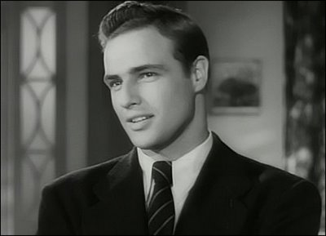
‘Normal Guy’
Male, heterosexual, masculine, assertive, breadwinner, etc.

Slide 15

‘Normal Woman’
Female, heterosexual, feminine, passive/compliant, housewife, etc.

Slide 16
Radical lesbian thinking
Adrienne Rich, ‘Compulsory Heterosexuality and Lesbian Existence’ (1980)
The ‘lesbian continuum’
Monique Wittig, Les Guerillères (1969)

Slide 17
In what senses, then is gender an act? As in other ritual social dramas, the action of gender requires a performance that is repeated. This repetition is at once a re-enactment and re-experiencing of a set of meanings already socially established; and it is the mundane and ritualized form of their legitimation. Although there are individual bodies that enact these significations by becoming stylized into gendered modes, this ‘action’ is a public action. […] [I]ndeed, the performance is effected with the strategic aim of maintaining gender within its binary frame—an aim that cannot be attributed to a subject, but, rather, must be understood to found and consolidate the subject.
Judith Butler, Gender Trouble (1990) p. 97.

Slide 18
queer reading strategies: applied to unearth queer meanings in ostensibly straight texts.
queer writing strategies: applied by authors to convey queer meanings without addressing them explicitly.
recourse to queer reading and writing strategies is particularly relevant under conditions in which a direct treatment of the subject is rendered impossible, for example the presence of taboos or censorship.

Slide 19
example of a queer writing strategy: is the use of code words signalling homosexual activity (e.g. "cottage" or "trade," which have an everyday meaning as well as a subcultural meaning).
example of a queer reading strategy: gender switching (for instance, reading a female character as a male character, or vice versa, in order to decode an ostensibly heterosexual couple as a homosexual couple, as you can convincingly do with the protagonists of Noël Coward's Still Life [or Proust’s A la recherche du temps perdu, the character of Albertine]
Hanna Kubowitz, ‘The Default Reader and a Model of Queer Reading and Writing Strategies Or: Obituary for the Implied Reader’, Style (46: 2) [Summer 2012], pp. 201-228.

