Slide 1
FR118 Strategies for Reading French Texts
History and Contextualization

Slide 2
Today’s lecture
about the theory lectures
what exactly is “a timeless classic”?
three approaches to history and contextualization:
  structuralism: Barthes on Racine
  poststructuralism: the narrativity of history
  considering Candide

Slide 3
‘What is theory?’
literary or cultural theory
asking metaquestions of cultural texts:
  question: which famous earthquake is featured in Voltaire’s Candide?
  metaquestion: what kind of ‘contextual’ knowledge of historical events is required to read a cultural text with understanding?
  question: what are the main thematic concerns of Al Malik’s music?
  metaquestion: in what ways does it help (and in what ways hinder) a ‘reader’ (…or listener, or cinema audience) to have direct first-hand experience of the thematic concerns evoked in a cultural object?

Slide 4
‘What is theory?’
making explicit, analyzing and, where appropriate, criticizing ‘our’ presuppositions as readers
‘How am I reading?’ (for example, how much of a historian do I need to be and what kind of historian?)

Slide 5
“a timeless classic”
try this as a Google search-string (but add the restrictive specification “French novel”)
  Edith Wharton, A Motor-Flight Through France (1908)
  Irène Némirovsky, Suite française (2004)
  Victor Hugo, Les Misérables (1862), or rather Cameron Mackintosh’s English-language musical adaptation (“Les Miz”)

Slide 6
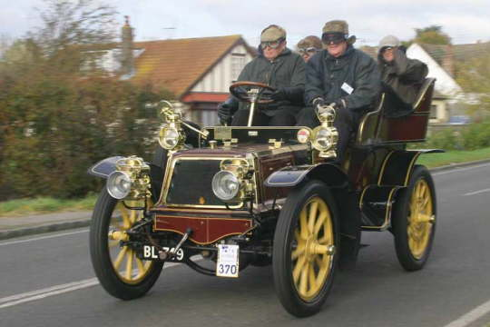
Wharton’s travel-novel: in what sense ‘timeless’?
An early Panhard-Levassor, image courtesy of the Panhard et Levassor Club GB

Slide 7
Némirovsky and Hugo: in what sense timeless?
Némirovsky, Suite française (1942): early years of German Occupation (from June 1940)
Hugo, Les Misérables (1862): 1815-32
note primarily thematic ‘timelessness’

Slide 8
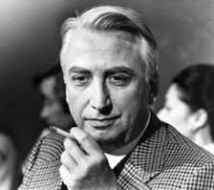
1) Structuralism: Roland Barthes on Racine

Slide 9
Barthes on Racine
arguing against Sorbonne professor and Racine expert Raymond Picard
describes the ‘structural anthropology’ of Racine’s world:
  consistent setting: an antechamber positioned between inner sanctuary and outside world
  consistent set of characters playing out ‘la relation fondamentale’:
    A has all power over B.
    A loves B, who does not love A.
emphasis on (often binary) relationships within text as a closed system

Slide 10
2) Poststructuralism
for Jacques Derrida and deconstruction, ‘Il n’y a pas de hors-texte’
‘everything about the past is only available in textual form: it is “thrice-processed”, first through the ideology, or discursive practices of its own time, then through those of ours, and finally through the distorting web of language itself’ (Barry, p.169)

Slide 11
History only exists as writing
Barthes, ‘Le discours de l’histoire’ (1968): past events can only appear in historical writing as ‘reality effects’
‘reality effects’ are also found in fictional writing
the past can only figure in historical discourse in a manner indistinguishable from the way events figure in works of fiction
leads to studies of the ‘poetics’ of historical narrative (Barthes, Paul Ricoeur, Jacques Rancière, Hayden White)

Slide 12
Historian Jules Michelet (1798-1874)
Introduction to Histoire de la Révolution Française (1847), available through Gallica: http://gallica.bnf.fr/ark:/12148/bpt6k10558760
‘encore une génération que je ne reverrai plus’ (p. I)
‘L’été s’avance, la ville est moins peuplée’ (p. I)
‘J’interroge sur mon enseignement, sur mon histoire, son tout-puissant interprète, l’esprit de la Révolution.’ (p. I)
‘Lui, il sait, et les autres n’ont pas su. Il contient leur secret, à tous les temps antiérieurs. En lui seulement la France eut conscience d’elle-même.’ (pp. I-II)
all references pp. I-II
teleology (telos), teleological narrative (end-directed narrative)

Slide 13
Barthes on Michelet 1/3
‘Modernité de Michelet’ (1974)
The Annales School

Slide 14
Barthes on Michelet 2/3
scandalous modernity / contemporaneity:
  le sensuel
  la science du déplacement (‘Metabology’)
  taking sides:‘ tout son discours est ouvertement issu d’un choix, d’une évaluation du monde, des substances, des corps ; pas de fait qui ne soit précédé de sa propre valeur : le sens et le fait sont donnés en même temps’ (p. 257)
teleological conception of history: to Modernity

Slide 15
Considering Candide 2
as portrait of 18th c. French society
  work and social stratification
  the army as institution
Baron de Thunder-ten-tronck:
  ‘un des plus puissants seignuers de la Westphalie’ (p.20)
  ‘ses palefreniers étaient ses piqueurs; le vicaire du village était son grand aumônier’ (p.20)
  Candide as tacitly reasserting power of literate governing élite

Slide 16
Meanwhile, ordinary people…
‘De jour comme de nuit, les habitants les plus simples, d’autres plus pauperisés sont atteints d’éclats de drames, de tragédies vives, d’accidents mortels. C’est le “bas-côté” de l’histoire qui accompagne, dans le silence, les grands évènements du siècle; c’est une des parts les plus pathétiques de la société, le tout recueilli par des greffiers.’
(Farge, La Déchirure: souffrance et déliaison sociale au XVIIIe siècle, Paris, Bayard, 2013, p. 94)

Slide 17
Militarism and the army as institution
‘On lui met sur-le-champ les fers aux pieds, et on le mène au régiment. On le fait tourner à droite, à gauche, hausser la baguette, remettre la baguette, coucher en joue, tirer, doubler le pas, et on lui donne trente coups de bâton; le lendemain il fait l’exercice un peu moins mal, et il ne reçoit que vingt coups; le surlendemain on ne lui en donne que dix, et il est regardé par ses camarades comme un prodige.’ (p.24)

Slide 18
Contextualization after poststructuralism: New Historicism
Stephen Greenblatt, Renaissance Self-Fashioning: from More to Shakespeare (1980)
‘The parallel reading of literary and non-literary texts, usually of the same historical period.’ (Barry, Beginning Theory, p. 166)
‘literary and non-literary texts are given equal weight and constantly inform or interrogate each other.’ (Barry, p. 166)

Slide 19
  3) Contextualization after poststructuralism: cultural materialism
Dollimore & Sinfield, Political Shakespeare (1985)
at least two historical contexts to be investigated and re-presented: present and past
overtly political: emphasis on unearthing suppressed connections in the past context and political agendas operating in the present context
cultural objects necessarily reflect the material conditions of their production but can also express human agency

