Slide 1
The Unconscious of the Text
Dr Susannah Wilson
s.m.wilson@warwick.ac.uk

Slide 2
Today’s lecture
The concept of the ‘unconscious’
The critical implications of psychoanalysis
Some limitations of psychoanalytical theory

Slide 3
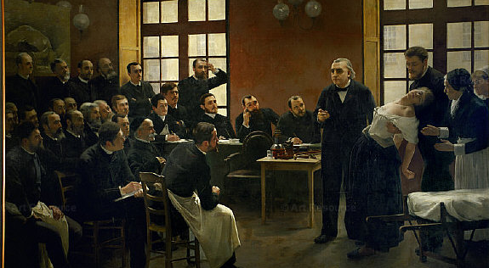
Jean-Martin Charcot, at the Salpêtrière hospital in Paris (1880s)

Slide 4
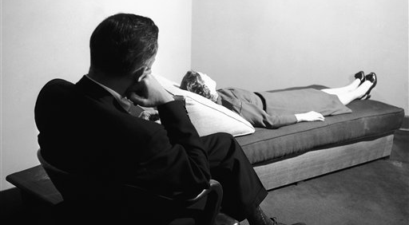
The psychoanalyst’s couch

Slide 5
Freud’s ‘structural’ model
ego = conscious self
superego = repressive, paternal authority (unconscious)
id = drives and instincts (unconscious)

Slide 6
Psychosexual development
Oral, anal and phallic stages
Oedipus complex
Neurosis and psychosis

Slide 7
The Interpretation of Dreams (1900)
Dreams are the ‘royal road’ to the unconscious
The ‘dreamwork’
Condensation and displacement
Metaphor and metonymy

Slide 8
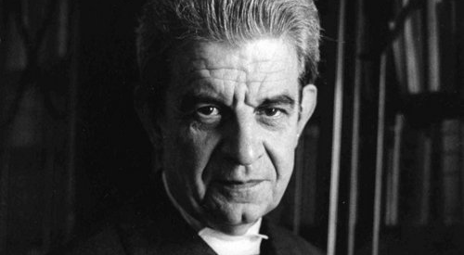
Jacques Lacan, Ecrits (1966)

Slide 9
Lacan
A return to Freud
‘The mirror stage’ (1936)
Imaginary
Symbolic
Real
Challenges the Enlightenment view of human subjectivity (Descartes, ‘cogito ergo sum’)

Slide 10
The Freudian psychology is the only systematic account of the human mind which, in point of subtlety and complexity, of interest and tragic power, deserves to stand beside the chaotic mass of psychological insights which literature has accumulated through the centuries. […] The human nature of Freudian psychology is exactly the stuff upon which the poet has always exercised his art.
Lionel Trilling, ‘Freud and Literature’, in The Liberal Imagination (1951)

Slide 11
Psychoanalysis and Literature
Freud, ‘The Uncanny’ (1919)
E. T. A. Hoffmann, ‘The Sandman’ (1817)
Freud and Romanticism: ‘the perception of the hidden element of human nature and of the opposition between the hidden and the visible.’ (Trilling).
Harold Bloom, The Anxiety of Influence (1973)

Slide 12

Laura Mulvey, ‘Visual Pleasure and Narrative Cinema’ (1973)

Slide 13
Psychoanalysis and Feminism
Is psychoanalysis descriptive or prescriptive?
Kate Millett, Sexual Politics (1970)
Criticises Freud alongside Henry Miller, D. H. Lawrence and Norman Mailer
Juliet Mitchell, Psychoanalysis and Feminism (1974)

Slide 14
Freudian psychoanalysis in fact sees sexual identity as an unstable subject position which is culturally and socially constructed in the process of the child’s insertion into human society. […] Millett’s theory of sexual ideology as a set of false beliefs deployed against women by a conscious, well-organised male conspiracy ignores the fact that not all misogyny is conscious, and that even women may unconsciously internalise sexist attitudes and desires.
Toril Moi, Sexual/Textual Politics (1985)

Slide 15

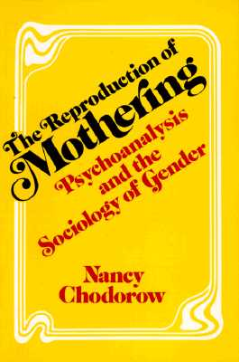

Slide 16
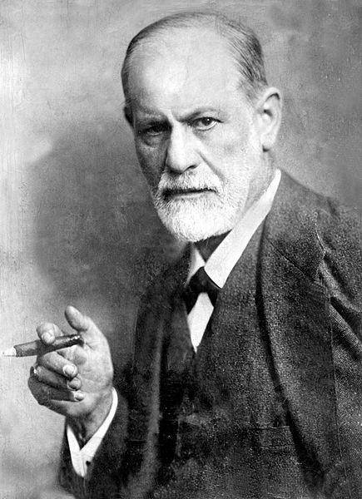
‘Gentlemen, sometimes a cigar is just a cigar…’

