Slide 1
Rabelais, print and polemic

Slide 2
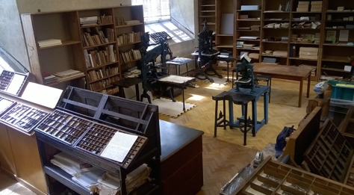
Notes:
Rich not the ones who instigated invention of printing press : had access to manuscripts

Slide 3
The printing press in France
1470 – 1st printing press
At the Sorbonne
Paris major centre (along with Italy and Germany)
France ‘most populous nation state in Europe.’ Developed regional printing centres
Lyon most important of these (c. 1473)
Notes:
Lyon has no university – educated but not necessarily scholarly clientele
law, medicine, theology, books in French

Slide 4
Press as agent of change
Manuscript (personal) print (commercial)
Readership? Audience?
Clerical: Bible (Vulgate), canon law, theology
‘lay’ readers
The book in print:
Title page (starts to look like what we would expect at end 15th C)
Discrepancy between title page and content: did contents really live up to claims?
Notes:
Rich not the ones who instigated invention of printing press : had access to manuscripts
‘In the manuscript era books had characteristically announced their subject in the first lines of the text, often with the formula incipit (literally, ‘here begins’)…’ Ist off books followed this practice, but as they were transported, grter need to project work itself. Hence title page appears
Different kind of relationship between reader and narrator / author

Slide 5
Popular print… vernacular?
The Bible
The chivalric novel
Music
School books
Science
Medicine
Chapbooks

Slide 6
Questions and anxieties
Corruption of morals?
Printers ‘uncultured’
Competition amongst publishers / financial risk
Personal transaction (manuscript) to mass audience…
Advertising – of author? Of printer?
Censorship

Slide 7
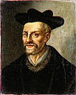
Rabelais (1483 / 1494 – 1553)
French humanist, medical doctor, and author of comic fictions.
Franciscan Order in 1510-11, at Fontenay-le-Comte until 1524. Studied Greek and Latin
changes to Benedictine order; then abandons clerical status
studies medicine
correspondence with humanists (Budé, later also Erasmus)
1534: travels to Rome with Cardinal Jean Du Bellay
La Vie inestimable du grand Gargantua (1534 / 1535)
second sojourn in Rome 1535-1536 > upon return, becomes a secular priest and takes up study of medicine again
Notes:
Tease out meaning of humanism…
Rab immersed in worlds of books and words

Slide 8
Rabelais (1483 / 1494 – 1553)
Useful introduction to the man and his works:
Samuel Kinser, Rabelais’s Carnival (Berkeley and Los Angeles: University of California Press, 1990). Available electronically from library catalogue:
http://encore.lib.warwick.ac.uk/iii/encore/record/C__Rb2233917__Skinser%20rabelais%27s%20carnival__Orightresult__U__X2?lang=eng&suite=cobalt

Slide 9
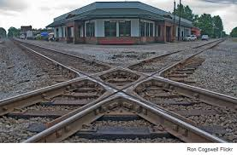
Reading Rabelais
Latin meets vernacular
Orthodox Catholicism meets Reformation
Medieval meets Renaissance

Slide 10
Unique moment in history of French language
« Marot et Rabelais sont inexcusables d’avoir semé l’ordure dans leurs écrits; tous deux avaient assez de génie et de naturel pour pouvoir s’en passer, même à l’égard de ceux qui cherchent moins à admirer qu’à rire dans un auteur. Rabelais surtout est incompréhensible: son livre est une énigme, quoiqu’on veuille dire, inexplicable; […] c’est un monstrueux assemblage d’une morale fine et ingénieuse et d’une sale corruption. » La Bruyère, Les Caractères, 1688.

Slide 11
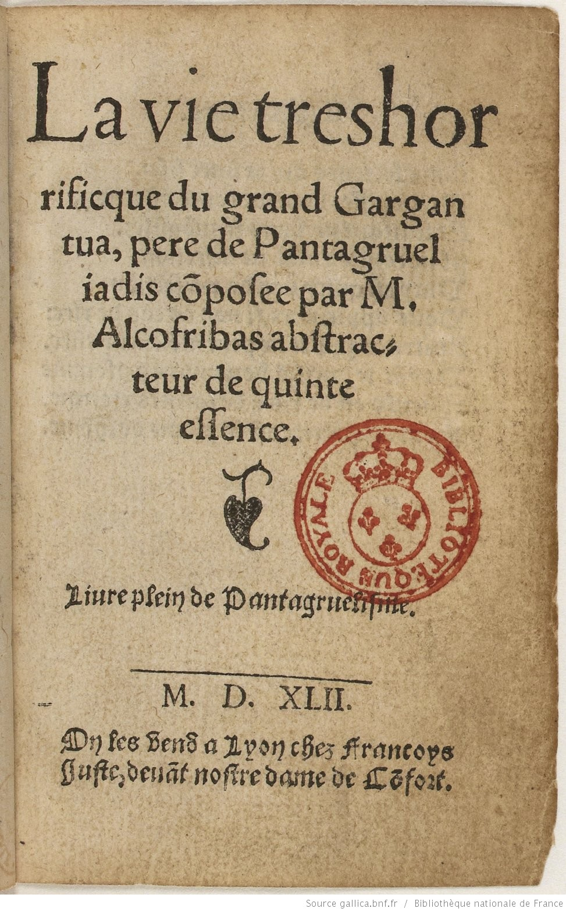
Rabelais and print…
Alcofribas (Nasier)
Pseudonym
Also used in Pantagruel
Notes:
Polarisation of print: title page :celebrates book with a view to selling it, but also leads inquisitors to the author / publisher: place of danger…

Slide 12
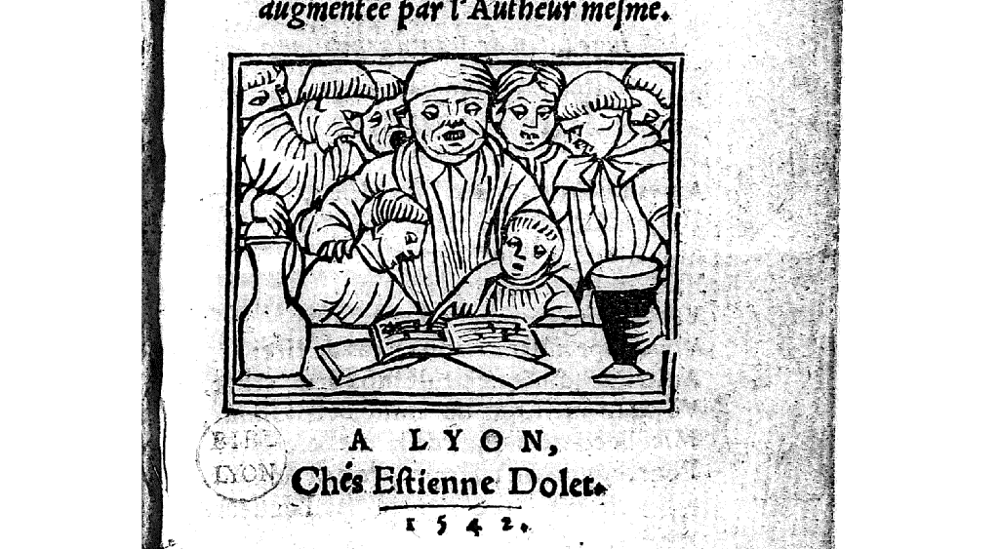
Notes:
What printing press offers to Rabelais (see Kinser): communion with a diverse audience. Orality

Slide 13
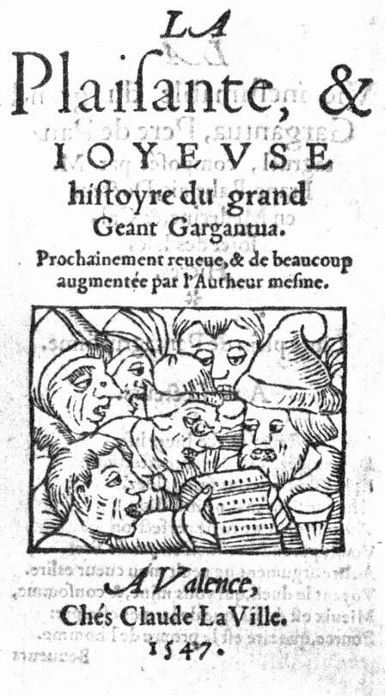
A word about language and style
Dear readers: hereon cast your eyes;
All sterile passions lay aside.
No offence here to scandalize;
Nothing corrupting lurks inside.
Little perfection here may hide
Save laughter: little else you’ll find.
No other theme comes to my mind
Seeing such gloom your joy doth ban.
My pen’s to laughs not tears assigned.
Laughter’s the property of Man.
LIVE JOYFULLY!
Notes:
Laughter to dispel fear…

Slide 14
Paratextual material:
Prologue
Title page
Plays with ‘author-reader connection’ (Kinser)
‘Paratext is a linking place between elements proper to a book’s composition and elements related to a book’s reception.’ (Kinser)
Good-humoured but more serious side?
Notes:
Why is this important given censorship? Laughter dispelling fear…

Slide 15
Rabelais’s language: some characteristics
Abundant: energetic
Amplification
Repetition
Enumeration
Colloquial expressions
Vulgar
Jovial
Riddles & puns
Alliteration & assonance
Hyperbole
Word-play & made-up words
Mock precision

Slide 16
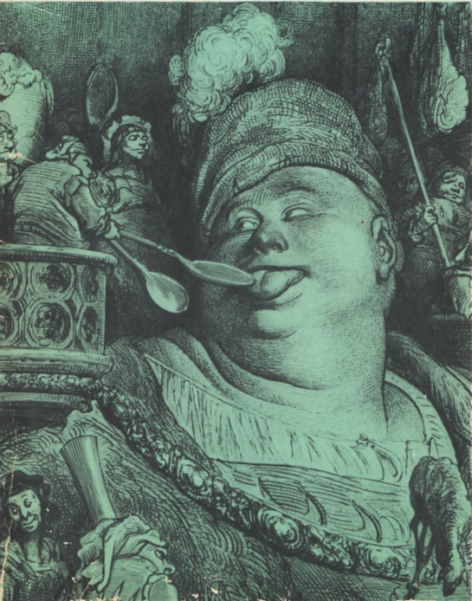
Forms of laughter in Gargantua
Image taken from: http://www.fll.vt.edu/Johnson/330503/Qrabelais1.html
Popular vernacular:
Dialect words; oaths, etc
Language of the body:
Scatology
Mock medical precision
Giant humour
Parody =
Of chivalric romances and epic
Of the bible and liturgical language
Satire; influences =
Lucian (Ancient Greek satirist)
Erasmus

Slide 17
Rabelais’s humour: some popular theories
Mikail Bakhtin
Rabelais and his world
Carnival (popular) culture
Reversal
Unofficial
Bodily / sensual
Contrasted with satire
Gauna, Coleman, Berrong
Classical heritage
Satire – Lucian, Horace
Humanism
Screech
Historical context
Notes:
Influential since 1960s but composed in 30s in Russia of Stalin

Slide 18
Prologue
« Gens de bien, Dieu vous saulve et guard! Où estez vous? Je ne vous peuz veoir. Attendez que je cherche mes lunettes! »
(Rabelais, Prologue, Quart Livre, 1552)

Slide 19
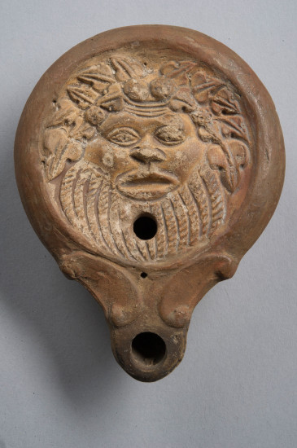
http://archaeologicalmuseum.jhu.edu/the-collection/object-stories/the-roman-house-at-hopkins/the-art-of-light/wreathed-silenus/

Slide 20
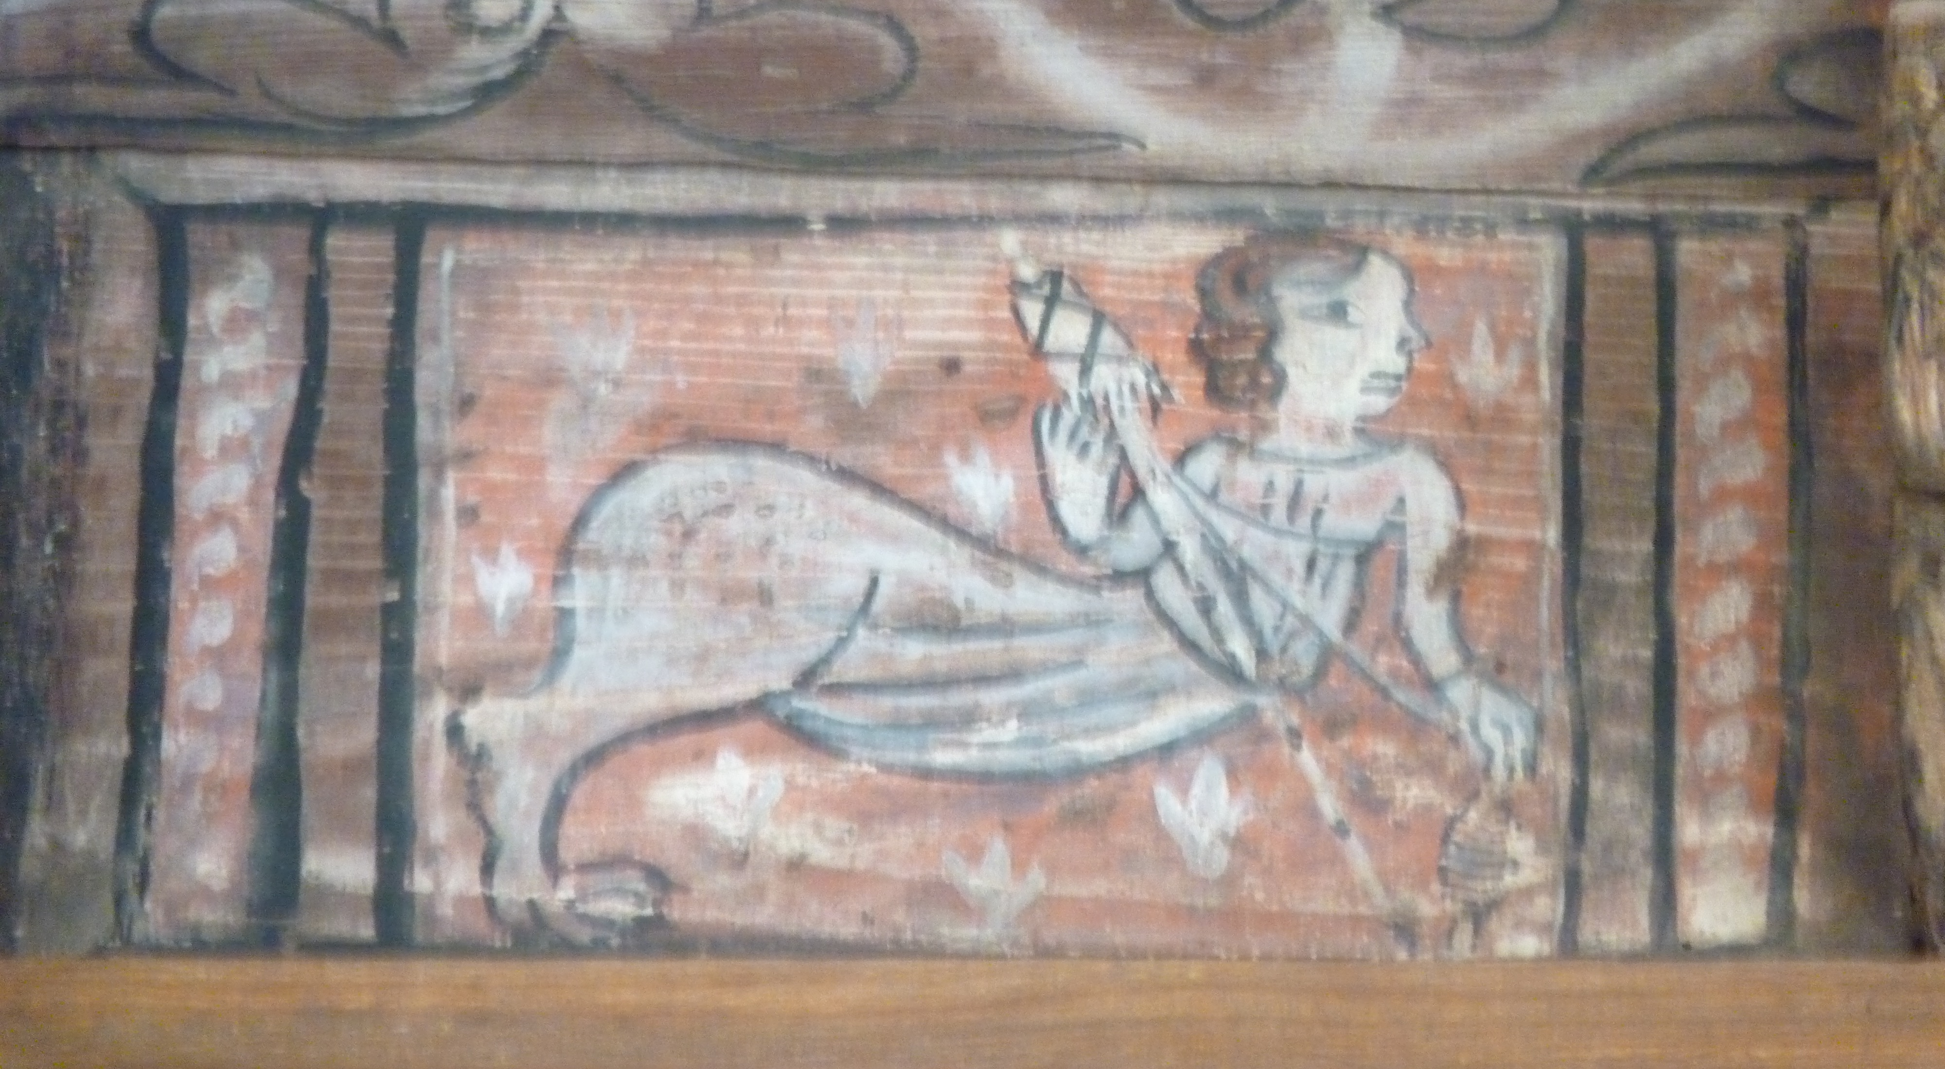

Slide 21
Old-style teachers
De faict, l’on luy enseigna un grand docteur sophiste nommé Maistre Thubal Holoferne, qui luy aprint sa charte si bien qu’il la disoit par cueur au rebours; et y fut cinq ans et troys moys. Puis luy leut Donat, le Facet, Theodolet et Alanus in Parabolis, et y fut treze ans six moys et deux sepmaines.
Mais notez que cependent il luy aprenoit à escripre gotticquement et escripvoit tous ses livres, car l’art d’impression n’estoit pas encores en usaige […]
Puis luy leugt De modis significandi, avecques les commens de Hurtebize, de Fasquin, de Tropditeulx […] (113)

Slide 22
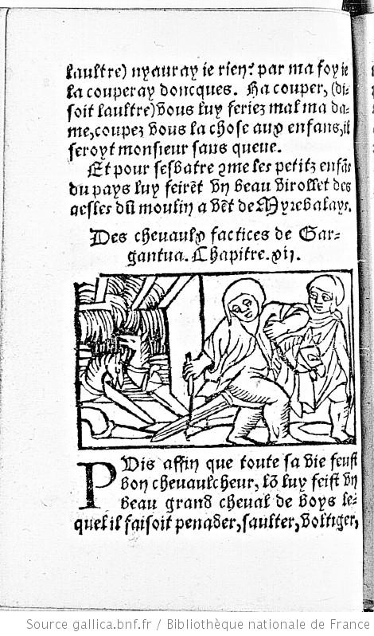
Gargantua’s Education chs 12 and 13
http://gallica.bnf.fr/ark:/12148/btv1b2200060m
We see evidence of
Imagination – wooden horse game
Misplaced intellectual activity – research into bum wipes
Rhetorical skills – finds words to rhyme with ‘chiart’!
Note the use of scatology!

Slide 23
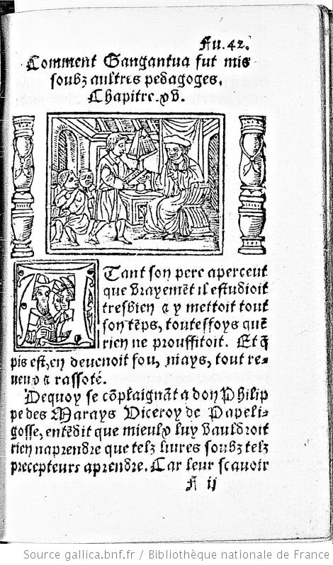
The Change of Regime
http://gallica.bnf.fr/ark:/12148/btv1b2200060m.item.r=gargantua.f8.langEN
Humanist education
Eloquence. Example of Eudemon:
‘Voyez vous ce jeune enfant? Il n’a encore douze ans; voyons, si bon vous semble, quelle difference y a entre le sçavoir de voz resveurs mateologiens du temps jadis et les jeunes gens de maintenant.’ (117)
Imitation of ancients (here, rhetoric of Cicero)

Slide 24
To keep exploring
Gallica.fr
http://gallica.bnf.fr/ark:/12148/btv1b2200059z/f1.planchecontact.r=rabelais%20gargantua

