Slide 1
Romanticism and politics
Historical and literary context
1830-1848

Slide 2
Indiana, a Romantic text?
Nature in contrast to corruption of Paris
Exoticism
Melancholy
Supernatural and sentimental vs worldly and material
Paired opposites and structural device of doubles
Slave and master

Slide 3
A realist text?
Realism: one of the most appreciated aspects
‘L’écrivain n’est qu’un mirroir’ (1832 preface)
About society rather than individual
Characters embedded in historical reality
Life in provinces as opposed to Paris
Financial realities of marriage and business

Slide 4
‘des mœurs, des personnages comme il en existe autour de nous, un langage naturel, des scènes d’un encadrement familier’
Sainte-Beuve, 1832

Slide 5
First phase of Romanticism
The trauma of the French Revolution
An aristocratic movement
In reaction to Enlightenment values
Opposition to the classical forms of literary expressions

Slide 6
Under the Restauration
Split between Romantics and royalists
A generation with blocked prospects
A new Romanticism is called for
On the side of the people and liberty
Power struggle between king and government
27, 28, 29 July 1830: les Trois Glorieuses, insurrection, Charles X abdicates, replaced by Louis-Philippe d’Orleans

Slide 7
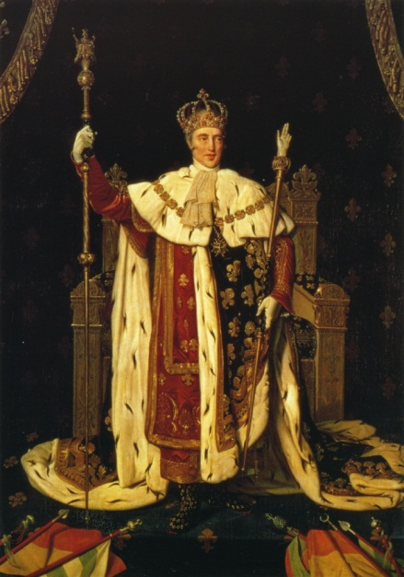

Slide 8
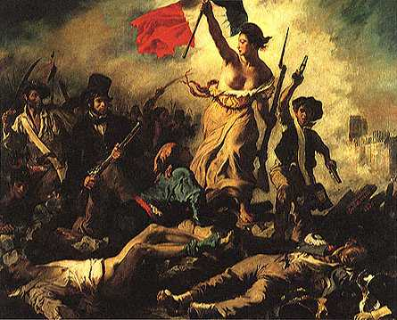

Slide 9
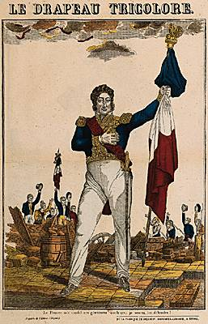

Slide 10
Under Louis-Philippe
New king wants to be seen as modern and humane
But growing discontent
Power in the hands of the bourgeoisie, census suffrage
Romanticism clearly on the side of the people
Economic crisis
1848: king abdicates, II Republic proclaimed

Slide 11
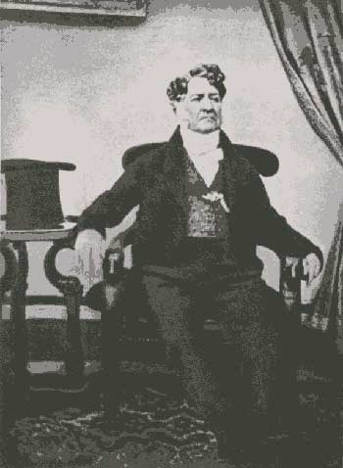

Slide 12
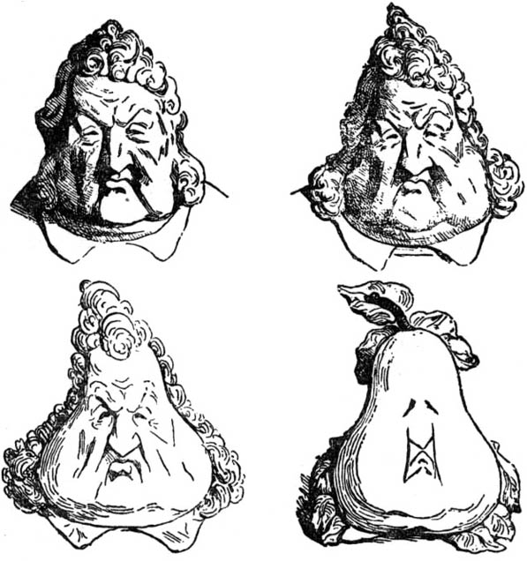

Slide 13
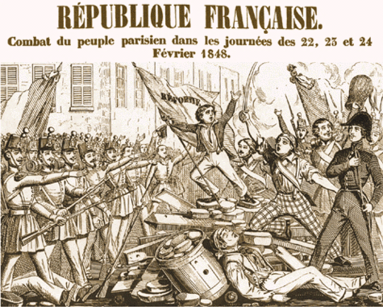

Slide 14
