Slide 1
La Bête Humaine, Zola
Zola, his Time and Naturalism

Slide 2
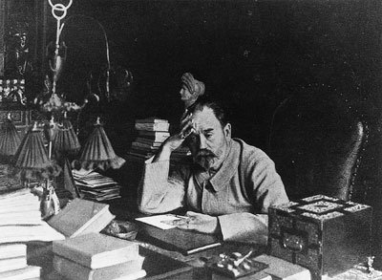

Slide 3
1840: birth of Emile Zola under Louis-Philipp’s reign
1852: Second Empire officially proclaimed = Paris modernised (Haussmann), growth of railways, silencing of political opposition, economic boom burst, capitalism, struggling working class
1868: Zola starts thinking of the Rougon-Macquart cycle
1870: France in war with Prussia, Napoleon III taken prisoner, proclamation of the III Republic

Slide 4
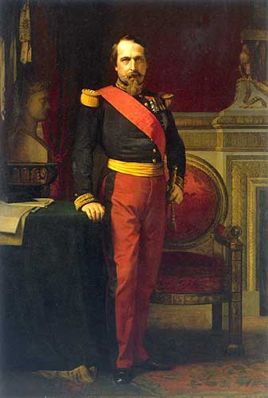

Slide 5
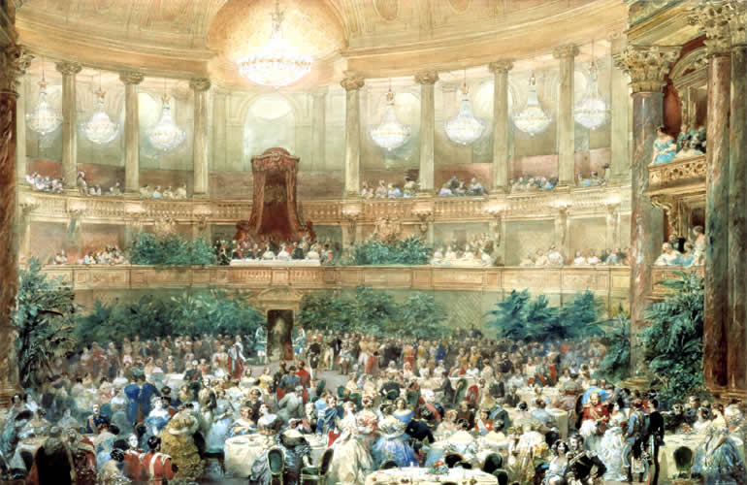

Slide 6
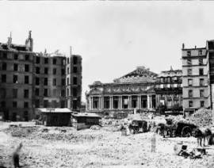

Slide 7


Slide 8
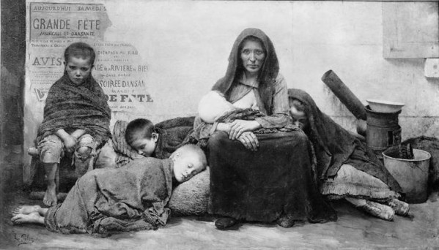

Slide 9
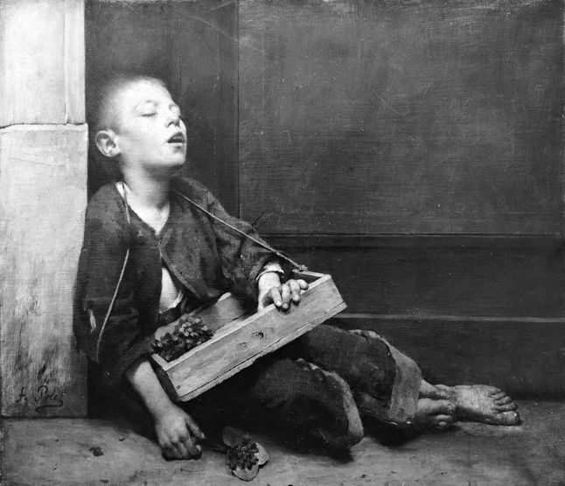

Slide 10
Sept. 1870 – Jan. 1871: Paris under siege
March – May 1871: Government moves to Versailles, creation in Paris of the Commune as an insurrectional government, Paris yet again under siege
May 1871: Armistice signed with Prussia, France loses Alsace-Lorraine, Paris punished
1894-1902: Affaire Dreyfus, Zola’s involvement, exile to England, back in Paris dies asphyxiated (murder?)

Slide 11
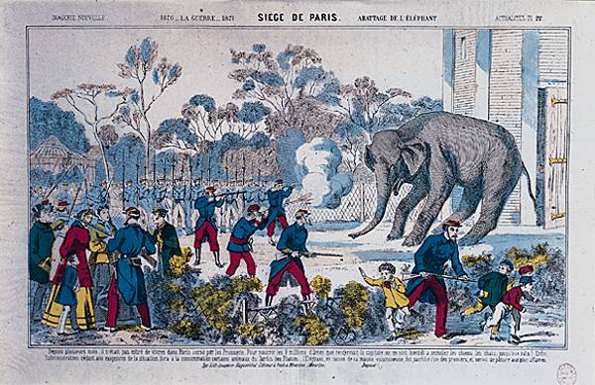

Slide 12
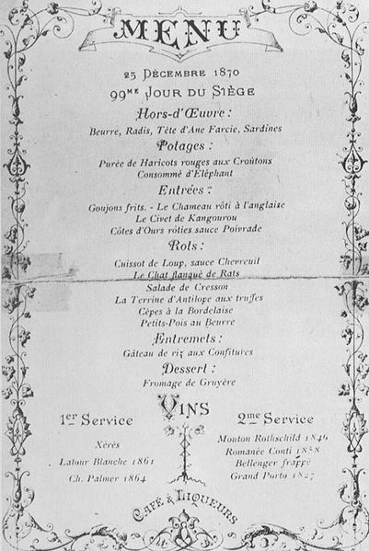

Slide 13
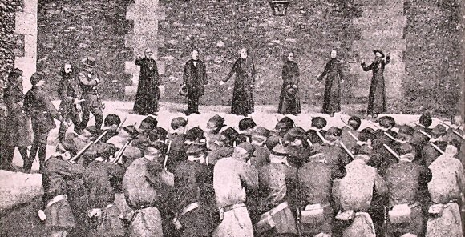

Slide 14
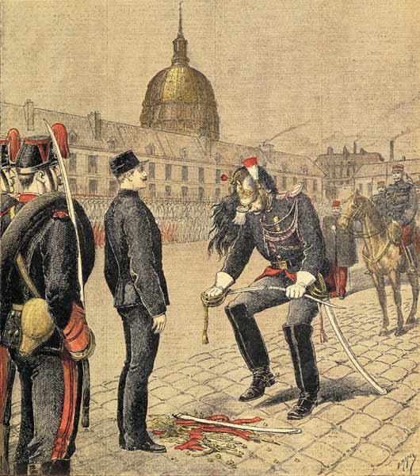

Slide 15
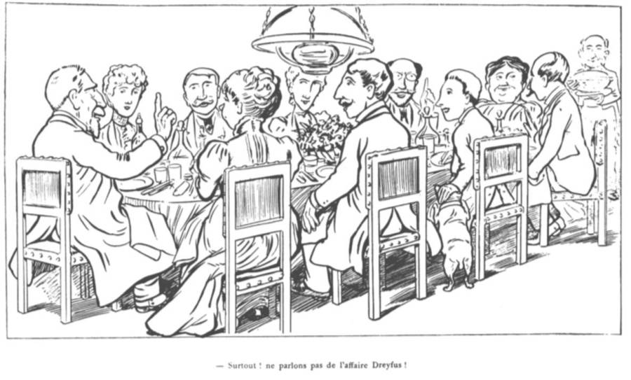

Slide 16
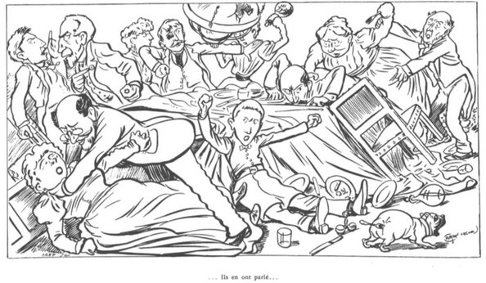

Slide 17
Zola and Naturalism
Realism vs Naturalism
Purely scientific approach
Man is observed like any other animal in a completely impartial and neutral way
Cult of atheistic science
Determinism applied to everything
Belief that everything can be explained by science

Slide 18
Zola admires the Realist movement
But wants to take the scientific approach in literature further
Patterns of behaviour determined by heredity and so are predictable
Literature as ground for experiment: what happens when a character with certain heredity traits is placed in a certain environment
Increased interest in the working class

Slide 19
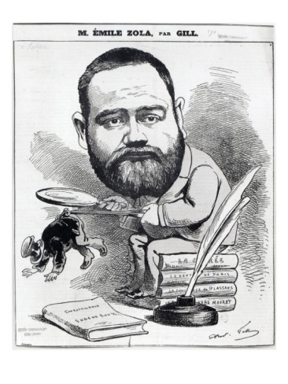

Slide 20
Je veux expliquer comment une famille, un petit groupe d'êtres, se comporte dans une société, en s'épanouissant pour donner naissance à dix, à vingt individus qui paraissent, au premier coup d'œil, profondément dissemblables, mais que l'analyse montre intimement liés les uns les autres. L'hérédité a ses lois, comme la pesanteur.
Je tâcherai de trouver et de suivre, en résolvant la double question des tempéraments et des milieux, le fil qui conduit mathématiquement d'un homme à un autre homme.
(Préface to La Fortune des Rougon (1871))

