Slide 1
Indiana, George Sand
Life of George Sand
Literary and historical context

Slide 2
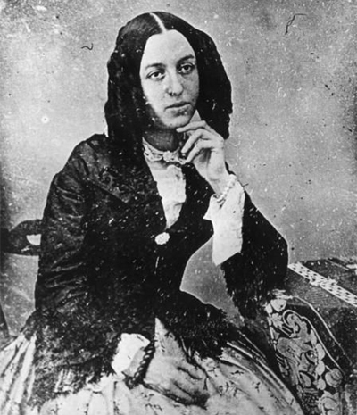

Slide 3
George Sand
1804: birth of Aurore Dupin
Married at 18 to the Baron Casimir Dudevant, an unhappy marriage
1831: separates from her husband and goes to Paris
1832: publication of Indiana under the name of George Sand. It is a huge success
3 different portrayals of Sand: the femme fatale, the benevolent old lady of Nohant, the socialist

Slide 4
Historical overview
1804-1814: Napoleon’s Empire
1815-1824: reign of Louis XVIII
1824-1830: reign of Charles X
27, 28, 29 July 1830: les 3 Glorieuses
1830-1848: reign of Louis-Philippe I (change from the de Bourbon to the d’Orléans line)

Slide 5
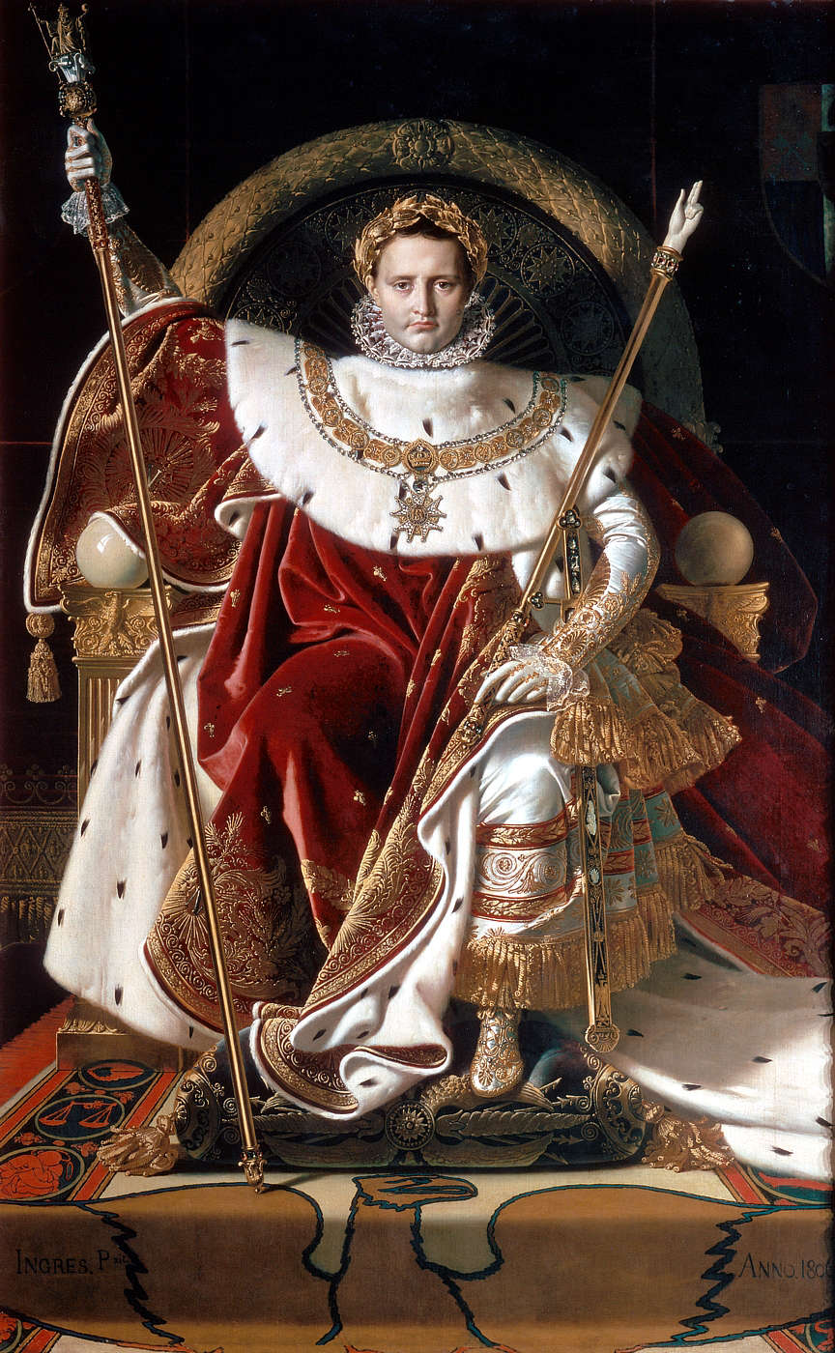

Slide 6
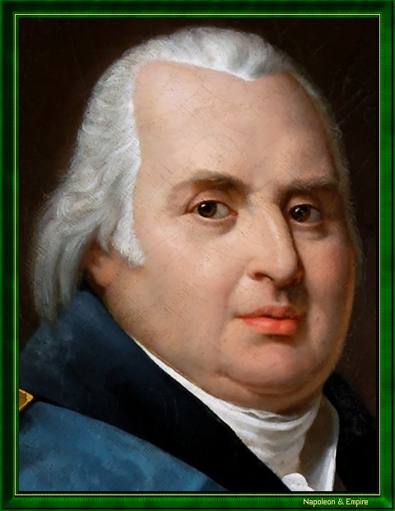

Slide 7
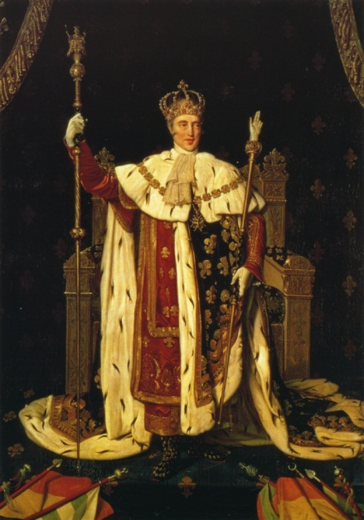

Slide 8
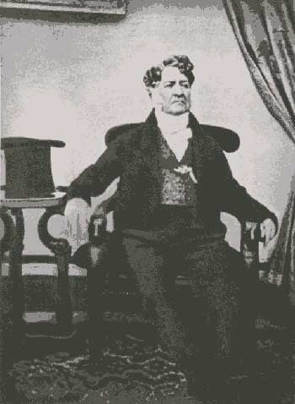

Slide 9
Romanticism
Quest for meaning after the Revolution
Mal du siècle
Nostalgia for the past
Spiritual longing
Melancholy
Obsession with love and death

Slide 10
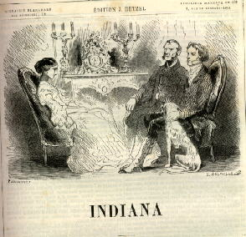

Slide 11
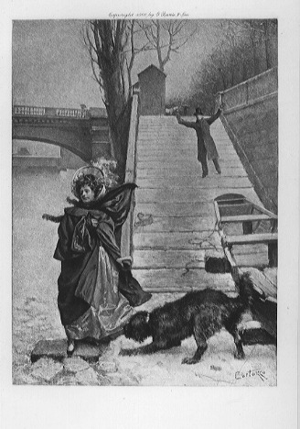

Slide 12
