Slide 1
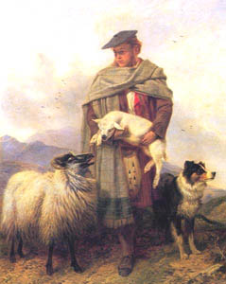
THE FATHER FIGURE
The father figure is significant in Griselidis and the two father figures are contrasting.
The King is the dominant father figure and is the driving force behind the plot.
Does the King, as an absolutist monarch, represent Louis XIV?
Identify:
Dominant King:
Predatory hunter?
Demands obedience from daughter, wife and subjects.
Shepherd
Protecting
The two father figures present contrasting male roles.
Analysis of king:
Hunter:
Singular – absolute authority
Interest in self-gain and posterity
Obedience:
Head of family = father of all
Be all and end all
Perrault’ s criticism of caprice/ the “jaloux”
His role as the ‘tester’ - redeem his cruelty?
Analysis of shepherd:
Protector:
Vocation = preservation for greater good
Maternal / implicit christian values
Stability
Familial unity: “Retournons” p.78
Morality of the conte: virtue, especially patience, is truly valued by men. The King is made to learn this.
The shepherd embodies the teaching of virtue and the Prince wants his own daughter to mirror her mother’s virtue.

