Slide 1
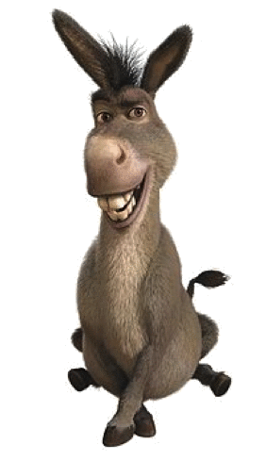
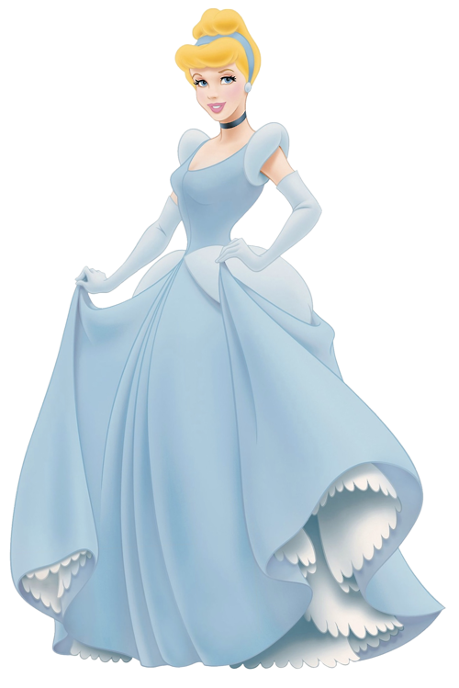

Does the treatment of sons and daughters differ in Perrault’s
Cendrillon, Petit Poucet and Peau d’Âne?

Slide 2
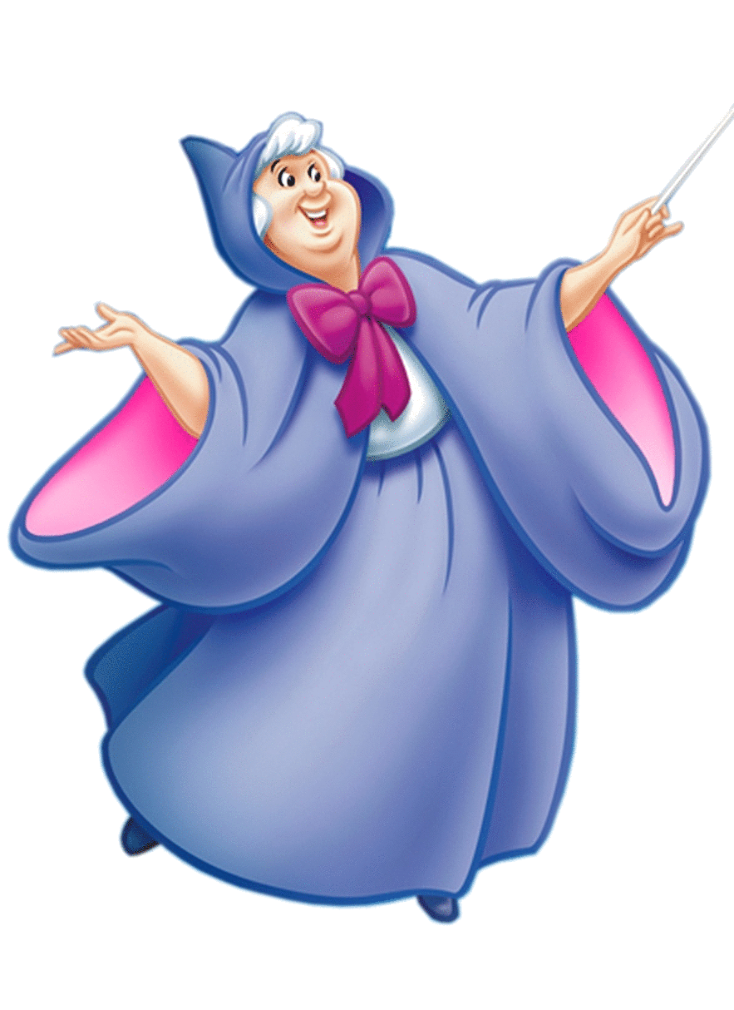
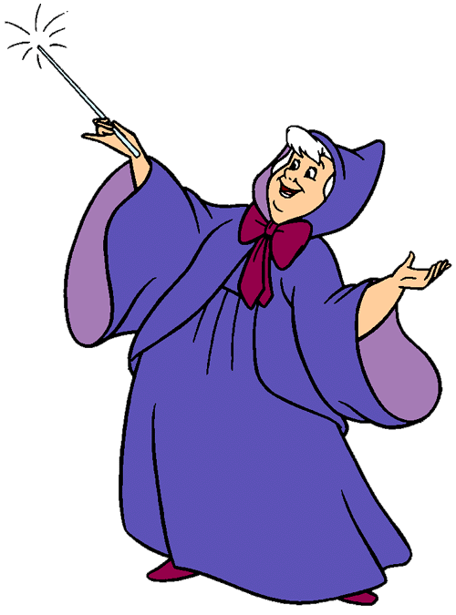
is crafty and intelligent, and independently so! He doesn’t rely on his parents OR…
and need a
surrogate mother figure
Notes:
So, Petit Poucet uses his wits not only to escape the ogre, but to become an important courier and raise the social and economic status of his entire family, despite the fact that they never help him in the first place. He has psychological independence and the moralité emphasises the point that, despite the fact that people may be small and quiet, they also often have deep intelligence and wit. The two princesses, by contrast, need extra help, and this help is needed to dissuade/attract a male. Peau d’Âne needs to escape her father and find a new prince, and the godmother gives her beautiful dresses to do so. Cendrillion’s story mirrors this. Therefore, daughters need a mother figure and materialism in order to have their stories resolved…

Slide 3
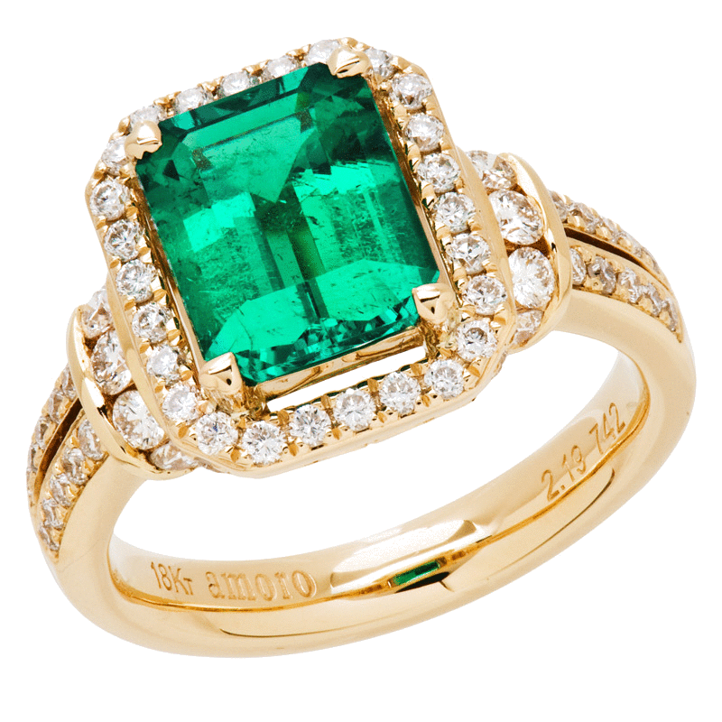
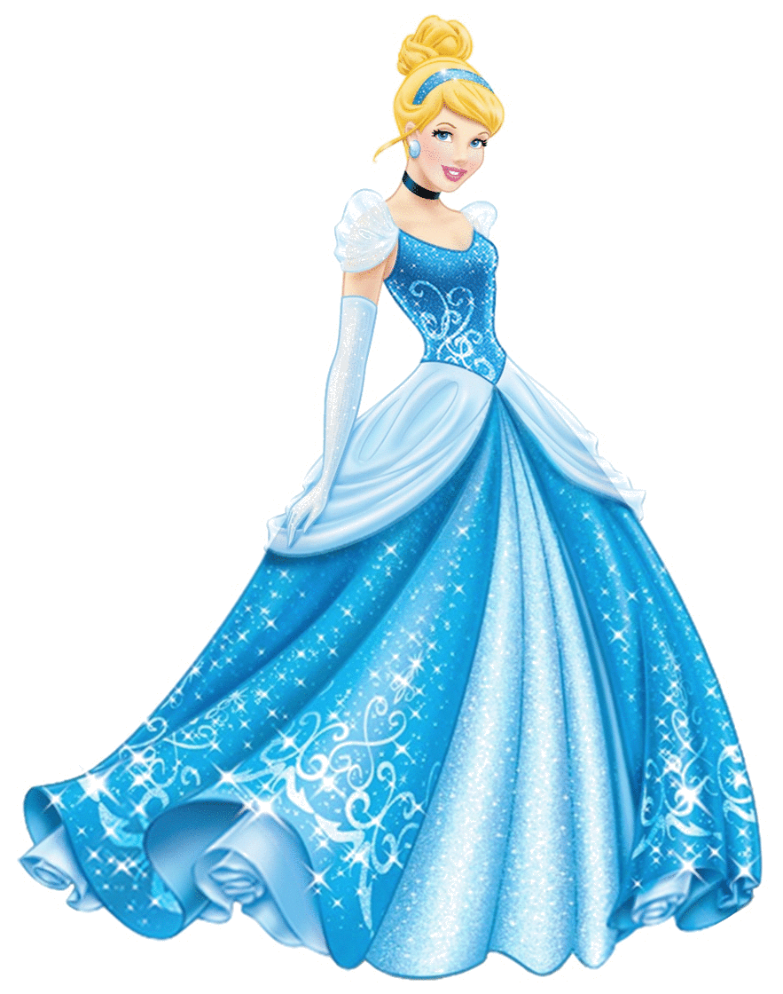
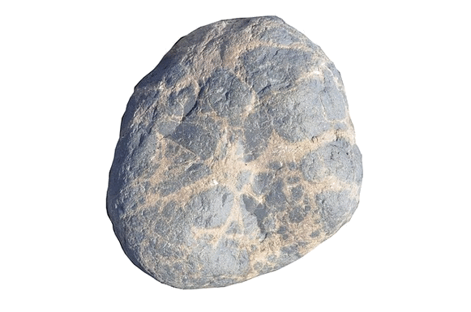
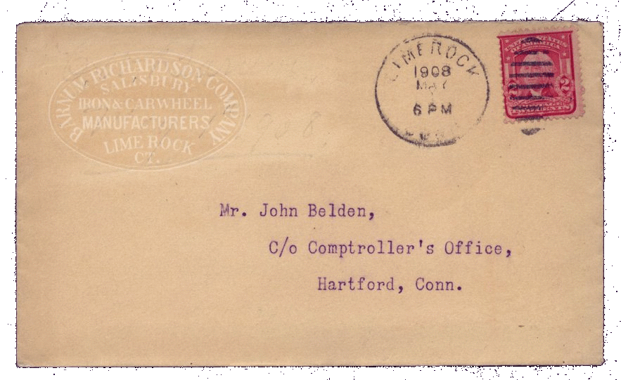
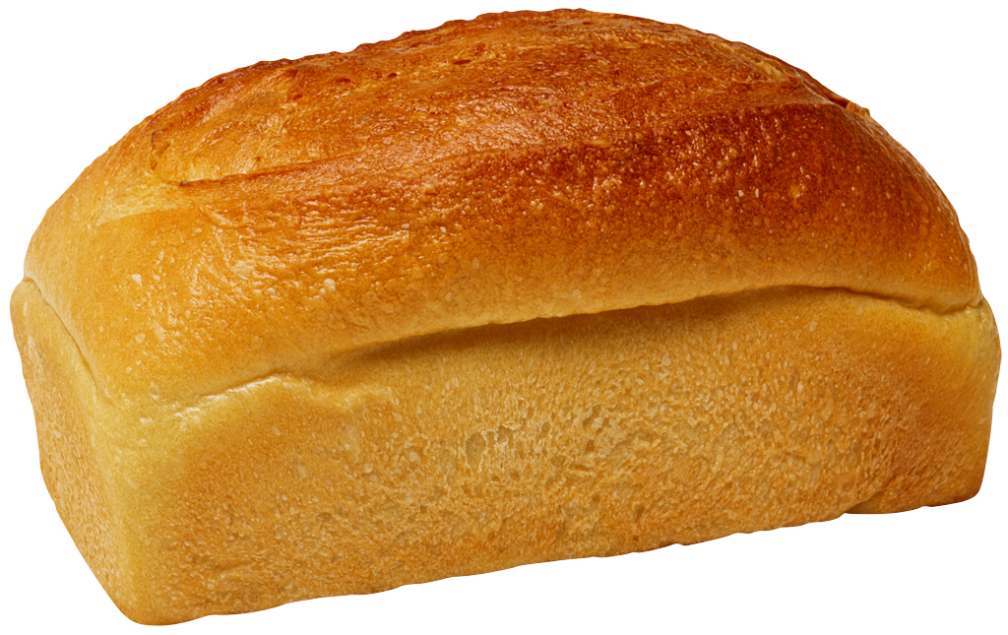
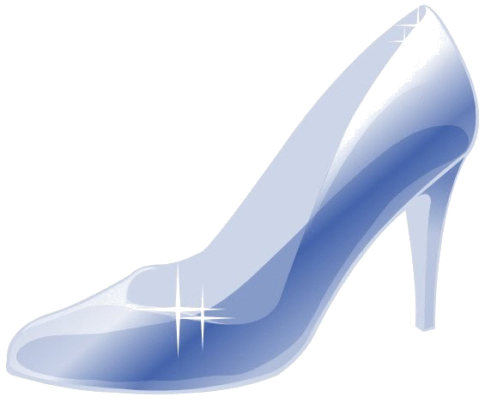
WOMEN = PHYSICAL
MEN = PSYCHOLOGICAL
Notes:
We noticed that the two daughters needed physical amelioration → cendrillion has a new dress/shoes and peau d’ane has her three dresses/emerald rings. They have these physical tokens to represent their true social status – they pose as poor people whereas they are truly royalty. They are given these things by their fairy godmothers – this shows that daughters need these beautiful things/material tokens in order to marry. Petit Poucet, however, is not given any magical help or material token, he rather relies on his natural talents to save his life/gain a rewarding job. Therefore, can we conclude that daughters need extra maternal help whereas sons can be left alone?

Slide 4

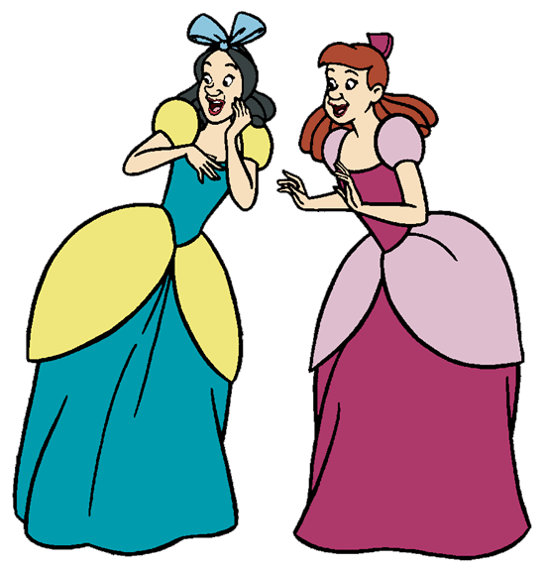
Notes:
The moralité to peau d’ane however hints at the importance of storytelling – the grandmothers and mothers telling their children stories is the final image in the verse. This offers the idea that there is an importance in psychological stimulation for cross generational learning and entertainment. Also the mention of female family members highlights the gender of the pedagogy. So, women are not purely physical beings. This links to petit poucet’s moralité which preaches don’t judge a book by its cover, which juxtaposes looks with intelligence. In a similar vein, cendrillion’s moralite says that beauty is not everything – so whilst the stepsisters are attractive, they are evil, and lack cendrillion’s grace and virtue. This shows the rift between STEP daughters and biological daughters…need to think more on this!! Anyway,, main point is, sons and daughters need to be well rounded and clever

Slide 5
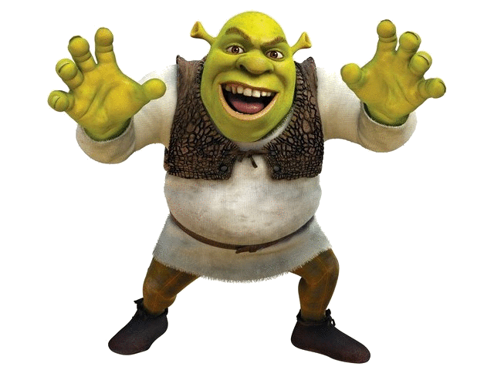
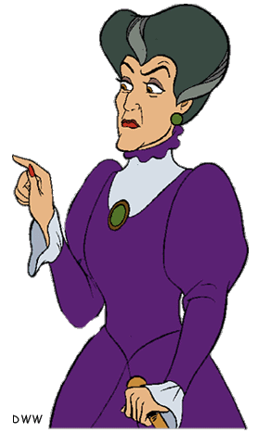

Notes:
We also noticed that the children were abandoned by their parents. Both princesses have dead mothers – which are duly replaced by fairy godmothers. Therefore the gender of child does not help parents decide who should leave/be mistreated in some way. Child abuse is seemingly universal then. However the evil stepmother resents and is jealous of cendrillion maybe …the tension between the mother and step-daughter is therefore one of jealousy. Peau d’ane’s danger is also inside the home and BECAUSE of the mother…are daughters therefore threatened from the inside of the family unit? Petit Poucet is also threatened by his surrogate father figure, so it seems that there is danger in the matching parent gender. OEDIPAL COMPLEXES? → the abandon of the domestic idyll

Slide 6
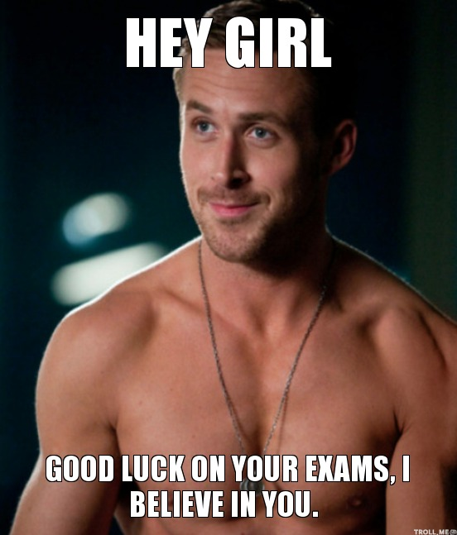
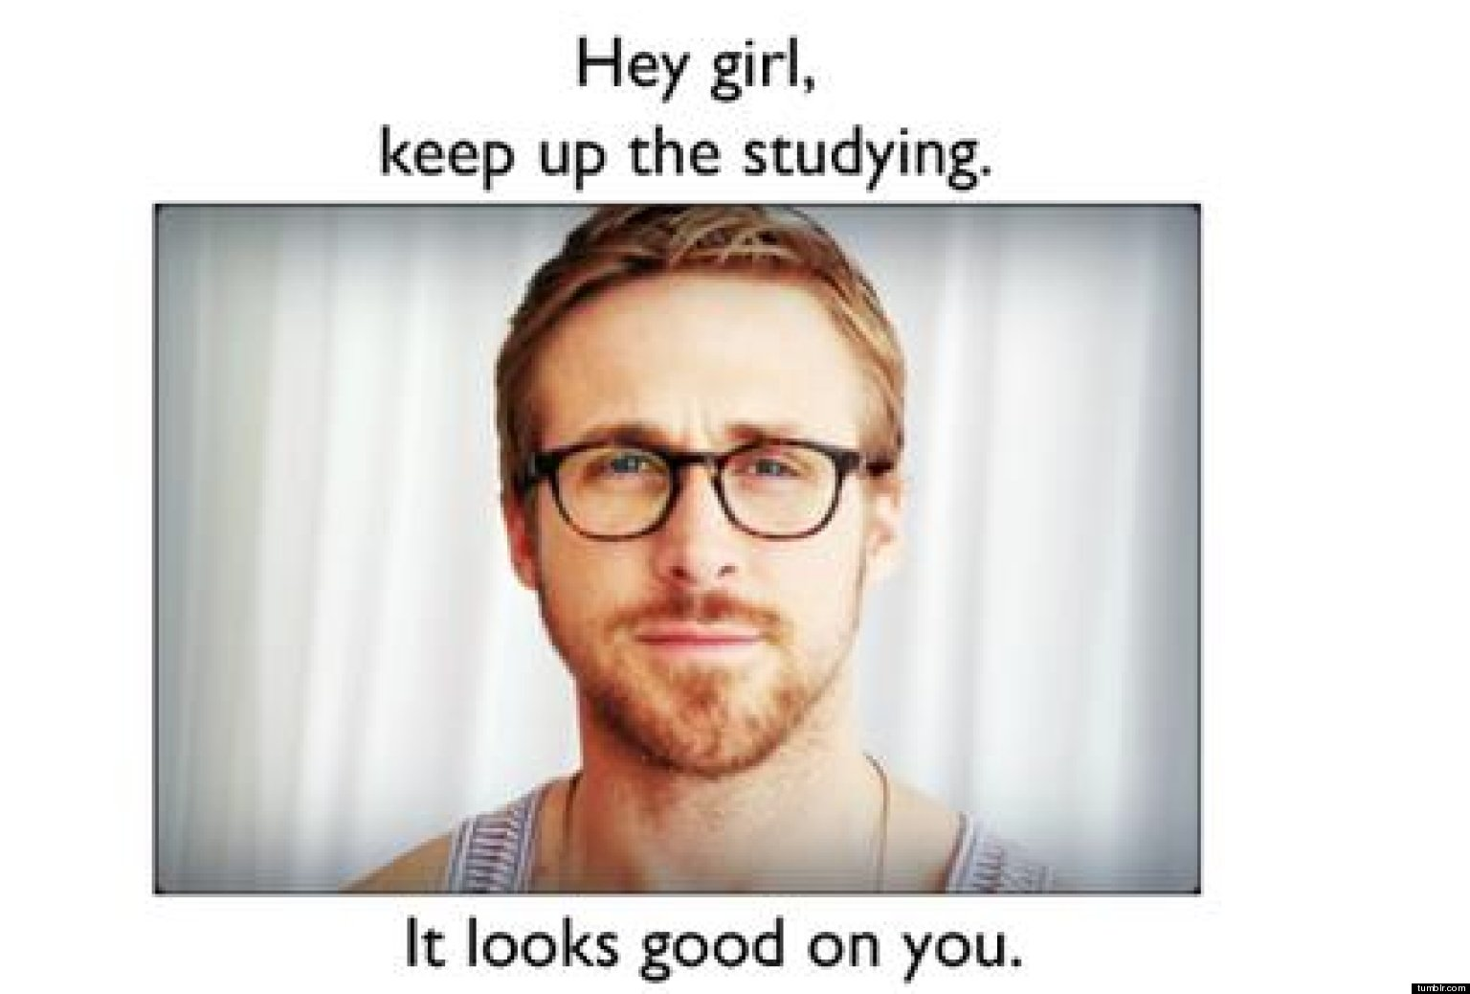
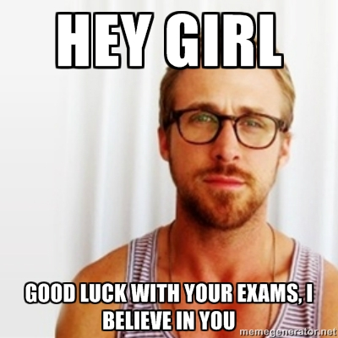

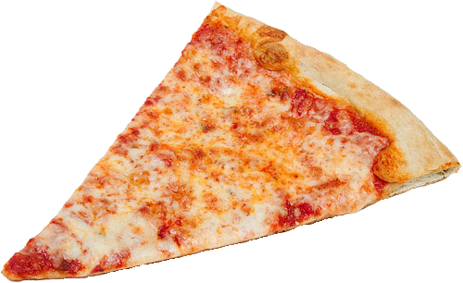
Thank you and good luck!

