Slide 1
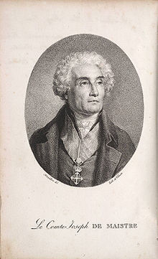

Joseph de Maistre (1753–1821)
‘La Révolution mène les hommes plus que les hommes ne la mènent.’
(Considérations sur la France, 1797)

Slide 2
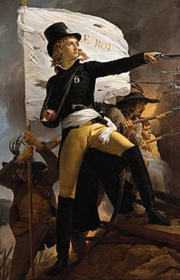
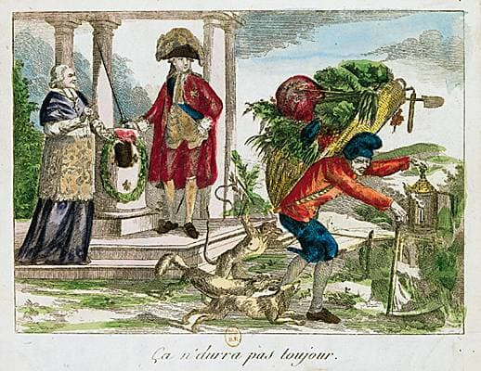
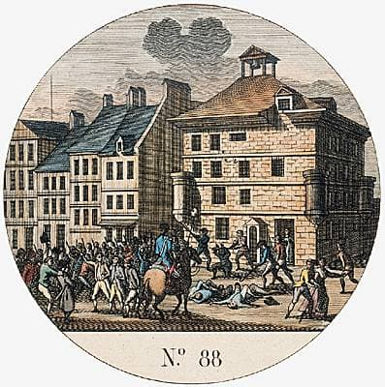
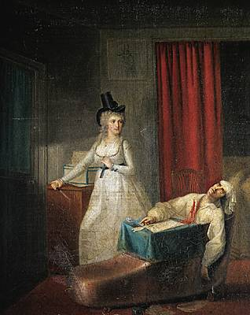
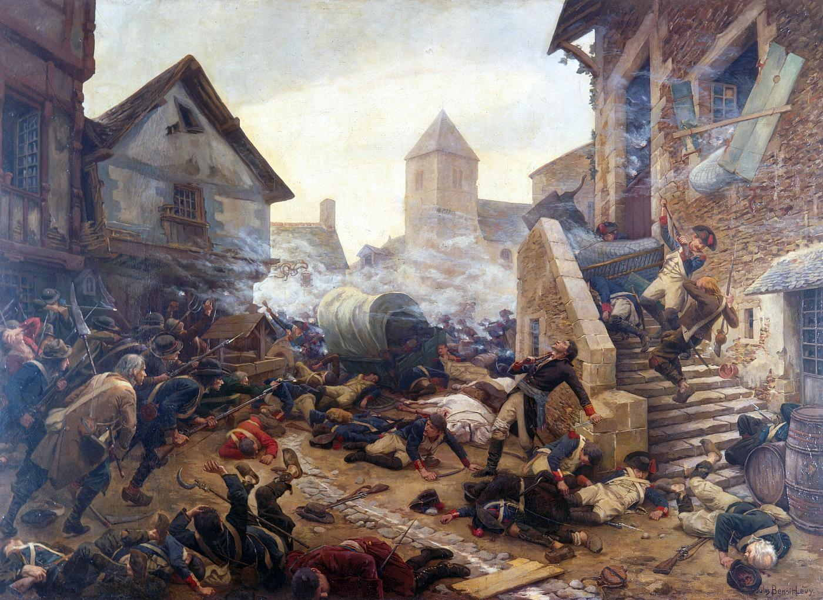
Counter-revolutionaries

Slide 3
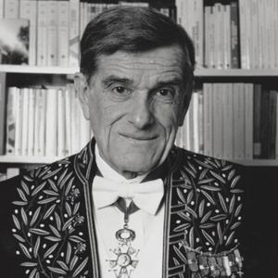
III. Classifying the French Right
René Rémond famously divided the French right into three families: Legitimist, Orleanist, and Bonapartist

Slide 4
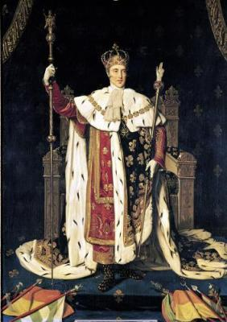
Charles X, King of France (Bourbon)

Slide 5
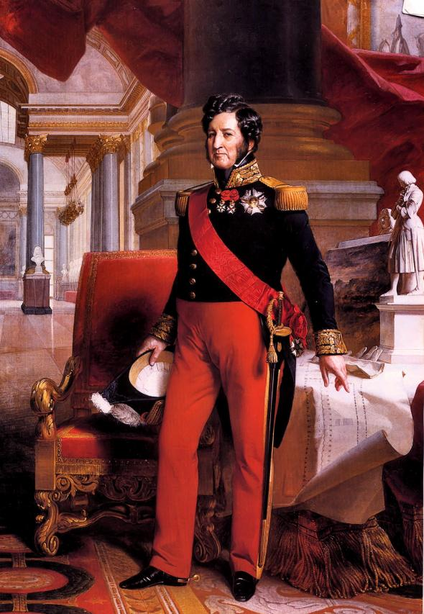
Louis-Philippe, King of the French (Orleanist)

Slide 6
Charles X Louis-Philippe

Slide 7
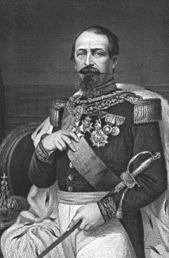
Louis-Napoléon Bonaparte

