Slide 1
FR422 Politics & Violence in Modern France
Week 2:
I. What is political violence?
II. Interpretations of political violence: Sorel & Marx interpreted by Balibar

Slide 2
Lecture outline
Part I: Introduction
What is political violence?
Defining political violence: some examples
Defining political violence: more complex approaches
France and political violence

Slide 3
Lecture outline
Part II: Interpretations of political violence, Sorel & Marx interpreted by Balibar
Marxism
Sorel
Balibar’s interpretations of Marx
Conclusions

Slide 4
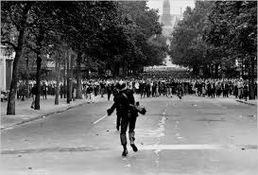
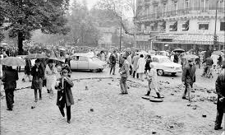
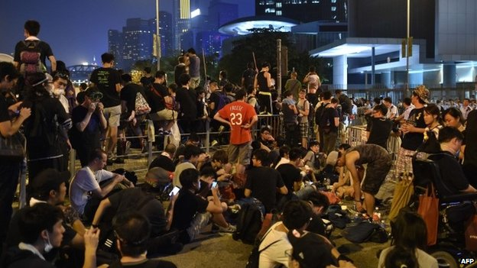
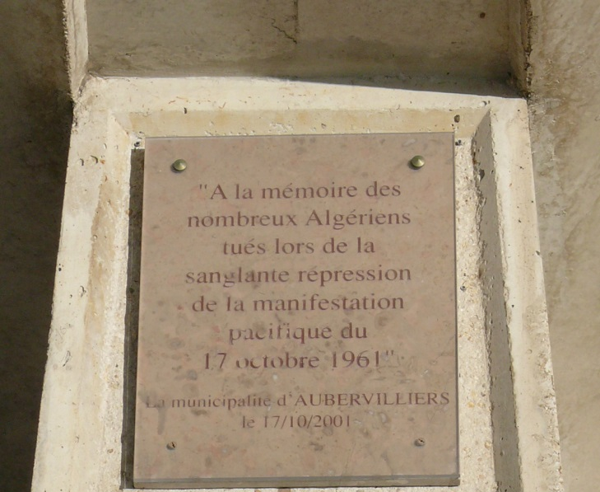
What is political violence?

Slide 5
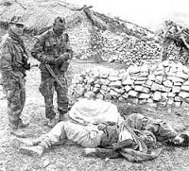
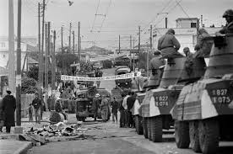
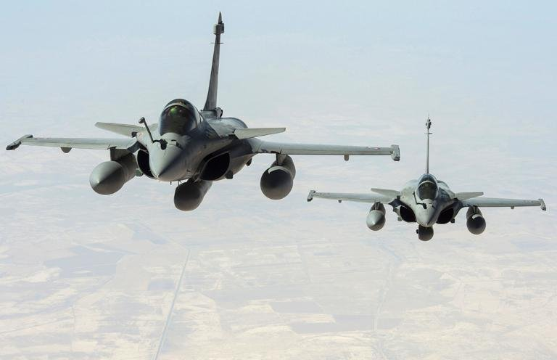
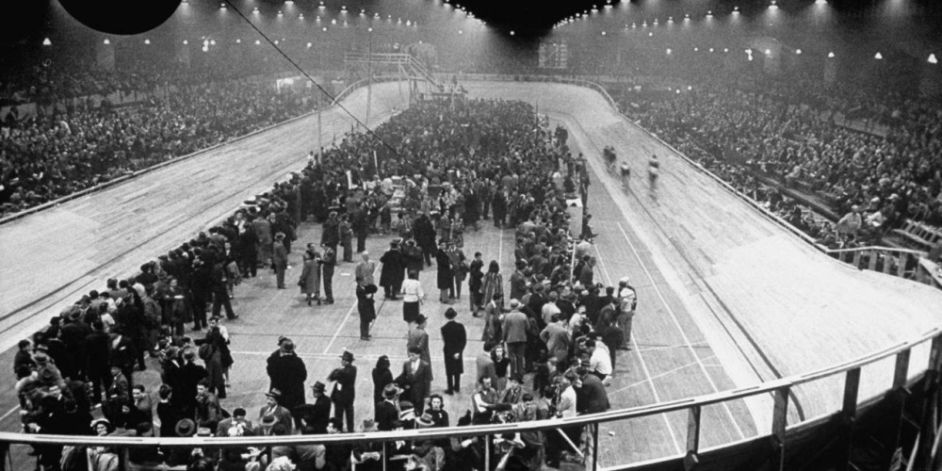
What is political violence?

Slide 6
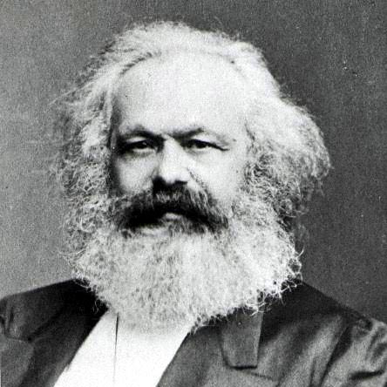
Marx

Slide 7
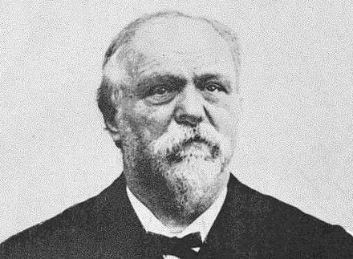
Sorel

Slide 8
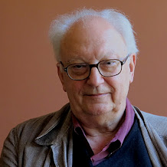
Balibar

