Slide 1
Politics & Violence in Modern France
Week 3: Revolutionary violence, democracy & the Republican tradition

Slide 2
Lecture outline
Introduction
The revolutionary tradition
Republicanism
Other ‘conflictual’ currents
Conclusions

Slide 3
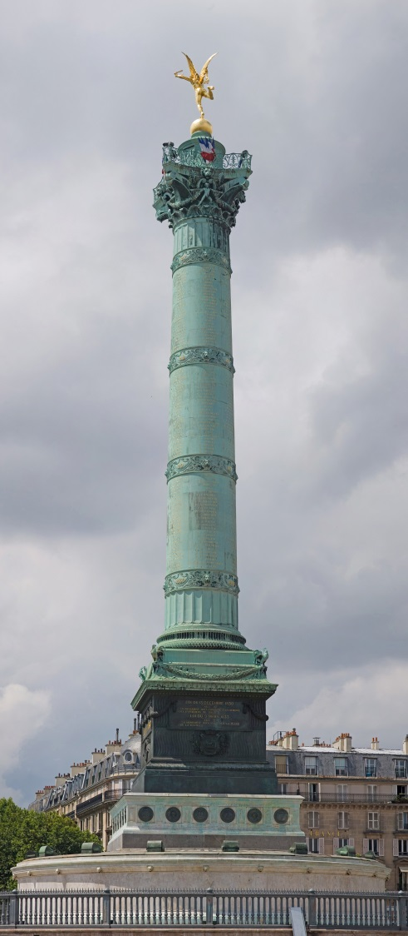
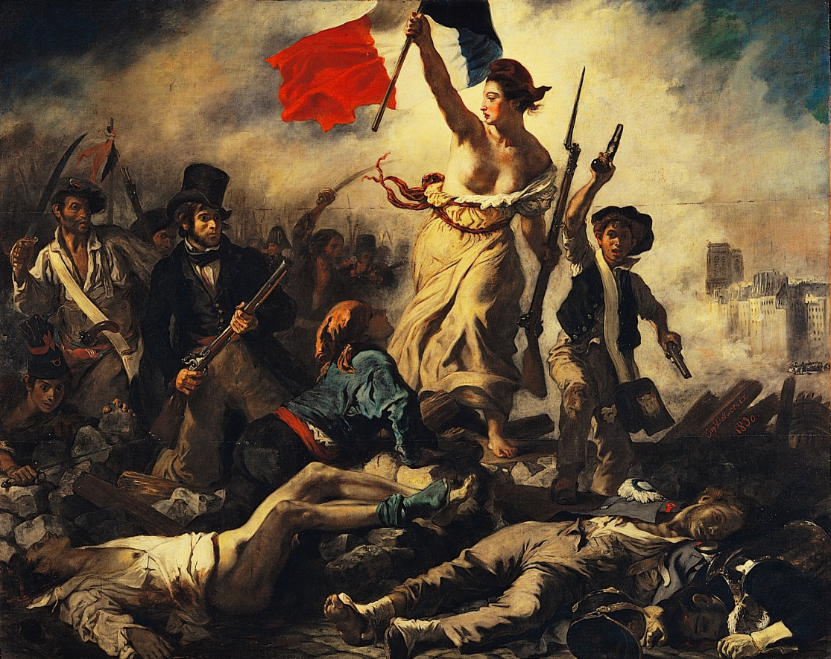
The revolutionary tradition

Slide 4
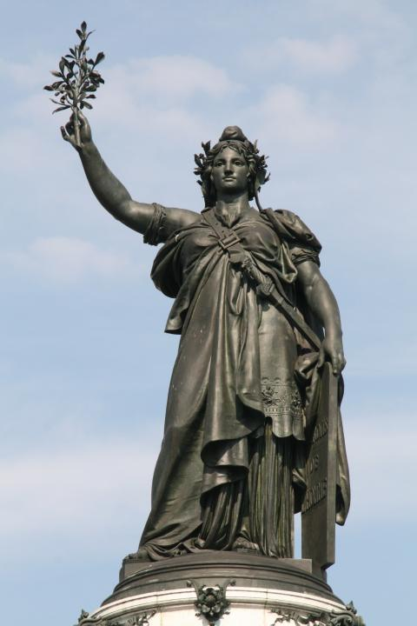
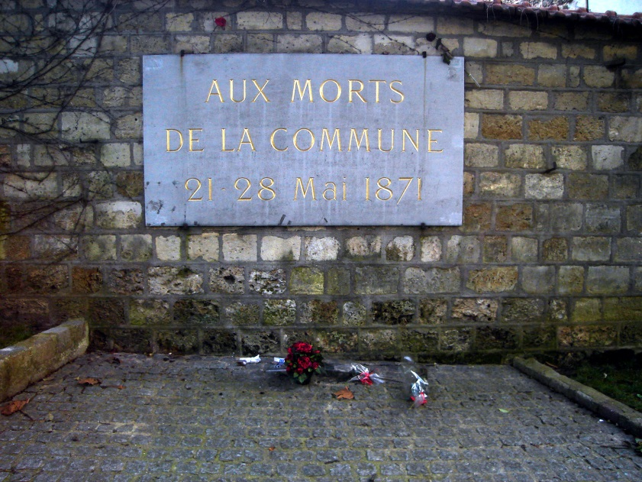
Republicanism

Slide 5
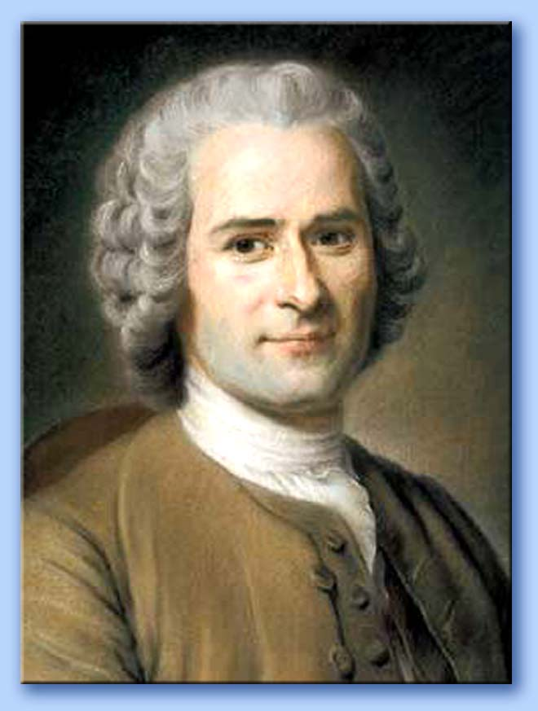
Republicanism

Slide 6
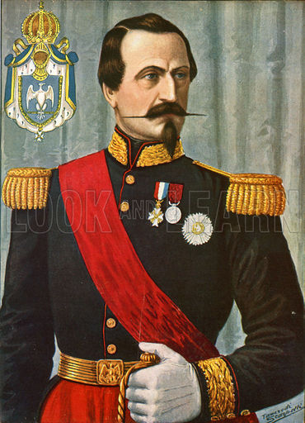
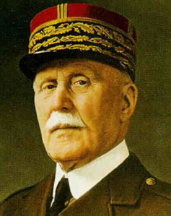
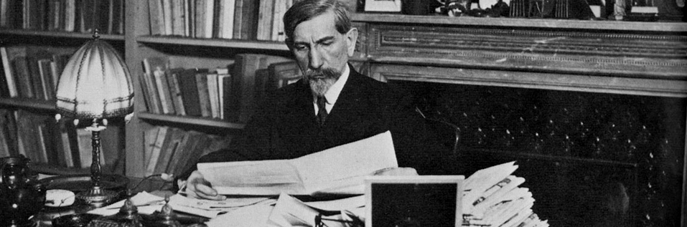
Other ‘conflictual currents’

