Slide 1
Politics & Violence in modern France
Week 4, Term 2
Vichy, the Occupation & the Resistance, 1940-1944

Slide 2
Lecture outline
Introduction: Vichy & the Occupation in context
Occupation & Collaboration
Persecution of the Jews
Resistance
Liberation
Conclusions

Slide 3
Introduction

Slide 4
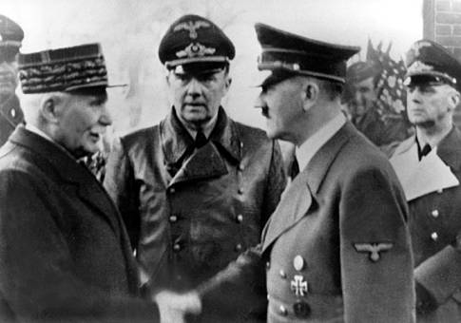
Occupation & Collaboration

Slide 5
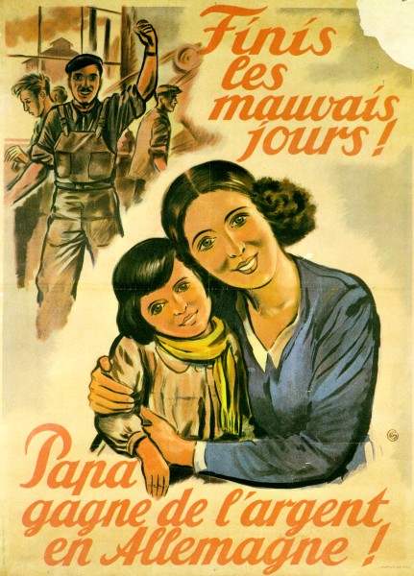
Occupation & Collaboration

Slide 6
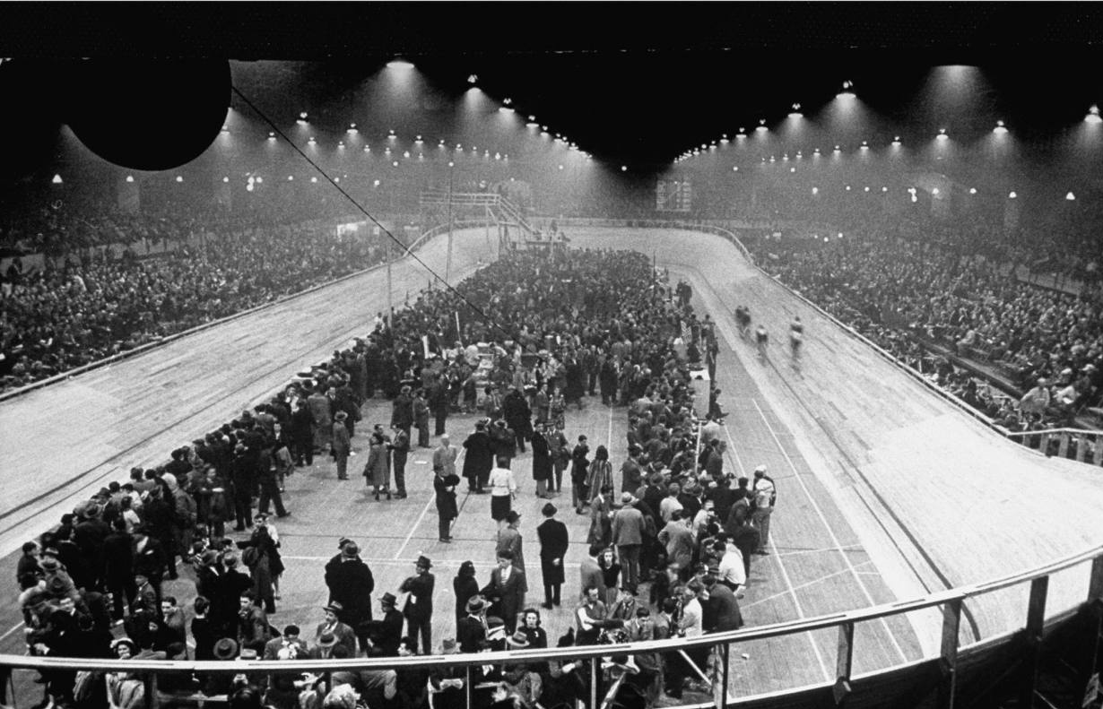
Persecution of the Jews

Slide 7
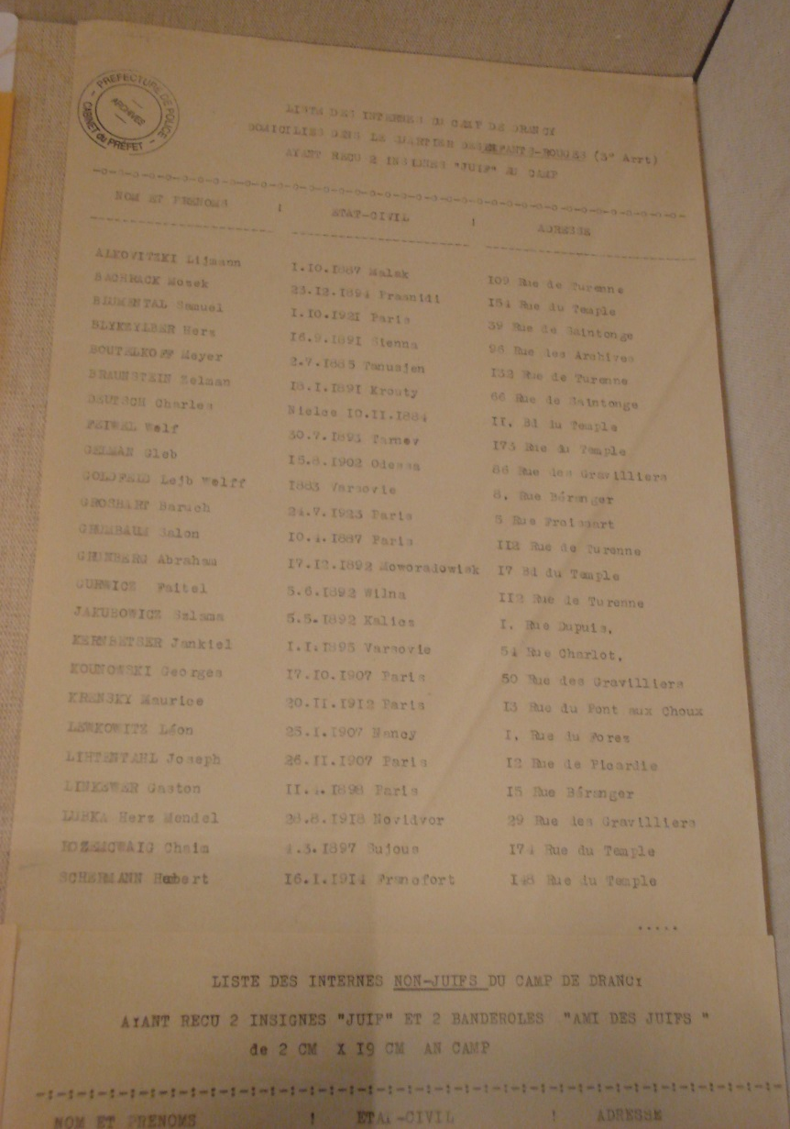
Persecution of the Jews

Slide 8
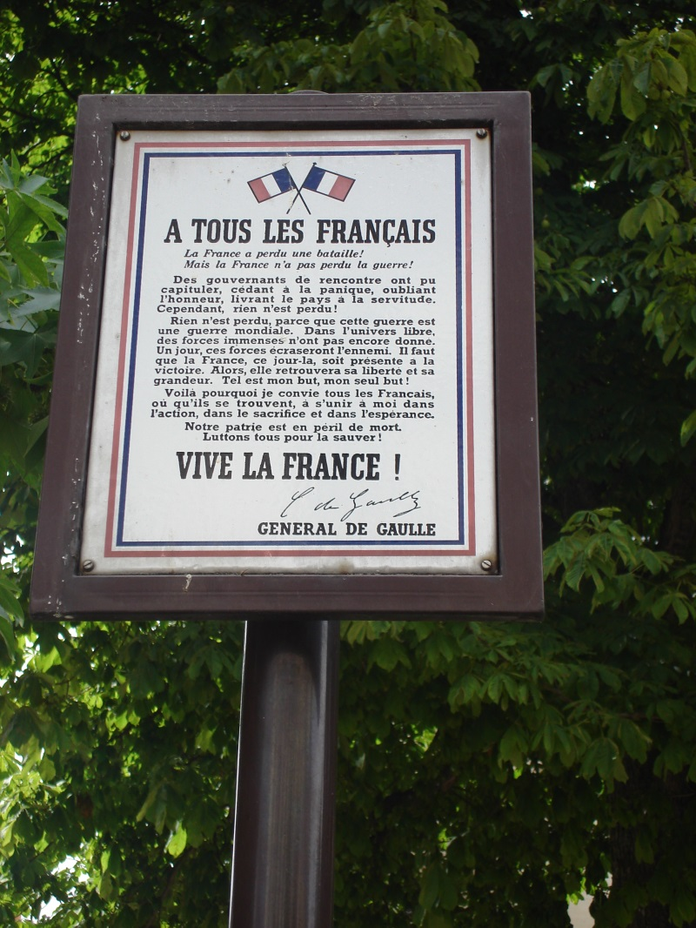
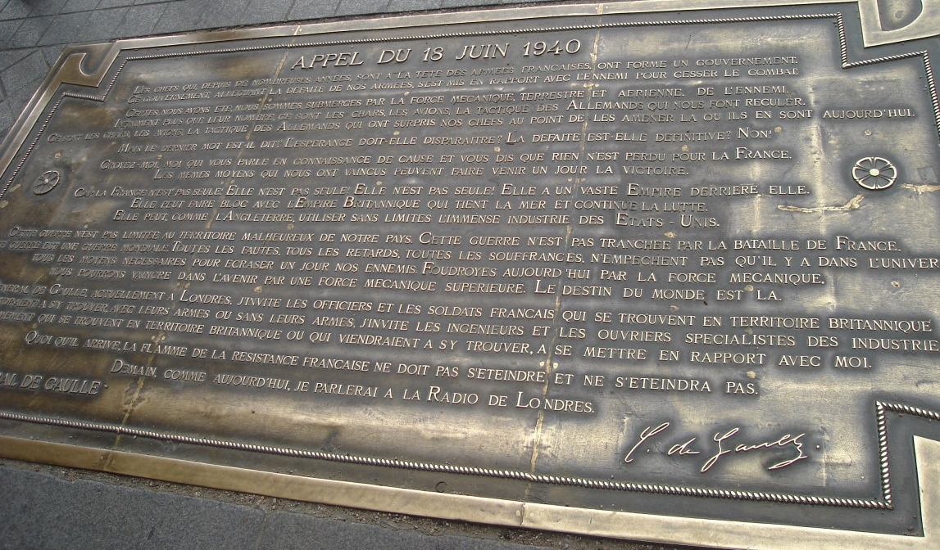
Resistance

Slide 9
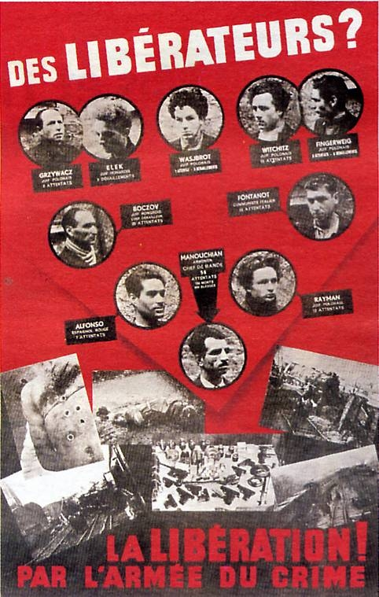
Resistance

Slide 10
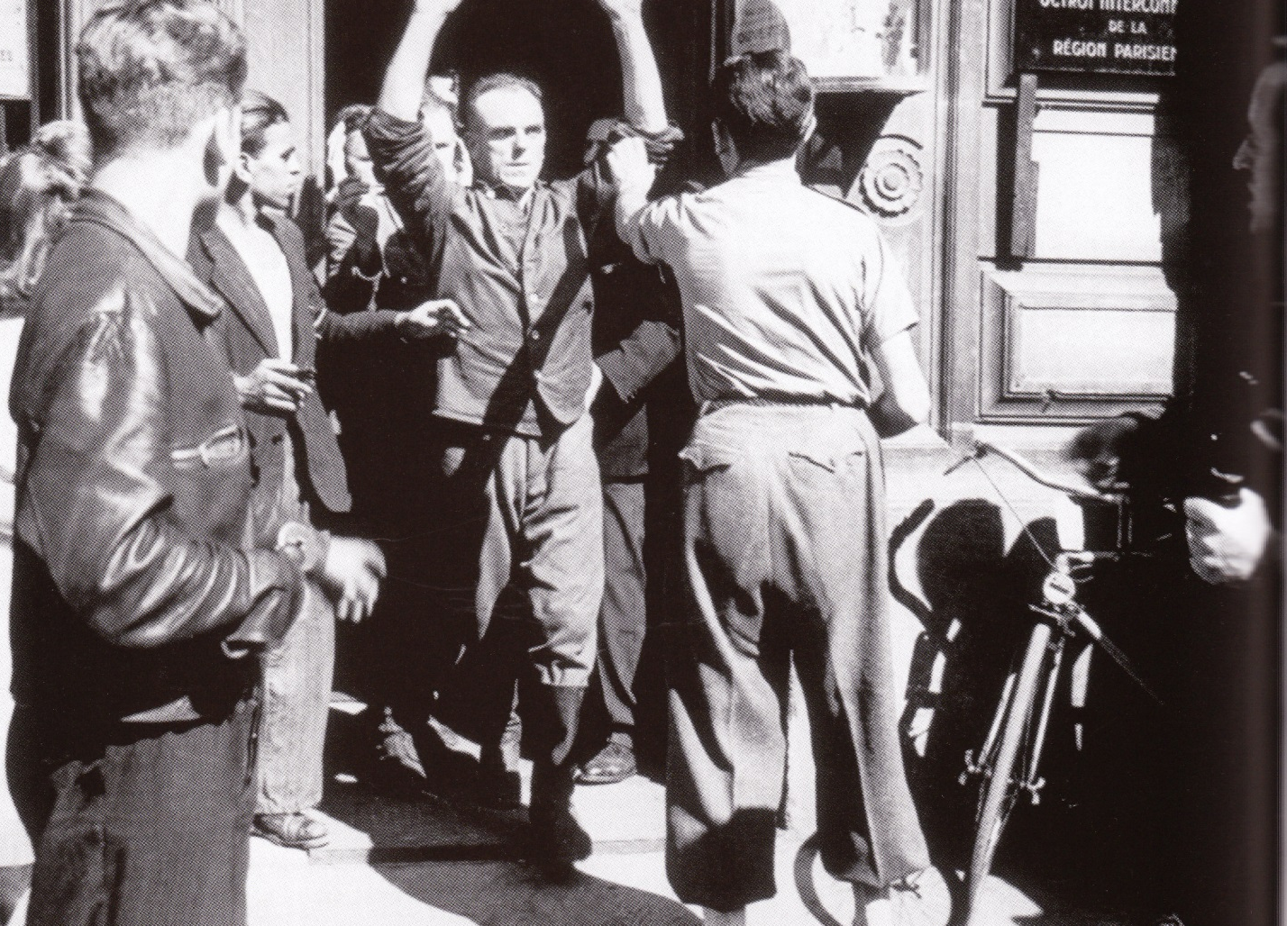
Liberation

Slide 11
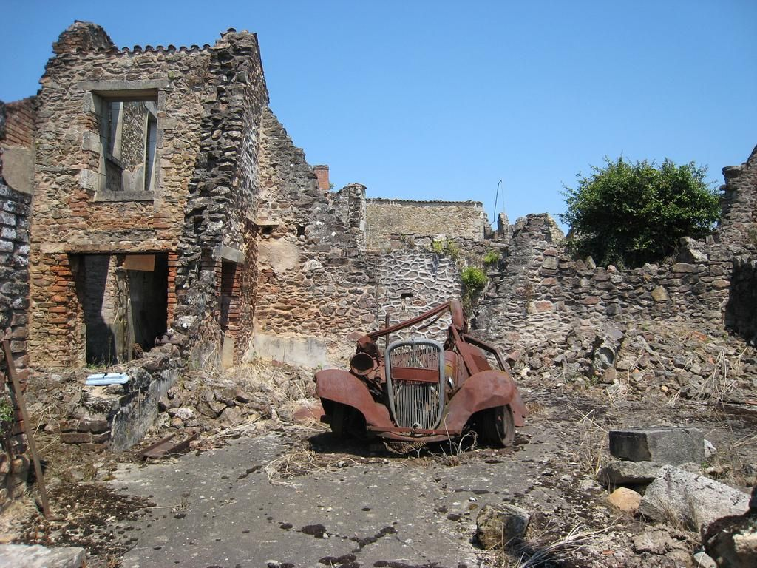
Liberation

Slide 12
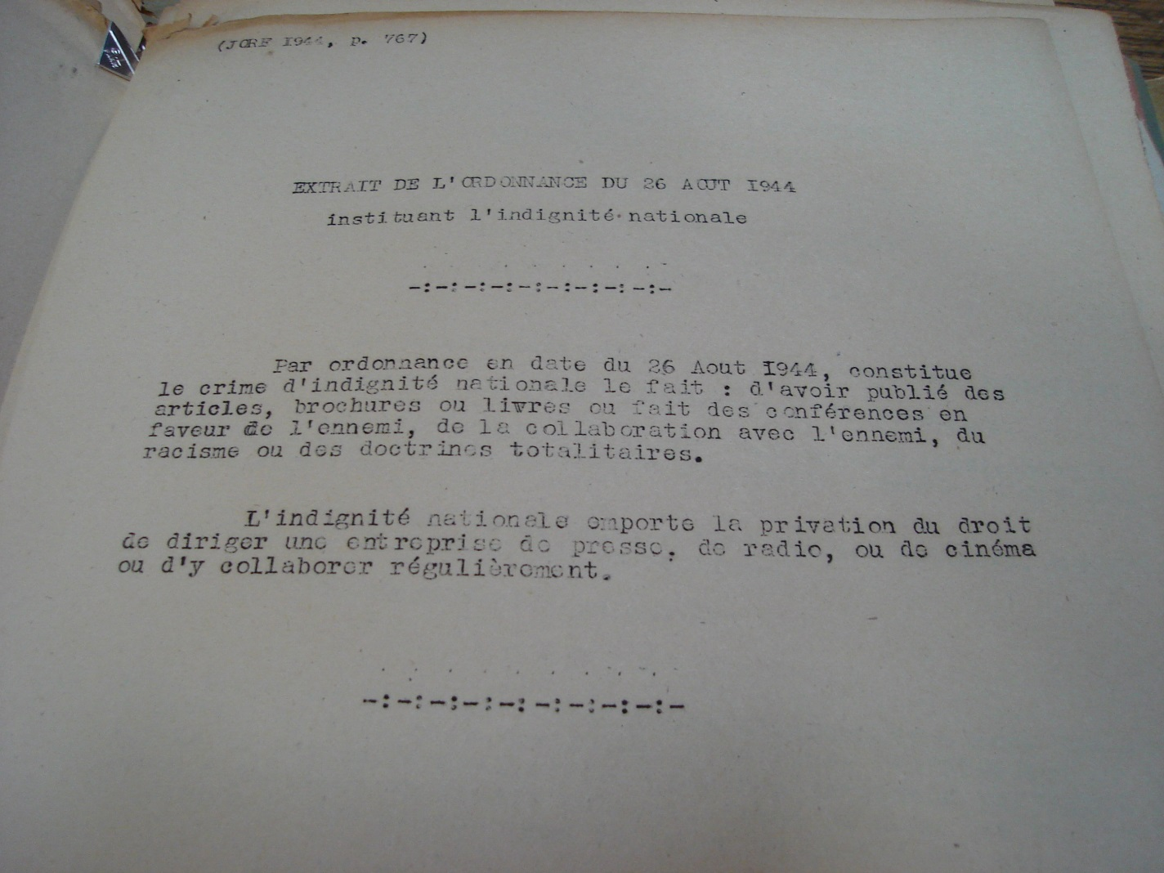
Liberation

Slide 13
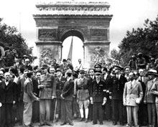
Liberation

Slide 14
Conclusions
Why were Vichy, the Occupation and the Liberation so violent?
How much was this down to the revolutionary tradition? To the Republic? To long-held beliefs?
Was collaboration necessarily violent?
Was Resistance necessarily violent?
How and why did the Republican tradition shape the ‘dark years’?

