Slide 1
Politics & Violence in Modern France
‘Struggles for independence & their interpretation: Fanon and Sartre
Week 5, Term 1

Slide 2
Lecture outline
Introduction
International context
Indochina and Algeria
Sartre
Fanon
Conclusions

Slide 3
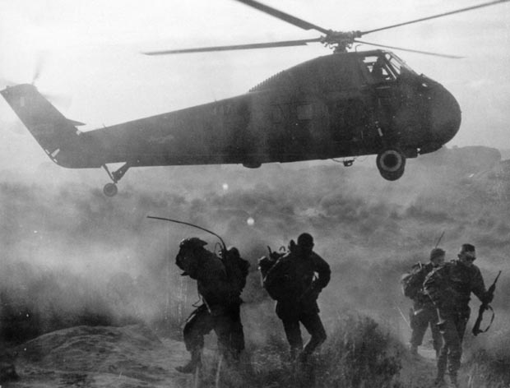
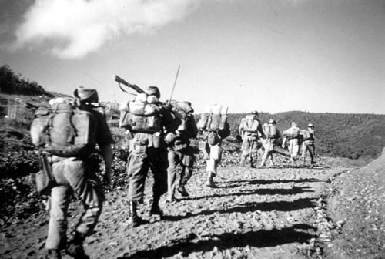
Introduction

Slide 4
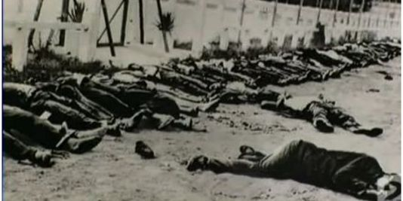
International context

Slide 5
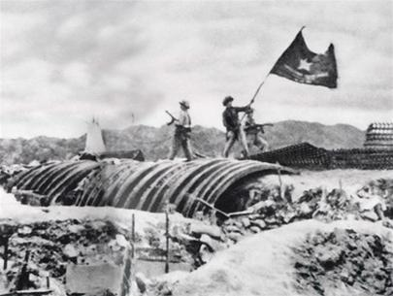
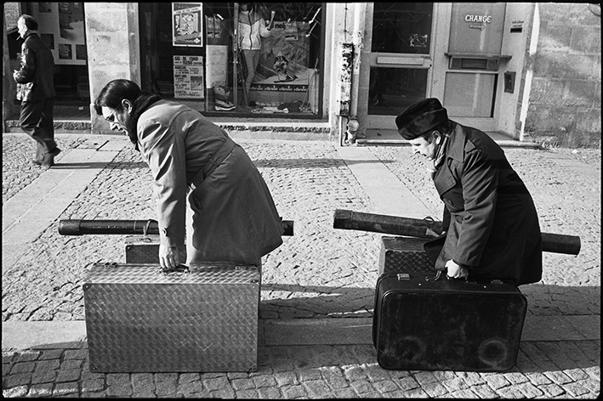
Indochina & Algeria

Slide 6
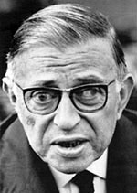
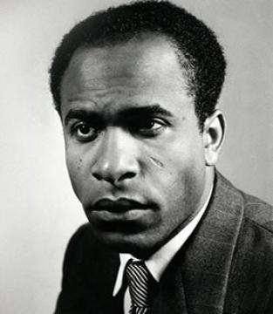
Fanon and Sartre

Slide 7
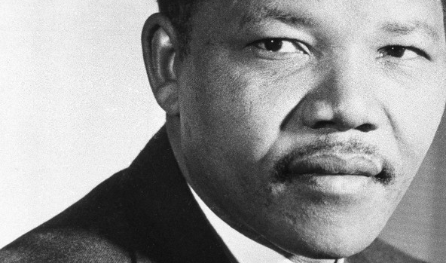
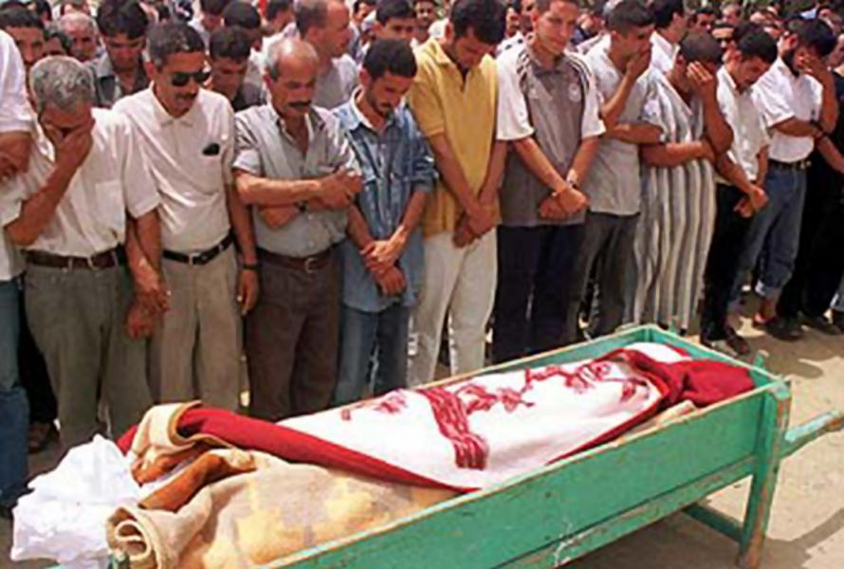
Conclusions

Slide 8
Key questions
How was France’s attitude towards her colonies shaped by the defeat of 1940?
To what extent was this a ‘cycle’ of violence?
Why was Sartre so supportive of decolonisation?
Why did Sartre come out so strongly in support of the FLN yet fail to act under the Occupation?
Why did Fanon believe that violence was necessary to achieve decolonisation?
Must all decolonisation necessarily be violent?

