Slide 1
GENDER AND REPRESENTATION IN FRENCH MEDIA SINCE 1970
Welcome to the course!
Week 1: Introduction/The Buddy Film à la
française

Slide 2
Structure of the First Session
Rationale of the course
General background; why gender matters (cf. Stuart Hall).
History of theorisations of gender roles in academia (French and Anglophone) and the organisation of the course in relation to this.
Introduction to the history of gender roles and their representation in France
Gender and feminism in French society since the 1970s (Christine Bard)
Introduction to the representation of gender historically in French film and visual culture
Blier and Les Valseuses
Context of the film
Sequence analysis (opening)
Discussion of gender issues in Blier’s oeuvre and the film as a whole

Slide 3
(Late) Landmarks in Legislation Around Women’s Rights in France
Early 1900s: women allowed to manage property and income – around a century later than women in the US and Britain.
1944: women’s suffrage (1918 in Britain, 1920 in the US).
1969-72: legislation grouped together under the heading of the Loi Neuwirth legalising contraception, notably the pill (1961 in Britain, for married women).
1975: Loi Veil, decriminalising abortion (1967 in Britain); also divorce legal by mutual consent.

Slide 4
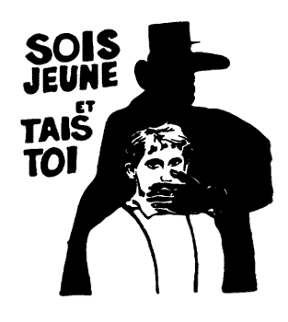
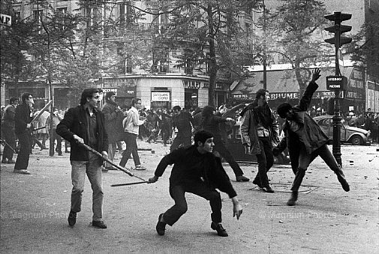
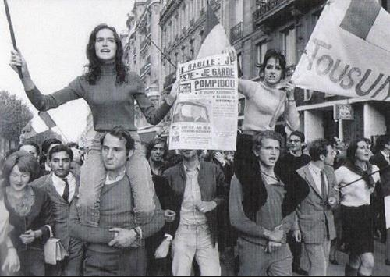
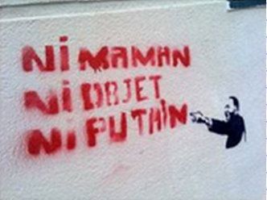
May ‘68

Slide 5
Christine Bard, ‘Les Antiféminismes de la deuxième vague’
Her thesis throughout her book Un siècle d’antiféminisme is that feminist movements are always shadowed by anti-feminist backlashes (cf. Susan Faludi, Backlash: the Undeclared War Against American Women, 1991, Susan J. Douglas, The Mommy Myth, 2004, or in France Elisabeth Badinter, Le conflit: la femme et la mère, 2010, and others).
A key feature of 1970s French feminism:
Two strands: the previously dominant ‘courant différentialiste’ versus the new more globally-influenced, equality-focused movements spearheaded by the Mouvement de libération des femmes (MLF).

Slide 6
pp. 309-10 ‘L’enjeu de la libération sexuelle’: a problem area for feminism
‘Avoir une sexualité “épanouie” est désormais reconnu comme une condition nécessaire à l’équilibre psychique. Les années 1970 célèbrent la fin d’un long siècle victorien. Les féministes ont participé à cette évolution, mais elles jouent aussi les trouble-fête, car nombreux sont ceux qui pensent qu’une femme “libérée” est une femme disponible, sexuellement, pour eux.’

Slide 7
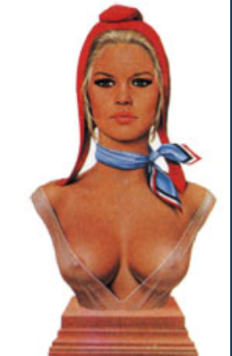
La Marianne

Slide 8
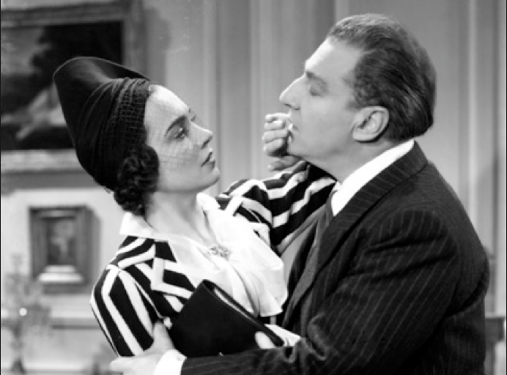
Gender Representation in French Cinema
In 1988 Ginette Vincendeau has identified an ‘incestuous’ ‘father-daughter’ model of couple pairing in classical (1930s) French cinema, in Vincendeau, ‘Daddy's Girls (Oedipal Narratives in 1930s French Films).’ Iris no. 8: 70-81.
Noël Burch and Geneviève Sellier (see extra reading) identify this paradigm in 300 out of one thousand films produced in that period and still frequent in decades since then. They point out that the term ‘incest’ allows us to relate screen thematics to ‘a psychosocial paradigm in real life, where the sexual abuse of young girls by men having power over them is not merely a daydream’. (Burch and Sellier 2002, p.153)

Slide 9
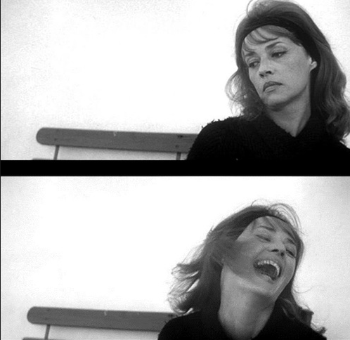
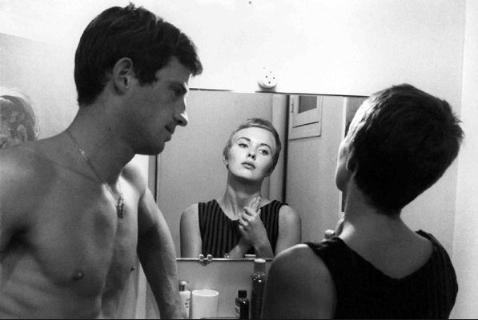
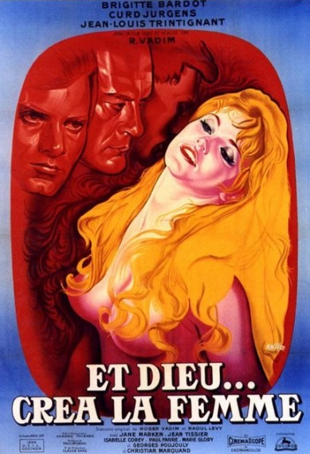
Burch and Sellier also find this model to be frequent if not dominant in the portrayal of romances in subsequent decades.
What about the New Wave?
See Geneviève Sellier, La Nouvelle Vague: un cinéma au masculin singulier. Paris: Broché, 2005,
Vincendeau (2000) in ‘New Wave, New Stars’ on ‘phantasmic male projections’ (p.113).
Truffaut: ‘Filmmaking is pointing the camera at beautiful women.’
Á bout de souffle (J.-L. Godard, 1960)
1956

Slide 10
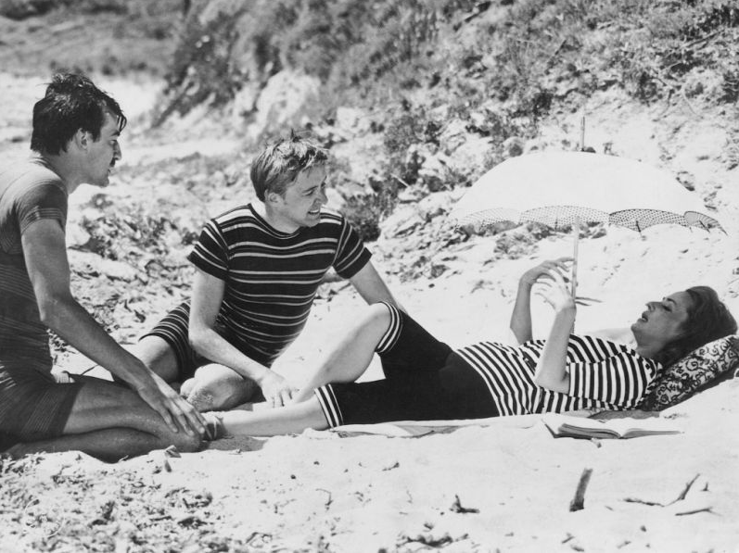
Jules et Jim (François Truffaut, 1962): an ambivalent intertext

Slide 11
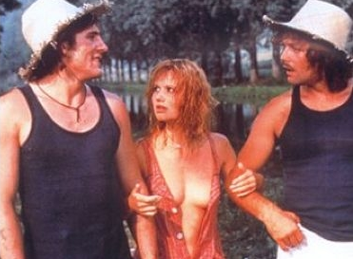
Les Valseuses (1974)
5.7 million entries at French box office - succès de scandale
Context
Disaffection among youth cut off from the Trente glorieuses (1945-75), in which France underwent unprecedented economic expansion and modernization
Economic dislocation and social strife following 1973 oil crisis (high oil prices due to embargo by many producing nations)
Global liberationist politics and movements in 1960s and 1970s; the rise of ‘counter-culture’….

Slide 12
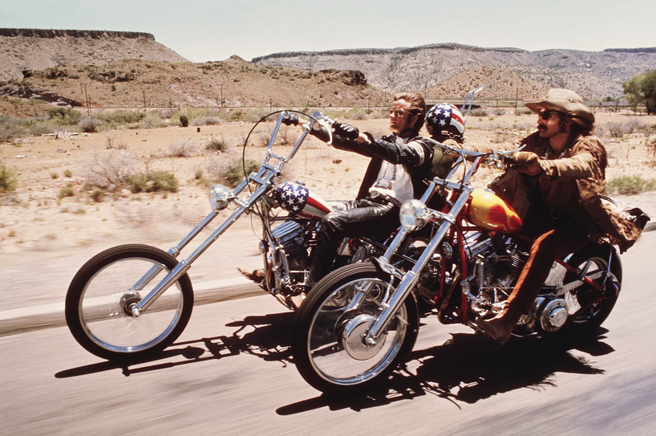
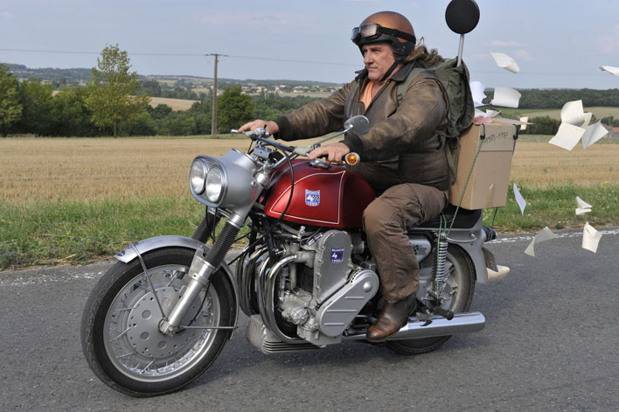
France’s answer to Easy Rider (1969)?
Compare Mammuth (Benoît Delépine and Gustave de Kervern, 2010)

Slide 13

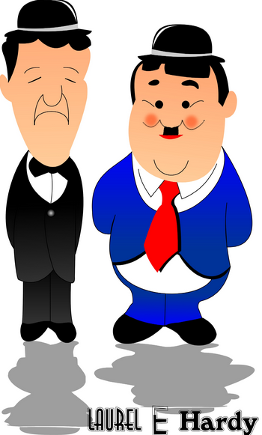
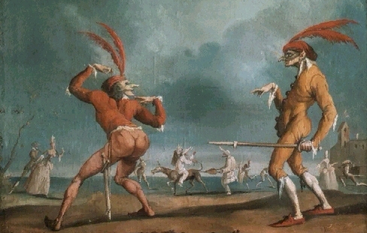


Comic Buddy Duos
A transnational, transhistorical phenomenon.
La Commedia dell’Arte
But particularly common in French cinema? See Raphaëlle Moine, Remakes: les films français à Hollywood (Paris: CNRS Editions, 2007), 165-7.

Slide 14
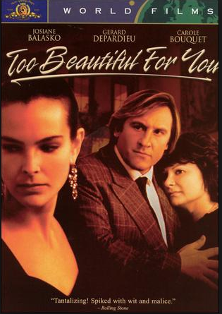
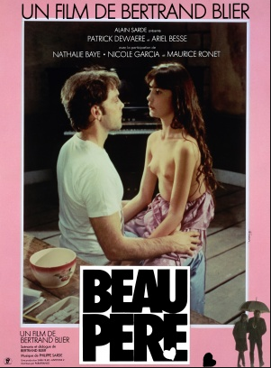
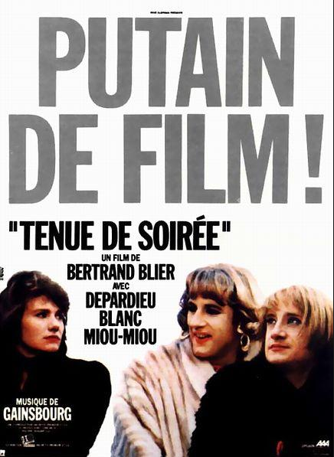
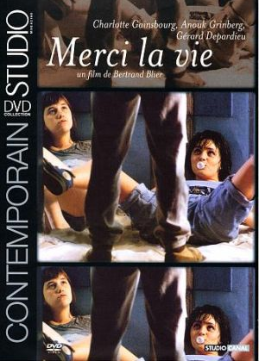
Filmography includes:
The Problem of Gender in Bertrand Blier’s Films

Slide 15
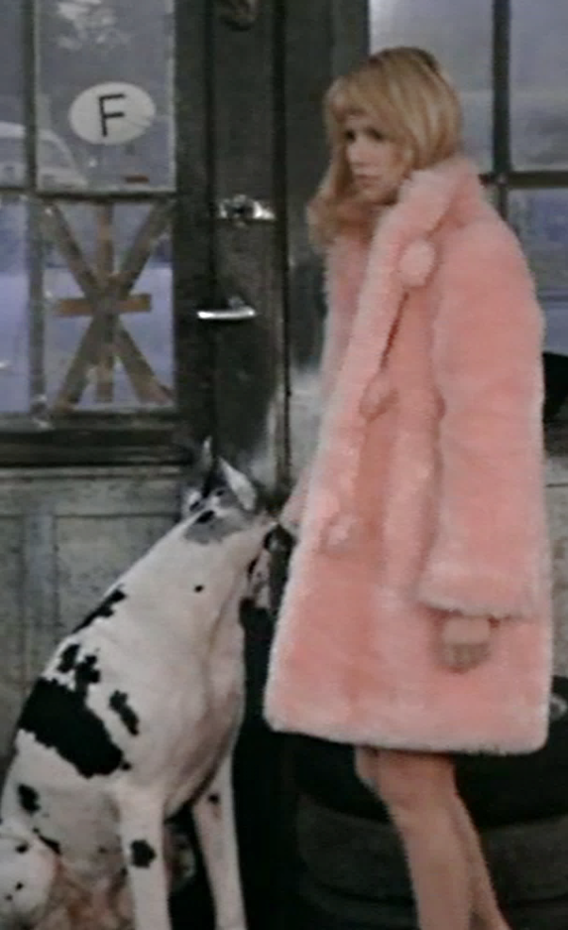
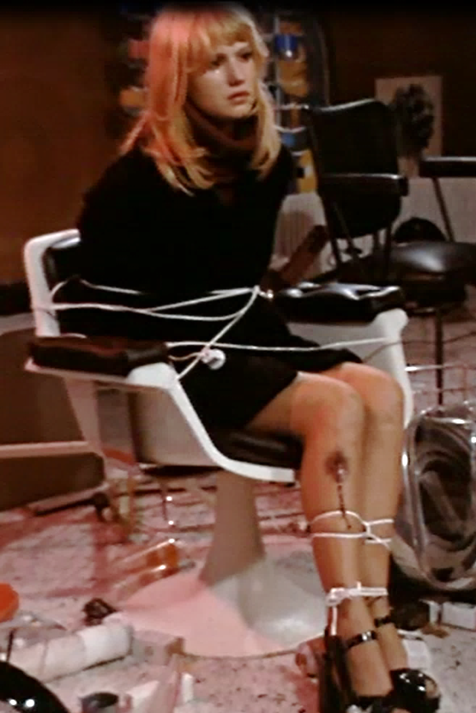
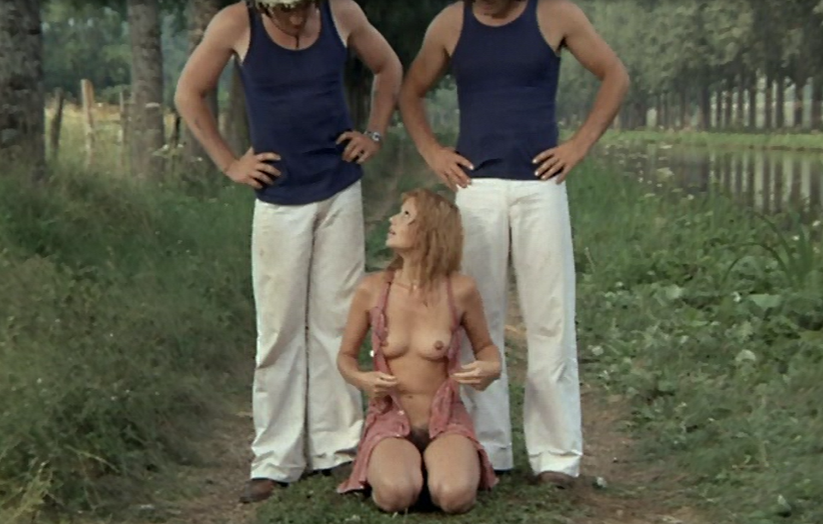
Brigitte Rollet, ‘“The Man Who Disliked Women: Blier – Misogynist or “Gynophobe”?’,
in R. Gunther and J. Windebak (eds.), Violence and Conflict in Modern French Culture (Sheffield Academic Press, 1994).
Rollet describes a ‘reduction of women to their genitals. Blier’s characters are defined solely in terms of their sexual organs and hence their sexual activity’ (p. 241).

Slide 16
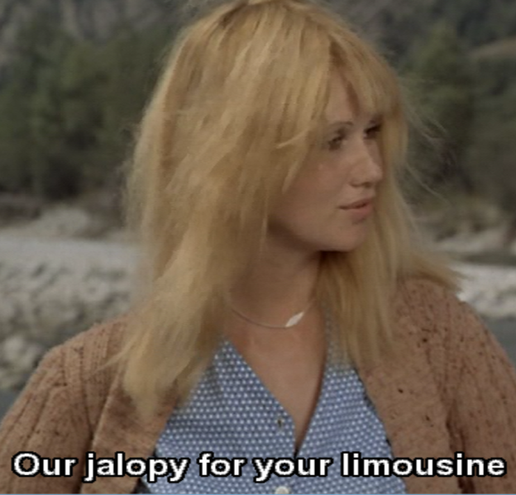
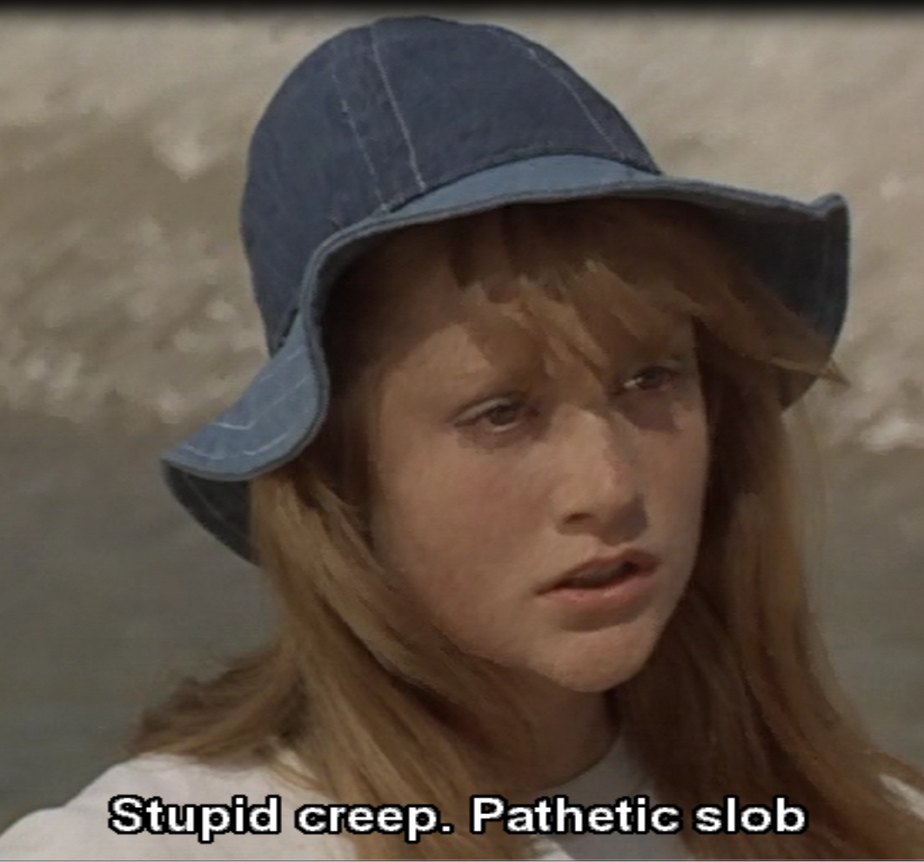
Sue Harris, ‘Bending Gender,’ [see extra reading]
‘Blier’s ambiguous construction of female representation mounts a series of explicit challenges to cinematic conventions […] Codes of attractiveness, emotional response, and female corporeality are all explored and subverted in Blier’s construction, and […] the comic potential of the female body in relation to the male body, and the wider community is highlighted.’
‘She is constructed not as the object of travesty […] but rather as the vehicle for travesty, the one who undoes the “specific codes of coherence” [described by Judith Butler] […] her consistently ambiguous narrative function and unconventional image also pose a threat to the established gender hierarchy with which spectators are familiar.’ (p.115)

