Slide 1
GENDER AND REPRESENTATION IN FRENCH MEDIA SINCE 1970
WEEK 3
Theorising the Representational Other

Slide 2
Structure of the Session
Mulvey in hindsight
Some thoughts on her legacy and applications since the 1970s
Steve Neale’s response to Mulvey – buddy films as an example?
Introduction to Emmanuel Levinas
Luce Irigaray and the feminist dialogue with Levinas
Levinas and the Dardenne brothers; gendered representation in the Dardenne brothers
- With special reference to La Promesse and L’Enfant

Slide 3
“Visual Pleasure and Narrative Cinema” : some conclusions
Feminine subjectivity has no place in classical narrative cinema
The challenge to the patriarchal language of narrative comes from a cinema of ‘un-pleasure’: avant-garde experimentation such as Chantal Akerman’s Jeanne Dielman: 23 quai du commerce, 1080 Bruxelles (watch on Youtube)
Mulvey’s essay raises two important questions/problems:
How do women relate to feminine images? Can there be a feminine position, different from the dominant masculine position?
Can woman as spectator derive pleasure from mainstream cinema in her own terms (ie not upholding the masculine structure of the gaze and the patriarchal narratives)?

Slide 4
Some responses to Mulvey:
LM revises her theses in “Afterthoughts on ‘Visual Pleasure and Narrative Cinema’” inspired by Duel in the Sun (1946)
Mary Ann Doane, “Film and the masquerade: Theorising the Female Spectator”, Screen, 23.3-4 (1982)
Tania Modleski, “Hitchcock, Feminism and the Patriarchal Unconscious”, in The Women Who Knew Too Much (1988)
Steve Neale, “Masculinity as Spectacle”, Screen, 24 (1983) (further reading)
Also, considering Mulvey’s 2009 introduction: how do technological changes since the 1970s inflect this approach to spectatorship?
Notes:
4

Slide 5
Thinking about masculinity
The male gaze: narrative and power
MULVEY’s theses:
Femininity: the perpetual object of the gaze
The look is male & active; the object of the look is female and passive. Woman is the object of desire that provokes the narrative. Man is a “powerful ideal ego” for the spectator.
NEALE’s theses:
Masculinity, an impossible ideal
1) The male gaze as instrument for the Oedipal trajectory of classic Hollywood narrative. This makes heterosexual masculinity: a “structuring norm” (Neale, 9).

Slide 6

2) the to-be-looked-at-ness of woman places the spectator in a male position. The spectator is aligned with the camera’s gaze, as well as the gaze of the masculine characters.
2) The male image provides a source of identification, but it is also a source of contemplation. Its eroticism must be repressed/disavowed. 2 ways:
sado-masochistic fantasies that involve the destruction of the male body
2. the male body is placed in a feminized position

Slide 7
3) Woman evokes the threat of castration (early stage in the child’s psychosexual development). In order to disavow the anxiety of castration, the masculine unconscious
fetishises woman (ie the over-valuation of the star’s image)
and punishes her (through narratives that lead to woman’s death or her subjugation to male power)
Neale says: “The construction of an ideal ego… is a process involving profound contradictions. While the ideal ego may be a “model” with which the subject identifies and to which it aspires, it may also be a source of further images and feelings of castration, inasmuch as that ideal is something to which the subject is never adequate.” (Neale, 13)

Slide 8
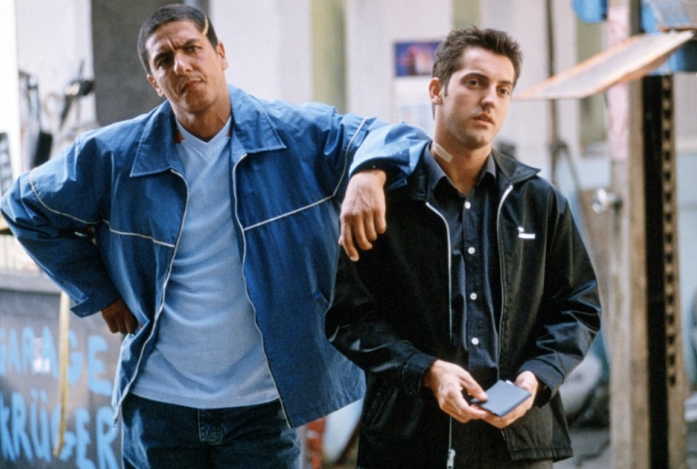


The male gaze: narrative and power
Contradiction between narcissism (linked to silence) and the law (linked to language): tension between “an image of narcissistic authority on the one hand and the image of social authority on the other” (Neale 14) . Neale, following Mulvey, argues that these two diverging images of masculinity are at play in the Western.
Also elsewhere?
Taxi (1998)

Slide 9
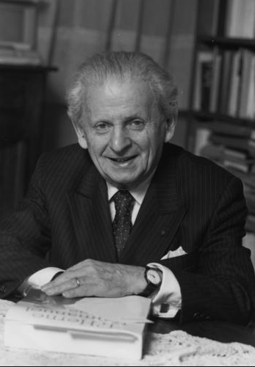
Emmanuel Levinas
1906 (Lithuania) – 1995 (Paris)
Came to France in 1923, researched and taught there predominantly until his death.
Played a key role in introducing Husserl’s phenomenology* to France but develops a gradually more critical relation to his phenomenological forebears, both Husserl and Heidegger.
Spent WWII as POW: Lithuanian relatives killed by Nazis.
Known principally for his ethics, developed in two key works: Totalité et infini: essai sur l’extériorité (1961) and Autrement qu'être ou au-delà de l'essence (1974).
* ‘The discipline of phenomenology may be defined initially as the study of structures of experience, or consciousness. Literally, phenomenology is the study of “phenomena”: appearances of things, or things as they appear in our experience, or the ways we experience things, thus the meanings things have in our experience. Phenomenology studies conscious experience as experienced from the subjective or first person point of view. This field of philosophy is then to be distinguished from, and related to, the other main fields of philosophy: ontology (the study of being or what is), epistemology (the study of knowledge), logic (the study of valid reasoning), ethics (the study of right and wrong action), etc.’ Stanford Encyclopedia of Philosophy http://plato.stanford.edu/entries/phenomenology/

Slide 10
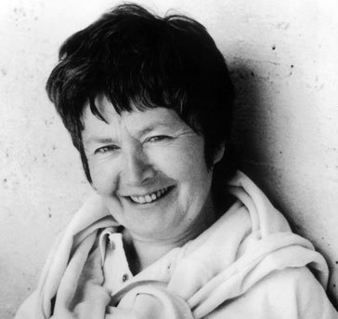
Luce Irigaray
1930 -
Belgian-born French feminist philosopher.
Best known for her works:
Speculum de l’autre femme (1974)
Ce sexe qui n’en est pas un (1977)
(to an extent) Éthique de la différence sexuelle (1984)
A disciple of Jacques Lacan who later moved away from psychoanalytic preoccupations.
Influenced by but critical of Levinas, especially when it comes to theorisations of gender.

Slide 11
Tina Chanter, ‘Levinas and the Question of the Other,’ in Irigaray’s Rewriting of the Philosophers
‘Irigaray’s task […] is to put the issue of sexual difference on a new footing, so that the case is not already decided against it by the discourse of equal rights – that is, so that women’s differences from men do not automatically signify inferiority.’ p.171
‘The question for Irigaray is neither how women can become similar to men, nor merely how women can become different from men. Insofar as these two assumptions simply reverse one another, neither challenges the presumed authority of the masculine ideal.’ 172

Slide 12
Irigaray calls for women to ‘“move back through the ‘masculine’ imaginary, that is, our cultural imaginary,’ [quoting Ce sexe qui n’en est pas un, abbreviated by Chanter to TS for This Sex] in order to “(re)discover a possible space for the feminine imaginary’ based not on the tradition that has always designated women as its other, but on the relations between women in “among themselves”’.
‘In asking how to think sexual difference Irigaray does not restrict the scope of her question to women’s differences from men, she also introduces the question of how to think sexual difference in terms of absolute alterity or radical otherness. She thereby joins Levinas in his attempt to break with a venerable tradition, which, since Parmenides, has judged it impossible to think otherness in abstraction from sameness, to conceive of difference except in relation to the same or multiplicity as anything other than a repetition of the one.’ 173
And yet…

Slide 13
Luce Irigaray, ‘Fécondité de la caresse: Lecture de Lévinas: Totalité et infini, section IV, B, Phénoménologie de l’éros.’ In Éthique de la différence sexuelle, pp.173-99 (extra reading)
Irigaray’s critique of Levinas’ description of the erotic relation as the ethical encounter par excellence in Totalité et infini
L’amant la* renvoyant à l’enfance, l’animalité ou la maternité, laisse ce mystère d’un rapport cosmique pour une part non elucidé. (p. 181)
*l‘amante
[L’amant] Englobant l’autre, en toutes ses dimensions et directions, pour le/la capturer, le/la captiver dans un langage qui ne connaît, commes principales ressources, que la consommation et la vitesse de ses contradictions. (ibid)

Slide 14
Mais, sous ce bouclier, comment vivre? Quel futur est laissé à qui est ainsi entourée? Qu’elle joue, à l’intérieur de ce pays de l’homme, à se cacher sous de multiples parades, coquetteries diverses qu’il fera “tomber” dans l’amour, elle demeure sans identité ni passeport avec lesquels traverser, transgresser, la langue de l’amant. (p. 182)
Si l’aimée se présente et apparaît à l’amant comme paradis à ramener à l’enfance et l’animalité, l’acte amoureux signifie profaner aussi: faire tomber. Entraîner dans la chute. L’aimée serait ramenée à l’abÎme pour que l’amant soit renvoyé au plus haut. L’acte amoureux reviendrait à toucher à la démesure du discours pour renvoyer l’aimée à la chute de l’animal ou de l’enfant, et à l’extase de l’homme en Dieu. (p.183)
Cf. Beauvoir on Levinas in Le Deuxième sexe, despite her other differences from Irigaray.

Slide 15
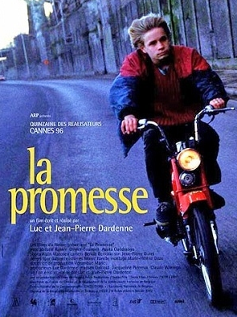
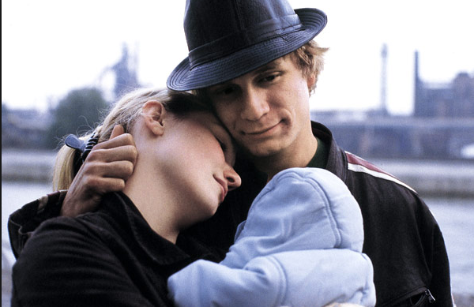
The Dardenne brothers
-- Discuss the possibility of their cinema as a Levinasian anti-ocular ‘haptic’ cinema
CLIP – La Promesse
Discuss their cinema as an ethical cinema cf. Cooper. Are these ethics gendered?
CLIPS – La Promesse, L’Enfant

Slide 16
- Discuss the possibility of their cinema as a Levinasian anti-ocular, perhaps ‘haptic’ cinema
CLIP – La Promesse
Theories of embodied and/or haptic cinema, prominently the work of Vivian Sobchack (embodiment) and Laura U. Marks (haptics), seek to broaden and contest film theory’s traditional privileging of visuality.
Implications for a gendered reading.
See also Mai (extra reading), especially article on La Promesse.
Discuss their cinema as an ethical cinema cf. Cooper. Are these ethics gendered?
CLIPS – La Promesse, L’Enfant

