Slide 1
GENDER AND REPRESENTATION IN FRENCH MEDIA SINCE 1970
Week 5: Le Cinéma du corps

Slide 2
Structure of the Session
Picking up on last week – CLIP: 2 Days in Paris (2007)
For this week’s topic
- Introduction to the New Extremism/le cinéma du corps – other examples
- Breillat in context
- Overview of Kristeva reading
- Kristeva and film studies (MH)
- Overview of Downing and Keesey readings
- General discussion of À ma soeur! through questions and in relation to the readings

Slide 3
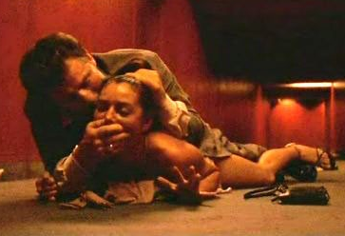
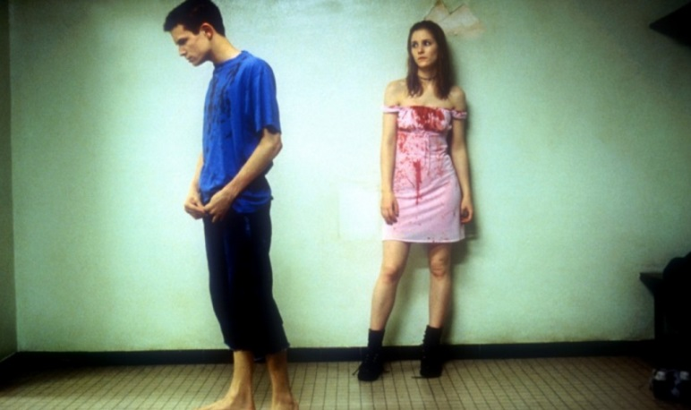
The New French Extremism
See J. Quandt on extra reading.
From ‘realism’ to ‘extremism’
N.B. On realism in cinema see Hallam, J. and M. Marshment. 2000. Realism and Popular Cinema. Manchester: Manchester University Press, especially pp.197-201.
Bruno Dumont (La Vie de Jésus, L’Humanité, Twentynine Palms)
Gaspar Noé (Carne, Seul contre tous, Irréversible)
François Ozon (Sitcom, Les Amants criminels)

Slide 4
Violence (rape, self-mutilation)
Irréversible (Noé 2002)
Dans ma peau (Marina de Van, 2002)
Demonlover (Olivier Assayas, 2002)
Le Vie nouvelle (Philippe Grandrieux, 2002)
Sex/pornography
Le Pornographe (Bertrand Bonello, 2001)
Choses secrètes (Jean-Claude Brisseau, 2002)
Pola X (Leos Carax, 1999)
Intimacy (Patrice Chéreau)2001))
Elements of both
Trouble Every Day (Claire Denis, 2001) (cannibalism)
Baise-moi (Virginie Despentes and Coralie [Trinh-Thi], 2000)
‘Cerebral sex’
Ma mère (Christophe Honoré, 2004) (Based on Georges Bataille; necrophilia)
Breillat: Romance (1999), A ma soeur! (2001), Sex is Comedy (2002), Anatomy of Hell (2004), Une vieille maîtresse (2007)

Slide 5
Features:
Explicit representation of sex and violence
Blurring of boundaries (auteur/popular; art cinema/pornography; good/bad taste*) – e.g. Une vieille maîtresse (Breillat, 2007)
Academic interest: the body, the abject, representation of desire and sexuality
Mainstream reception: provocation, moral panic
Extremism and the ‘political void’ (cf. critic Noël Burch)
An export category*
* See M. Selfe, 2010. ‘“Incredibly French?” Nation as an interpretative context for
Extreme Cinema.’ In L. Mazdon and C. Wheatley (eds), Je t’aime...moi non plus: Franco-British Cinematic Relations. New York and Oxford: Berghahn Books, pp.153-168.

Slide 6
Historical Determinants
‘French’
Literary: Sade, Dada/Surrealism, Artaud, Bataille, Céline, Michel Houellebecq, Catherine Millet, Virginie Despentes
N.B. see Maddock and Krisjansen on extra reading re the links to Bataille and surrealist poetics.
Cultural valuation of libertinage and seduction
Art film: Dada/Surrealism, Godard (Weekend), Blier, Last Tango in Paris (Bertolucci 1972), La Mamain et la putain (Jean Eustache, 1973)
Popular cinema: 1970s ‘explosion’ in soft-core and hard-core porn e.g. the exploitation films of Jean Rollin, Emmanuelle (1974 end of censorship, essentially for pornography)
International
Increased sexualisation of culture
Film genres: horror (torture porn), sexual thriller, rape-revenge films
Relationship to politics (the ‘retreat’ from ideology)
Retreat of militant feminism

Slide 7
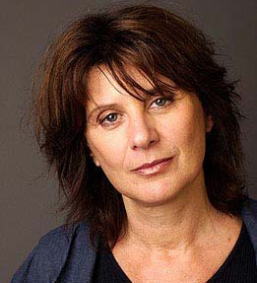
Catherine Breillat
Born 1948
Writer and filmmaker (and actress)
First novel, L’Homme facile, written at the age of 17
‘You always have to test yourself to the limit, even at the risk of destroying yourself or others’ [to Cahiers du cinéma, 1999]
Representations
Explorations of heterosexual sexuality from a ‘cerebral’ perspective (‘Pas le sexe, la question sexuelle’, À ma soeur!)
Critique of machismo
Frequent adoption of female point of view, especially young women
‘Real time’ sex scenes

Slide 8
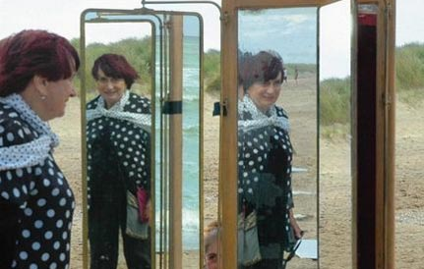
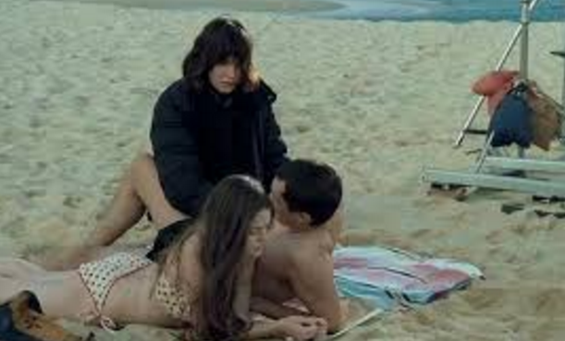
Women’s Cinema as Art Cinema in France: A Historical Precedent
L
Les Plages d’Agnès (Agnès Varda, 2008)
Sex is Comedy (Breillat, 2002)

Slide 9
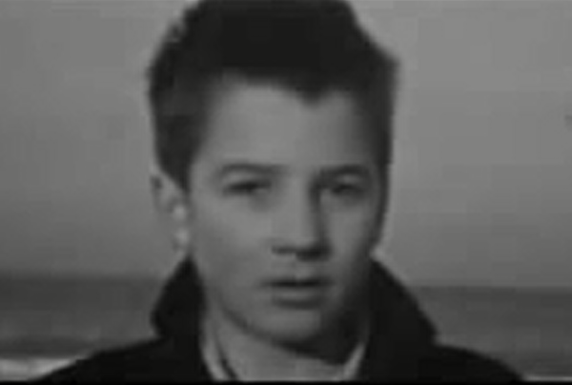
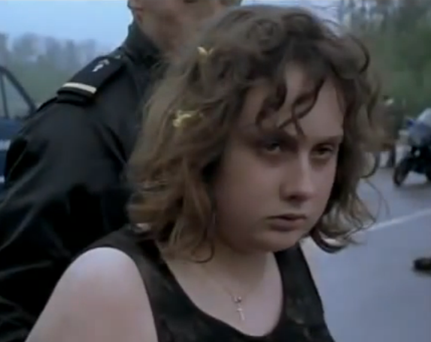
Alongside a Dialogue with the Male Auteur Canon
Subverting gaze structures…
… while exploring the morality of rape

Slide 10
Relation to feminism
Refusal of ‘woman director’ label.
‘Feminists do not love me. My own position is that a woman must be a militant feminist in life, but when she is making a work of art, things are different. [to Monthly Film Bulletin, 1998.]
Adoption of ‘male’ discourse (intellectual, professional)
Provocation
Libertinage discourse (protest against the regulation of prostitution) – see https://mauvaiseherbe.wordpress.com/tag/noel-burch/

Slide 11
Breillat since À Ma Soeur!
The turn to the past – Une vieille maîtresse (2007), , set in nineteenth century; Barbe bleue, 2009, which is more difficult to categorise as extreme.
‘I love Dandyism and the nineteenth century […] The novel was written by a man [Barbey d’Aurevilly]. I identify myself as a painter. And a painter’s signature is his last name. My name is Breillat. We know it’s feminine, but that’s not because of what you see on the screen.’
‘I haven’t left provocation behind, but when I made Anatomy of Hell, I said that was the tenth film with a big X; the last, the most hard-core, the one that transgresses every taboo. […] Once I got that out of my system, I wanted to make a film about pleasure and passion, something more soothing for the viewer.’
‘The thing that interests me… is that the two characters exchange qualities as their relationship progresses. Asia [Argento] is masculine and dominates Ryno de Marigny, and sometimes he is the one who dominates her […]’
Source 2007 Cannes Film Festival Press Conference
http://www.festival-cannes.com/en/theDailyArticle/55627.html
Le Cinéma du corps as a phenonenon of the 2000s? Cf. Abus de faiblesse 2013 – more interested in non-sexual power dynamics and seen as more ‘humane’ in general.

Slide 12
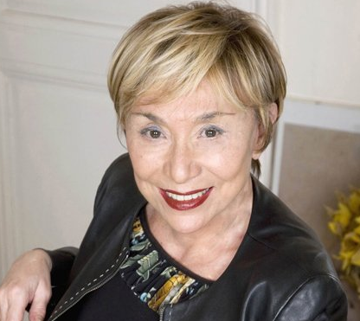
Julia Kristeva
1941-
Bulgarian-French academic, philosopher, literary critic, psychoanalyst, sociologist, feminist, and, most recently, novelist. She has lived in France since the mid-1960s. T
Probably best known for her work on the abject in Pouvoirs de l’horreur.
This is not least due to its enormous influence on film studies scholarship focused on the horror genre, notably in the work of Barbara Creed.the University Paris Diderot.

Slide 13
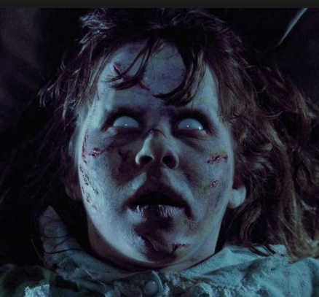
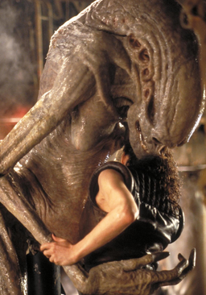
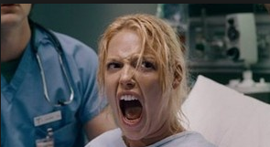
For instance, on Alien:
‘The horror [then] played out can be read in relation to Kristeva’s concept of the semiotic chora […] Kristeva argues that the maternal body becomes the site of conflicting desires (the semiotic chora). These desires are constantly staged and restaged in the workings of the horror narrative where the subject is left alone, usually in a strange, hostile place, and forced to confront an unnameable terror, the monster. The monster represents both the subject’s fears of being alone, of being separate from the mother, and the threat of annihilation – often through reincorporation. As oral-sadistic mother, the monster threatens to reabsorb the child she once nurtured. Thus, the monster, like the abject, is ambiguous; it both repels and attracts.’
Creed, ‘Horror and the Monstrous-Feminine: An Imaginary Abjection.’ In B. K. Grant (ed.), The Dread of Difference: Gender and the Horror Film (Austin, University of Texas Press, 1996), p. 58.
Wider resonances – ‘gross-out’ comedy

Slide 14
À ma soeur!
Seminar Questions
- How can we describe the film's aesthetics? Are they realistic/stylised/expressionistic/symbolic? Think here about the characteristics of its spaces, colour palette and mise-en-scène in general.
- Where might we find 'abject' sites within the film, using Julia Kristeva's term? What is the force of these from a feminist perspective?
- How are the graphic sex scenes filmed, compared with conventional representations, and why?
- What is the meaning of the ending?

