Slide 1
GENDER AND REPRESENTATION IN FRENCH MEDIA SINCE 1970
Week 9: Gender in Television and New Media

Slide 2
Structure of the Session
Television in France
The possibility of feminist perspectives within the mainstream: Adele King and Judith Butler
Postfeminist television in a global context
Un gars, une fille – general discussion and textual analysis
Engrenages – McCabe, general discussion and textual analysis
Despentes article analysis – demonstration for next week (MH).

Slide 3


Television in France
The medium holds a different, lower status than in Anglo-American nations thanks to the links between French national identity and high intellectual culture.
After a slow start in the early 1950s, 1958-64: ownership went from 10% to over 40%; it was a truly mass medium by the end of the 1960s.
See Lucy Mazdon, ‘French Television: Negotiating the National Popular.’ ( further reading).

Slide 4
Television in France
‘Television in France is at once more adult and more amateurish than in Britain or some other countries. A relatively high intellectual level in programmes goes hand in hand with clumsy technical blunders of presentation due to lack of discipline or preparation.’
Charles Hildesley, Sight and Sound, 1958, cited by Mazdon.
July 1982: Broadcasting Bill – end of State monopoly control of television.
See also Mazdon, ‘Contemporary French Television, the Nation, and the Family: Continuity and Change.’ Television and New Media 2, pp.335-339 (2001).

Slide 5

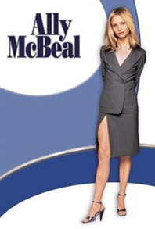
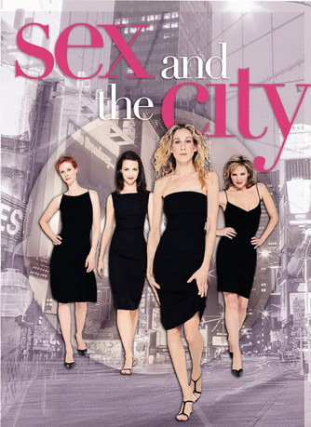
More recently…
‘The demise of the state monopoly, the advent of cable and satellite television, coupled with the development of new terrestrial channels and the privatization of TF1 [the original, State-controlled station] have caused a fragmentation of the French televisual landscape and undermined the apparent certainties of the national broadcast to a national audience carried out by a state-controlled public television.’ Mazdon 2001, p.338.
And more global circulation.
2001
1997-2003
1998-2004

Slide 6
‘The brunt of the joke in the end, in post-feminist television comedy […], is on men not measuring up to very traditional standards, in which a real guy is not gay, already sports a stiff upper lip and so on. With only a few exceptions, men are paraded in a freak show, whether as discarded sexual partners deemed unsuitable, or as gay men. […]’
Joke Hermes, ‘“Ally McBeal”, “Sex and the City” and The Tragic Success of Feminism (extra reading).

Slide 7
Deborah Jermyn on Prime Suspect (extra reading)
“[D]espite the prominence of […] male protagonists throughout the history of crime fiction, a number of the finer attributes we admire and expect to find in a good detective are generally thought of in wider cultural terms as ‘female’. An attention to detail; the capacity to listen and ‘read’ people; the ability to multitask as clues and leads mount; all of these characteristics are typically (though not unproblematically) culturally designated ‘feminine’.” P. 29.
Cf. Miss Marple as ‘a slightly dotty, inquisitive old lady’ p. 30.
Discusses DCI Tennison’s interweaving of ‘masculine’ and ‘feminine’ traits.

