Slide 1
STATES OF THE NATION: FRENCH CINEMA AND SOCIETY FROM 1990 TO THE PRESENT
Week 4: Women’s Auteur Filmmaking

Slide 2
STRUCTURE OF PART 1 OF THE SESSION
Overview of women’s filmmaking in France
Women’s auteur filmmaking
Introduction to Agnès Varda
Background and relationship to the Nouvelle Vague
Group exercise: formal analysis of Cleo de 5 à 7 (1962) as a way into…
Varda’s relationship with feminism, as this relates to recurring tropes in her work (e.g. the relationship with literature and art, the treatment of time and character, self-reflexivity and the theme of ageing)
Learning outcomes: by the end of the session students should
Be able to discuss in general terms the place of women in French auteur filmmaking
Have consolidated their skills in close formal analysis of film
Ba familiar with typical features of the work of Agnès Varda and how these relate in general terms to feminist themes and issues

Slide 3
French Women Filmmakers
1990-2010: female directors have been responsible for between 14 and 19% of overall production during the period, compared with 9% in Hollywood in 1998, falling to only 5% in 2010.
More specifically, for France, Carrie Tarr with Brigitte Rollet cite 14% for the 1990s (Tarr with Rollet, 2001. Cinema and the Second Sex: Women’s Filmmaking in France in the1980s and 1990s. London and New York: Continuum, p.1);
and Ginette Vincendeau (2010) finds this to rise to 19.4% in the year 2009 (Vincendeau, 2010. ‘The Rise and Rise of French Women Filmmakers: Victory for Feminism or French Exception?’ Paper delivered at ‘Women’s Filmmaking in France 2000-201’ conference, Institute of Germanic and Romance Studies, London, 4 December.)
All basing data on CNC statistics – see http://www.cnc.fr/web/fr;jsessionid=16DB5765B3ABCB94C9C6F54059F50602.liferay
For Hollywood, see Melissa Silverstein, 2014. ‘The Celluloid Ceiling: Behind-the-Scenes Employment of Women on the Top 250 Films of 2011.’ http://blogs.indiewire.com/womenandhollywood/what-bigelow-effect-number-of-women-directors-in-hollywood-falls-to-5-percent#.T_r9RpH_yVo.

Slide 4
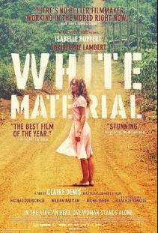
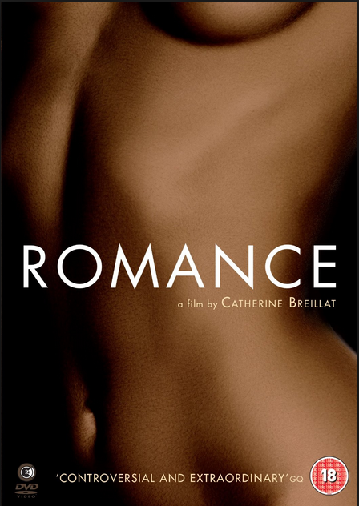
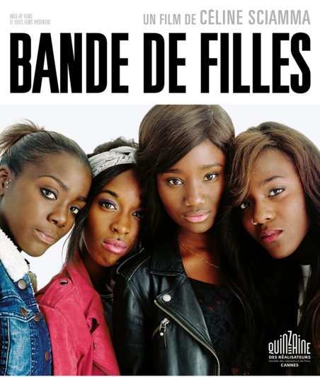
French Women Auteurs
Some prominent names include Varda, Marion Vernoux, Laetitia Masson, Claire Denis, Catherine Breillat, Céline Sciamma and many more. Associated with:
An intellectually elite target audience and market positioning (through publicity materials, festival exhibition, awards, type of cinema run)
Often ‘serious’ themes
A recognisable style?

Slide 5
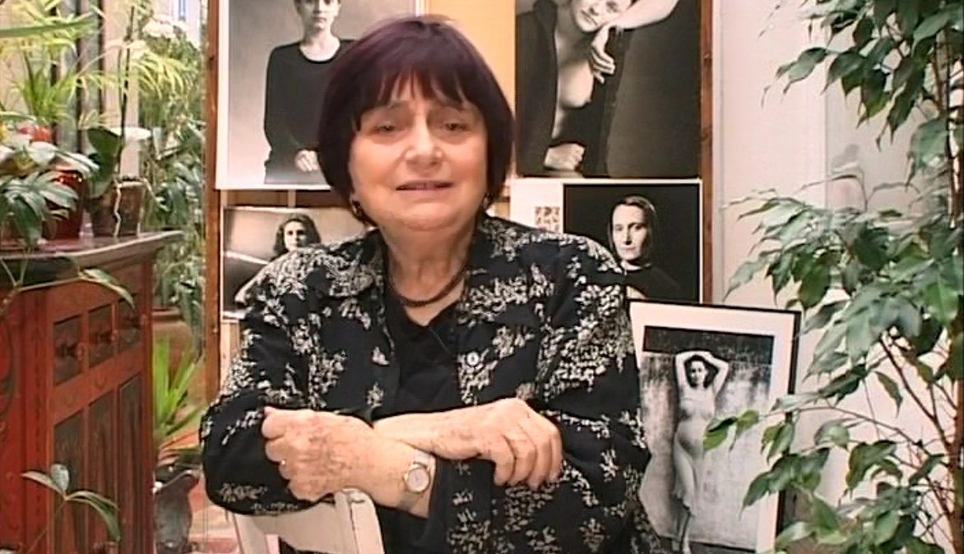
Agnès Varda, born 1928 (Brussels)
Background in philosophy, history of art and photography

Slide 6
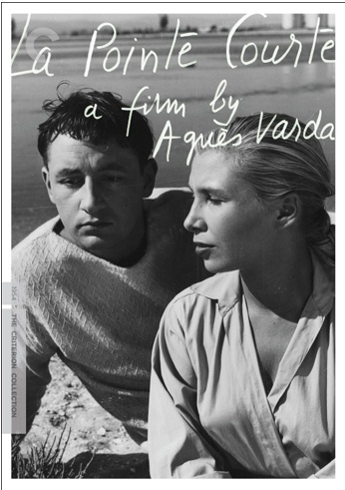
The First Film of the New Wave?
Structure borrowed from Faulkner’s novel The Wild Palms
Cultural eclecticism: focus on the realism of the everyday alongside modernist formal organisation
Marginal exhibition and positioning
1955

Slide 7
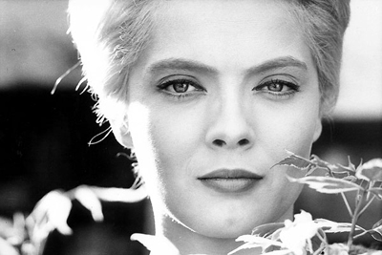
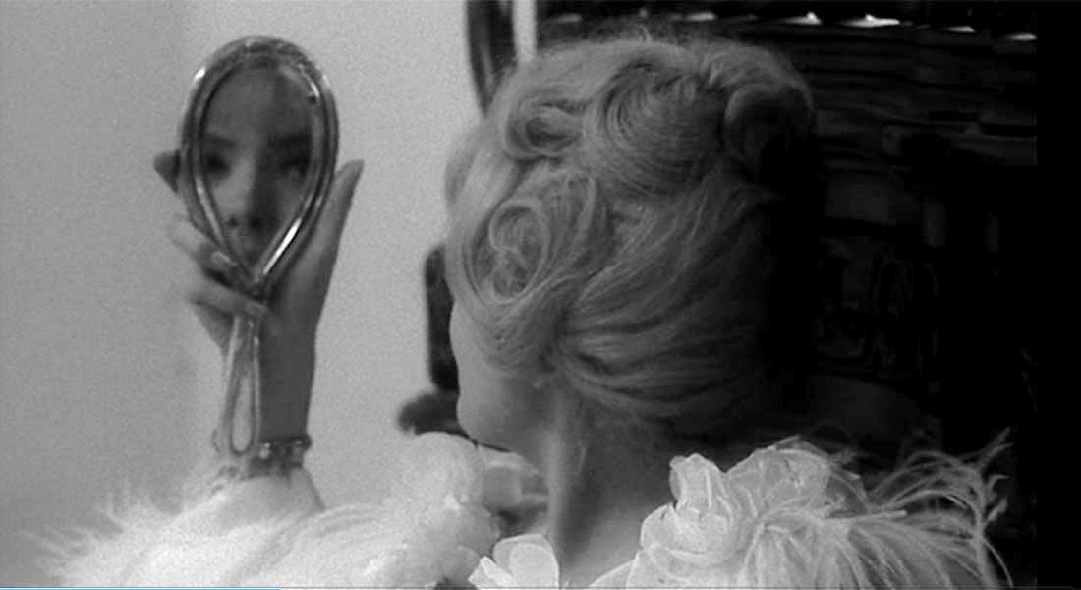
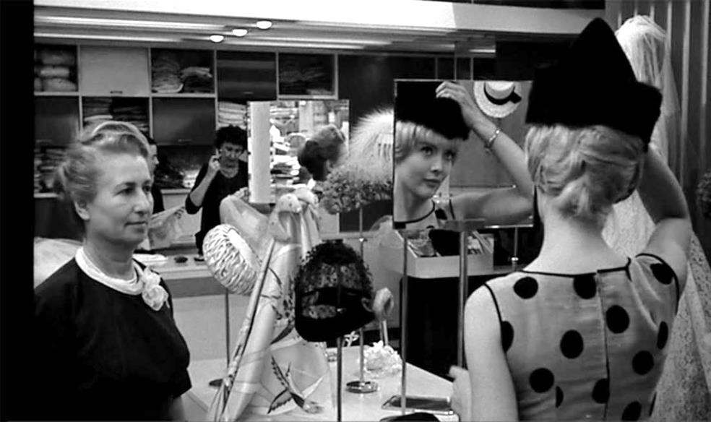
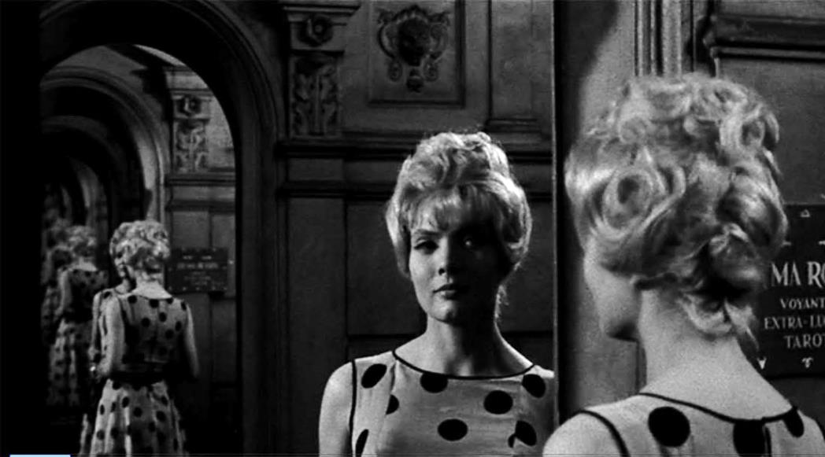
Cléo de 5 à 7 (1962): Varda’s interest in Gender Politics (cf. Flitterman-Lewis)

Slide 8
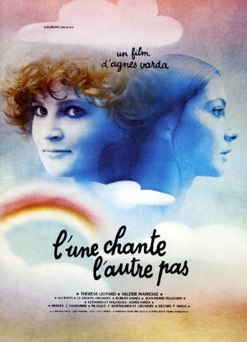
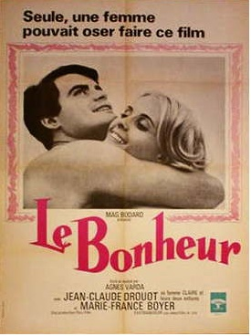
A ‘committed rather than militant’ feminist? (Smith 1998: 8) Films Typified by Apparent Contradiction
1977
1965

Slide 9
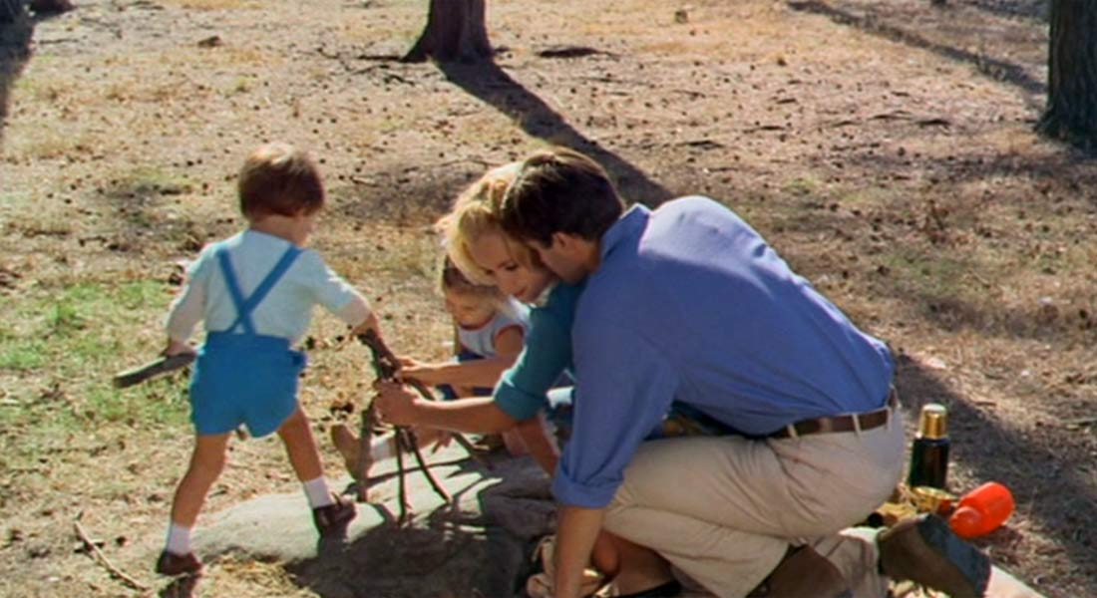
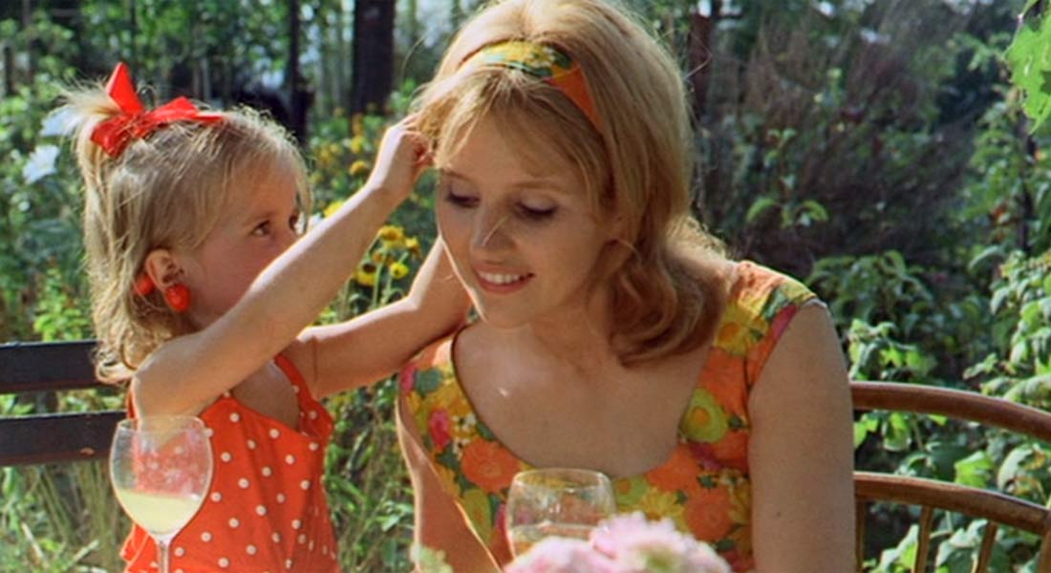
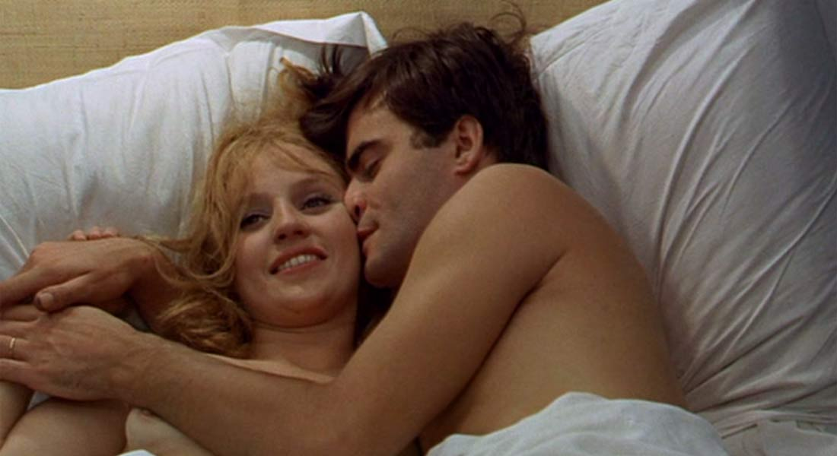
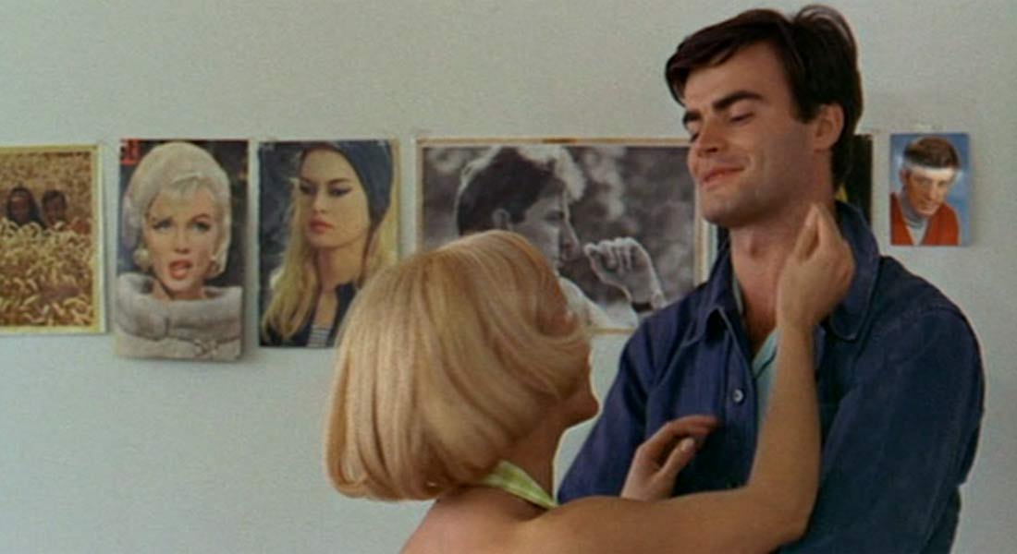
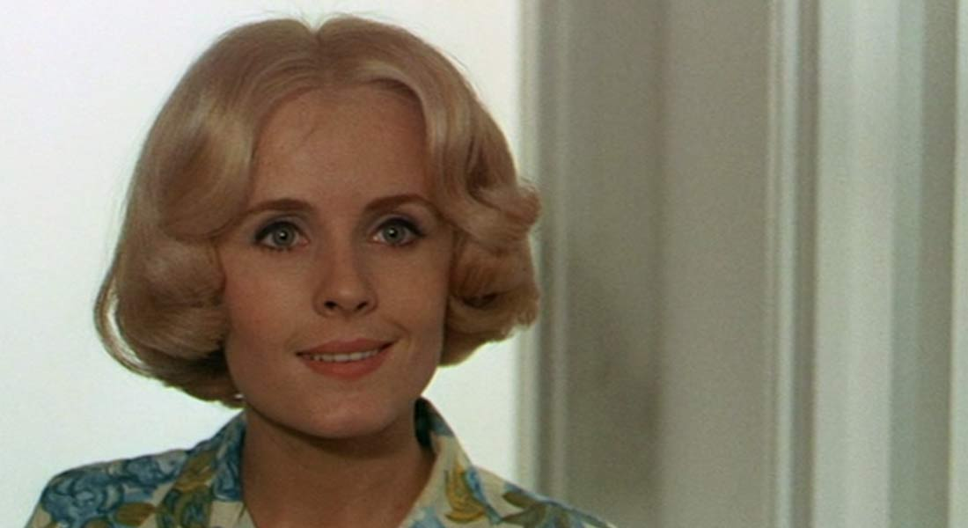
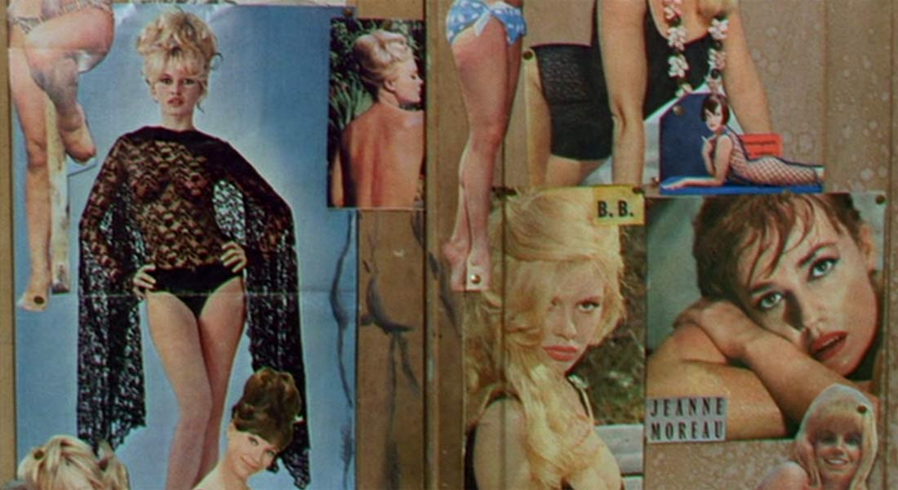
The Ambivalence of Varda’s Mise-en-Scène: Le Bonheur

Slide 10
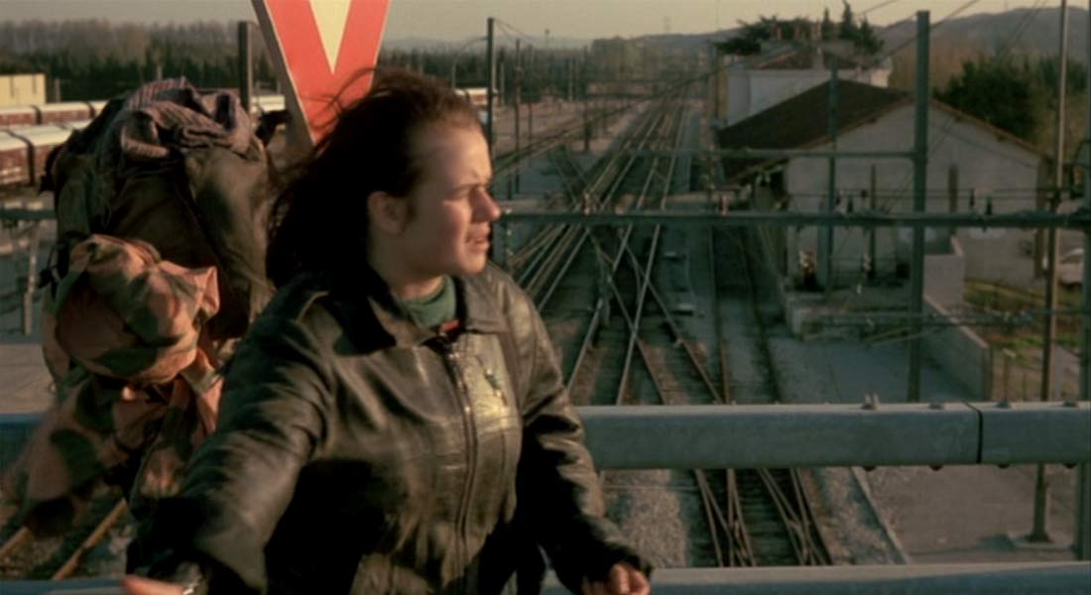
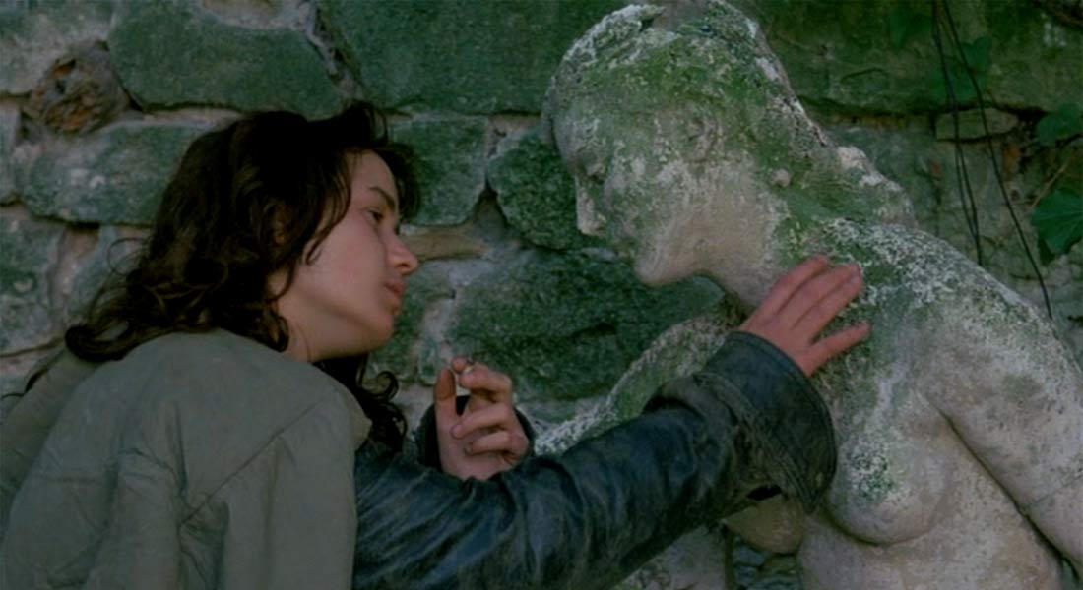
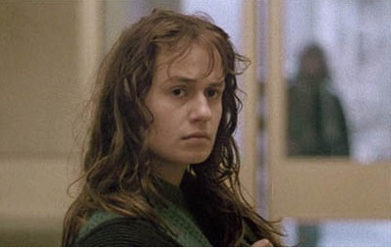
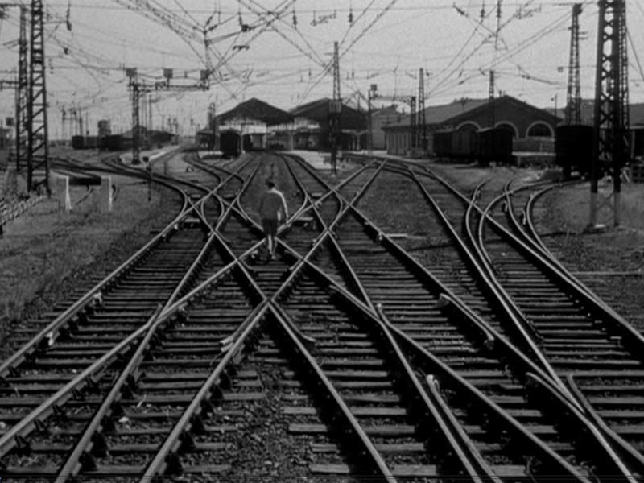
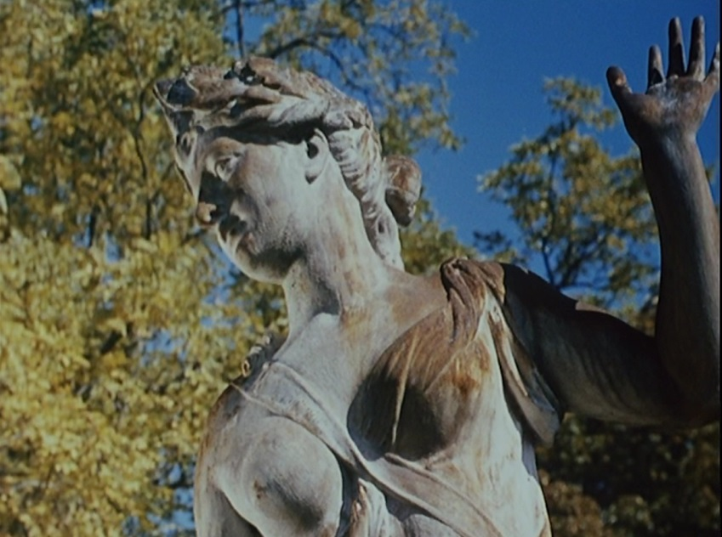
The Focus on Women’s Relationships and Experience
Sans toit ni loi (1985)
… and some aesthetic particularities
La Pointe courte, 1955
O saisons, ȏ châteaux

Slide 11
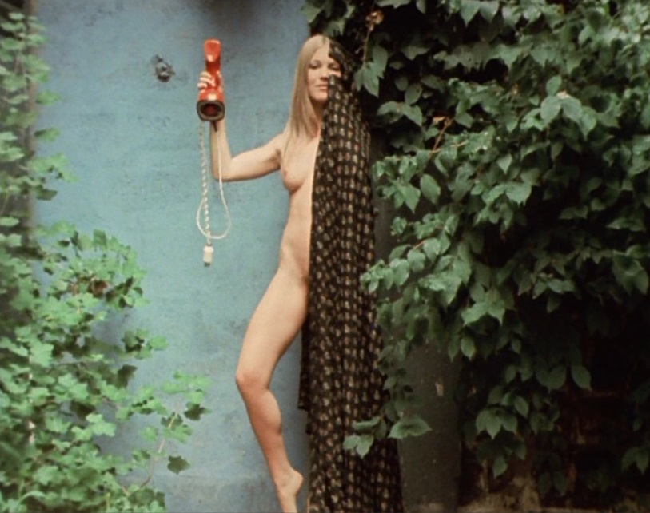
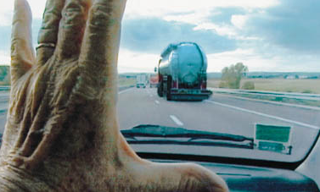
Filming the (Ageing) Female Body
L’Une chante, l’autre pas
Les Glaneurs et la glaneuse
‘[W]e keep hidden from view the grotesque, fearful and laughable signs of female ageing.’ (Wearing 2007: 290).

Slide 12
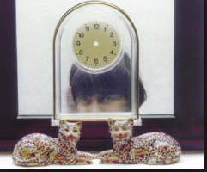
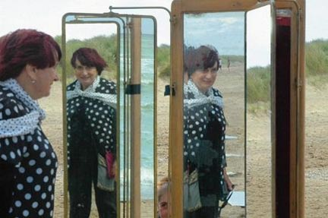
Les Glaneurs: Formal Innovation at a Structural Level
Episodic architecture
Akin to Julia Kristeva’s ‘women’s time’ as outside official histories and narratives
Self-reflexivity: beyond the (male) voiceover.
Cf. Jane B par Agnès V (1988)(, Jacquot de Nantes (1991)?), Les Plages d’Agnès (2008)
Varda reversing Laura Mulvey’s (1975) description of classical narrative cinema as making woman ‘the bearer, not the maker, of meaning’.

Slide 13
Additional Bibliography
Stella Bruzzi, ‘Narration: The film and its voice.’ In S. Bruzzi, New Documentary: A Critical Introduction, London: Routlegde, 2000, pp. 40-65.
Sandy Flitterman-Lewis, To Desire Differently, Columbia: Columbia University Press, 1996.
Julia Kristeva, ‘Le Temps des femmes.’ In Kristeva, Les Nouvelles maladies de
l’âme, Paris: Fayard, 1993, pp.297-332.
Laura Mulvey, ‘Visual Pleasure and Narrative Cinema’, Screen, 16, 3 (1975): 6-18.
Sadie Wearing, ‘Subjects of Rejuvenation.’ In Y. Tasker and D. Negra (eds),
Interrogating Postfeminism. Durham and London: Duke University Press, 2007, pp. 277-310.
On Contemporary Auteurism/Authorship
Pam Cook, 'Authorship and Cinema.' In The Cinema Book (2nd Edition), eds. Pam Cook and Mieke Bernik, 235-241, 246, 250-8. London: BFI, 1999.
Pam Cook, 'Authorship revised and revived.' In In The Cinema Book (3rd Edition), ed. Pam Cook, 479-482. London: BFI, 2007.
Noel King and Toby Miller, 'Auteurism in the 1990s.' In The Cinema Book (2nd Edition), 311-14.

