Slide 1
STATES OF THE NATION: FRENCH CINEMA AND SOCIETY FROM 1990 TO THE PRESENT
Week 10: Transnational Filmmaking

Slide 2
Structure of the Session
Transnational filmmaking
National versus transnational cultures
Features of transnational filmmaking and film studies
France-Hollywood: a dialogue
A brief history of Franco-American cultural and filmic relations
A recent case study of French attitudes towards Hollywood: reception of the romcom
Cinephilia and (film) history
Postmodernity and the ‘crisis of memory’
The productive possibilities of cinephilia, including transnational – e.g. The Artist, Blancanieves…
Melodramatised masculinity
The ‘crisis of masculinity’ in mainstream film and media culture
The case of Jean Dujardin and/as (transnational) French masculinity

Slide 3
Learning Outcomes
By the end of the session students will be able to:
Define the transnational in the context of film studies.
Describe some of the complexities of France’s attitude towards Hollywood with explanations provided from geo-cultural history and examples from recent film culture.
Situate postmodern cinephilic pastiche film practices in relation to generalised cultural attitudes towards the historical past.
Consider the role of cross-cultural film referentiality in contributing to transnational identities.
Describe how Jean Dujardin’s star persona reflects and contributes to discourses of cultural anxiety about French masculinity and identity as a whole today.

Slide 4
The Idea of a Nation
Benedict Anderson on the nation as an ‘imagined political community’, formulated through technology and modernity:
‘[It] is imagined because even the members of the smallest nation will never know most of their fellow-members, meet them or even hear of them, yet in the mind of each there lives the image of the communion.’
Anderson, Imagined Communities: Reflections on the Origins and Spread of Nationalism (first published in 1983))

Slide 5
Factors highlighted by transnational film studies since 1990s
1) Impact of the economic processes of globalisation
2) New multicultural realities that result in new composite and ‘floating’ identities.
3) The transnational critique explores the ‘contingency or instability of the national’ in a challenge to the cohesiveness of the nation’s ‘imagined community’ (Benedict Anderson). Challenge to local and national interpretations in favour of readings that stress ‘hybrid’ and ‘impure’ elements.
(See Andrew Higson, ‘The Limiting Imagination of National Cinema’, in Hjort and McKenzie (eds) Cinema and Nation, pp. 63-74. London: Routledge, 2000)

Slide 6
Factors highlighted by transnational film studies since 1990s cont.
Considering film as a transnational medium at sites of both production and distribution foreground its role in:
‘trans-local understandings’ (Vertovec and Cohen 1999,p. xvii, cited in Ezra and Rowden 2006)
‘felt internationalism’ (Acland 2005, p. 239)
‘As a marker of cosmopolitanism, the transnational at once transcends the national and presupposes it. For transnationalism, its nationalist other is neither an armored enemy with whom it must engage in a grim battle to the death nor a verbose relic whose outdated postures can only be scorned. From a transnational perspective, nationalism is instead a canny dialogical partner whose voice often seems to be growing stronger at the very moment that its substance is fading away. Like postmodernism and poststructuralism, other discourses that have complicated the notion of unmediated representation, transnationalism factors heterogeneity into its basic semantic framework.’ (Ezra and Rowden 2006, p. 4)

Slide 7
France- Hollywood: a love-hate relationship
For Richard Kuisel, in the post-war decades it has been primarily in the realm of culture, including and at times principally film culture, that the threat of envelopment by US ‘imperialism’ has been most keenly debated in France (Kuisel 1993, p. 230)
Case study: Attitudes towards Hollywood cinema on display in reviews of French rom-coms of the late 1990s and 2000s reveal two major trends
Suspicion
Self-abasement
See ‘Reception of the Rom-Com’ in M. Harrod, From France with Love: Gender and Identity in French Romantic Comedy, London: I.B. Tauris, (forthcoming 2015; e-mail to request a copy).

Slide 8
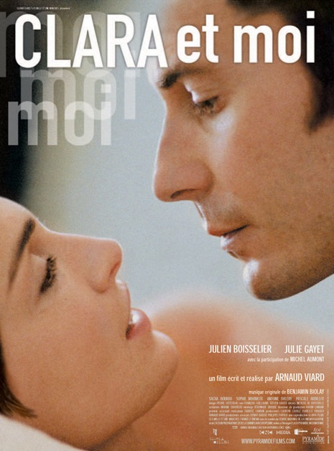
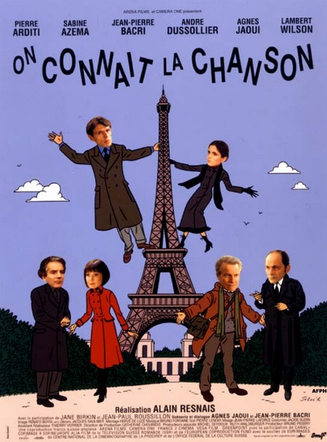
Open Suspicion
Arty French rom-com /social drama: better than ‘les comédies made in Hollywood’ (Le Nouvel Observateur)
In interview Alain Resnais seeks to distinguish his ensemble musical rom-com from films by ‘les marchands de soupe hollywoodiens’ (Le Monde).

Slide 9

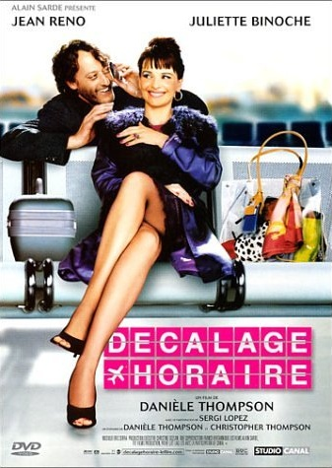
Pale imitations
‘imitation pathétique du modèle hollywoodien d’hier’ (L’Humanité)
‘Binoche insupportable en faux “Funny Face” qui prend son petit déjeuner à l’aéroport de Roissy’ (Positif magazine)

Slide 10
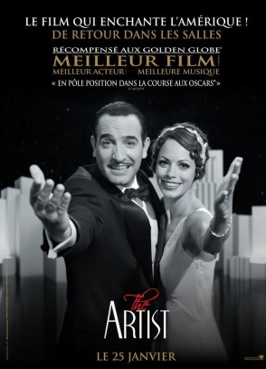
The Cinephile’s Film that Spoke to the Masses
Worldwide box office - $44.7m

Slide 11
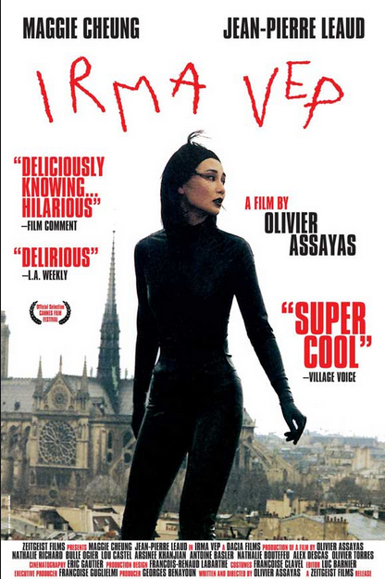
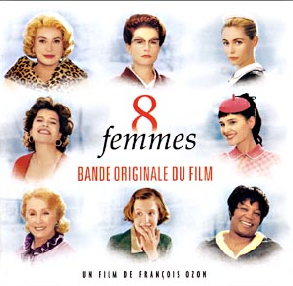
Films in Dialogue with the History of Cinema

Slide 12
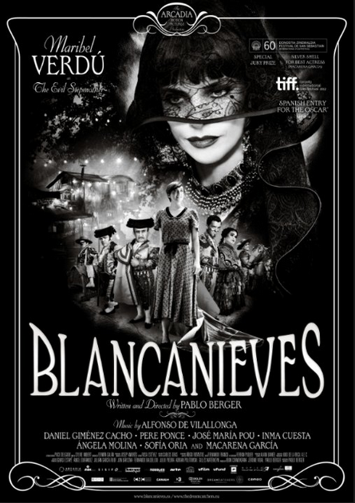
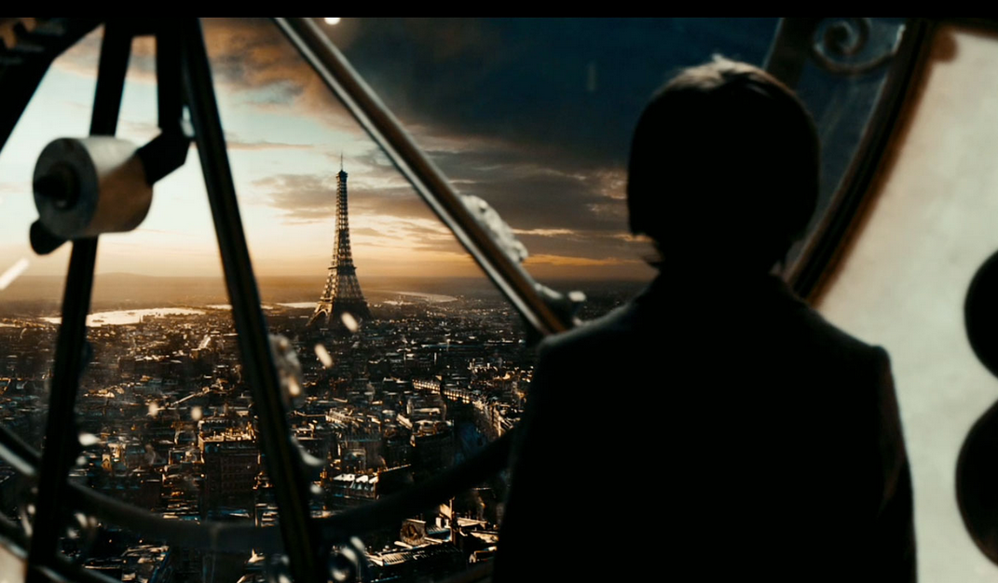
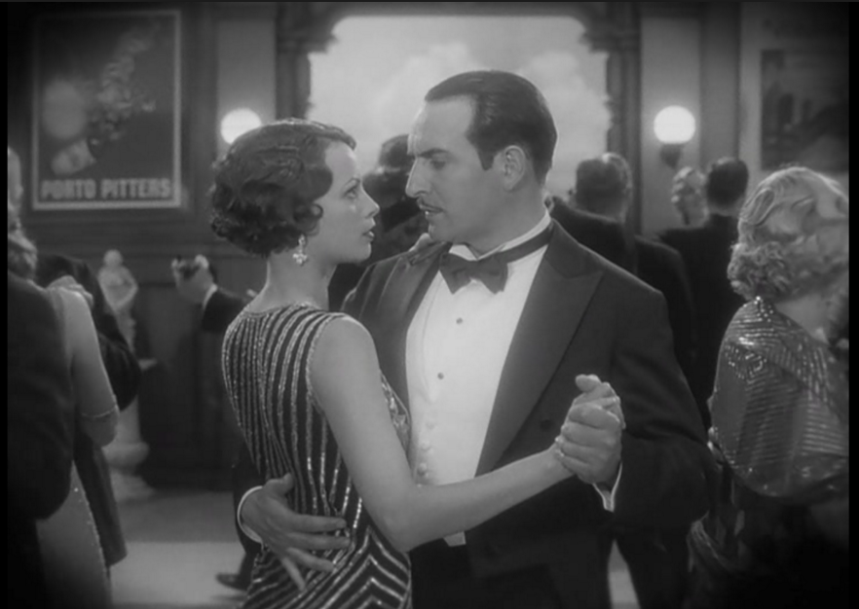
Films in Dialogue with the History of Cinema cont.
Hugo (Martin Scorsese, USA 2011)
‘The impossibility of experience in the present, and the need to always be conscious of several temporalities, which I claimed is fundamental to cinephilia, has become a generalized cultural condition.’ (Elsaesser 2005, p. 40)

Slide 13

On the History of Pastiche and Nostalgia in Cinema
1980s ‘crisis of memory’
Fredric Jameson on the ‘nostalgia film’ (retro New Hollywood films such as American Graffiti) in terms of ‘blank parody’ and disengagement from history. (See Jameson, ‘Postmodernism, or the cultural logic of late capitalism’, 1984)
Linda Hutcheon challenges Jameson to argue for the possibility of pastiche modes negotiating questions of cultural memory and historical meaning (Linda Hutcheon, The Politics of Postmodernism , New York, NY and London: Routledge, 1989, pp. 93–117)
1990s/2000s
A renewed focus on the affective qualities of ‘retro’ art: see
Richard Dyer, Pastiche (London: Routledge, 2007).

Slide 14
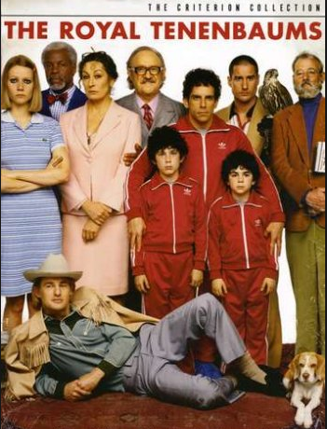
  The dialogue with (film) history
Elena Gorfinkel discusses films whose referential universe ‘invites spectators to engage affectively, though not necessarily uncritically, with history’ (2005, p.153)
‘[Some recent films that recreate the past e.g. by Todd Haynes and Wes and Paul Thomas Anderson] utilize allusion, but also eclipse it, in their preference for a kind of overt aesthetic and temporal disjunction […] The viewer always inevitably becomes aware of his or her own historical position, caught between different periods, in a region of illegible temporality and mobile film historical space.’ (p. 155)
Mary Harrod (extra reading): can this not also be seen in terms of making us aware of and opening up new possibilities for ‘film geography’?

Slide 15
On Suffering or Melodramatised Masculinity in Contemporary Culture: A Feminist Perspective
Tania Modleski (1991) and, in France, Christine Bard (1999: 324-5) have associated the notion of the crisis of masculinity with anti-feminism.
Kathleen Rowe (The Unruly Woman: Gender and the Genres of Laughter, Austin: University of Texas Press, 1995: 193-7) is critical of the melodramatised male’s appropriation of the traits traditionally associated with female suffering and his concomitant vilification of women. Arguably depicting men’s position as worthy of sympathy takes the focus off the ongoing inequalities still confronting women.
Some feminists have further suggested that male appropriation of ‘feminine’ characteristics – such as suffering – ‘represent[s] an expansion of the concept of legitimate masculinity, and thus an extension of its power over women’ (Chapman 1988: 247).

Slide 16
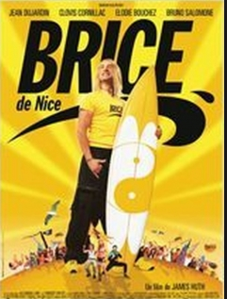

Brice de Nice parodies Point Break
Dujardin’s French masculinity
‘Décidément, Bice de Nice vit dans son corps, comme dans sa langue, les tiraillements du français complexé.’ Chion 2008, p. 172.

Slide 17
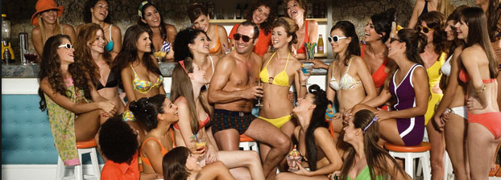
Dujardin’s French masculinity cont.
OSS 117: Out of step with both men’s status and France’s status in the contemporary world (Chedaleux)

Slide 18
Acland, C. 2005. Screen Traffic: Movies, Multiplexes, and Global Culture.
Durham: Duke University Press.
Bard, C. 1999a. ‘Les antiféministes de la deuxième vague.’ In C. Bard (ed.),
Un siècle d’antiféminisme. Paris: Fayard, pp.301–328.
Chapman, R. 1988. ‘The Great Pretender: Variations on the New Man
Theme.’ In R. Chapman and J. Rutherford (eds), Male Order: Unwrapping
Masculinity. London: Lawrence and Wishart, pp.225–248.
Elsaesser, T. 2005. ‘Cinephila or the Uses of Disenchantment.’ In M. de Valck and M. Hagener
(eds), Cinephilia: Movies, Love and Memory. Amsterdam: Amsterdam University Press
Gorfinkel. E. 2005. "The Future of Anachronism: Todd Haynes and The Magnificent
Andersons." In M. de Valck and M. Hagener (eds), Cinephilia: Movies, Love and Memory. Amsterdam: Amsterdam University Press.
Kuisel, R.F. 1993. Seducing the French: The Dilemma of Americanization. Berkeley: University of California Press.
Modleski, T. 1991. Feminism Without Women. Culture and Criticism in a Postfeminist Age. New York: Routledge.
Additional Bibliography

