Slide 1
STATES OF THE NATION: FRENCH CINEMA AND SOCIETY FROM 1990 TO THE PRESENT
Week 2: History and Heritage

Slide 2
Structure of Part One of the Session
World War II in the popular French cinematic imagination
Overview
Au Revoir les enfants clip analysis
Heritage films in France
Definitions and periodisation
Budget, production values, marketing, reception
Mise-en-scène
Lucie Aubrac as war film and heritage film

Slide 3
History and Historiography
‘History’ – France occupied by German forces 1940-44 and governed by a ‘puppet’, German-controlled government; it was known during this period, the Occupation, as the Vichy state.
‘Historiography’ - see Henry Rousso, Le Syndrome de Vichy: 1944 – 198…, Paris: Éditions du Seuil, 1987.
‘Vichy syndrome’ = a reaction to the internal divisions that were revealed within France during the Occupation.

Slide 4

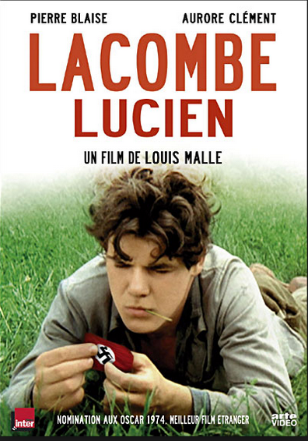
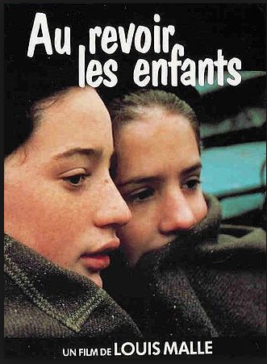
Myths of resistencialism intact and the Occupation otherwise broadly shrouded in silence until…
1969
1974
1987

Slide 5
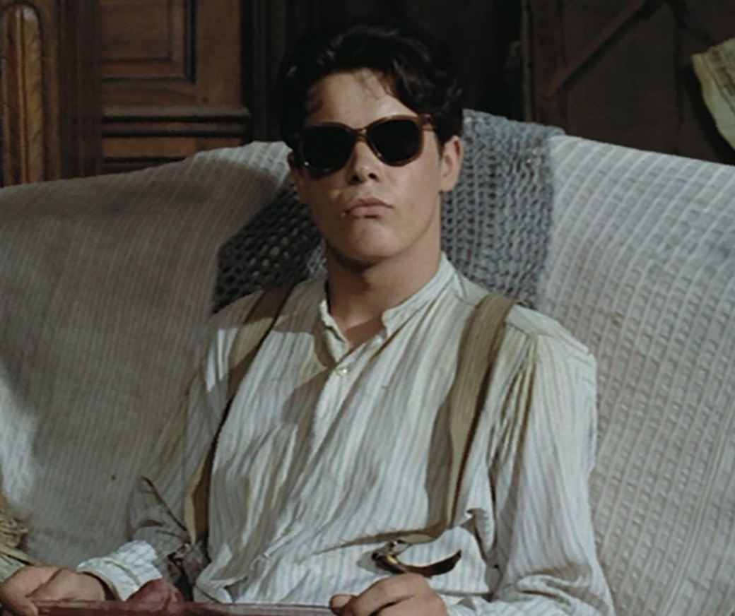
Moral Blankness in Lacombe, Lucien

Slide 6
HERITAGE CINEMA IN FRANCE: SUPERPRODUCTIONS PATRIMONIALES
Definitions and periodisation
Arose in the 1980s (key texts: Jean de Florette/Manon des sources, 1986)
Situated in the past
Often literary adaptation
BUT different from ‘just’ costume drama ….

Slide 7
Definitions and periodisation cont.
Self-consciousness (a change from New Wave cinema) – ‘loss of innocence’ – e.g. Lucie Aubrac as much about previous films about Resistance (e.g. La Bataille du rail; L’Armée de l’ombre – see Hayes ) as the topic.
Reliant on authenticity of period details – ‘museum aesthetics’ (Richard Dyer) – part of ‘postmodern’ culture (pastiche)
Since mid-1990s or so: post-heritage
A) more sex and violence (Elizabeth, La Reine Margot [1994])
B) New cycle of bio-pics (Girl with a Pearl Earring, Marie Antoinette, The Duchess) and…

Slide 8
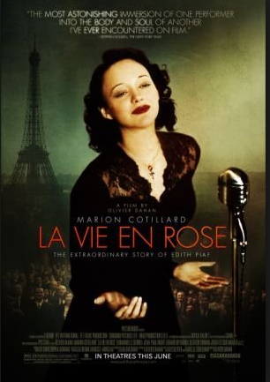
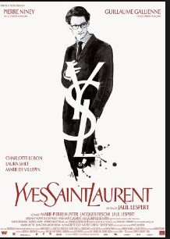
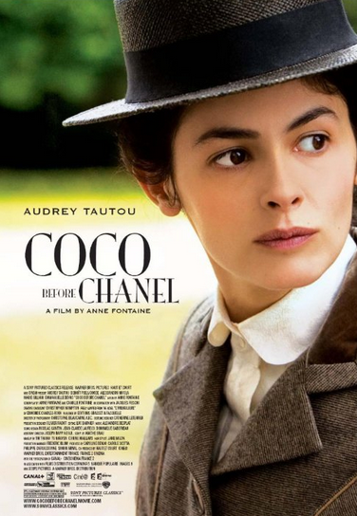
Some Recent Big-budget Successes: Heritage Bio-pics
2007
2014
2009

Slide 9
Budget, Production Values, Marketing, Reception
Major project (in this case star director and producer [Berri]; leading French actors [Bouquet, Auteuil])
Huge budget (Lucie Aubrac the most expensive film of its year)
Exhibit craft of French film industry e.g. train sequence – exportability
Tie-ins (Aubrac books, debates etc., as discussed by Suleiman)
A ‘middle-brow’ cinema, between auteur film and truly mass-popular genres e.g. comedy: different positioning and critical reception – notions of ‘quality’

Slide 10
Heritage mise-en-scène
Return to studio aesthetics (typical of 1980s)
Return to ‘tradition of quality’ of 1940s and 1950s
Heritage narrative and narration:
Distant but real historical past and events
Mediated by literary text or biography of subject
‘Big’ figures played by big stars N.B. Casting of Chéreau as Moulin)
Concern with national identity – use of ‘national themes (regional/national// national/foreign // Franco-French war)
Aesthetic self-consciousness: reprising earlier costume dramas but with modern aesthetics (painterly references, naturalist decors, modernist acting)

Slide 11
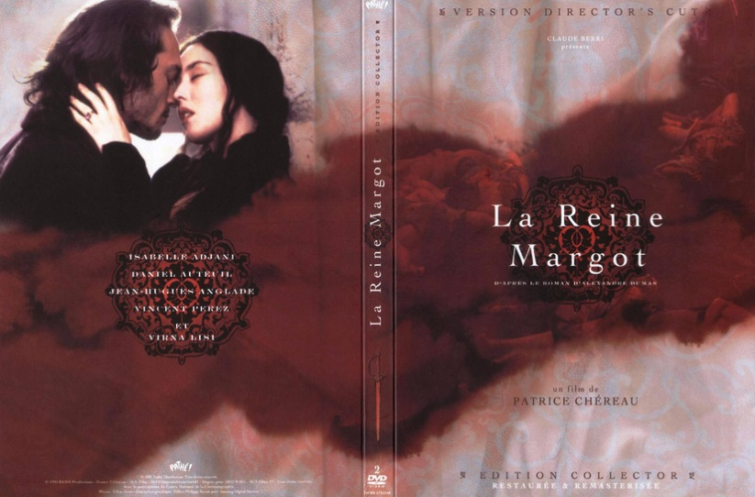
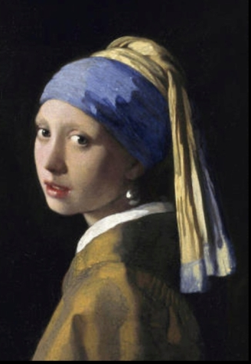
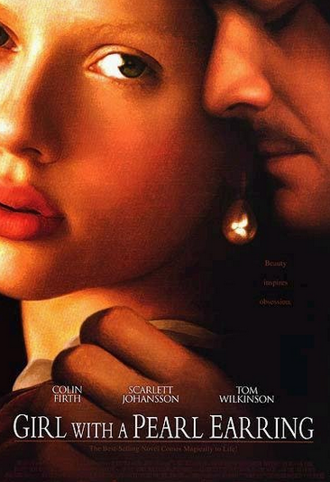
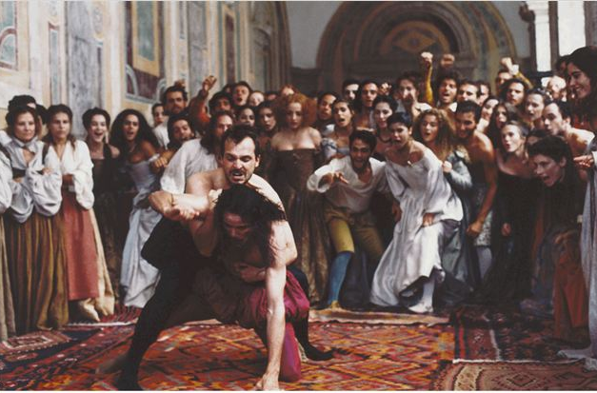
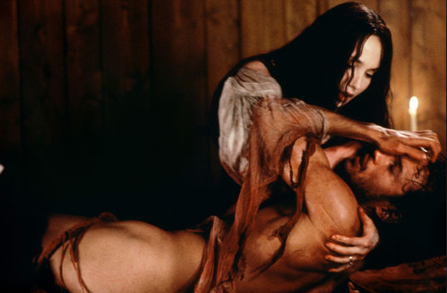
See also Belén Vidal, Figuring the Past: Period Film and the Mannerist Aesthetic (Amsterdam University Press, 2012).

Slide 12
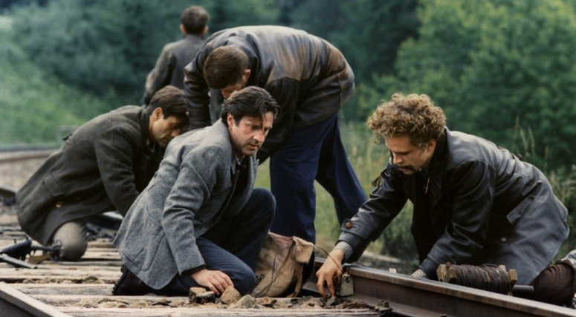
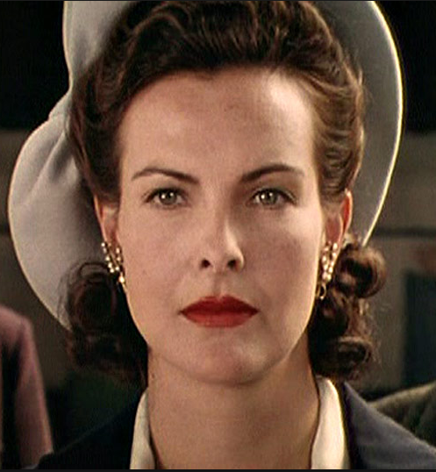
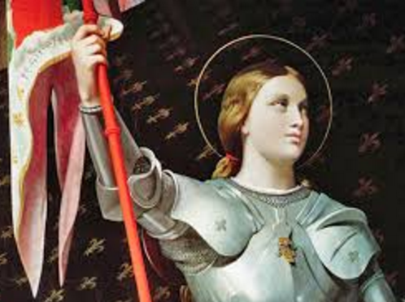
Lucie Aubrac as Heritage Film and War Film
High production values: stunts, action, wide shots to show off period detail
Extract: Lucie visits the German police chief
Lush interior sets, costume
Stereotyping
Iconicity

Slide 13
Select Additional Bibliography Relating to Heritage Film
Andrew Higson, ‘Re-Presenting the National Past: Nostalgia and Pastiche in the Heritage Film,’ in Lester Friedman (ed.), Fires Were Started: British Cinema and Thatcherism, Minneapolis: University of Minnesota Press; London: UCL Press, 1993.
Claire Monk, ‘Sexuality and Heritage.,’ Sight and Sound, October 1995, in Ginette Vincendeau (ed.), Film/Literature/Heritage: A Sight and Sound Reader, London: BFI, 2001.
Phil Powrie, French Cinema in the 1980s, Nostalgia and the Crisis of Masculinity, Oxford: Clarendon Press, 1997.
Ginette Vincendeau (ed.), Film/Literature/Heritage: A Sight and Sound Reader, London: BFI, 2001.
Belén Vidal, Heritage Film: Nation, Genre and Representation, Columbia University Press, 2012.

