Slide 1
STATES OF THE NATION: FRENCH CINEMA AND SOCIETY FROM 1990 TO THE PRESENT
Week 3: Queering the Auteur

Slide 2
Structure of Part One of the Session
Introduction to Queer Studies in Visual Culture
- Background – the question of camp
- The emergence of queer studies
Queer Cinema in France and Beyond
- Gay-inflected French films
- Comparisons with New Queer Cinema
- Beyond theme: Aesthetics in queer cinema
Introduction to François Ozon
Positioning
Recurrent elements in his work
The question of ideology
Learning outcomes: by the end of this session you should be able to
Describe in broad terms the emergence of queer studies from theories of camp
Constellate French cinema within global queer cinemas of the past few decades
Situate the Ozon’s oeuvre in relation to this corpus and describe how some features of his work relate to a possible ‘queer’ positioning for him as an auteur

Slide 3
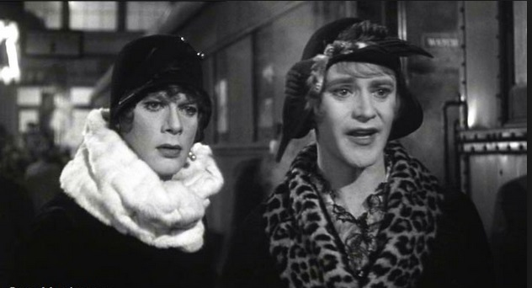
Queerness and its Relation to Camp Aesthetics
For Susan Sontag, in her seminal 1966 essay ‘Notes on “Camp”’:
- camp is a sensibility that is ‘almost ineffable’ but that is linked to ‘things-being-what-they-are-not’ and that thrives on artifice and exaggeration.
Some like it Hot (Billy Wilder, 1959)

Slide 4
Camp Aesthetics (Sontag cont.)
‘To emphasize style is to slight content, or to introduce an attitude which is neutral with respect to content. It goes without saying that the camp sensibility is disengaged, depoliticized – or at least apolitical.’ (p.277)
And yet….
marginality may be a prerequisite – Cocteau not Gide (p. 278); ‘[c]amp taste turns its back on the good-bad axis of ordinary aesthetic judgement’, rejecting ‘the pantheon of high culture’ (p.286) [cf. postmodernism as a whole].
‘[E]very sensibility is self-serving to the group that promotes it [… and] Camp taste […] definitely has something propagandistic about it’ (p.290).
Notes:
Does it have an ideological resonance?

Slide 5
‘Camp and the Gay Sensibility’ – Jack Babuscio (1980)
The explicitly stated aim of this piece:
‘I define the gay sensibility as a creative energy reflecting a consciousness that is different from the mainstream; a heightened awareness of certain human complications of feeling that spring from the fact of social oppression; in short, a perception of the world which is coloured, shaped, directed and defined by the fact of one’s gayness’ (p.40)
Notes:
Babuscio aims ‘to promote solidarity and a greater sense of identification among gays’.

Slide 6
The Emergence of Queer Studies
‘[I]n the 1990s the notion of “camp” is often replaced by the term “queer”.
Camp is historically more associated with the closeted homosexuality of the 1950s and only came to the surface in the 1960s and 1970s. Postmodernism of the 1980s and 1990s brought campy strategies into the mainstream.
Now, lesbians and gay men identify their oppositional reading strategies as “queer”. Away from the notions of oppression and liberation of earlier gay and lesbian criticism, queerness is associated with the playful definition of a homosexuality in non-essentialist terms. Not unlike camp, but more self-assertive, queer readings are fully inflected with irony, transgressive gender parody and deconstructed subjectivities.’
The Oxford Guide to Film Studies (1998), p.142.
Notes:
Yet as we have seen camp remains a fruitful critical framework today, even if it has perhaps returned somewhat to its aesthetic roots as opposed to being requisitioned for (narrowly defined) identity politics to the same extent, as the terms of that debate have moved on.

Slide 7
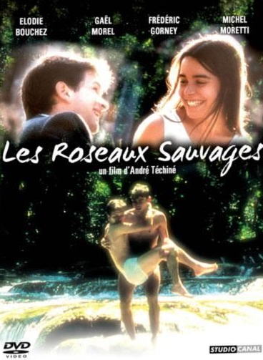
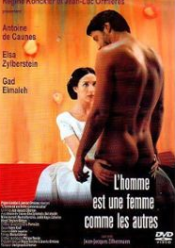
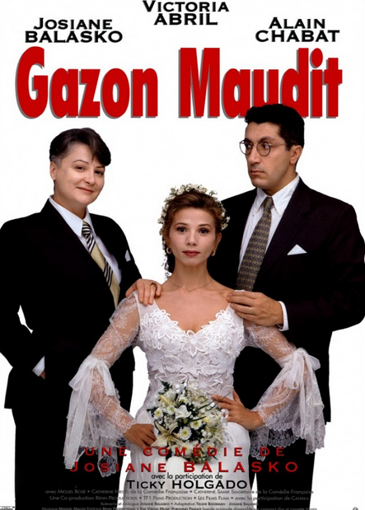
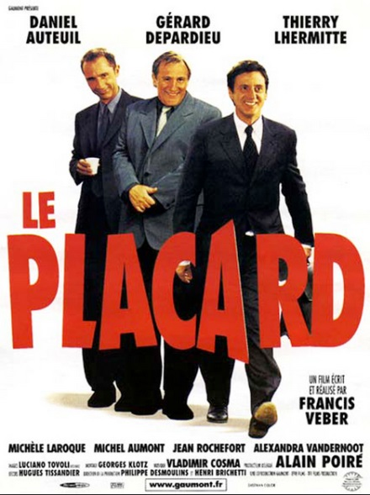
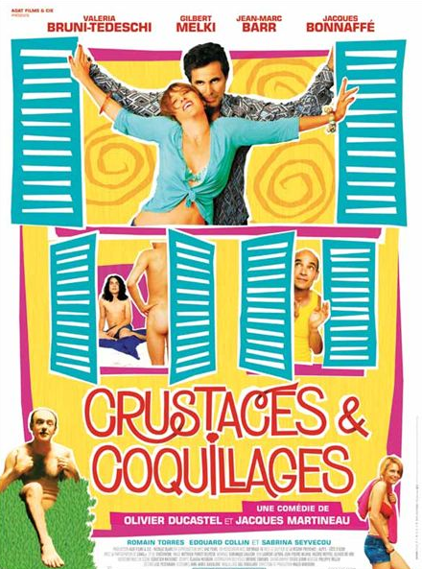
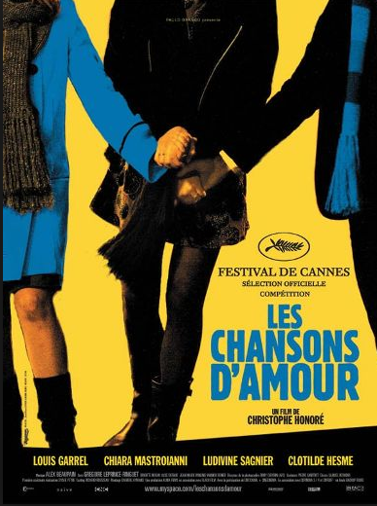
Queer Themes in French Cinema
1994
1995
1997
2000
2007
2005

Slide 8

The Limitations of Queerness in French Filmmaking: Theme
Nonetheless, in 1998 Bill Marshall argued that French cinema was a long way from any self-consciously queer filmmaking practice.
Marshall, B. 1998. ‘Gay cinema.’ In A. Hughes and K. Reader (eds), Encyclopaedia of Contemporary French Culture. London and New York: Routledge, pp. 262–63.
Contrast e.g. New Queer Cinema (B. Ruby Rich, 1992) – rejects heteronormative categories and is concerned with LGBT communities, often depicted in the margins of society e.g. films by Todd Haynes, Derek Jarman and Gregg Araki.

Slide 9
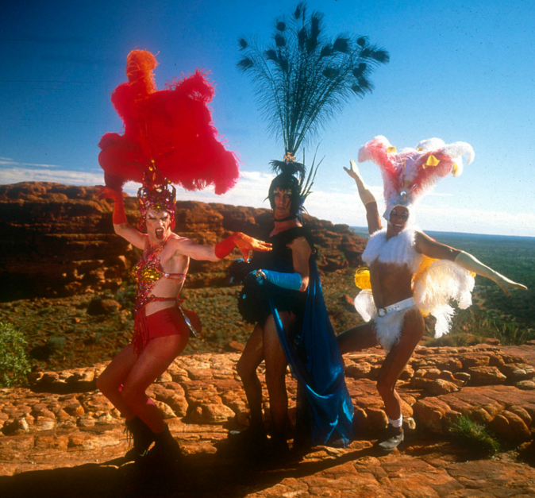
The Limitations of Queerness in French Filmmaking: Aesthetics
Campy, queer aesthetics are often typified by:
A caricatural performance style
Ornate, expressive, heightened or otherwise non-naturalistic mise-en-scène
Improbable, often melodramatic plot developments
A provocative sensibility
See films by e.g. John Waters, Baz Luhrman, Almodóvar.
The Adventures of Priscilla Queen of the Desert (Luhrman, 1994)

Slide 10
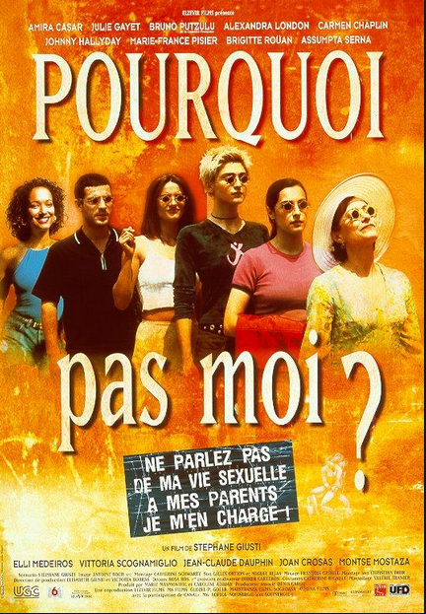
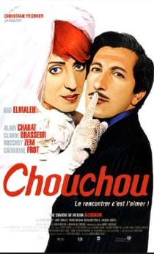
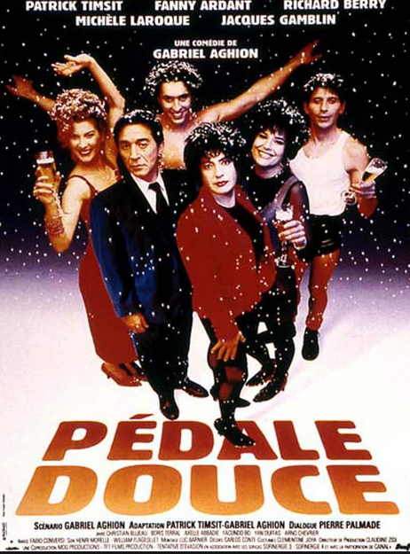
A Few Exceptions?
1996
2003
1999

Slide 11

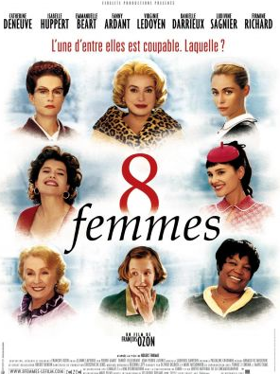
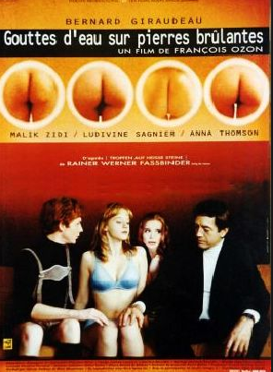
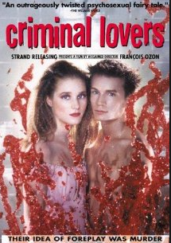
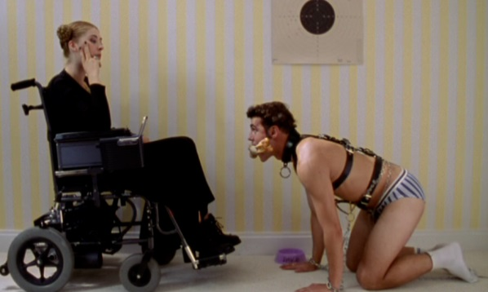
Ozon’s Filmography as Director
2014 Une nouvelle amie
2013 Jeune et jolie
2012 In the House
2010 Potiche
2009 Le refuge
2009 Ricky
2007 Ange
2005 Le Temps qui reste
2004 5x2
2003 Swimming Pool
2002 8 femmes
2000 Sous le sable
2000 Gouttes d’eau sur pierres brûlantes
1999 Les Amants criminels
1998 Sitcom
The Case of Ozon

Slide 12
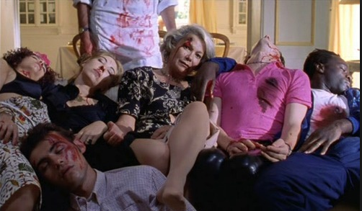
Schlock Horror in Ozon
‘[c]amp taste turns its back on the good-bad axis of ordinary aesthetic judgement’, rejecting ‘the pantheon of high culture’ (p.286 Sontag)

Slide 13
Musicals, Melodrama and Postmodern Allusionism

Slide 14
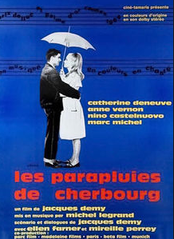
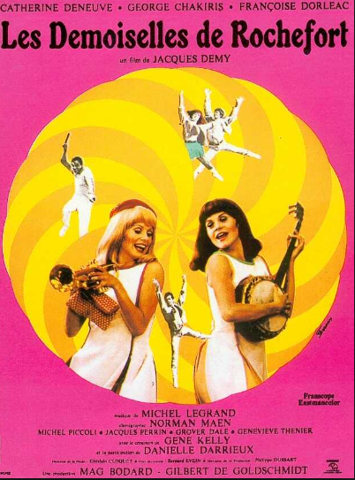
(Trans)National Intertextual Palimpsests
1964
1967

Slide 15
Additional Bibliography
Rick Altman, The American Film Musical, Oxford: John Wiley & Sons, 1988.
Lucille Cairns, Sapphism on Screen: Lesbian Desire in French and Francophone Cinema, Edinburgh: Edinburgh University Press, 2006.
Richard Dyer, Only Entertainment, London and New York: Routledge, 2002.

