Slide 1
STATES OF THE NATION: FRENCH CINEMA AND SOCIETY FROM 1990 TO THE PRESENT
Week 5: French ‘New Realism’

Slide 2
Structure of Part 1 of the Session
Discussion of assessment practicalities/formatting
Recap of some key trends in French cinema over the earlier sections of the module
The 1990s and the ‘return of the political’
The ‘sans-papiers’ affair
French ‘new realism’: style and theme
The place of melodrama within ‘realism’ and in La Ville est tranquille
Spectatorship and ideological address in such films
Setting in La Ville est tranquille
Marseille as postmodern city in Guédiguian’s films
the south in French cinema

Slide 3
Learning Outcomes:
By the end of the session students will be able to
Discuss key trends in French filmmaking of the late 1990s into the 2000s, including ‘political’ filmmaking and ‘new realism’
Discuss the relationship between realism and melodrama in French and other cinemas and how these relate to spectatorial adddress
Contextualise the depiction of Marseille in Guédiguian’s films in relation to other representations of the city and the south in French and other cinemas

Slide 4
Some key trends in 1990s French Cinema (and into the 2000s)
The continued centrality of heritage cinema (also the case in the 1980s).
A renewed visibility of and interest in the auteur e.g. through autobiographical elements, broadly defined, in texts – Ozon is an obvious example. [cf. emergence of le jeune cinéma français français after commissioning of television show Tous les garçons et les filles de leur âge in 1994, with episodes by e.g. André Téchiné, Chantal Akerman, Claire Denis, Olivier Asseyas and others]
A linked ‘retour du politique’.
P. Powrie, ‘Heritage, History and “New Realism”,’ in French Cinema in the 1990s: Continuity and Difference (Oxford: Oxford Uni’ Press, 1999), pp.1-21.

Slide 5
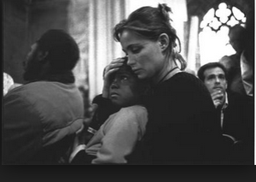
The retour du politique and the sans papiers affair
February 1997: a petition drawn up by prominent film directors Pascale Ferran and Arnaud Desplechin and signed by 59 others apeared in Le Monde protesting at repressive immigration laws.
Signatories included mostly younger directors
e.g. Olivier Assayas, Jacques Audiard, Claire Denis, Mathieu Kassovitz and Cédric Klapisch
but also some older ones
e.g. Catherine Breillat, Patrice Chéreau, Claude Miller and Bertrand Tavernier
May 1997: 35 more names added:
Claude Chabrol, Jean-Luc Godard, Mehdi Charef…
(Actress Emmanuèle Béart involved in sans papiers protests/press campaign even earlier [1996].)

Slide 6
The retour du politique and the sans papiers affair cont.
In between, various media publications e.g.
‘Douze cinéastes témoignent de leur engagement citoyen,’ Le Monde, 19 March 1997.
According to Powrie a common thread between these pieces is that filmmakers claim to have no party-political experience and reference the collapse of traditional left-wing party politics.
In these circumstances, there is a sense of ‘something needing to be done’ and filmmakers being as well-placed as anyone to do it.
Ex-communist Robert Guédiguian thus calls for a ‘militantisme de proximité’.
(Powrie p. 486)

Slide 7
O’Shaughnessy, ‘Post-1995 French Cinema’ (extra reading)
‘Politics, raw and immediate, is what emerges from the irruption of the film into the real and thus of the other, of a conflictual present and of social structures.’ (p. 194)
Cf. For him, the return of the political takes the form of films:
characterised by a privileged relation with the real [hence the cinema’s so-called ‘new realism’].
But also:
- films focused on various contemporary social issues (unemployment, insecurity, social atomisation.. see p. 195)
Associated with various filmmakers (Masson, Ferran, Dumont, Zonca [Cantet] and others [an ill-defined group in general – more of a tendency?] p. 195.)
CLIPS: Ressources humaines (Cantet 1999); La Vie rêvée des anges (Zonca, 1998)

Slide 8
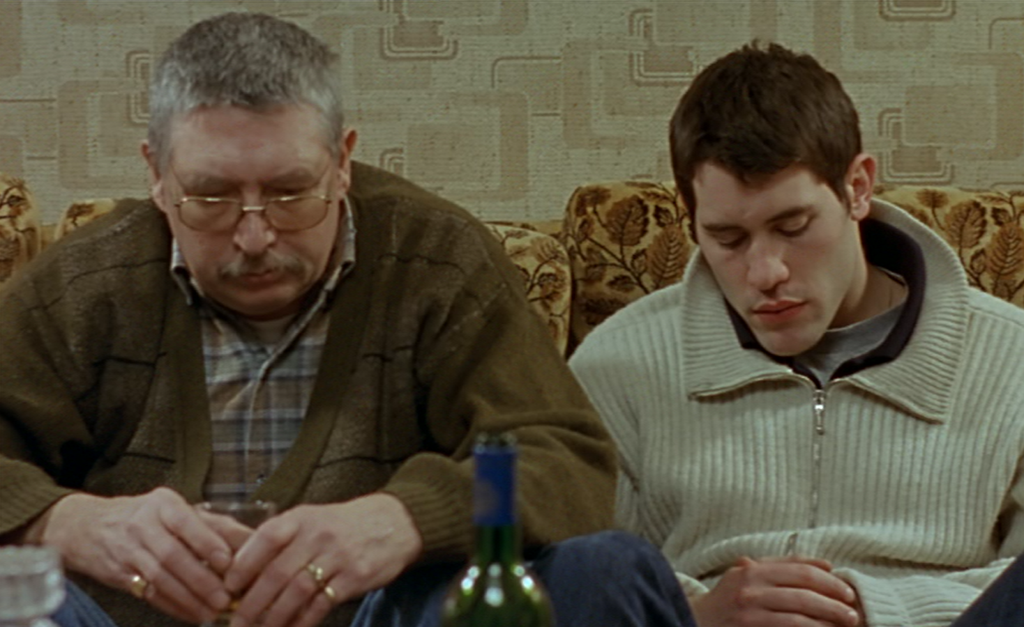
O’Shaughnessy, The New Face of Political Cinema: Commitment in French Film since 1995
(New York: Berghahn Books, 2007).
Here again, ‘new realism’ is typified by a style of filmmaking, this time more concretely defined in terms of:
‘an unpolished, naturalistic image’ and seemingly loosely structured ‘episodic plots’.
[N.B. Note also the films’ signature locations – places of work, industrial spaces, typically Northern France.]

Slide 9
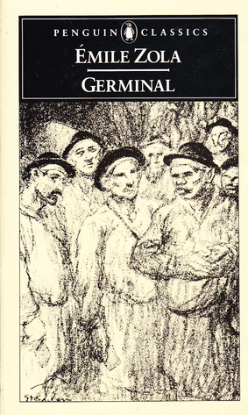
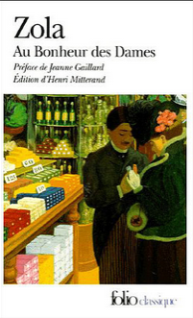
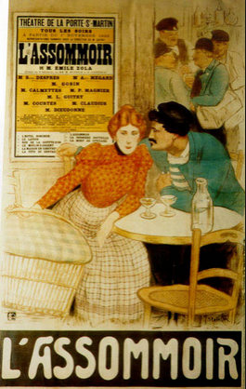
Literary Naturalism, Zola and the Working Classes

Slide 10
O’Shaughnessy (2007) Cont.
These films also feature ‘melodramatic qualities’ such as:
‘the production of moments of confrontation and collision;
the corporeal and the gestural;
the restoration of ethical transparency to a world that has become opaque;
the emotive focus on individuals and families rather than abstract forces.’
pp. 135-6.

Slide 11
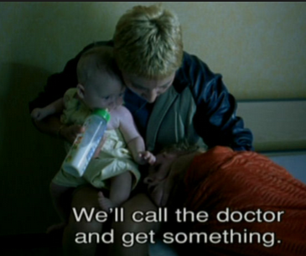
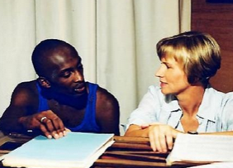
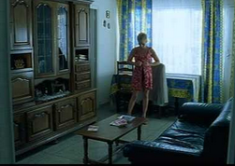
Melodrama re-enacts traumatic events
E. Ann Kaplan, “Melodrama, Cinema and Trauma”, Screen, issue 42.2 (Summer 2001). pp. 201-204.
Watching trauma – modes of spectatorship:
the melodrama spectator: engages with trauma through the film’s themes and techniques while getting the comfort of closure or ‘cure’
OR
the ‘witnessing’ spectator: the spectator of experimental and research documentaries that seek direct political intervention

Slide 12
La Ville est tranquille: appealing to a melodrama and a witnessing spectator?
Working on different levels:
Didacticism: social realism - to make problems (la fracture sociale/post-industrial poverty, racism, drug abuse…) visible in a specific social context.
Bearing witness to those who suffer the effects of these problems.
A melodramatic, affective mode: a film that fulfils the pleasures of narrative and resolution – to discuss.
A film that calls for an emotionally involved ‘spectator’ as the first step for an ethically committed one?

Slide 13

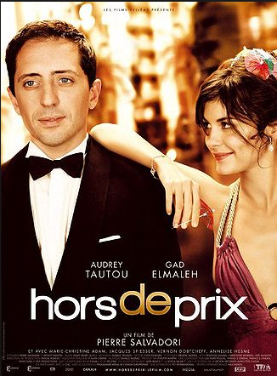

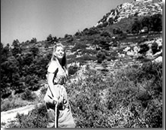

Idealisations of the South in French Cinema
From the classical… to the contemporary.

