Slide 1
STATES OF THE NATION: FRENCH CINEMA AND SOCIETY FROM 1990 TO THE PRESENT
Week 5: Multi-Ethnic France and ‘Beur’ Cinema

Slide 2
STRUCTURE OF THE SESSION
‘Beurs’ in the context of multi-cultural France
‘Beur’ cinema
- Origins and features
- As an ‘accented’ cinema
- A comparison with Italian Neorealism
Kechiche’s work
- Cultural references
- Language
- Gaze structures – the Orientalist/sexist critiques
Seminar discussion – to include thoughts on essay organisation

Slide 3
Learning Outcomes
By the end of the session students will be able to:
Discuss the broad history of immigration in France and attitudes towards it
Give a general definition of ‘beur’ cinema, as well as discuss the existence of other films about multi-cultural France
Discuss Kechiche’s positioning and reference points
Discuss Kechiche’s production methodology and the importance of dialoguein his films
Discuss the contribution of La Graine et le mulet to representations of beur identity in France and the intersectionality of this identity category with others such as class identities
Discuss the presentation of Rym as as an example of representing ethnic minority women in La Graine et le mulet

Slide 4
Origins of the term Beur
Beur = Arabe in verlan
Second-generation children of North African immigrants to France
Most are Algerian extraction although some Moroccan or Tunisian
Provocative as almost all Moroccans and a majority of Algerians are or Berber origin.

Slide 5
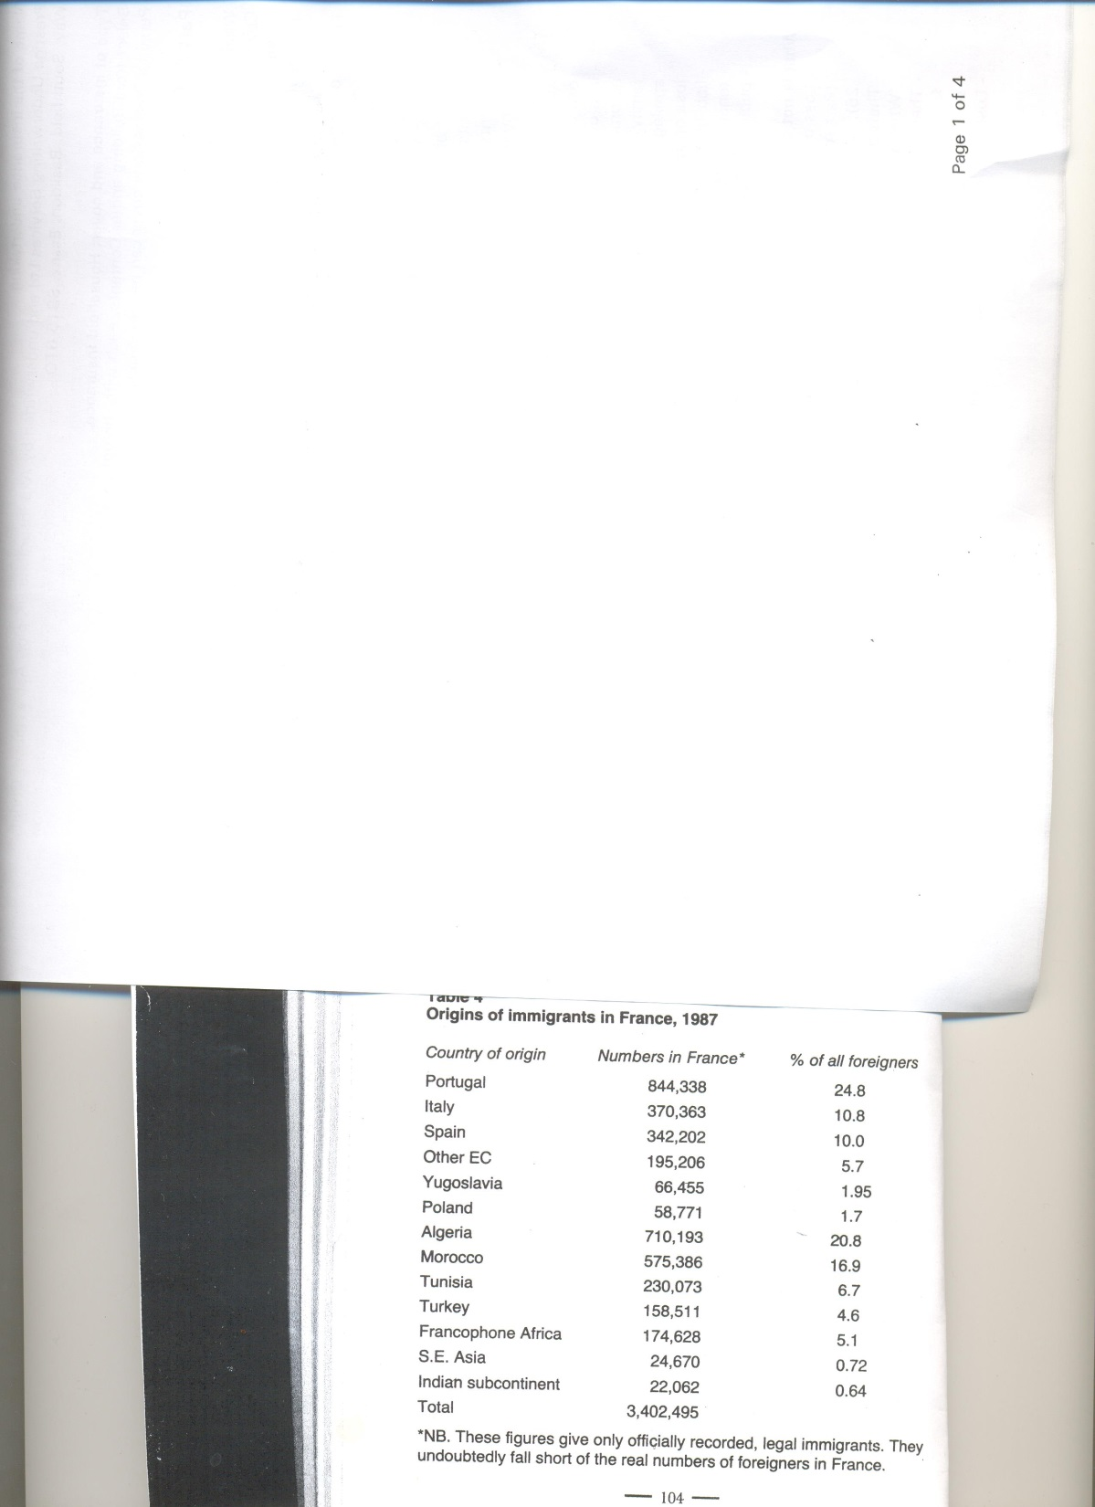
John Flowers, France Today (1998).
By the 1980s, there were 1.5m immigrants from the North Western African region known as the Maghreb, or 44% of France’s total immigrant population (Flowers p. 103).

Slide 6
Background to Contemporary Immigration Politics in France
1970s – Introduction of measures designed to prevent unchecked immigration into France
1980s – Mitterrand first introduces in earnest the policy of assimilation
For Flowers and others, this can be linked to fact that France has two very strong traditions that have shaped the concept of citizenship:
- rational philosophical universalism
- the Christian Right’s notion of a patrie based on blood soil and ancient rights

Slide 7
Immigration in popular attitudes and media
1990s surveys by newspaper Le Nouvel observateur found 70% of French people thought there were two many immigrants (p. 117 Flowers).
Rise of the Front National since 1980s.
Sarkozy’s inflammatory public attacks on the banlieue cités as Ministre de l’intérieur following 2005 riots.
2000/2010ss: aggravated by high unemployment and the radicalisation of some Muslims; immigrants soft targets for press.

Slide 8
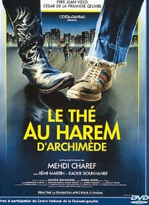
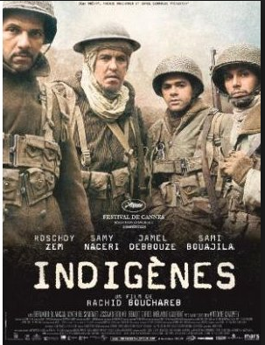

‘Beur’ cinema
To prominence in 1980s and 1990s, especially following Le Thé au harem d’Archimède (Charef, 1985) (see Bosséno) (extra rdg)
1995
1985
2006

Slide 9
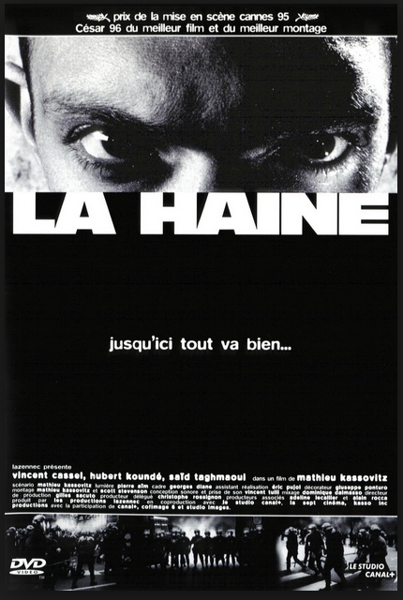
Troubling the limits of ‘beur’ cinema as a genre
Famous use of the tagline ‘black-blanc-beur’ in advertising the film.
Yet director Kassovitz is a second-generation Eastern European immigrant.
Carrie Tarr (2005) and Ginette Vincendeau (2005), however, do suggest the non-white identites are side-lined in the film.

Slide 10
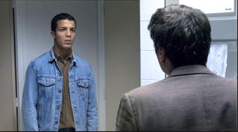
Troubling the limits of ‘beur’ cinema as a genre cont.
Caché (Haneke, 2005)
Haneke Austrian but works quite often in France – much more serious, arthouse films – paradigmatic modern-day European auteur.
Concern with immigrant experience in general and pan-European themes of guilt and post-colonial responsibility.
But also specific interrogation of the traumatic legacy of atrocities against French-Algerians.

Slide 11
Bosséno on the features of ‘beur’ cinema (extra rdg)
Small in number.
Typically embrace a comic rather than a purely dramatic aesthetic.
A reconciliatory function.
Aesthetically, characterized by a kinship with documentary and a populist ethos altogether.
Marked by an absence of strong female roles.

Slide 12
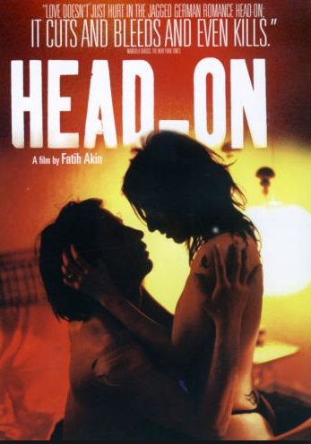
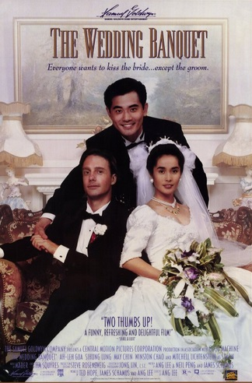
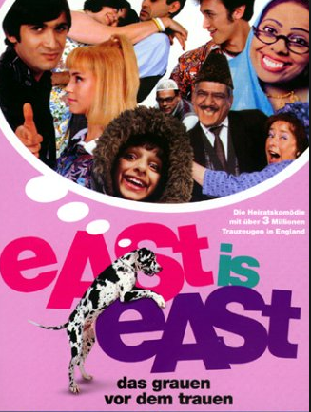
Diasporic Cinema as ‘Accented Cinema’ (Naficy – see extra reading)

Slide 13
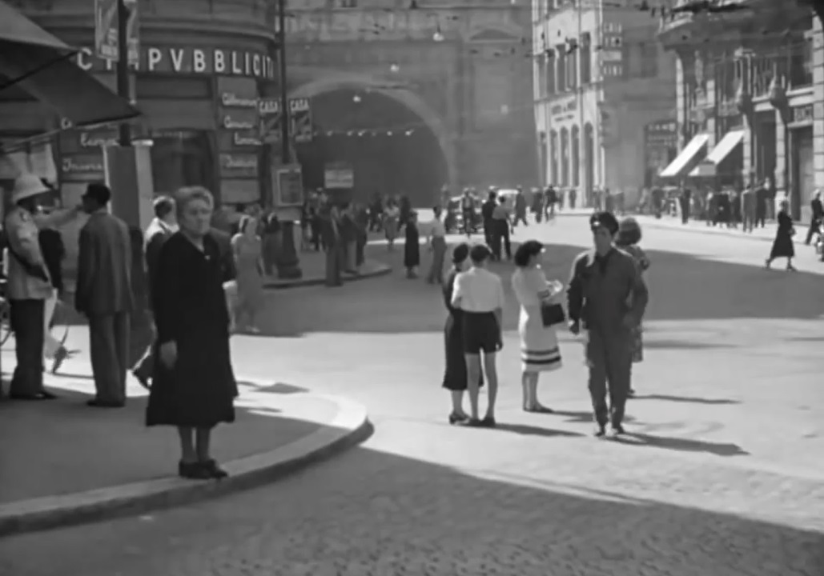
Italian Neorealism
A populist focus through a combination of themes, an improvisational aesthetic, non-professional actors, wide-screen compositions and shooting in depth.
Ladri di biciclette/Bicycle Thieves (Vittorio de Sica, 1948)

Slide 14
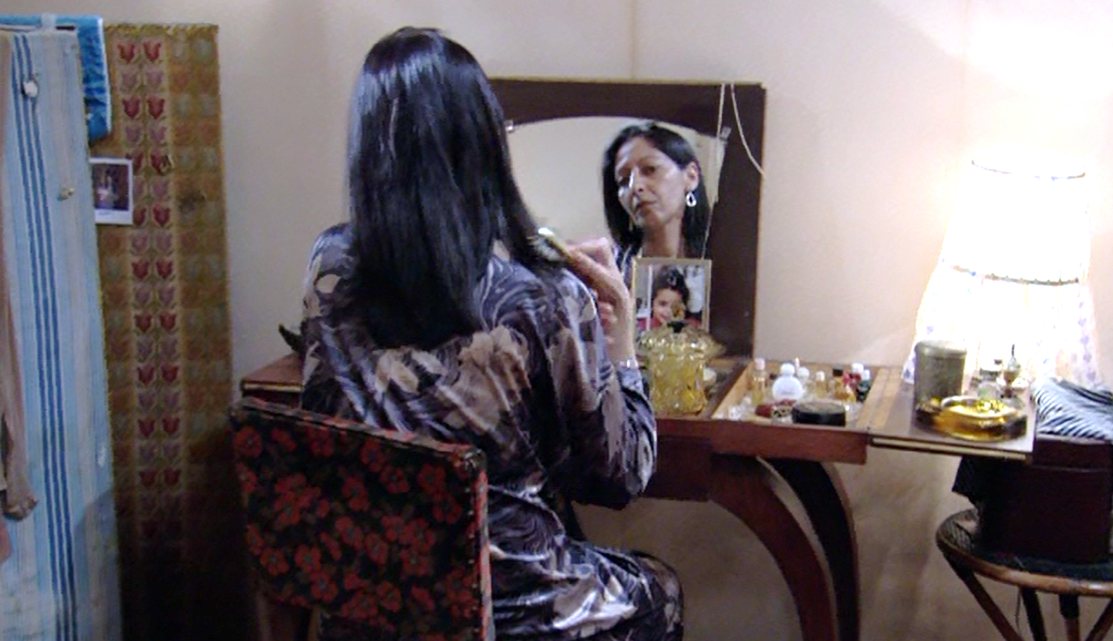
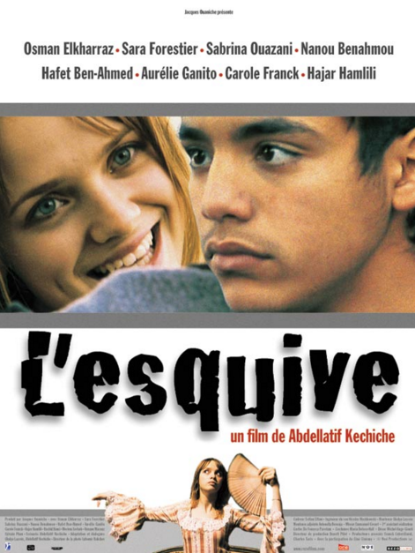
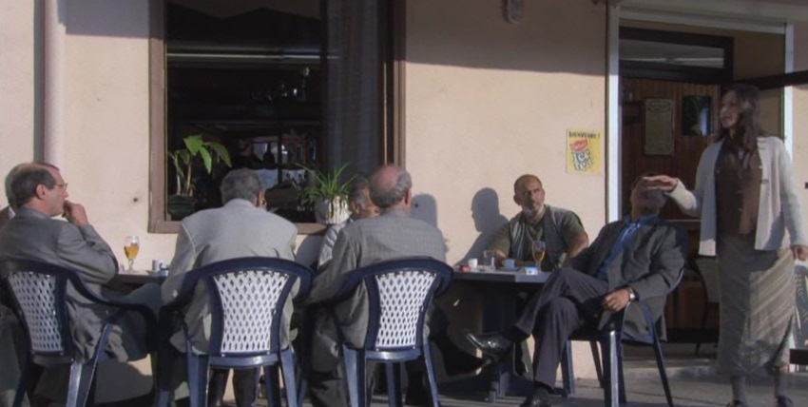
Kechiche and Theatre
‘High’ French theatrical heritage culture often frames a more locally inflected depiction of ‘multi-cultural’ France.
2003
From Marivaux to neo-Classical touches.

Slide 15
Kechiche and Dialogue
Writes own screenplays and openly discusses methodology e.g. Jean-Michel Frodon and Stéphane Delorme interview with him in Cahiers du cinéma no.627 (December 2007).
Extensive rehearsals but no ‘method’ – rejects aestheticism and allows the actors input cf. use of DV cameras to get in close when desired (typically two, in order to catch the unexpected) and long takes, respecting the integrity of performances: ‘une démarche pour rendre la vie au cinéma’.
But many takes and also a high degree of control by him, including in the edit.
Dialogue highly meaningful, including silences; a mixture of registers, from the literary to the highly colloquial.

Slide 16
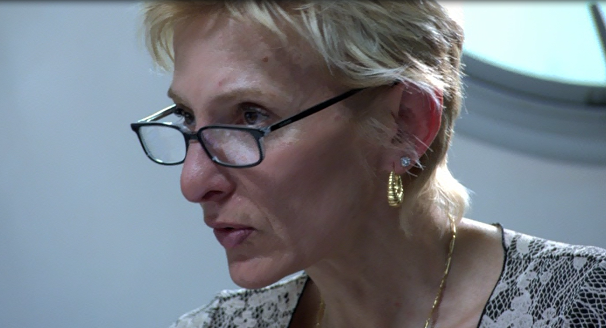
Dialogue register and socio-ethnic stratification in La Graine et le mulet
Cf. Vincendeau (‘The Frenchness of French Cinema…’, 2011) on extra reading:
‘Attention to language in La Graine et le mulet […] highlights the contradictions inherent in representing multi-ethnicity, for a director who also clearly positions himself within a different kind of Frenchness – that of auteur cinema. La Graine et le mulet, then, is multi-accented in its content but singularly French in its form.’ p. 350.

Slide 17
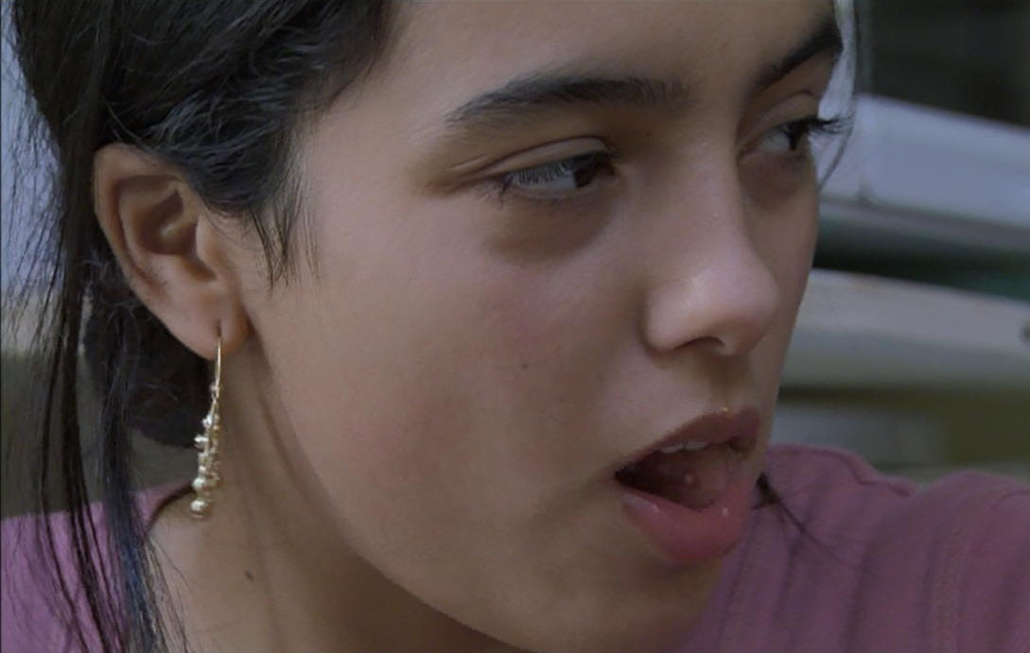
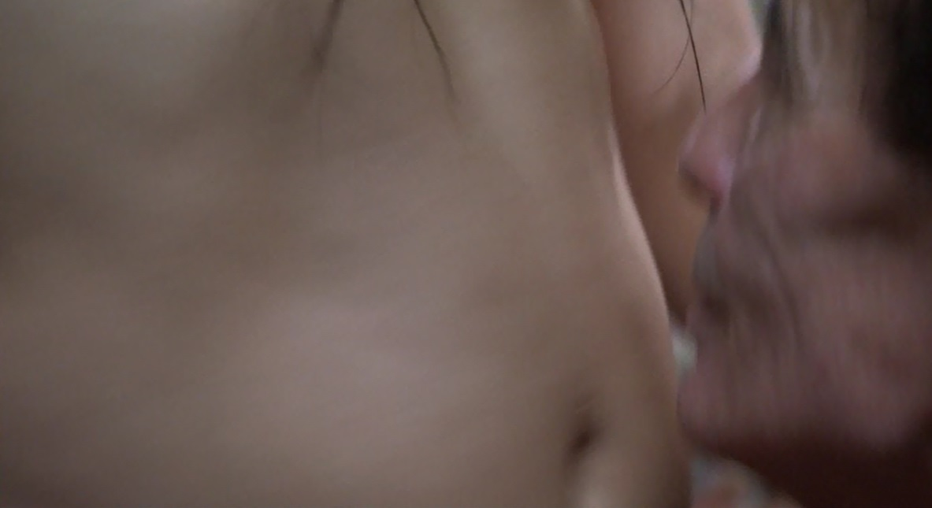
Kechiche and Female Representation
Rym: an embodiment of Kechiche’s self-Orientalism (cf. Green) or an empowered practitioner of of the feminist masquerade?
Compare La Vie d’Adèle (2013)

Slide 18
Additional Bibliography
Michel Chion, Le Complexe de Cyrano: la langue parlée dans les films français (Paris: Cahiers du cinéma, 2008).
John Flowers, France Today, 7th Edition (London: Hodder and Stoughton, 1998).
Carrie Tarr, Reframing Difference: Beur and banlieue filmmaking in France (2005), especially Chapter 3 on Métisse and La Haine.
Isabelle Vanderschelden, ‘The ‘Cinéma du milieu’ is falling down: New challenges for auteur and independent French cinema in the 2000s,’ Studies in French Cinema 9:3 (2009).
Isabelle Vandeschelden, 'Jamel Debbouze: a New Popular French Star?’ Studies in French Cinema 5, no.1: 61-72 (2005).
Ginette Vincendeau, La Haine (London: I. B. Tauris, 2005).

