Slide 1
STATES OF THE NATION: FRENCH CINEMA AND SOCIETY FROM 1990 TO THE PRESENT
Week 9: Masculinity and French Neo-Noir

Slide 2
French Neo-Noir
Noir films, US and French
Gendering the genre
(More) marginality in the neo-noir? Racial and spatial
Audiard: screening the outsider
Race and language
Gender
The dialogue with US genres
STRUCTURE OF THE SESSION
Learning outcomes - by the end of the session the students will be able to:
Discuss the history of noir films in the US and France
Discuss the position of male and female characters in the genre and how it addresses gendered spectators
Connect Audiard’s work with generic French noir themes and settings
Situate Audiard’s work in relation to a broader nexus of themes about the (male) outsider and consider how aspects of his films’ genre and style influence the exploration of such themes

Slide 3
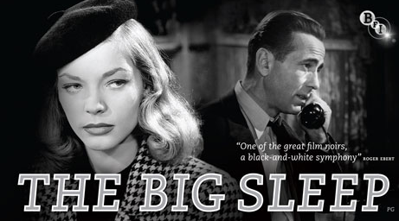
Classic US Noir
1946

Slide 4
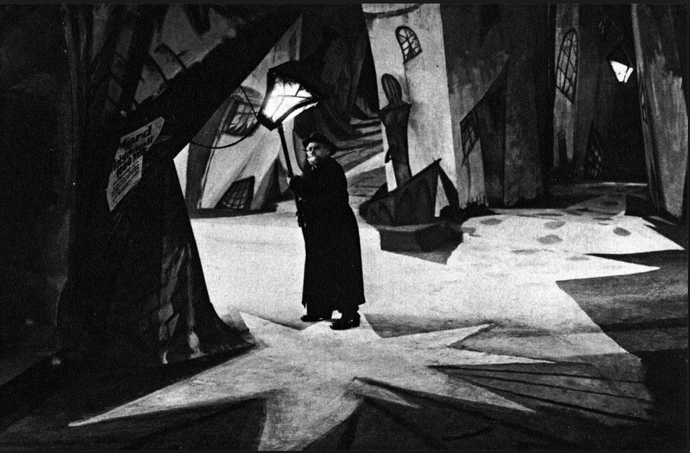
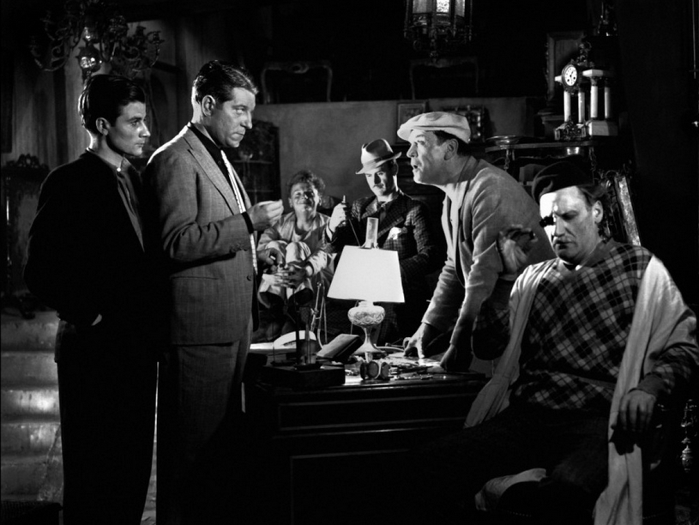
European Antecedents to US Film Noir: From German Expressionism to French Poetic Realism
Das Cabinet des Dr. Caligari/The Cabinet of Dr. Caligari (Wiene, Germany 1920)
Pépé le Moko (Duvivier, France 1938)

Slide 5
On Classic French Noir (heyday in 1950s)
Two forms:
The ‘policier/polar’: crime films that were visually ‘noir’ but narratively upbeat.
‘Social noir’: not crime films proper but urban dramas that were more truly ‘noir’ in narrative, mood and visual style.
On Neo-Noir
Since the mid-1990s, in a period that has seen more genre-blurring in French cinema as a whole, social commentary and [inherently generic] crime narratives have tended to mix [e.g. La Haine], ‘neo-noir’ can refer to any crime film or urban drama.
Vincendeau (set reading)

Slide 6
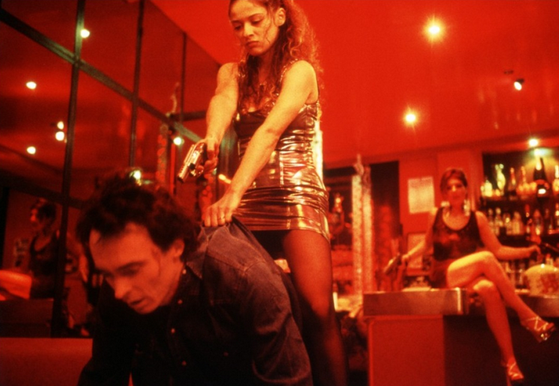
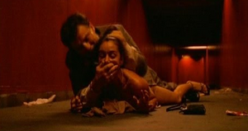
1980s – cinéma du look included police films e.g. Diva
1990s/2000s:
More social issue films, by both established directors e.g. Bertrand Tavernier’s L.627 (clip to follow) and linked to the jeune cinéma français, of which Audiard is on the margins.
‘Extreme’ films like Baise-moi (2000) and Irréversible (2002) feature violent crimes
3. A return to the classic policier e.g. 36 Quai des Orfèvres (2004; clip)
Vincendeau Cont.

Slide 7
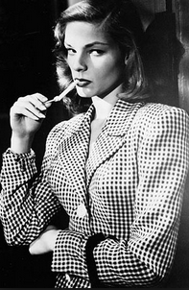
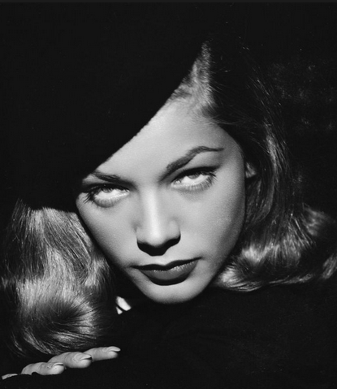
The Femme Fatale: disavowing the threat of castration in US noir?
See Laura Mulvey, “Visual Pleasure and Narrative Cinema” (1975)
Fetishism and voyeurism as two possible strategies for dealing with women’s fear-provoking difference in male-authored classical cinema.

Slide 8
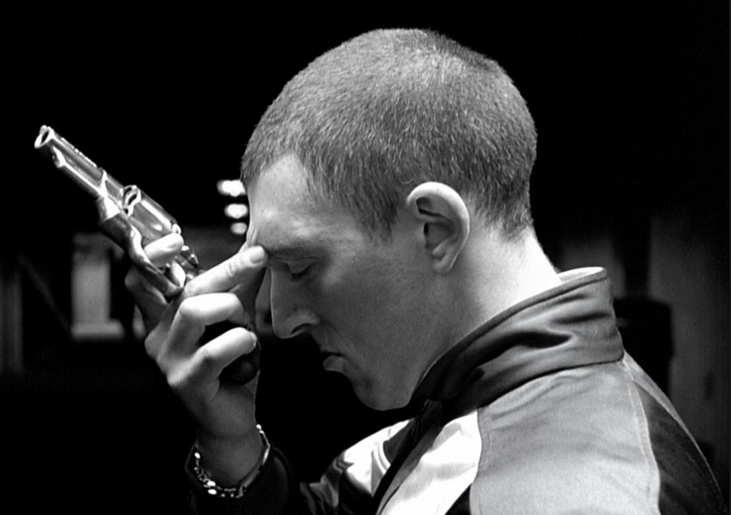
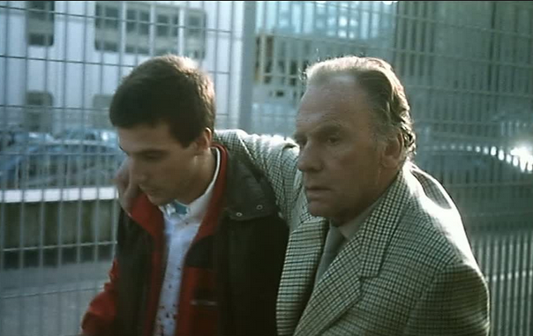
Equally but differently beleaguered masculinity in French neo-noir
- Women less disavowed than simply absent - equality less of a ‘problem’ for French men?
- A greater climate of moral relativism nonetheless poses questions about the meaning of masculinity – traditional ideals of power and assertiveness are no longer viable.

Slide 9
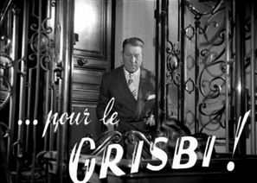
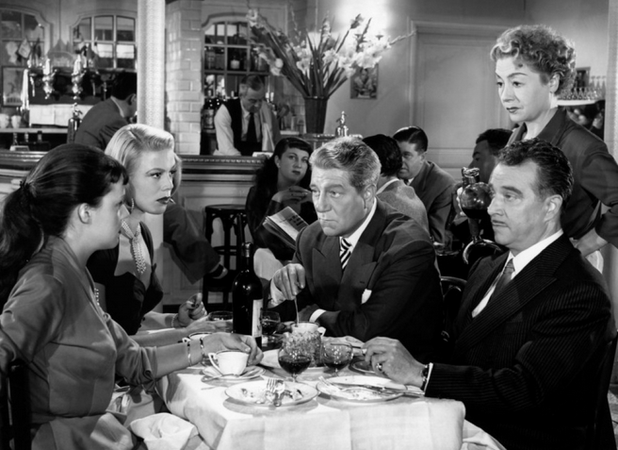
Vincendeau Cont.
The ‘lower depths’ in which these films are set moves from the classical ‘metonymic city’, populist microcosms of the French community e.g. Touchez pas au grisbi (Becker 1954) …
… to increasingly peripheral and/or anonymous locations since the 1990s – Marc Augé’s ‘non-places’: underpasses, car-parks, the banlieue in general, the postmodern office and other dreary public spaces, typified by sterility or chaos and squalor.
CLIPS: Sur mes lèvres (Audiard 2001), De battre mon coeur s’est arrêté (Audiard 2005).

Slide 10
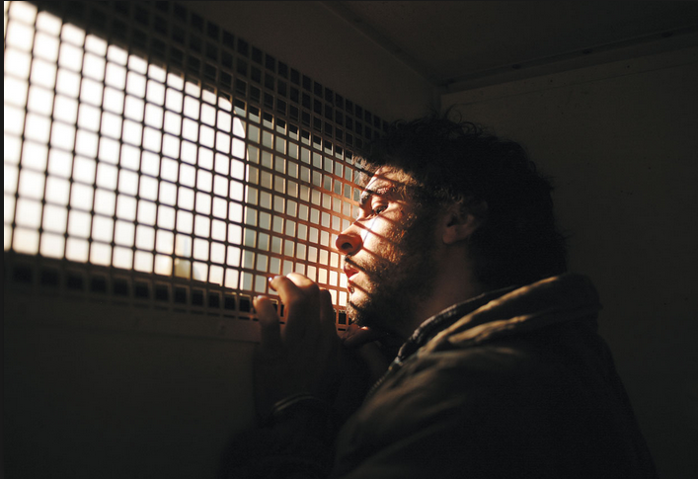
Tahar Rahim as a limited example of narrative progression for ‘beurs’.

Slide 11
Jacques Audiard, b. 1952.
Son of highly respected screenwriter Michel Audiard
Immediately inscribed in a relatively high art cinema tradition – an auteur cf. films critically rated, Un prophète awarded Palme d’Or, highest honour at Cannes film festival,
But also popular (e.g. that film took around $20m worldwide), with generic elements in his work – see Dobson (set reading).
Filmography
Regarde les hommes tomber (1994)
Un héros très discret (1996)
Sur mes lèvres (2001)
De battre mon coeur s’est arrêté (2005)
Un prophète (2009)
De rouille et d’os (2012)
Dheepan (2015)

Slide 12
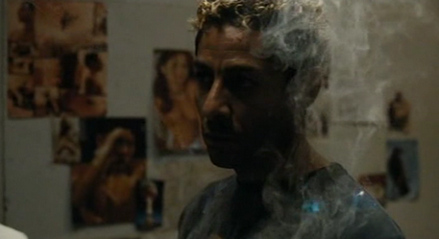
- Should we see Un Prophète as a dark (French) neo-noir urban drama or as an (Americanised) gangster film?
Audiard’s ambivalent relationship with US models: De battre remakes Fingers but heavily reworks; Audiard rejects the label ‘remake’
Powrie (extra rdg) argues that a truly ‘noir’ sensibility resides in recent French cinema in oneiric elements
Can we see the ending as celebratory? A triumph of the will or of the imagination? Should this be seen as social commentary or escapist entertainment?

Slide 13
ADDITIONAL BIBLIOGRAPHY
Marc Augé, Non-places: Introduction to an Anthology of Supermodernity, trans. John Howe (London: Verso, 1995).
Laura Mulvey, “Visual Pleasure and Narrative Cinema.” (originally published in Screen, 1975). In B. Nichols (ed.), Movies and Methods. Volume II, pp. 303-315. Berkeley: University of California Press, 1985
Kathleen Rowe, The Unruly Woman, Austin: University of Texas Press, 1995, pp. 191-200 on ‘Melodramatised Masculinity’.
Ginette Vincendeau, ‘From the Margins to the Centre: French Stardom and Ethnicity,’ in Raphaelle Moine, Hilary Radner, Alistair Fox & Michel Marie (eds), A New Companion to Contemporary French Cinema (Chichester: John Wiley: 2014), pp. 547-69.

