Slide 1
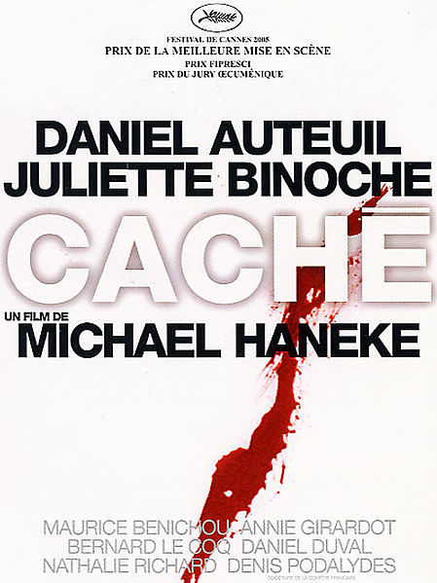

Slide 2


Slide 3
PLOT
H
Daniel Auteuil plays GEORGES, a famous presenter of an intellectual talk show and lives in an apartment in Paris with publisher wife Anne and son Pierrot, 12.
Georges is being sent creepy surveillance tapes of the exterior of their apartment, some accompanied by crude, child-like drawings.
G suspects he knows the sender, someone from his past - an Algerian man called Majid whose parents were killed in the ‘61 massacre, yet he refuses to tell his wife of these suspicions.
One tape leads G to Majid’s apartment and after accusations, Majid denies sending them.

Slide 4
PLOT
A
Son Pierrot goes missing, he’d stayed at a friends without saying. Once home he accuses mother Anne of adultery.
After an invitation, G returns to Majid’s apartment where he watches as Majid slits his own throat.
G now comes clean to his wife – aged 6 he tricked Majid into cutting a chicken’s head off to prevent his parents from adopting him. Majid was sent to an orphanage.
G has some confrontation with Majid’s son, he denies sending the tapes and G denies responsibility for his father’s unhappiness/death.
Shot of school steps as end credits start to roll – in a corner we see Pierrot and Majid’s son having a conversation.

Slide 5
GUILT
France’s guilt over colonial memory, struggling to deal with the past.
17th October 1961 – Paris police force kill Algerian FLN demonstrators, 200+ bodies dumped in the Seine.
Commentary on the collective French amnesia of the treatment on French Algerians
Georges vague explanations and frequent use of ‘alors’ and ‘rien’

Slide 6
GUILT
Is Georges responsible for what he did aged 6?
Haunted by his own past, shown through flashbacks
Narrative follows Georges struggling with his subconscious as he comes to terms with his actions

Slide 7
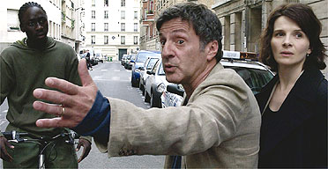
SOCIAL DIVISIONS

Slide 8
SOCIAL DIVISIONS
Unfair treatment of ethnic minorities – immediate arrest of Majid and his son.
Integration issues still present in France today.
Georges vs Majid – white bourgeoisie vs maghrebin working class.
Majid’s parents working for Georges’ family.
News on TV in background – current political context.

Slide 9
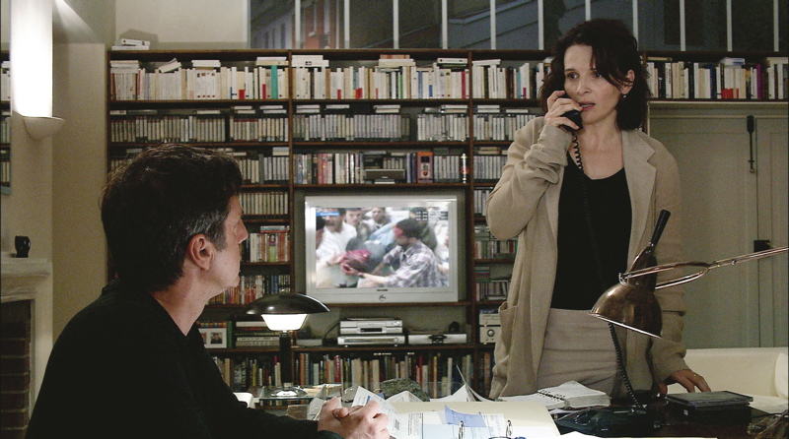

Slide 10
SUPERFICIALITY OF BOURGEOIS EXISTENCE
CONTROL, CENSORSHIP
Appearances upheld despite grave situation.
TV show edited to give a distorted view of interview
Breakdown of family life
Georges’ self preservation

Slide 11
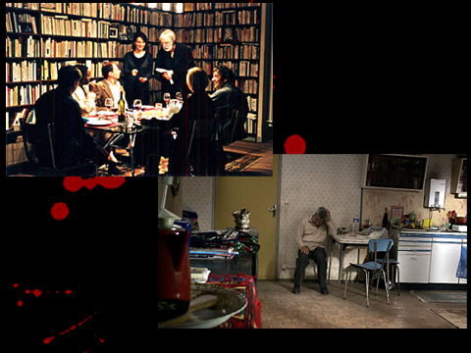

Slide 12
ALL THINGS CACHÉ…
Hidden cameras
Hidden guilt of Georges, his mother, Anne?
Hidden past
Hidden facial expressions
Hidden discrimination
Hidden suicide

Slide 13
CLIP 40.49 - 43

Slide 14
DANIEL AUTEUIL
As in other roles, his acting approach is minimalistic, LESS IS MORE
G can’t face up to reality, Auteuil shows this through lack of expected emotion and vague responses
Likeability factor is low, never lets the audience in on the chicken
Relationships with other characters

Slide 15
‘Georges jumps to conclusions – perhaps warranted perhaps not – based as much on his own guilt as on the facts of today. And, despite his repeated protestations of blamelessness, we don’t believe him and, more importantly, we know that he doesn’t believe his own words.’ J. Berardinelli
‘Auteuil, a great actor, is so good inside Georges’ twitchy skin that the performance itself is invisible.’ R.Clifford

Slide 16
RECEPTION
21 wins and 23 nominations
Cannes – Won Best Director, nominated for Palme d’Or
European Film Awards – Won Best Actor (Auteuil), Best Film, Best Editor, Best Director
Chlotrudis Awards – Nominated for Best Actor (Auteuil)

Slide 17
RECEPTION
“Hidden is Michael Haneke's masterpiece: a compelling politico-psychological essay about the denial and guilt mixed into the foundations of western prosperity, composed and filmed with remarkable technique. It is one of the great films of this decade.” - Peter Bradshaw (The Guardian)
“Ce film splendide et vertigineux est riche de réflexions sur les blessures d'enfance à jamais béantes, la solitude face aux démons intérieurs, les ravages du secret dans un couple, la manière dont la culpabilité ronge un individu, la revanche du refoulé.” – Jean-Luc Duoin (Le Monde)
“Porté par un formidable duo d’acteurs, son film a reçu le Prix de la mise en scène au Festival de Cannes 2005, mais aurait mérité bien plus encore...Daniel Auteuil, mari tâchant de faire bonne figure, vire au trouble et presque à l’indécent, tant son personnage refuse de s’impliquer. Paranoïa, culpabilité, aveux, sont au programme de ce film, fort et perturbant.” - Olivier Bachelard (www.abusdecine.com)

Slide 18
OUR OPINION
Deceived by trailer
We weren’t thrilled as promised
However, Auteuil’s performance convincing
BUT ambiguous ending left us somewhat dissatisfied
Despite all this we’d probs give it a solid 7/10

