Slide 1
Isabelle Huppert Violette Nozière
By Claude Chabrol

Slide 2
Plot Summary
Film was based on a true story about a young woman and her relationships with older men, resorts to prostitution – rebellion, sexual encounters
Set in 1930s Paris, Paris is beautiful in the shots yet mostly based in claustrophobic settings, Violette’s family are from a modest background but with bourgeois pretensions
Her father, Baptiste, and mother, Germaine, appear to have a loving relationship with Violette and she is always polite, yet there are moments of tension between her and her father – she flinches away from his touch on several occasions.
She contracts syphilis and the doctor informs her parents who believe her to be a virgin. She manages to trick them into thinking she inherited it, they all take medication together – later on we realise that she took this opportunity to begin poisoning them.
She meets and falls in love with Jean, she steals from her parents to support him.
She ends up killing her father, believes her mother to also be dead (initially). She goes on the run and is eventually arrested by police and condemned to be guillotined.
She confesses to the murder and accuses her father of abusing her, we discover that her mother has survived at this point.
The remainder of the film is a series of flashbacks, from her childhood and the final scenes.
Voiceover at the end tells us that she was released from prison and went on to live a happy family life.

Slide 3
Flashbacks
One of the ways in which her allegations against her father are supported, scene from childhood
Impossible to tell whether the flashbacks are Violette remembering or imagining what happened (as her version of accounts) or reality.
Flashbacks make the film far less readable, takes the focus off the narrative.
Chabrol uses flashbacks to mark important plot changes, forks in the possibilities of the narrative.
“Les films les plus forts de ce point de vue sont ceux qui parviennent à donner le sentiment du rêve sans en passer par sa representation. (I. Huppert) Cahiers du cinéma

Slide 4
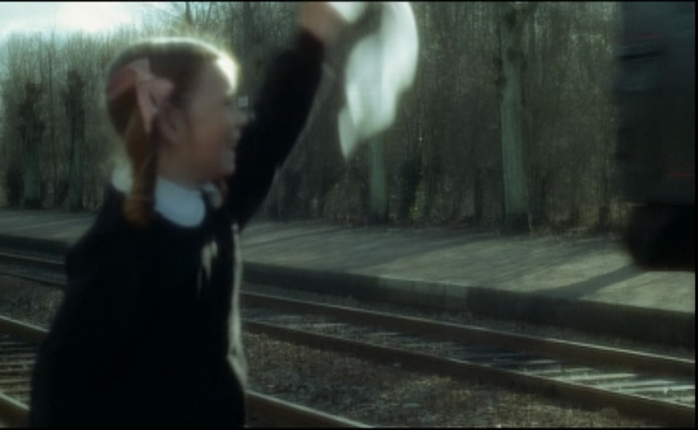

Slide 5
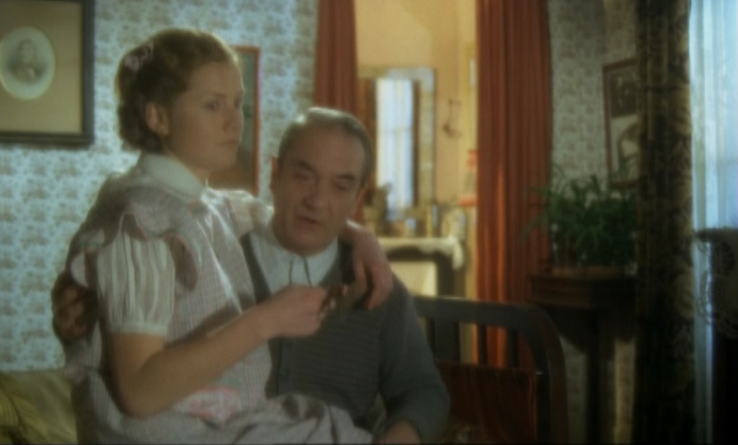

Slide 6
Isabelle Huppert
Imperceptible behaviour – neither cold nor warm
She is quite confident, she has no hesitations about behaving brashly around men and is dominant when with her friends – this could be naïve
Mysterious, unflinching liar – emotionless
Without makeup she is clearly childish, but when she is made-up and wearing her fur coat she looks very adult.
Contrast with Deneuve and Auteuil –
Huppert shares a coldness with Deneuve and Auteuil, although unlike Deneuve’s coldness which hides a vivid sexuality, Huppert’s coldness is mysterious, like Auteuil’s, suggesting it is hiding something but we never find out what.
She often goes against your expectations of Violette, one night she is out alone and gets into a stranger’s car. Lead to believe given previous promiscuity that its a sexual encounter yet when he attempts to touch her she reacts against him.
Maculine vs Feminine
reversal of gender roles
she wants to support Jean because she’s afraid he’ll stop loving her.

Slide 7
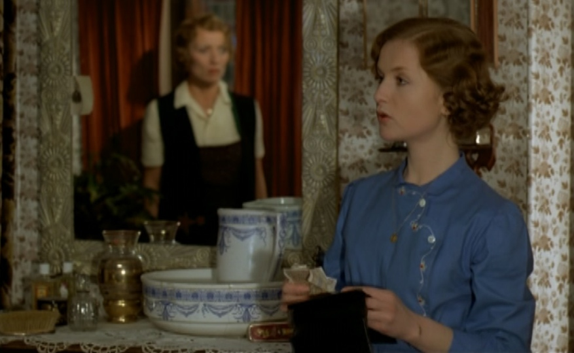

Slide 8
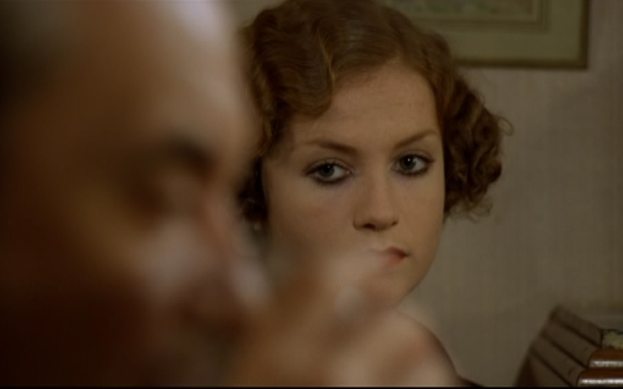

Slide 9
Possible motives
Sexuality
not about sexual desire
financial independence
rebelling against repressive upbringing.
adolescents
Murder
materialism - financial independence
support Jean
molestations from her Dad
punishing the mother by killing her father
despises her parents
‘As Violette, Huppert portrays an ultimately unknowable individual. The ambivalence of all human psychology (as Chabrol sees it) is paralleled in the film by competing explanations for Violette’s notorious crime.’ (Guy Austin)

Slide 10
Clips
Mother 11.19
Father 30.19

