Slide 1
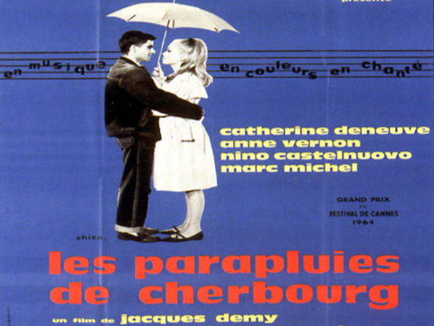

Slide 2
SYNOPSIS
Madame Emery and her 17-year-old daughter Geneviève (Catherine Deneuve) sell umbrellas in the town of Cherbourg, Normandy
Deneuve falls in love with 20-year-old Guy (Nino Castelnuovo), a mechanic who lives with and cares for his sick Godmother, Elise
The 2 want to get married, but Guy must leave for 2 years for a tour of duty in the Algerian War

Slide 3
The night before Guy leaves, he and Geneviève sleep together and she (obviously) gets pregnant, as we see later on
They promise to each other that they will be together when he gets back
Guy doesn’t write to Geneviève often and she takes it to heart. Her mother manages to convince her that he doesn’t love her anymore, belittling their relationship- in reality we know he’s just busy in Algeria
Meanwhile, a rich diamond dealer, Roland Cassard, falls in love (at first sight, literally) with Geneviève

Slide 4
Geneviève marries him to keep her mother happy. He is even happy to bring up Guy’s child
UH OH……
Guy returns home early as he had a knee injury and finds out Geneviève is married and the umbrella shop has been sold
He gets a bit cheeky after being hurt so badly, quits his job as a mechanic and goes and sleeps with Jenny, a prostitute

Slide 5
In the morning he discovers Jenny’s real name is Geneviève – coincidence?
He goes home and Madeleine, Godmother Elise’s young, pretty care-giver, opens the door telling him Elise had died in the night
He then “falls in love” with Madeleine, who has clearly been in love with him from the beginning- note that it’s never clear whether he has ever gotten over Geneviève, even to Madeleine
They open an ESSO garage and have a son, François

Slide 6
Geneviève comes back to Cherbourg and pulls into the ESSO station for gas- her and Guy meet
They chat and Françoise, their love child, is in the car
Guy decided he can’t cope with seeing her and the 2 say goodbye
FIN

Slide 7
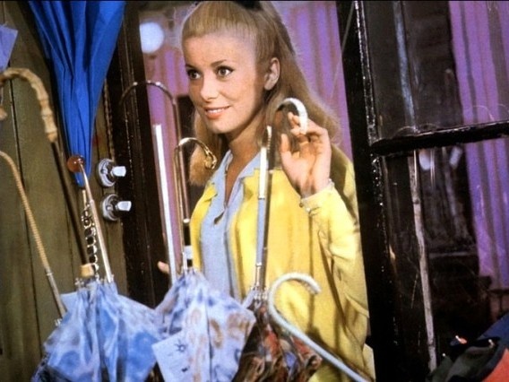
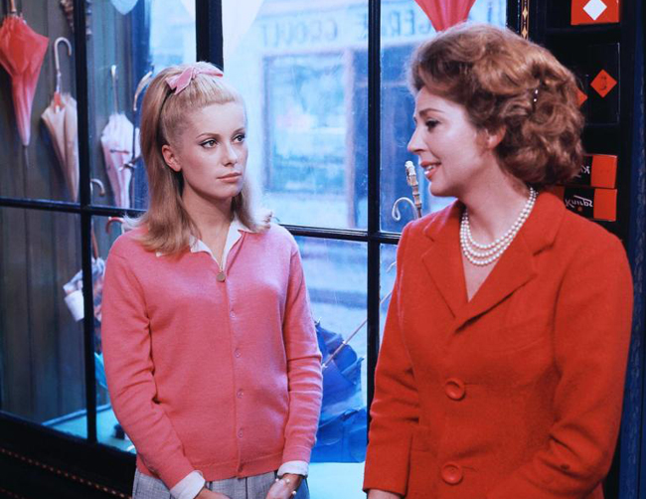
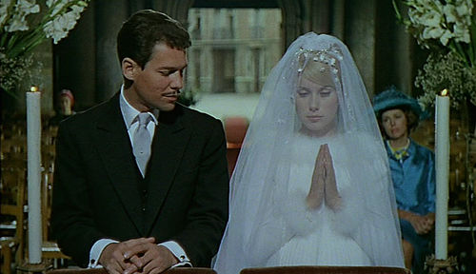
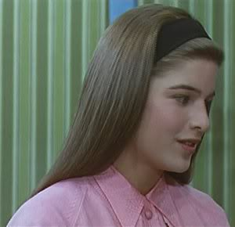
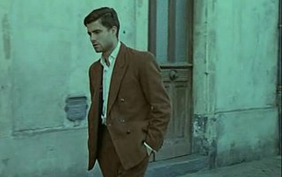

Slide 8
Film takes place in three parts.
“Le depart”-
Concentrates on love between Guy and Geneviève .
1957, “L’absence”-1958- Focus on Geneviève and how she copes with his absence.
“Le retour”-1959- Concentrates on Guy and how he copes with her absence.
…then 1963 Epilogue

Slide 9
What the film REALLY MEANS
The film deals with the principle worry of the youth- LOVE
The film depicts the inevitable changes which take place as we grow into adulthood.

Slide 10
COLOUR
COLOUR = EMOTION
‘The colour throughout is brilliant down to the smallest details.’ (Marianne and the Puritan: the Transformation of the Couple in French and American Films, by David L. Grossvogel)
The wallpapers are visibly bright and vibrant, often reflecting upon what is happening in that particular scene
Le Mythe Deneuve (Gwénaëlle Le Gras)

Slide 11
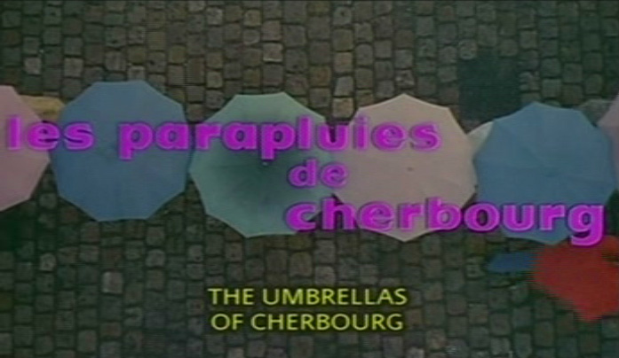
This shot from the opening scene demonstrates the film’s use of colour. The opening scene renders ‘invisible those who are carrying them and weave in and out of the printed words.’ (Marianne and the Puritan: the Transformation of the Couple in French and American Films, by David L. Grossvogel).

Slide 12
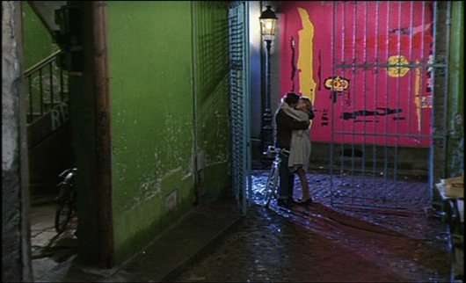
The film is LUMINOUS, reflecting the ‘bourgeois dream world’ that they live in, often very unrealistic . Colour is as useful as music in ‘poeticizing every day speech’ (Grossvogel).

Slide 13
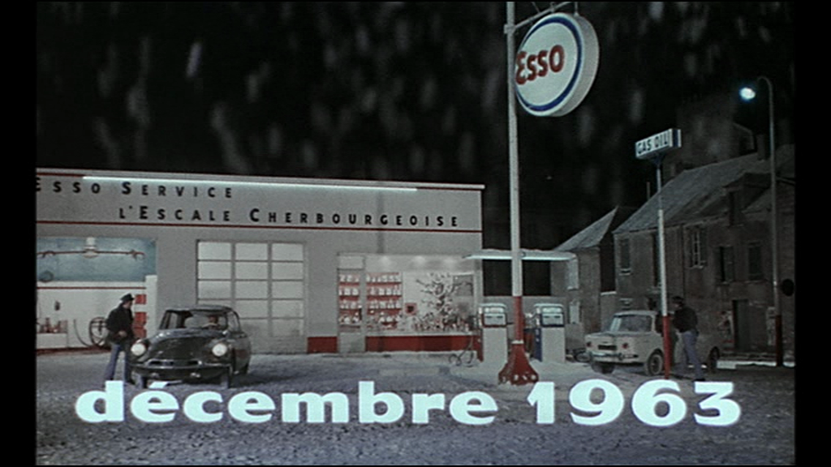
Chris Petit said “never has an Esso station looked so romantic.”

Slide 14
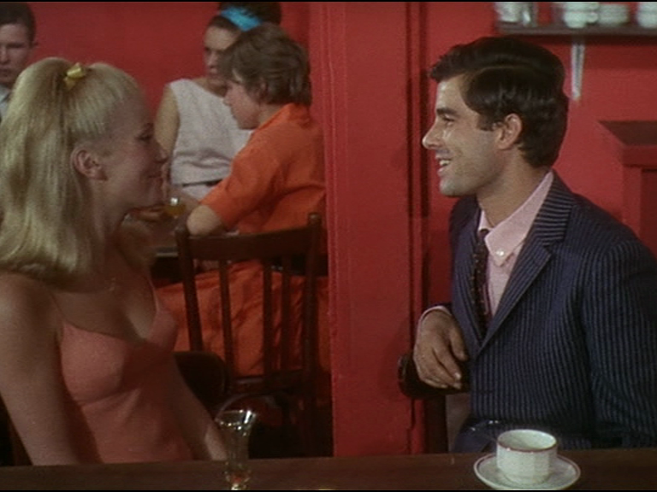
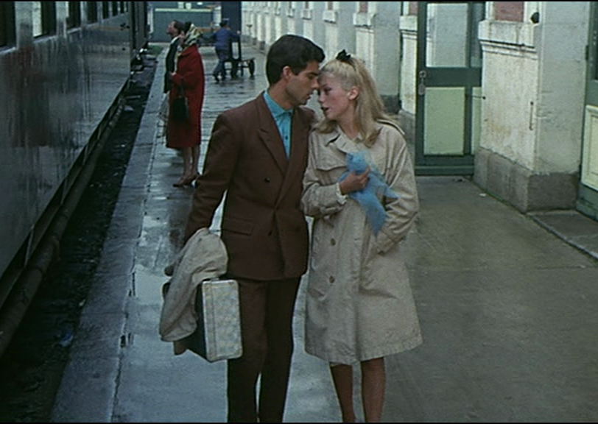
Early scenes in the film are filled with pinks and reds, highlighting the young love which is ever-important in the first section.
This shot pre-empts the dull reality that is to come once Guy leaves. ‘The story veers away from melodrama…a more realistic view of the world.’ (Grossvogel)

Slide 15
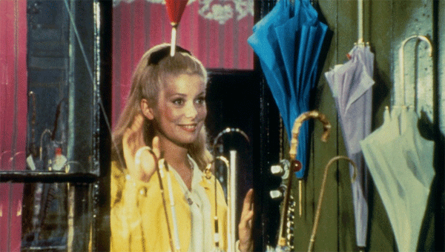

Slide 16
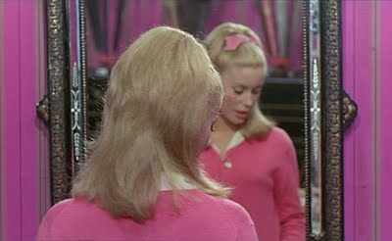
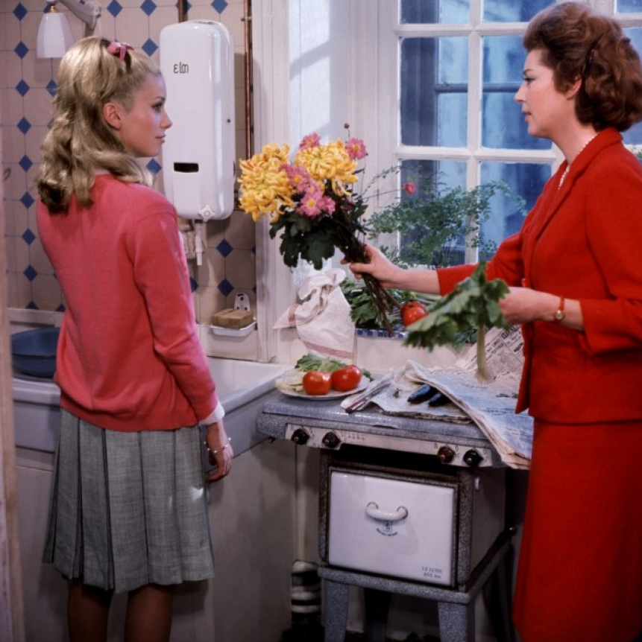
Pinks and reds are used to emphasise the image of young love .

Slide 17
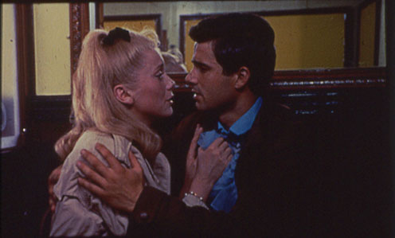
As Guy and Genevieve say their goodbyes, melancholia is evoked through grey tones.
The station and their costumes are presented with beige, brown and greys, in order to highlight the difference between their colourful dream world and the dull and dreary colours of reality.

Slide 18
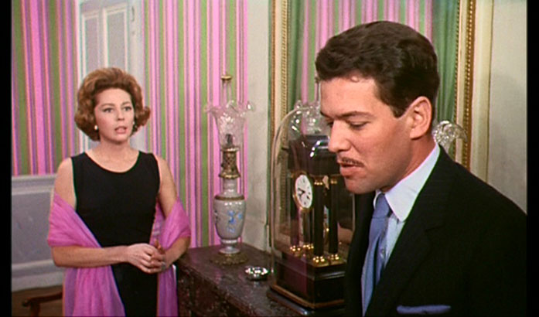
Roland always dress in black = he does not exist in their dream world

Slide 19
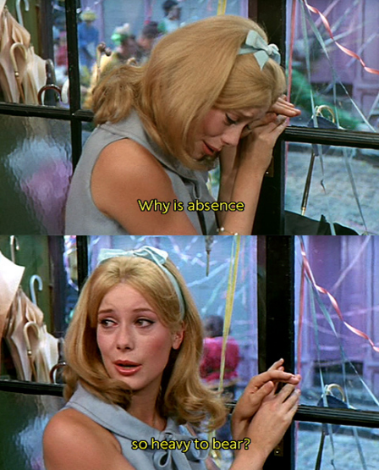
Blue is often seen in the film to represent Geneviève’s pregnancy. It could also be seen to represent her grief.

Slide 20
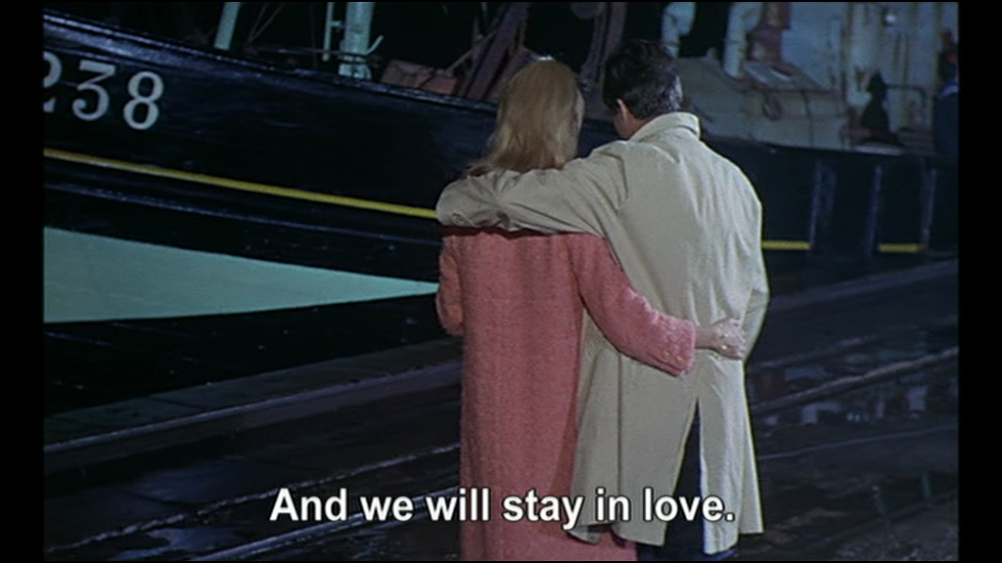
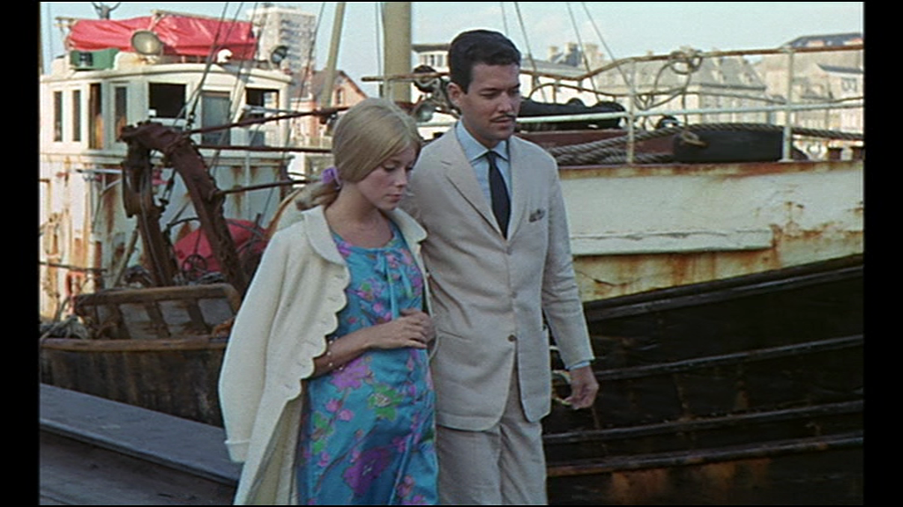
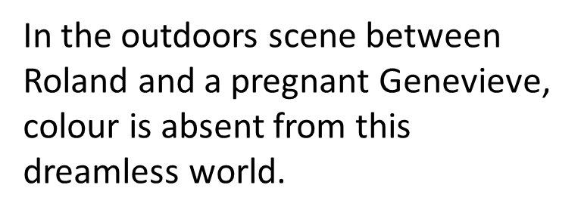
Repetition of images

Slide 21
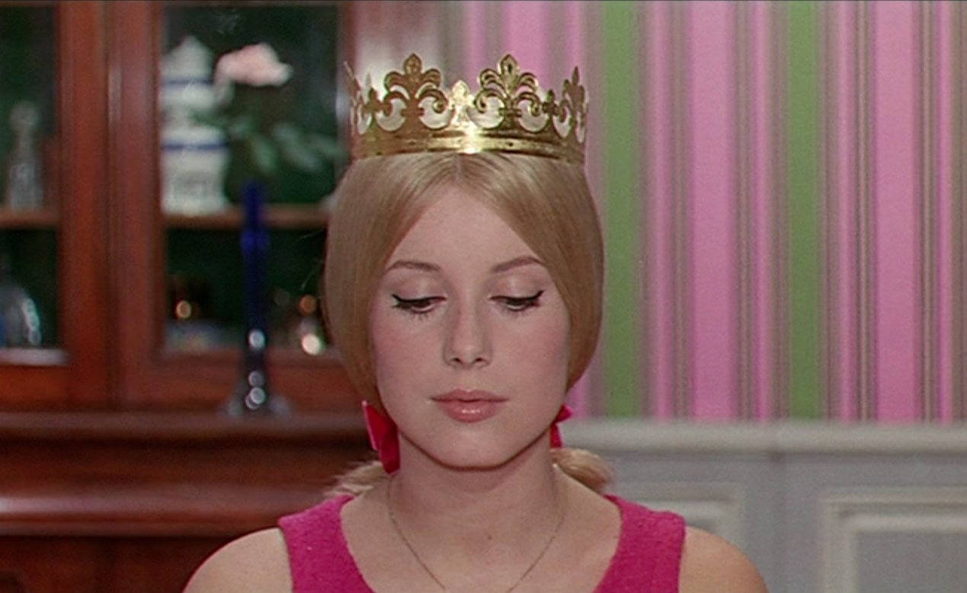
In this scene, Geneviève is seen to accept her ‘crown’ without saying a word. This highlights her complicity and resignation to her circumstances.

Slide 22
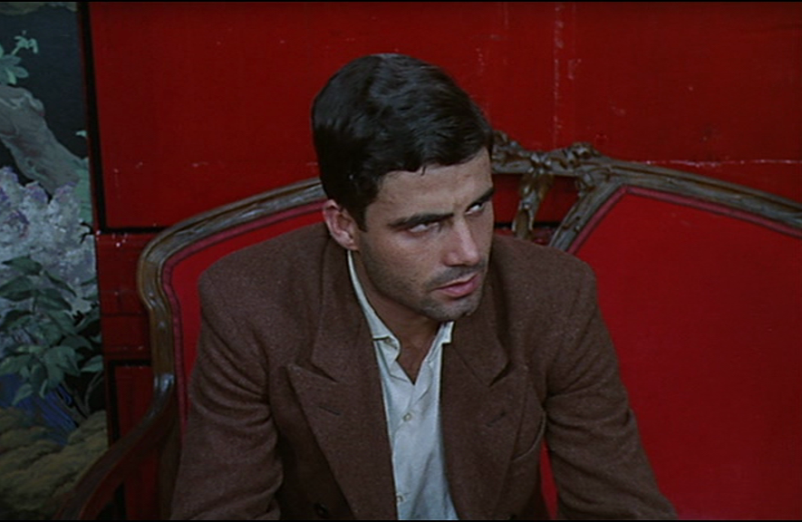
‘when Guy sinks briefly into his private hell, the bar where he ultimately lands is a fiery red.’ (Grossvogel)

Slide 23
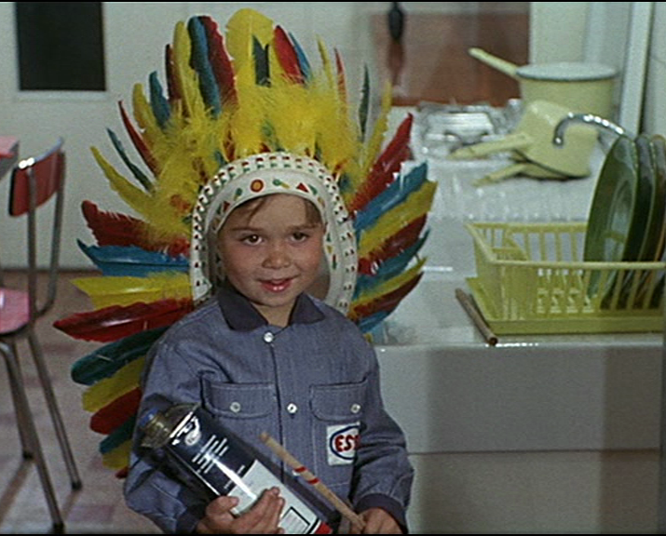
The multitude of colours can be seen to represent youth and childhood innocence.

Slide 24
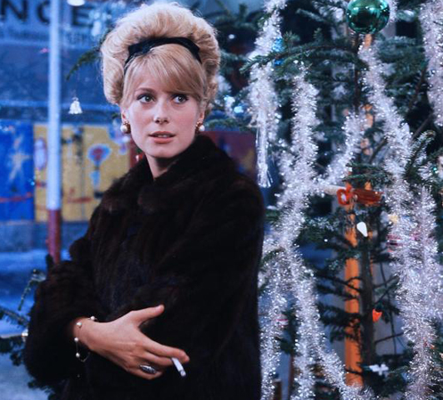
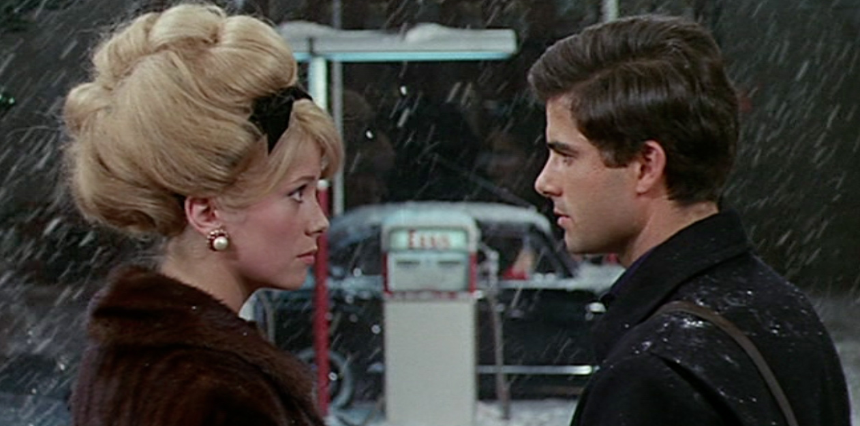
Unlike earlier scenes, in which Genevieve is seen to wear pink (representing her love for Guy), in later scenes, she can be seen to wear black clothing, especially seen in her final meeting with Guy.

Slide 25
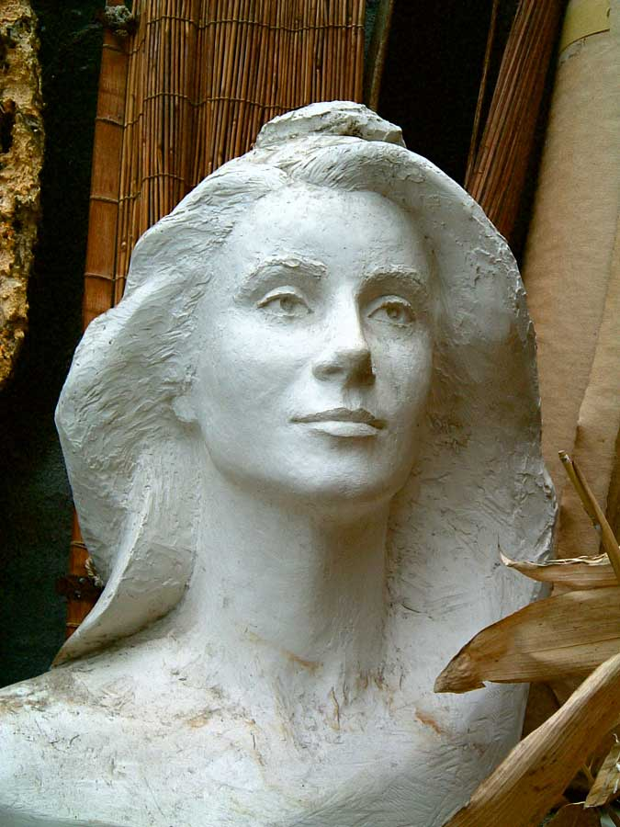
DENEUVE the STAR
She rose to fame after her role in Les Parapluies de Cherbourg and she went on to become the muse for Yves Saint Laurent and also the face of Chanel.
She even became the template for Marianne figures (like America’s Uncle Sam) following the likes of Brigitte Bardot.

Slide 26
The French opinion…
The French associate her with Jacques Demy and his colourful musicals.
“Within the still repressive sexual mores of early 1960s France, CD triumphed as a sweet, sexy-but-innocent and yet glamorous blonde” (p. 198, Ginette Vincendeau, Stars and Stardom)
The French felt she had a type of glamour associated with Hollywood greats such as Grace Kelly and Greta Garbo.

Slide 27
Internationally…
“Catherine evokes two things: French chic and ‘perverse’ sexuality. The first derives from her association with YSL and Chanel and the second from her performances as the angel-faced schizophrenic murderess of Polanski’s Repulsion, and, especially, Séverine, the shy bourgeois wife of Buñuel’s Belle de Jour who spends her afternoon as a prostitute in a discreet but luxurious Parisian brothel.”
(p. 198, Ginette Vincendeau, Stars and Stardom)

Slide 28
Scandalous…
Interestingly, only months before shooting began on les Parapluies de Cherbourg, Catherine gave birth to an illegitimate son with Roger Vadim (who went on to marry Jane Fonda and Brigitte Bardot among others) when she was 19 and he was 35. This added a little scandal to her image and meant that her apparently innocent screen image was not quite the full truth, giving her an air of mystery.

Slide 29
Reception and adaptations of Les Parapluies de Cherbourg…
1. In Stars and Stardom in French Cinema the film is described as one of the three classics which helped Deneuve establish herself as an international star in the 1960s. “Born in 1943, Deneuve has made over eighty feature films since she began her career in the late 1950s, still in her teens. She established herself as a major international star in the 1960s with three classics: Les Parapluies de Cherbourg (1964), Repulsion (1965) and Belle de jour (1967).”

Slide 30
2. It has won many awards, including:…
Prix Louis-Delluc, 1963
Palme d'Or at the 1964 Cannes Film Festival
Critics' prize for Best Film, by the French Syndicate of Film Critics, 1965

Slide 31
3. …and it was nominated for five more which it did not win: The Academy Award for Best Foreign Language Film at the 37th Academy Awards held in 1965 …and… Best Song (for "I Will Wait For You")
Best Original Score
Best Scoring - Adaptation or Treatment
Best Screenplay Written Directly for the Screen
…at the 38th Academy Awards held in 1966, but it did not win any.

Slide 32
4. The film was very successful in France with a total of 1,274,958 admissions. It was was adapted into stage productions more than once and was restored in 1992…

Slide 33
Les Parapluies de Cherbourg underwent an English-language stage adaptation in 1979 and premiered at the Public Theatre… …and more recently, in 2011, the Kneehigh Theatre Company presented the musical. It was given tryouts at Leicester's Curve Theatre from 11th to 26th February 2011 and began previews in the West End at the Gielgud Theatre from 5th March, officially opening on 22nd March. It was due to run until October 2011, but closed on 21st May 2011.

Slide 34
Fin…

